Slide 1
The local in the global: universal bibliographic control from the bottom up
Gordon Dunsire and Mirna Willer
Presented to Session 86 — Universal Bibliographic Control in the Digital Age: Golden Opportunity or Paradise Lost?
IFLA WLIC, 18 August 2014, Lyon, France

Slide 2
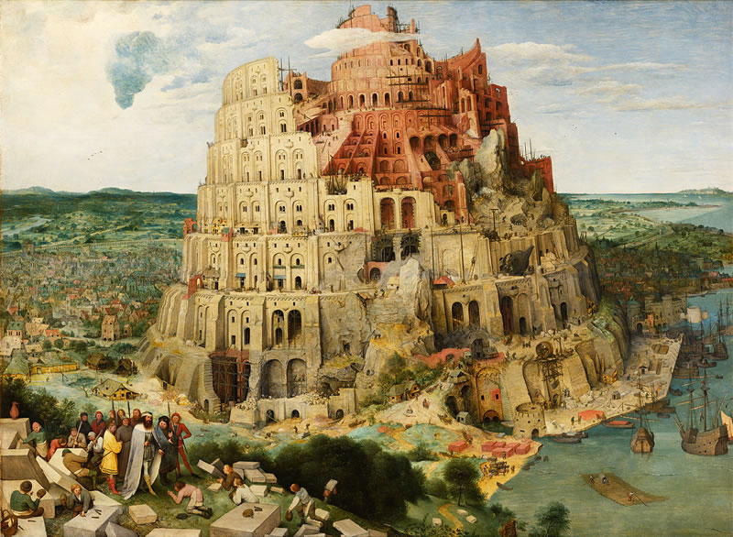
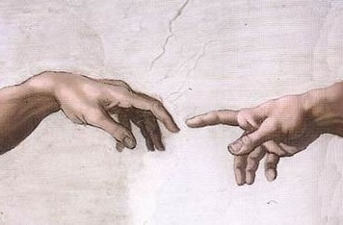
Acting locally
Universal
Bibliographic
Control
Thinking globally
KOS++
Confusing
tongues?
RDF
BIBFRAME:
Bibliographic
Framework
FR: Functional
Requirements
ISBD: International Standard
Bibliographic Description
Say what
we mean
BibO:
Bibliographic
Ontology
DC: Dublin Core
RDA: Resource
Description
and Access
CRM: Conceptual
Reference Model
MARC21
schema.org
UNIMARC

Slide 3
Granularities and overlaps
Property label in English | Granularity
RDA: has place of publication | Fine
ISBD: has place of publication, production, distribution | Medium
BIBFRAME: Place, name, and/or date information relating to the publication, printing, distribution, issue, release, or production instance | Coarse
Granularity of “Place”
Aggregation of “Place” +
other elements

Slide 4
Black box
?
!
La
boîte
bibliographique
magique
Input
Output
?
!
We do not need to know what goes on inside

Slide 5
Subject | Predicate/property | Object
This resource | has place of publication (RDA) | "Zagreb"
ex:Resource1 | rdam:P30088 | "Zagreb"
Schema Translator
?
!
La
boîte
bibliographique
magique
?
!
Subject | Predicate/property | Object
This resource | has place of publication, production, distribution (ISBD) | "Zagreb"
ex:Resource1 | isbdu:P1016 | "Zagreb"

Slide 6
Subject | Predicate/property | Object
This resource | has frequency of issue … (UNIMARC) | “daily"
ex:Resource1 | unimarc:U110__a1 | unimarccf:h
Term Translator
?
!
La
boîte
bibliographique
magique
?
!
Subject | Predicate/property | Object
This resource | has frequency of issue … (UNIMARC) | “daily"
ex:Resource1 | unimarc:U110__a1 | rdaf:1010

Slide 7
Subject | Predicate | Object
ex:Resource1 | isbd:P1016 | “Zagreb"
ex:Resource1 | isbd:P1017 | "Hrvatsko knjižničarsko društvo"
ex:Resource1 | isbd:P1018 | “2012”
Statement Maker
?
!
?
!
La
boîte
bibliographique
magique
Subject | Predicate | Object
ex:Resource1 | isbd:P1162 | "Zagreb : Hrvatsko knjižničarsko društvo, 2012"

Slide 8
Subject | Predicate | Object
ex:Resource1 | isbd:P1162 | "Zagreb : Hrvatsko knjižničarsko društvo, 2012"
Statement Breaker
!
?
La
boîte
bibliographique
magique
!
?
Subject | Predicate | Object
ex:Resource1 | isbd:P1016 | “Zagreb"
ex:Resource1 | isbd:P1017 | "Hrvatsko knjižničarsko društvo"
ex:Resource1 | isbd:P1018 | “2012”

Slide 9
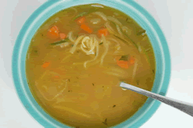
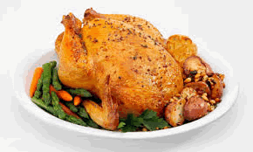
Soup of triples
Record maker
!
?
?
La
boîte
bibliographique
magique
!
Reconstituted
ingredient

Slide 10
Record breaker
!
?
La
boîte
bibliographique
magique
!
?

Slide 11
Magic?
Act locally
!
?
!
?
!
!
?
?
?
!
!
?
!
?
?
!
Think globally
Or Technique?

Slide 12
Merci!

