Slide 1
Linking bibliographic standards: alignments and maps, protocols and liaisons
Gordon Dunsire
Presented at AKM 18, Rovinj, Croatia, 26-28 Nov 2014

Slide 2
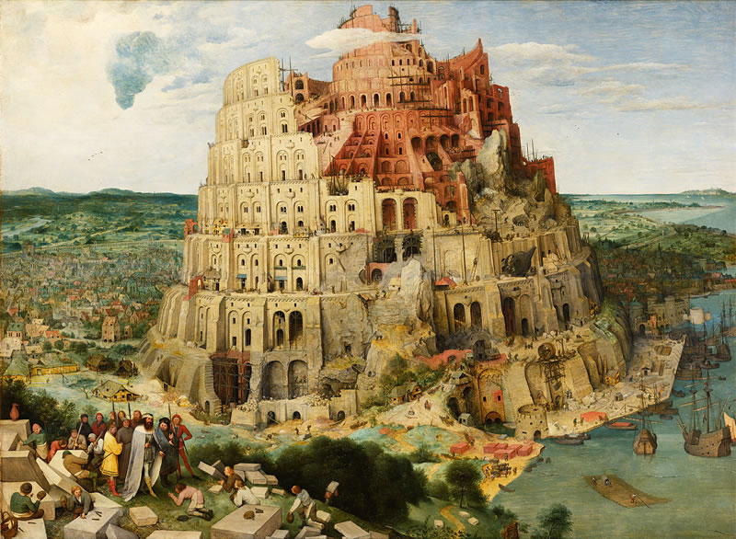
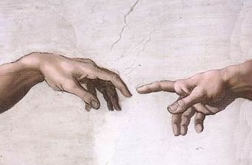
Acting locally
Universal
Bibliographic
Control
Thinking globally
KOS++
Confusing
tongues?
RDF
BIBFRAME:
Bibliographic
Framework
FR: Functional
Requirements
ISBD: International Standard
Bibliographic Description
Say what
we mean
BibO:
Bibliographic
Ontology
DC: Dublin Core
RDA: Resource
Description
and Access
CRM: Conceptual
Reference Model
MARC21
schema.org
UNIMARC

Slide 3

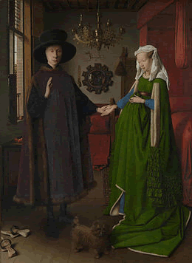
ISBD:
Content form?
RDA:
Content type?
A category that reflects the fundamental form or forms in which the content is expressed.
A categorization reflecting the fundamental form of communication in which the content is expressed and the human sense through which it is intended to be perceived.
Resource
Expression

Slide 4
Do you mean what I mean?
Communication protocol
Alignment of concepts
Mapping of vocabularies
Continuing interoperability

Slide 5
Protocol
Joint Steering Committee for Development of RDA
2014
ISBD Review Group
JSC liaison on ISBD RG
Publication of shared documents
Advance notification of changes
Joint development of element alignments

Slide 6
Element alignment
“enable harmonization between data produced according to the ISBD or RDA metadata content rules”
Version 3.0 (August 2014)
Alignment values: narrower (<), broader (>), same (=)
<
Content form (ISBD)
Content type (RDA)

Slide 7
Semantic mapping
RDF (Resource Description Framework) Schema ontology
Alignment | Mapping
A < B | A rdfs:subPropertyOf B .
A > B | B rdfs:subPropertyOf A .
A = B | A rdfs:subPropertyOf B . B rdfs:subpropertyOf A .
Terse triple
language
(ttl – “turtle”)
isbdu:P1001 rdfs:subPropertyOf rdau:P60049 .
“Unconstrained” elements (not constrained to entities)

Slide 8
Mapping
entities
rda:
Work
isbd:P1193 (has work aspect )
bf:
expressionOf
rdae:P20231 (has work expressed)
isbd:P1190
(has expression aspect )
bf:
Work
?
rda:
Expression
bf:
instanceOf
rdam:P30139
(has expression
manifested)
marc21:
Resource
isbd:
Resource
bf:
Instance
rda:
Manifestation
isbd:P1192
(has manifestation aspect )
rdai:P40049 (has manifestation exemplified)
rda:
Item
isbd:P1191 (has item aspect )

Slide 9
RDA/ONIX Framework
For Resource Categorization
Mapping
values
has Character
rofch:
“language”
has Sensory mode
rofsm:
“hearing”
isbdcf:
“spoken word”
rdact:
“spoken word”
<===================>
rofid:
“n/a”
has Image
dimensionality
rofim:
“n/a”
has Image movement

Slide 10
Conclusion
Semantic mappings support interoperability
of linked data
Mappings require alignments
Both sides must agree and maintain alignments
and mappings
Maintenance requires protocol

Slide 11
Thank you!
gordon@gordondunsire.com
Michaelangelo, Creation of Adam, Sistine Chapel, 1511-1512
Pieter Bruegel the Elder, The Tower of Babel, 1563
Jan van Eyck, Portrait of Giovanni Arnolfini and his Wife, 1434

