Slide 1
Linked data for manuscripts in the Semantic Web
Gordon Dunsire
Summer School in the Study of Historical Manuscripts
Zadar, Croatia, 26 – 30 September 2011
Topic II: New Conceptual Models for Information Organization
Wednesday, 28 September 2011

Slide 2
Overview
Basic concepts of RDF (Resource Description Framework)
  Basis of linked data in the Semantic Web
Library (+ archive + museum) standards and RDF
Methodology for creating linked data from bibliographic records for manuscripts

Slide 3
Semantic Web
“machine-readable metadata”
  Faster! 24/7/365! Global!
In a standard machine-processable format
  Resource Description Framework (RDF)
RDF supports simple, single metadata statements known as triples
  Each statement is in 3 parts

Slide 4
RDF triple
The title of this manuscript is “Ode to himself”
  Subject of the statement = Subject: This manuscript
  Nature of the statement = Predicate: (has) title
  Value of the statement = Object: “Ode to himself”
This manuscript – has title – “Ode to himself”
  subject – predicate – object
This letter – has author – Jane Doe
This codex – has material – papyrus

Slide 5
Identifiers
Need unambiguous way of identifying each part of the triple for efficient machine-processing
  Human labels (“This codex”, “has title”) no good
    Same thing, different labels; different things, same label
Exploit the utility of the URL
  Machine-readable, regular syntax, unambiguous, global
Uniform Resource Identifier (URI)

Slide 6
Uniform Resource Identifier
Can be any unique combination of numbers and letters
  No intrinsic meaning; it’s just an identifying label
Can look like a URL
  http://iflastandards.info/ns/isbd/elements/P1004
  But does not lead to a Web page (in principle ...)
RDF requires the subject and predicate of triple to be URIs
  Object can be a URI, or a literal string (“Ode to himself”)

Slide 7
Identifying bibliographic metadata
Represent bibliographic schema attributes and relationships as RDF properties (= predicates)
  Each property has own URI
    Resource Description and Access (RDA), International Standard Bibliographic Description (ISBD), Functional Requirements for Bibliographic Records (FRBR), etc.
Assign URIs to specific bibliographic resources
  The things described in catalogues and finding aids
    Manuscripts, collections, digital surrogates, etc.
    Vocabularies, subject headings, classifications, etc.

Slide 8
Ms1URI
hasTitleURI
“Ode to himself”
Ms1URI
hasAuthorURI
Name1URI
Name1URI
hasNNameURI
“Jonson, Ben”
Name1URI
hasBirthPlaceURI
Place1URI
Place1URI
hasCoordinatesURI
“abcxyz”
This ms
has author
“Ode to himself”
has title
Ben Jonson
Ms1URI
hasMaterial
Parchment

Slide 9
Ms1URI
hasTitleURI
“Ode to himself”
Parchment
material
“Requires ...”
treatment
title
This ms
“Ode to himself”
location
author
Place X
birthplace
Ben Jonson
coordinates
“abcxyz”
“Jonson, Ben”
normalised name

Slide 10
IFLA standards
RDF representations of standards for “universal” bibliographic control are being developed
“FR” (Functional Requirements) family of models
  For Bibliographic Records (FRBR)
  For Authority Data (FRAD)
  For Subject Authority Data (FRSAD)
International Standard Bibliographic Description (ISBD)
  Record structure and content standard for exchange of national metadata
UNIMARC
  Encoding for ISBD records (Bibliographic) and FRAD (Authorities)

Slide 11
Representation in RDF
Entities => RDF classes
  Class = category of thing
    E.g. FRBR “Person”
Attributes, tags, (sub)fields, relationships => RDF properties
  Property = category of statement about things
    E.g. ISBD “title proper”
    E.g. UNIMARC “200 $a” (title proper)
    E.g. FRBR “title of the manifestation”
Controlled term values => SKOS vocabularies
  SKOS = Simple Knowledge Organization System
    E.g. ISBD Area 0 (content and media type)

Slide 12
Namespaces
Each “element set” of RDF classes + properties, and each vocabulary, has its own namespace
Namespace is a set of URIs with the same common root or “base domain”
  E.g. “http://iflastandards.info/ns/isbd/terms/contentform/”
“Local part” is added to the root to form a URI
  E.g. http://iflastandards.info/ns/isbd/terms/contentform/ + T1009 = http://iflastandards.info/ns/isbd/terms/contentform/T1009
    URI for “text” in the ISBD Content form vocabulary

Slide 13
FR family
Each model has its own namespace
  To reflect historical development
  Each re-uses earlier RDF elements
Consolidated model under development
  Being informed by analysis of RDF representation
FRBR RDF published
  FRBRer (entity-relationship) ontology
    Namespace elements plus OWL
  FRBRoo (object-oriented)
    Extension of CIDOC Conceptual Reference Model (for museums)
FRAD and FRSAD now also published
  Approved at IFLA 2011 conference

Slide 14
ISBD
Element set, and vocabularies for content and media types
Namespaces now published
DC Application Profile in development
  Models the ISBD record
    What properties (fields)
    Mandatory? Repeatable?
    Aggregated statements
      Sub-elements and punctuation

Slide 15
ISBD AP snippet
<!-- Area 0 is mandatory and non-repeatable-->
<StatementTemplate ID="hasContentFormAndMediaTypeArea" minOccurs="1" maxOccurs="1" type="nonliteral">
<Property>http://iflastandards.info/ns/isbd/elements/P1158</Property>
<!-- Area 0 is an aggregated statement with SES -->
<NonLiteralConstraint descriptionTemplateRef="DThasContentFormAndMediaTypeArea">
<ValueStringConstraint>
<SyntaxEncodingScheme>http://iflastandards.info/ns/isbd/elements/C2003
</SyntaxEncodingScheme>
</ValueStringConstraint>
</NonLiteralConstraint>
</StatementTemplate>

Slide 16
UNIMARC
Proposal for RDF representation made at IFLA 2011
  http://conference.ifla.org/sites/default/files/files/papers/ifla77/187-dunsire-en.pdf
Discussed with Permanent UNIMARC Committee
  Now seeking funds for implementing a project

Slide 17
Other library standards in RDF (1)
RDA: resource description and access
  Content standard based on FR models
  Refines the FR properties
  Many more controlled vocabularies than AACR
    Anglo-American Cataloguing Rules
MARC21
  Preliminary construction of unofficial namespace underway
MODS/MADS (Metadata Object/Authority Description Schema)
  Metadata structure based on MARC21
  Library of Congress Name Authority File in MADS RDF
  RDF representation of MODS just beginning ...

Slide 18
Other library standards in RDF (2)
BIBO: Bibliographic Ontology
  Classes and properties for citations and bibliographic references
DCMI Metadata Terms (Dublin Core)
  High-level common-denominator classes and properties for memory institution metadata
Lots of controlled vocabularies
  Library of Congress Subject Headings, Rameau (French subject headings), SWD (German subject headings), Dewey Decimal Classification, RDA vocabularies, etc.

Slide 19
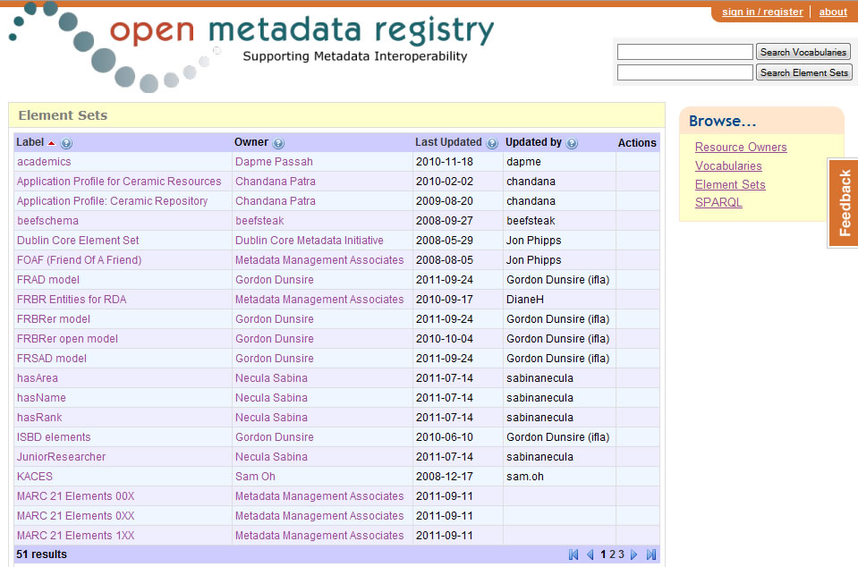

Slide 20
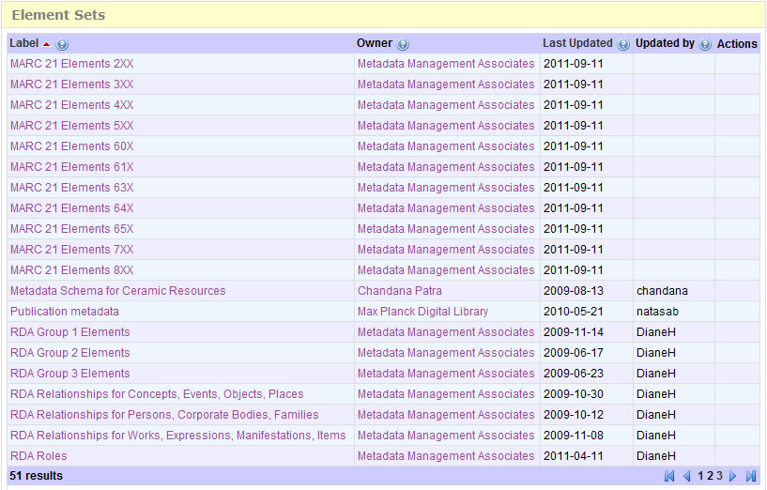

Slide 21
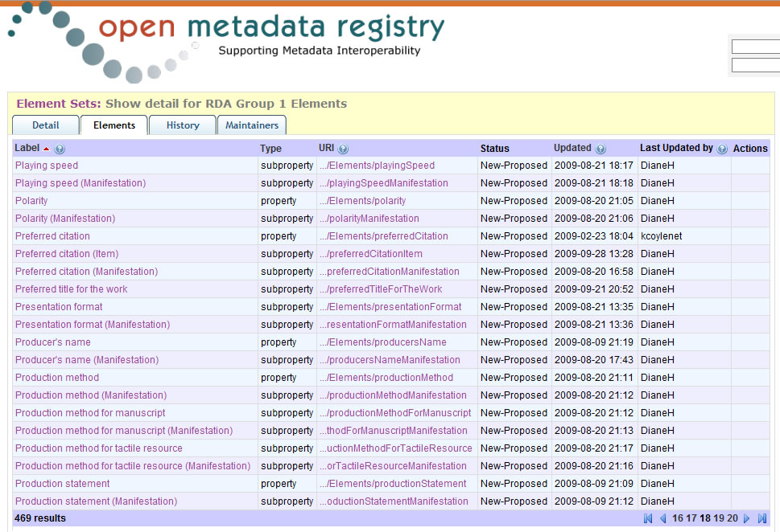

Slide 22
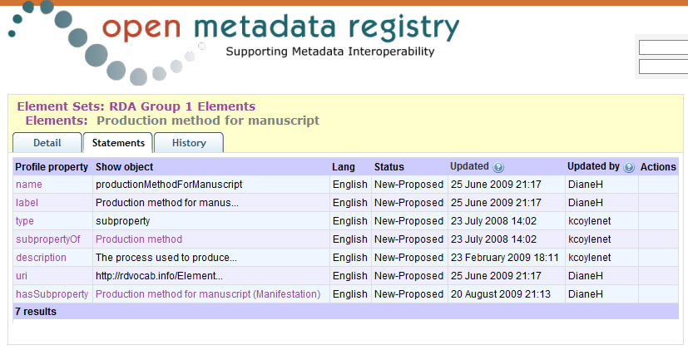

Slide 23
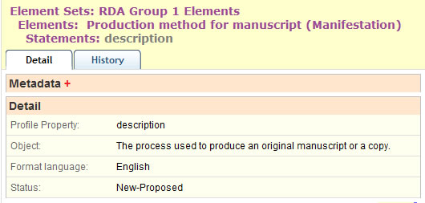

Slide 24
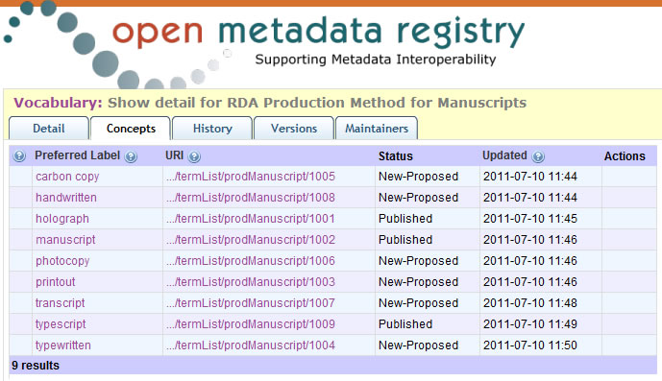

Slide 25
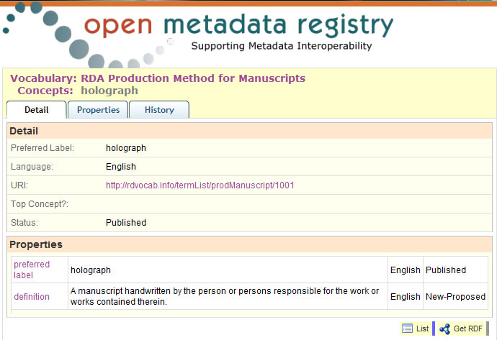

Slide 26
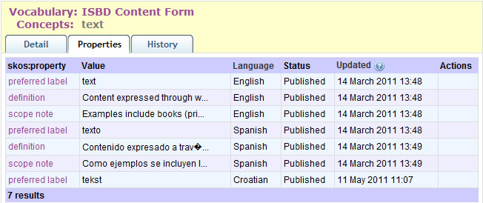

Slide 27
Manuscripts in other namespaces
Collex
  Tools for Digital Research in the Humanities
  http://www.performantsoftware.com/nines_wiki/index.php/Submitting_RDF
BiBO (Bibliographic Ontology)
  http://bibotools.googlecode.com/svn/bibo-ontology/trunk/doc/index.html

Slide 28
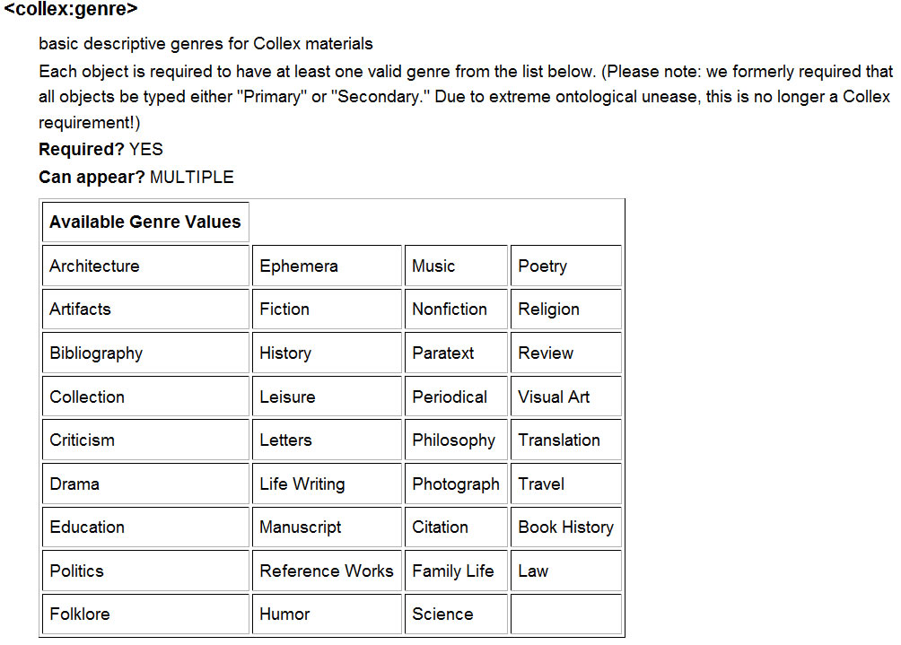
Text strings;
no URIs

Slide 29
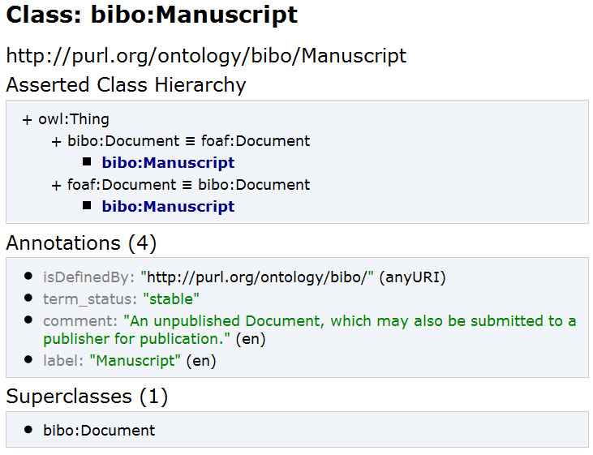
Notes:
http://bibotools.googlecode.com/svn/bibo-ontology/trunk/doc/index.html

Slide 30
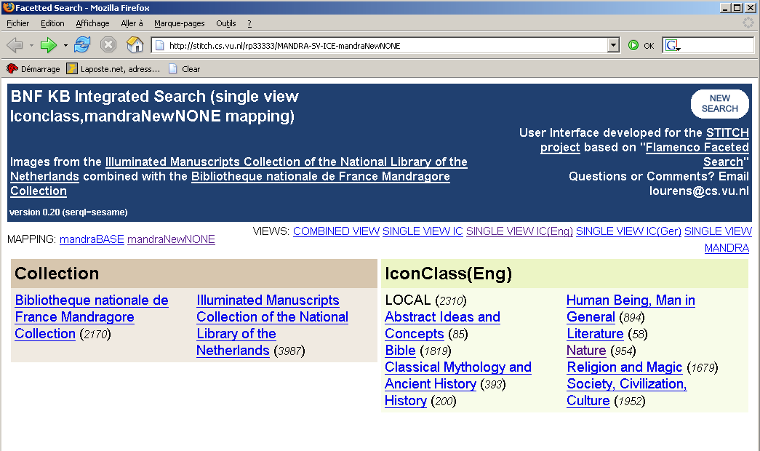
Demo: SKOS, browsing and alignment
Acknowledgement: Antoine Isaac, STITCH
Subject vocabulary, collection 1
Subjects
Notes:
http://stitch.cs.vu.nl/BNF_KB_demo.html

Slide 31
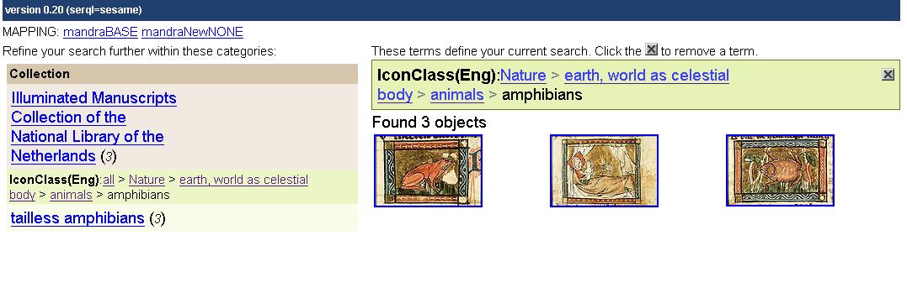
Demo: SKOS, browsing and alignment
Acknowledgement: Antoine Isaac, STITCH
Hierarchical path from root to selected subject
Possible specialization for selected subject

Slide 32
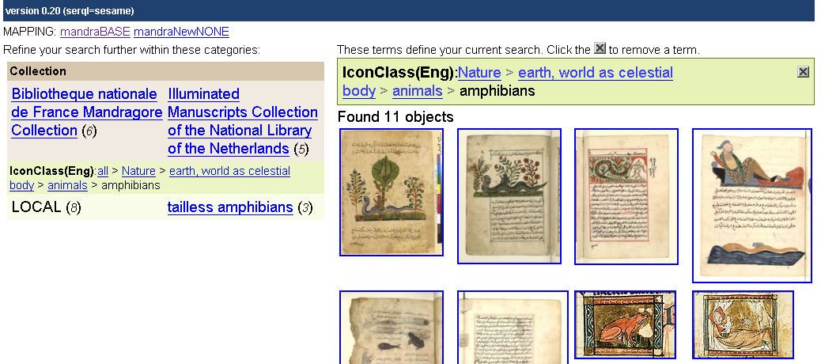
Demo: SKOS, browsing and alignment
Acknowledgement: Antoine Isaac, STITCH
Semantic alignment of subjects activated
Document from Collection 2

Slide 33
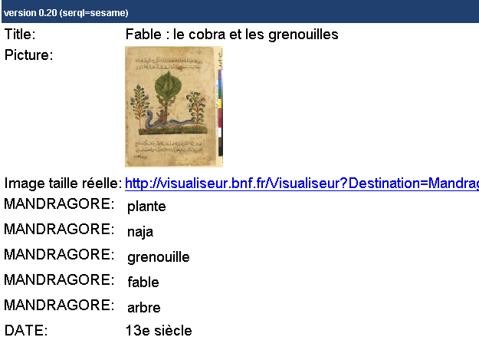
Demo: SKOS, browsing and alignment
Acknowledgement: Antoine Isaac, STITCH
Subject from voc2 aligned to voc1:amphibians”

Slide 34
From record to triples (in 9 stages)
Very large numbers of records
  Catalogue records, finding aids, etc.
  300 million; 1 billion?
High quality metadata
  In comparison with many other communities
Each record may generate many triples
  30 “raw” triples (no inferences) per MARC record?
Very, very large numbers of triples
  Billions? Trillions?

Slide 35
1. Take a record
Field/attribute | Value
Record ID | 54321
Title | Notes on an electrical experiment
Author | Michael Faraday
Date | 1845
LCSH | Impedance (electricity)
Material | Paper
Content form | Text

Slide 36
2. Disaggregate to single statements
Record | Attribute | Value
54321 | (has) title | Notes on an electrical experiment
54321 | (has) author | Michael Faraday
54321 | (has) date | 1845
54321 | (has) LCSH | Impedance (electricity)
54321 | (has) material | Paper
54321 | (has) content form | Text

Slide 37
3. Create URI for record
Must be unique, so 54321 no good on its own
http URIs are a good (“cool”) thing (W3C)
So add record ID to a unique http domain
  E.g. http://MyCollectionX.com
    unique to the library
  + 54321
http://MyCollectionX.com/54321
  (or http://MyCollectionX.com#54321)
This is not a URL!

Slide 38
4. Replace record ID with URI
URI | Attribute | Value
mlx:54321 | (has) title | Notes on an electrical experiment
mlx:54321 | (has) author | Michael Faraday
mlx:54321 | (has) date | 1845
mlx:54321 | (has) LCSH | Impedance (electricity)
mlx:54321 | (has) material | Paper
mlx:54321 | (has) content form | Text
“mlx” = qname (xmlns) = shorthand for “http://MyLibraryX.com/”

Slide 39
5. Find URIs for attributes
Attributes are modelled as RDF properties (predicates) in “element set” namespaces
  E.g. Dublin Core terms (dct); ISBD (isbd); FRBR (frbrer); RDA (rdaxxx); Bibliographic Ontology (bibo); etc.
Choose namespace, find property with same (or closest) “meaning” (e.g. definition) as attribute
  Nearest property minimises loss of information
Get URI for property
If no suitable property, choose another namespace
  Properties do not have to come from single namespace
Match and mix!

Slide 40
5 (cont). Find URI for title
http://purl.org/dc/terms/title (dct:title)
http://iflastandards.info/ns/isbd/elements/P1014 (isbd:P1014)
  hasTitleProper
http://RDVocab.info/Elements/titleProper (rdaGR1:titleProper)

Slide 41
5 (cont). Find URI for author
dct:creator
rdarole:author
(isbd does not cover “headings”)

Slide 42
5 (cont). Find URI for date
dct:date
isbd:P1018
  hasDateOfPublicationProductionDistribution
rdaGr1:dateOfProduction
  Unbounded version: no domain or range

Slide 43
5 (cont). Find URI for LCSH
LCSH is a subject vocabulary
  Controlled terms
So attribute is really “subject”
  And the term itself is the value
dct:subject

Slide 44
5 (cont). Find URI for material
rdaGr1:baseMaterial
  Unbounded version: no domain or range

Slide 45
5 (cont). Find URI for content form
Assuming record uses new ISBD Area 0 ...
isbd: P1001
  hasContentForm

Slide 46
6. Replace attributes with URIs
URI | URI | Value
mlx:54321 | isbd:P1014 | Notes on an electrical experiment
mlx:54321 | rdarole:author | Michael Faraday
mlx:54321 | isbd:P1018 | 1845
mlx:54321 | dct:subject | Impedance (electricity)
mlx:54321 | rdaGr1:baseMaterial | Paper
mlx:54321 | isbd:P1001 | Text

Slide 47
7. Find URIs for values
If object of a triple is a URI, it can link to the subject of another triple with the same URI
  Linked data!
Values from controlled vocabularies may have URIs
  Possible vocabularies: author, subject, material, content form
  NOT: title, date
For author: Virtual International Authority File (VIAF)
For LCSH: Library of Congress Authorities & Vocabularies
For ISBD Area 0: Open Metadata Registry
For RDA: Open Metadata Registry

Slide 48
7 (cont). Find URI for author
Author: Michael Faraday
viaf: http://viaf.org/viaf/
  viaf:38158158

Slide 49
7 (cont). Find URI for subject (LCSH)
LCSH: Impedance (electricity)
lcsh: http://id.loc.gov/authorities/subjects
  lcsh:sh85064610

Slide 50
7 (cont). Find URIs for other values
Material: Paper
RDA base material
  rdabm:1011
Content form: Text
ISBD Content form
  isbdcf:T1009

Slide 51
8. Replace values with URIs
subject | predicate | object
mlx:54321 | isbd:P1014 | “Notes on an electrical experiment”
mlx:54321 | rdarole:author | viaf:38158158
mlx:54321 | isbd:P1018 | “1845”
mlx:54321 | dct:subject | lcsh:sh85064610
mlx:54321 | rdaGr1:baseMaterial | rdabm:1011
mlx:54321 | isbd:P1001 | isbdcf:T1009

Slide 52
9. Publish triples (linked data)
mlx:54321 | isbd:P1014 | “Notes on an electrical experiment”
  mlx:54321 | rdarole:author | viaf:38158158
mlx:54321 | isbd:P1018 | “1845”
mlx:54321 | dct:subject | lcsh:sh85064610
mlx:54321 | rdaGr1:baseMaterial | rdabm:1011
mlx:54321 | isbd:P1001 | isbdcf:T1009

Slide 53
“Notes on an electrical experiment”
“Faraday, Michael, 1791-1867”
foaf:name
isbd:P1014
“1845”
isbd:P1018
viaf:38158158
rdarole:author
mlx:54321
dct:subject
lcsh:sh85064610
rdaGr1:baseMaterial
rdabm:1011
madsrdf:authoritativeLabel
skos:prefLabel
“Impedance (electricity)”
isbd:P1001
“paper”
“text”
isbdcf:T1009
skos:prefLabel
“tekst”

Slide 54
Thank you!
gordon@gordondunsire.com
  Open Metadata Registry
  http://metadataregistry.org

