Slide 1
LRM and RDA : overview of the 3R Project
Gordon Dunsire, Chair, RSC
Presented at “The redesigned RDA Toolkit: what you need to know to get ready”,
Montréal, Québec, Canada, 22 October 2018

Slide 2
3R Project
RDA Toolkit Restructure and Redesign
Modern responsive design
Users of mobile devices
Users with sensory preferences
RDA content infrastructure
Convert to DITA standard
Increase re-use of RDA Reference data
IFLA Library Reference Model
RDA Board strategy
Notes:
The RDA Toolkit Restructure and Redesign (3R) Project has several high-level goals.

Slide 3
RDA
“RDA is a package of data elements, guidelines, and instructions for creating library and cultural heritage resource metadata that are well-formed according to international models for user-focussed linked data applications.”
RDA Toolkit provides the user-focussed elements, guidelines, and instructions.
RDA Registry provides the infrastructure for well-formed, linked, RDA data applications.
Notes:
The RDA data ecosystem is summed up in this sentence introducing the RDA Board’s announcement of RDA’s strategic directions.
The RDA package is delivered by an infrastructure of two interacting services.
The human-facing components, including the guidelines and instructions, are the Toolkit.
The data-facing components are contained in the Registry.
Applying the data capture and storage techniques in RDA Toolkit to the data architecture in the RDA Registry produces well-formed data for RDA applications.

Slide 4
LRM
2017: Library Reference Model
International Federation of Library Associations and Institutions (IFLA)
LRM consolidates the FR family of models
1998: FR for Bibliographic Records (FRBR)
2009: FR for Authority Data (FRAD)
2010: FR for Subject Authority Data (FRSAD)
2011: Working Group on Aggregates report
Notes:
The IFLA Library Reference Model (LRM) is a recent consolidation of several models published over the past 20 years.
A significant shift of focus occurred in the middle of this period of development. This was indicated by a change in the title from “records” to “data”.

Slide 5
LRM and RDA
RDA was based on most of FRBR, some of FRAD, all of FRSAD (but mostly out of scope), and none of WGoA
LRM is the opportunity to fill in gaps and reconcile incoherencies
Notes:
The LRM is relevant to the development of RDA because RDA was based on the original FR family of models.
Not all of the models were fully adopted by RDA. The original Toolkit is based mainly on FRBR, with placeholders for the FRBR Group 3 entities. RDA only used parts of FRAD, and did not add specific elements for authority “headings”.
Detailed accommodation of subject data is out of scope for RDA, but RDA used FRSAD as the basis of high-level subject relationship elements.
RDA followed the advice given in the report of the Working Group on Aggregates and waited for the consolidation of the models before developing elements, guidance, and instructions for describing aggregates and serials.

Slide 6
Is LRM suitable for RDA?
LRM “a high-level conceptual model … intended as a guide or basis on which to elaborate cataloguing rules”
RDA guidance, instructions, elements
“operates at a greater level of generality than FRBRoo, which seeks to be comparable in terms of generality with CIDOC CRM”
RDA cultural heritage communities
LRM “this model is developed very much with semantic web technologies in mind”
RDA linked data communities
Notes:
There are several features of the LRM that make it suitable for use as the conceptual model behind RDA.
In particular, it supports the RDA Board strategy for improving the utility of RDA for international, cultural heritage, and linked data communities.

Slide 7
LRM as a model
High-level conceptual model
Entity-relationship structure
Intended for refinement by implementations
By sub-typing entities, relationships, and attributes
Notes:
The LRM only provides a high-level model for describing the resources found in library and related collections.
It uses an entity-relationship structure that specifies the entities that are useful to describe, the broad attributes that characterize each entity, and the broad relationships between entities.
The LRM is not intended to be applied directly. It needs to be refined for practical implementations of the model.
Refinements are specified by sub-types of the LRM entities, attributes, and relationships.
To develop RDA as a coherent implementation of the LRM, existing RDA entities and elements must be specified as entity or element sub-types.

Slide 8
LRM entities
Retained:
Work, Expression, Manifestation, Item, Person**
Added:
Agent, Collective Agent, Nomen, Place, Time-span
+ Res (super-class of other entities)
Notes:
The LRM retains the main “resource” entities from FRBR: Work, Expression, Manifestation, and Item.
The Person entity is also retained, but the definition is now confined to real human beings, and excludes bibliographic identities, fictional and legendary beings, and so on.
The LRM introduces several new entities, and an entity super-type labelled “Res”.
Res allows broad attributes and relationships to be cascaded down to, or inherited by, all other LRM entities.

Slide 9
IFLA LRM and RDA entities
Res
is sub-class of
RDA Entity = Any RDA Thing
Covers all other types of entity
RDA
Entity
has appellation*
Nomen
W
is created by
E
Agent
Place
is sub-class
of
is associated with
M
Collective
Agent
Time-span
I
is modified by
P**
F
C
Notes:
In RDA, the super-entity "RDA Entity" is used in place of Res for all other RDA entities. RDA Entity is a sub-type (sub-class in RDF) of Res.
This RDF graph shows new RDA entities taken from the LRM: Nomen, Place, Time-span, Collective Agent, and Agent. Current RDA entities are labelled only with their initials. The graph also shows the high-level relationships between the new and current entities.
* The “appellation” relationship does not normally apply to Nomen itself: Nomens do not have nomens.
** The only RDA entity which does not fit without significant modification is Person because of the narrower definition used by the LRM.
The integrated semantic structure of the LRM and RDA entities allows the RDA relationships to be refinements of the high-level LRM relationships, as element sub-types (sub-properties in RDF).

Slide 10
Beta release
Foundational structure for the organization of elements, instructions, and guidance
Combines
The organization of entities, attributes, and relationships in the IFLA Library Reference Model (LRM)
The extension of RDA as an implementation of the LRM and resolution of gaps and inconsistencies in RDA
Explicit provision of recording methods to improve support for RDA data applications
Notes:
The beta release of RDA Toolkit provides the foundation for the distribution and amendment of original Toolkit guidance and instructions, and the development of guidance and instructions for new entities and elements.
The structure combines features of RDA as an implementation of the LRM, and explicit provision of a range of recording methods for RDA metadata.

Slide 11
Elements
Element is the unit of focus in the new Toolkit
e.g. “performer” has a “page” all to itself
New elements for access points
Distinction between attribute and relationship elements is dependent on the recording method
New entities  more relationships  more inverses
Many more elements
Notes:
While the original Toolkit focussed on two pairs of entities (work/expression, and manifestation/item), the new Toolkit uses the much finer granularity of an individual element.
Each element has a page of guidance and instructions, using a standard layout.
Like the LRM, then new Toolkit blurs the distinction between attribute elements and relationship elements.
Many former attribute elements have become relationships as a result of the new entities; for example, Date of birth is now a relationship between a Person and a Timespan.
With many new entities, and relationships requiring inverses, the number of RDA elements has increased.

Slide 12
The numbers
13 entities
1700+ elements
Work | 388 |  | Agent | 175
Expression | 291 |  | Person | 85
Manifestation | 282 |  | Collective Agent | 34
Item | 70 |  | Corporate Body | 84
Place | 45 |  | Family | 46
Timespan | 54 |  | Nomen | 169
RDA Entity | 27
Notes:
This table shows the number of elements assigned to each entity.
RDA entity reflects the basic elements available for every entity.

Slide 13
Modular structure
Instructions are grouped by element and recording method
Finer granularity is more flexible for a wider range of applications
Every element page has the same basic structure
RDA Reference data are maintained and displayed separately from guidance and instructions
Reference data are extracted from the RDA Registry
Notes:
The new RDA Toolkit has a modular structure based on the RDA elements.
Each element has a “page” in the Toolkit, and each element page has the same basic structure.
The structure separates the RDA Reference data from the guidance and instructions.

Slide 14
RDA Registry
Linked data representations of RDA Reference
Entities (classes)
Relationships and attributes (properties)
Controlled terminologies (concepts)
+ Translations
+ Maps (e.g. to ISBD, MARC Relators, MARC 21)
Open license (BY)
Notes:
The RDA Registry represents RDA Reference in Resource Description Framework, the data format of linked open data and the Semantic Web.
RDA Reference consists of the RDA entities, represented as classes, and their relationship and attribute elements, represented as properties.
The controlled terminologies in RDA vocabulary encoding schemes are represented as concepts.
RDA Reference also includes all of the translations of these data, and machine-actionable maps from RDA to related standards.
All of the data in the Registry is freely available on an open license that requires only attribution if it is used in another application.

Slide 15
Registry data in Toolkit
3R Project
Basic structure of all element “pages” generated from Registry
Regular releases
Element page
Definition and scope; Element reference; Related elements
Glossary
Vocabulary encoding schemes
Relationship matrix
Notes:
During the 3R Project, the Registry data was used to generate the basic structure of every element page in the new Toolkit.
Registry data will be used in future releases of the new Toolkit to update basic element data, and the entire Glossary, Vocabulary encoding schemes reference, and Relationship matrix.

Slide 16
Element page structure
Definition and Scope
Element Reference
Prerecording
Recording
Recording an unstructured description
Recording a structured description
Recording an identifier
Recording an IRI
Instructions
RDA Reference
Related Elements
Notes:
This is an outline of the element page structure.
The RDA Reference data are displayed in the sections highlighted in gray.
All of these sections use content that has already been translated in the Open Metadata Registry.
The guidance and instructions are displayed in the sections highlighted in orange.
The content of these sections is translated in the Content Management System using Trados.
This allows translators to focus their work on specific areas of Toolkit content.

Slide 17
Recording methods
Extended to all elements
Confined to relationships in original Toolkit
Linked data “method” now explicit
4 methods = “4-fold path”
Unstructured description
Structured description
Identifier
IRI
Notes:
The three recording methods for describing a related entity in the original Toolkit are extended to all elements in the new Toolkit.
A fourth recording method, for linked data, has been added.
These recording methods accommodate the implementation scenarios of the original Toolkit.

Slide 18
Boilerplate
Guidance, instruction, and navigation content components that are re-used in multiple pages in the Toolkit
Re-usable components are updated once
And translated once
Repetition is a desirable feature of the new Toolkit
Improves consistency and understanding
Supports a modular editorial infrastructure
Reduces costs
Notes:
The Toolkit uses boilerplate, or fixed, text as much as possible.
Standard paragraphs and other content syntax are used for guidance, instructions, and in-page navigation.
These paragraphs are re-used in multiple pages.
This allows the content to be updated once, and used many times.
A translator only needs to translate the re-usable content once.

Slide 19
Instructions
There are no rules!
Most instructions are now optional
Accommodates local practice in a global framework
Instructions assigned to recording methods
Much more choice
Flexibility ☺
How to choose? ☹
Notes:
There have never been any “rules” for describing resources in RDA.
This basic open approach was reflected in the assignment of “core” status to elements, which was advisory and not compulsory.
RDA is intended for use in an international global environment, and has to accommodate a diversity of local practices and policies. This means that most instructions are optional. Instructions are mandatory where required to ensure well-formed metadata that is coherent with the LRM.
Instructions are assigned to a specific recording method where appropriate, and which applicable recording method to use is determined by local policy.

Slide 20
Optional instructions
Internationalization
No “one way” of describing and accessing a resource
Two or more recording methods are valid for many elements
No element is mandatory [except “nomen string”]
Same as original Toolkit
Most instructions are optional
Application profile is required to manage choice
Notes:
To sum up, most RDA Toolkit instructions are now optional.
The Toolkit is intended to be used with an application profile that specifies which options should be used for a specific application of RDA metadata.

Slide 21
Application profile
What elements must be recorded?
What elements should be recorded?
What elements may be repeated?
What vocabularies are used?
What recording methods are used?
What options are used?
Notes:
An application profile specifies the components of a well-formed set of metadata to be used in a specific application.
The profile effectively “picks and mixes” the elements from one or more ontologies or element sets.
An RDA application profile selects which RDA elements, vocabularies, recording methods, and optional instructions to use for a specific application.

Slide 22
Application profiles in RDA Toolkit
Multiple ways:
Bookmarks and notes
Policy statements
Workflows and other user documentation External documents
Range of contexts, usage, and sharing
Notes:
The new RDA Toolkit provides a range of mechanisms for specifying a profile.
Bookmarks and notes can be used for simple, “personal” profiles.
User-generated documentation can be used for institution-wide applications.
Policy statements are applicable across multiple institutional subscriptions.
External documents that link to Toolkit instructions are suitable for widespread use.

Slide 23
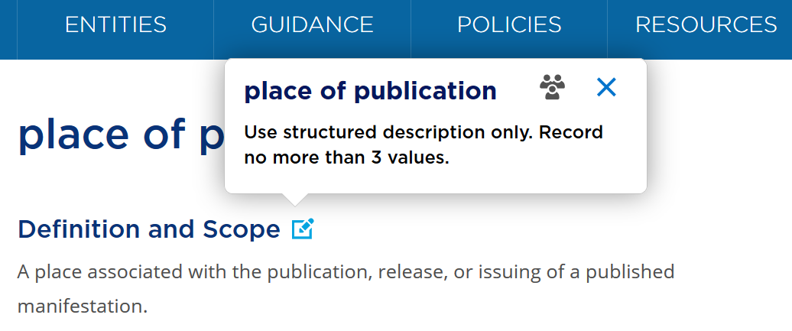
Bookmark + note
Notes:
This is an example of a simple application profile using the Toolkit Bookmarks and notes facility.
The simple text box gives basic instructions on using the element, and the bookmark acts as an alert to the cataloguer.
This approach may be suitable for occasional use of the Toolkit for a small, local application.

Slide 24
Conditions
Many instructions apply only when one or more conditions is met
Kind of resource being described
Specific characteristic of resource being described
Existence of pre-recorded data
Etc.
“Alternative” = option for the same set of conditions
“Exception” = different set of conditions
Notes:
Optional instructions are often associated with one or more specific conditions.
These may include the type of material and special characteristics being described, or the existence of pre-recorded metadata.
The new Toolkit applies a uniform structure to the presentation of conditions.
This helps to clarify the context of alternatives and exceptions in the original Toolkit:
An alternative is just another option for the same set of conditions, and an exception is a specification of a different set of conditions, usually refined or narrowed.

Slide 25
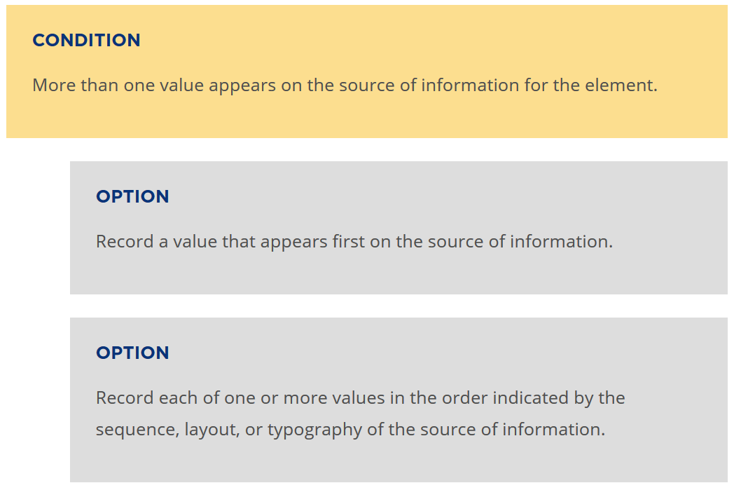
Notes:
Optional instructions are presented in a standard format and are linked to the conditions for which they can be applied.
This format allows policy statements and application profiles to be attached to individual options or groups of options with the same set of conditions.

Slide 26
Translations
Modular structure supports translation
Boilerplate; standard phrasing
RDA Reference is translated independently of other Toolkit content
Translated data processed in the same way as English data
Notes:
The new Toolkit is designed to improve support for translations.
Features include the modular structure that uses boilerplate and standard phrasing, which fit well with the TRADOS software available to translators of the full Toolkit.
RDA Reference is translated in a more open environment that is independent of Toolkit releases. This allows translations to be used in end-user displays of RDA metadata without the expense of translating the guidance and instructions for cataloguers.
Translations of RDA Reference are processed in the same way as the English data, so that the same areas of a Toolkit translation are generated from the Registry.

Slide 27
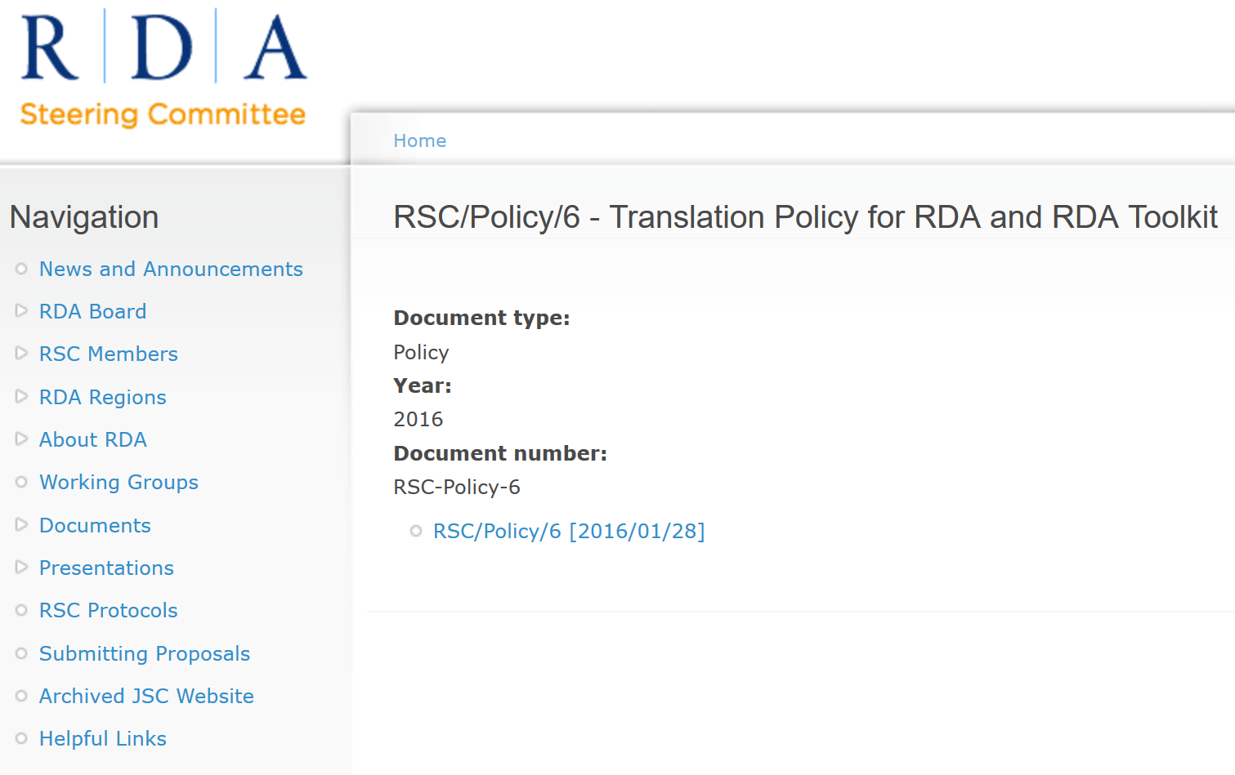
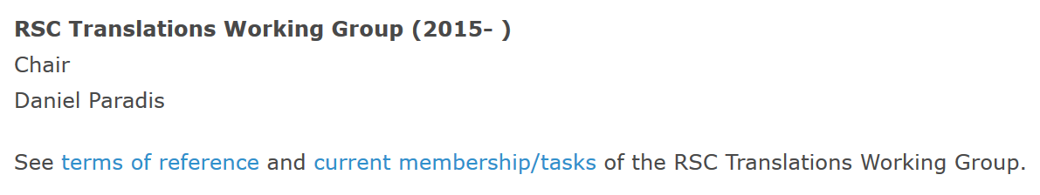
Notes:
The RDA Steering Committee (RSC) and ALA Publishing have a formal policy on translations.
This can be found at http://www.rda-rsc.org/sites/all/files/RSC-Policy-6.pdf
There is also an RSC Translations Working Group, established in 2015.
The Working Group is permanent, and its Chair is a full member of RSC.
The current Chair is Daniel Paradis, who leads the French translation of RDA.
Other members of the Working Group are involved in translations in Catalan, Finnish, German, Italian, and Spanish, which are translations of the complete RDA Toolkit. Another Working Group member represents the interests of partial translations of RDA Reference.
More information about the Working Group is available at http://www.rda-rsc.org/workinggroups

Slide 28
The new RDA Toolkit
A package of data elements, guidelines, and instructions ...
A package that meets the resource description and access needs of the 21st century

Slide 29
Thank you!
RDA Steering Committee
http://www.rda-rsc.org/
RDA presentations
http://www.rda-rsc.org/node/560
RDA Toolkit
https://www.rdatoolkit.org/

