Slide 1
Instructions, interfaces, and interoperable data: the RIMMF experience with RDA
Gordon Dunsire
Presented to Session 093 Let’s make IT usable! Formats, systems and users, WLIC 2016, Columbus, Ohio, USA

Slide 2
Cataloguing in the 21st century
From AACR/ISBD/MARC
To FRBR/RDA/Linked data
Asynchronous development
  Insufficient liaison, funding, priorities
Cataloguing systems lag behind everything
  Wait until it stops changing
Cataloguers working in a hybrid environment

Slide 3
RDA data
“RDA is a package of data elements, guidelines, and instructions for creating library and cultural heritage resource metadata that are well-formed according to international models for user-focussed linked data applications.”
RDA Toolkit provides the user-focussed elements, guidelines, and instructions.
RDA Registry provides the infrastructure for well-formed, linked, RDA data applications. Open Metadata Registry (OMR) provides linked data representation of RDA elements.
Notes:
The RDA data ecosystem is summed up in this sentence introducing the RDA Board’s announcement of RDA’s strategic directions.
The RDA package is delivered by an infrastructure of two interacting services.
The human-facing components, including the guidelines and instructions, are the Toolkit.
The data-facing components are contained in the Registry.
Applying the data capture and storage techniques in RDA Toolkit to the data architecture in the RDA Registry produces well-formed data for RDA applications.

Slide 4
Rich relationships require finer granularity
AACR2
ISBD
MARC
Resource
RDA
FRBR
Linked data
Work
Expression
Manifestation
Item

Slide 5
Technical terminology: I say this; you say that
RDA/FRBR | Linked data/RDF
entity | class
element | property
element sub-type | sub-property
designator | property
vocabulary encoding scheme | value vocabulary
term | concept
The users say ?

Slide 6
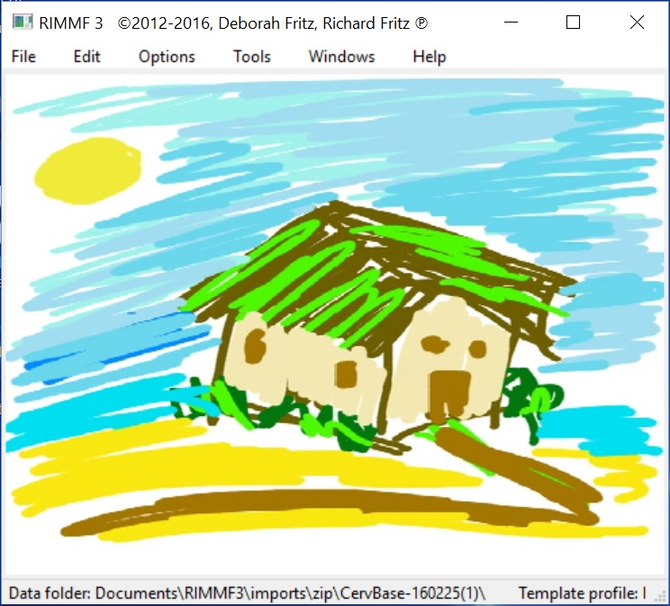
RIMMF: RDA in Many Metadata Formats
Developed as a training tool and prototype interface for RDA
RIMMF3 uses RDA linked data

Slide 7
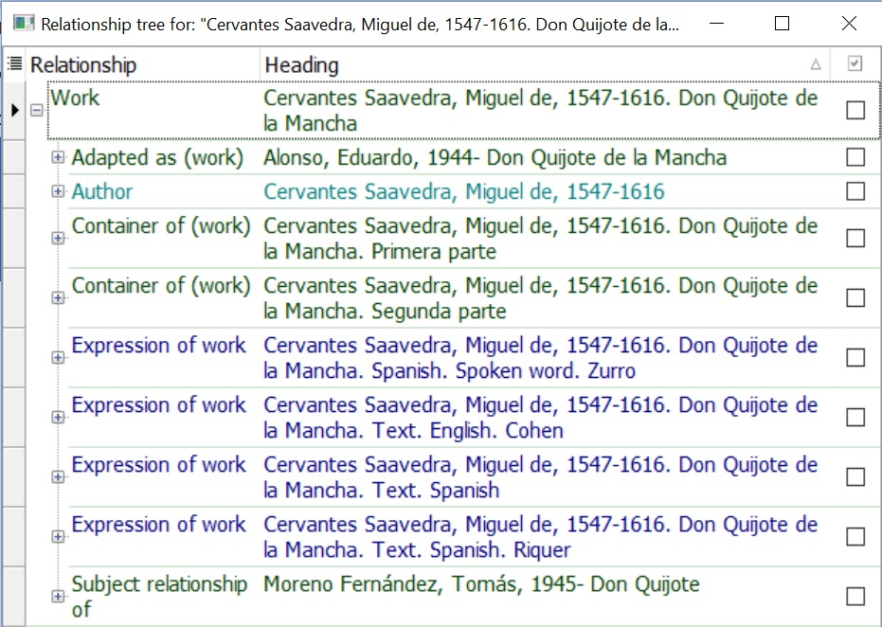
Displaying complex granular relationships

Slide 8
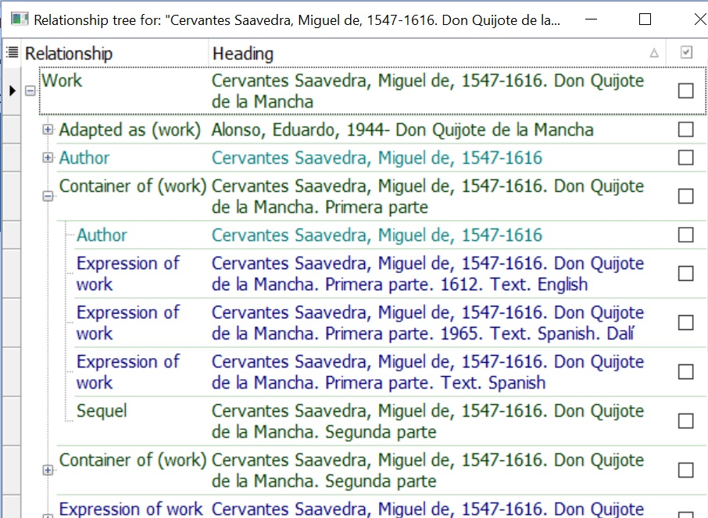
Displaying complex granular relationships

Slide 9
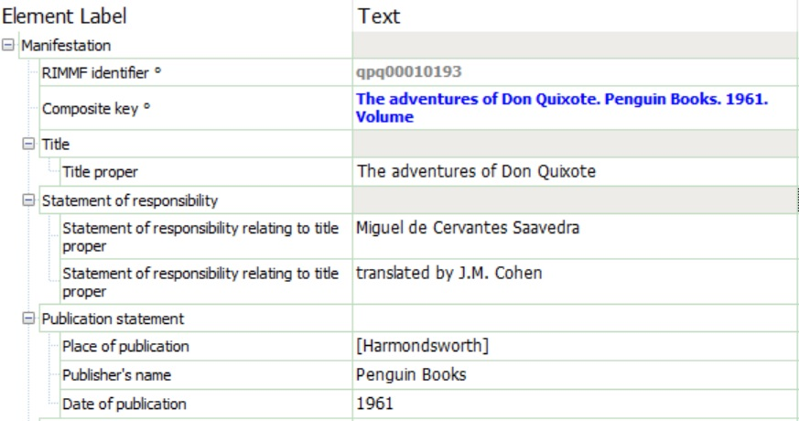
Manifestation data with RDA Toolkit labels

Slide 10
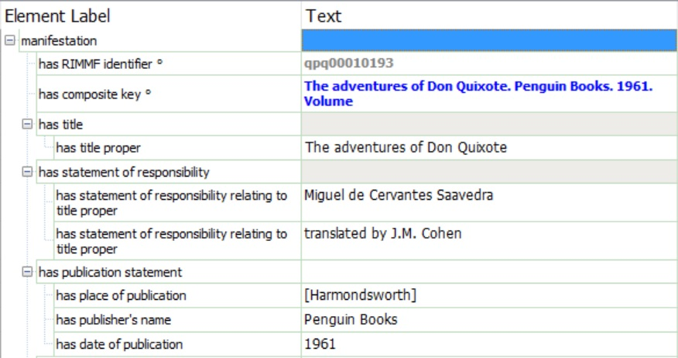
Manifestation data with RDA Registry (linked data) labels
Indicates focus/domain of the element/property

Slide 11
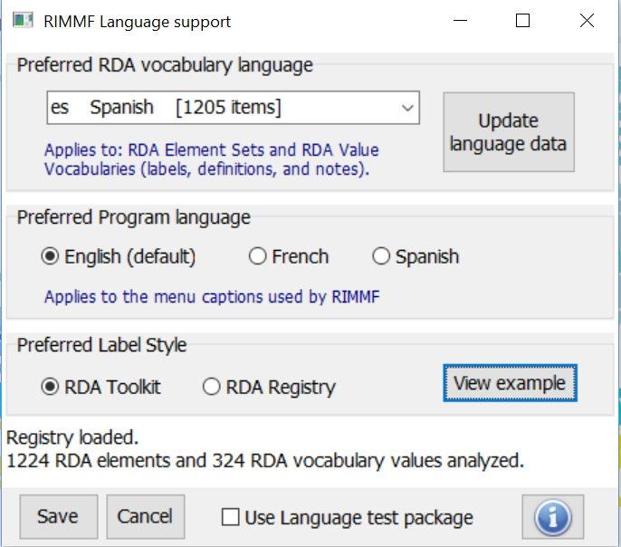
RIMMF support for multilingual cataloguing
Uses linked data language indicators
All data is taken from RDA Registry

Slide 12
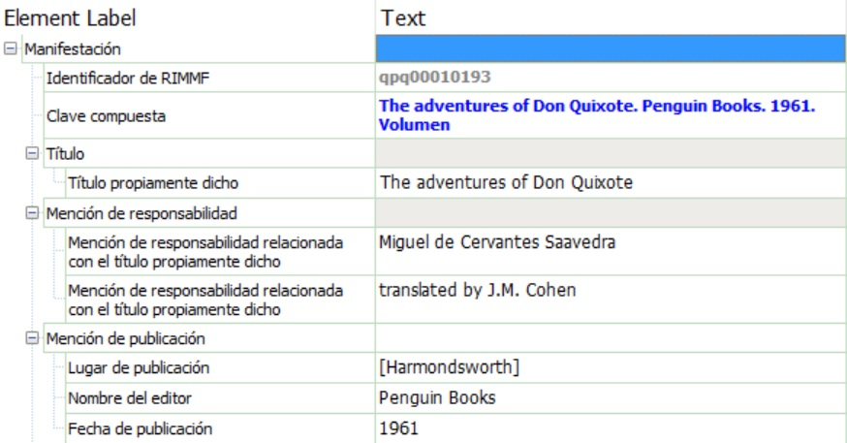
Manifestation data with Spanish Toolkit labels

Slide 13
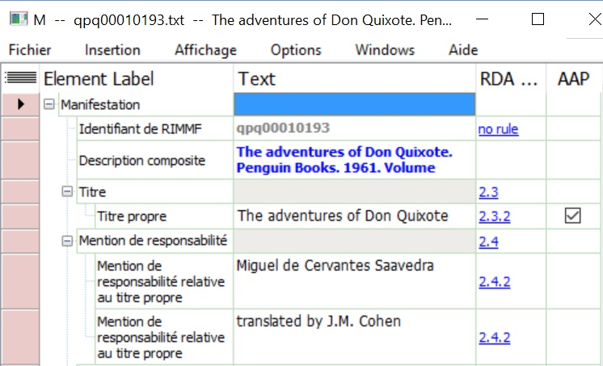
Manifestation data with French Toolkit labels + + +

Slide 14
Legacy data: MARC21 to RDA linked data
MARC21
RIMMF RDA
Semantic
Web
RDF linked data
MARC21
Legacy
systems

Slide 15
Global fun with RDA: the jane-athons
Jane-athon: A hackathon for RDA data using RIMMF
ALA Midwinter 2015: topic: Jane Austen and her works
Wellington (New Zealand)
Edinburgh (Scotland)
Madrid (Spain)
Stockholm (Sweden)
USA (x5)
Paris (France)
London (England)
Riga (Latvia)
The Hague (The Netherlands)

Slide 16
Conclusion
The "harmony" of international bibliographic standards in the 20th century is unlikely to happen again
  And will not be necessary (Semantic Web)
Cataloguers will need tools like RIMMF to provide a common (harmonious?) view of metadata from many source
And so will users.

Slide 17
Thank you!
rscchair@rdatoolkit.org
RDA Steering Committee
  http://www.rda-rsc.org/
RDA Toolkit
  http://www.rdatoolkit.org/
RDA Registry
  http://www.rdaregistry.info/
Open Metadata Registry
  http://metadataregistry.org/
RIMMF
  http://www.marcofquality.com/wiki/rimmf3/
Jane-athons, etc.
  http://rballs.info/

