Slide 1
Getting triples from records: the role of ISBD
Gordon Dunsire
Presented at Centar zu Stalno Stručno Usavršavanje (CSSU), Zagreb
21 Nov 2011

Slide 2
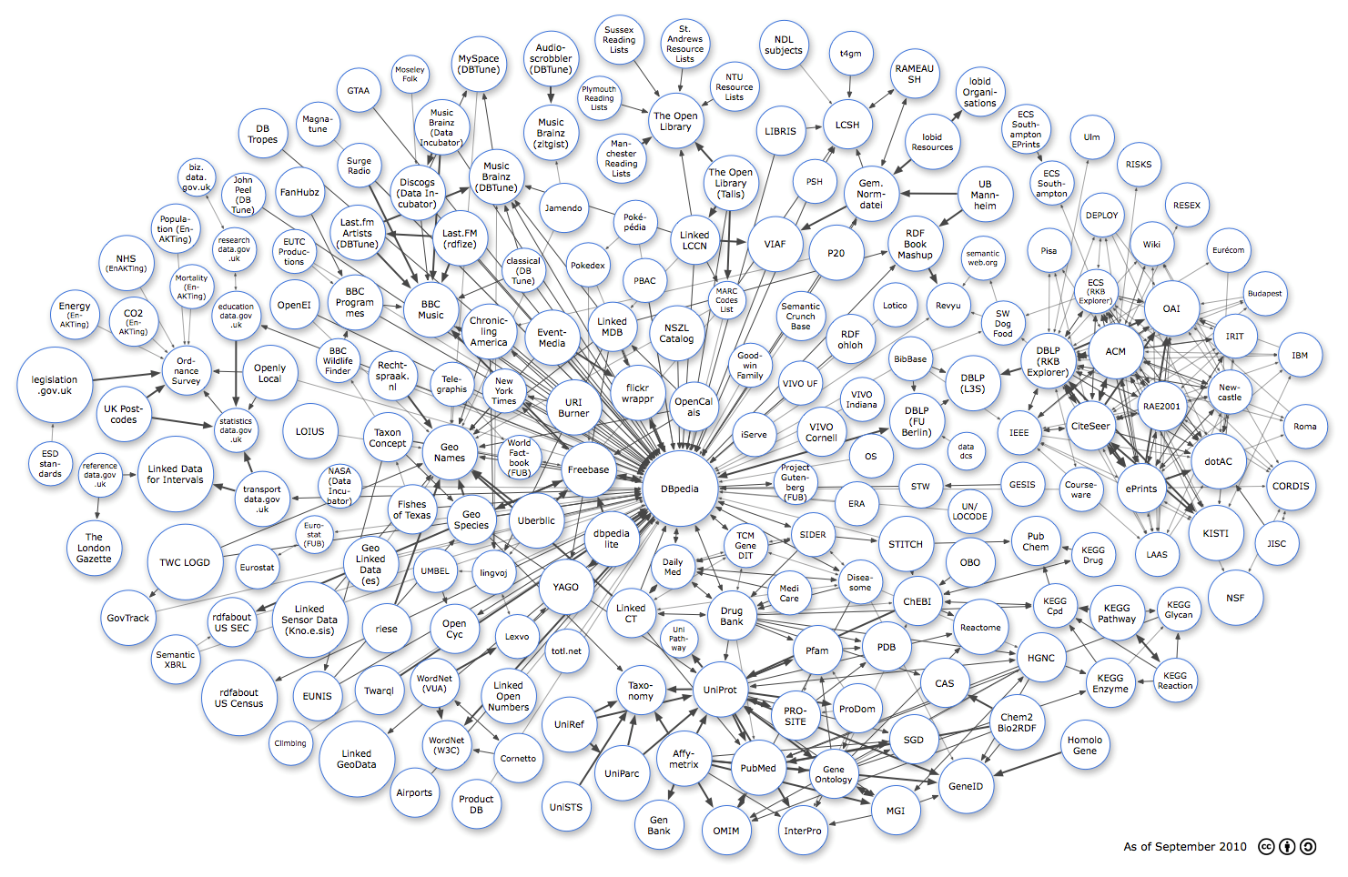
Linking Open Data cloud (LOD) September 2010
Diagram by Richard Cyganiak and Anja Jentzsch. http://lod-cloud.net/

Slide 3
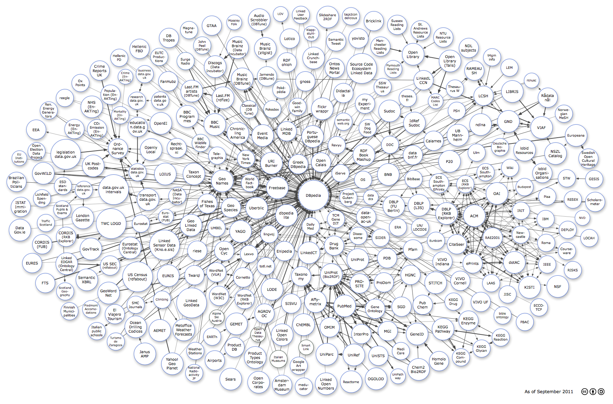
Linking Open Data cloud (LOD) September 2011
Diagram by Richard Cyganiak and Anja Jentzsch. http://lod-cloud.net/

Slide 4
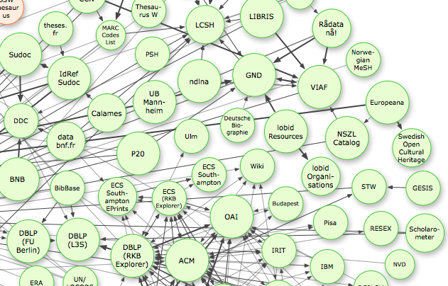
LOD: “Library” corner

Slide 5
Why get involved?
To share our data
We work for “society”
To share our expertise and experience
150 + years
To promote the power of libraries (and archives and museums)
To survive

Slide 6
From record to triples (in 9 stages)
Very large numbers of records
Catalogue records, finding aids, etc.
300 million; 1 billion?
High quality metadata
In comparison with other communities
Each record may generate many triples
50-200 “raw” triples (no inferences) per MARC record?
Very, very large numbers of triples
Billions? Trillions?

Slide 7
1. Take a record
Field/attribute | Value
Record ID | 54321
Title | Museum archives: an introduction
Author | Wythe, Deborah
Date | 2004
LCSH | Museum archives
Media/GMD | Electronic
Content form | Text

Slide 8
2. Disaggregate to single statements
Record | Attribute | Value
54321 | (has) title | Museum archives: an introduction
54321 | (has) author | Wythe, Deborah
54321 | (has) date | 2004
54321 | (has) LCSH | Museum archives
54321 | (has) media type | Electronic
54321 | (has) content form | Text

Slide 9
3. Create URI for record
Must be unique, so 54321 no good on its own
http URIs are a good thing (W3C)
So add record ID to a unique http domain
E.g. http://MyLibraryX.com (unique to the library)
+ 54321
http://MyLibraryX.com/54321
(or http://MyLibraryX.com#54321)
This is not a URL!

Slide 10
4. Replace record ID with URI
URI | Attribute | Value
mlx:54321 | (has) title | Museum archives: an introduction
mlx:54321 | (has) author | Wythe, Deborah
mlx:54321 | (has) date | 2004
mlx:54321 | (has) LCSH | Museum archives
mlx:54321 | (has) media type | Electronic
mlx:54321 | (has) content form | Text
“mlx” = qname (xmlns) = shorthand for “http://MyLibraryX.com/”

Slide 11
5. Find URIs for attributes
Attributes are modelled as RDF properties (predicates) in “element set” namespaces
E.g. Dublin Core terms (dct); ISBD (isbd); FRBR (frbrer); RDA (rdaxxx); Bibliographic Ontology (bibo); etc.
Choose a namespace, find property with same (or closest) “meaning” (e.g. definition) as attribute
Nearest property minimises loss of information
Get URI for property
If no suitable property, choose another namespace
Properties do not have to come from single namespace
Match and mix!

Slide 12
5 (cont). Find URI for title
http://purl.org/dc/terms/title (dct:title)
http://iflastandards.info/ns/isbd/elements/P1014 (isbd:P1014)
hasTitleProper
http://RDVocab.info/Elements/titleProper (rdaGR1:titleProper)

Slide 13
5 (cont). Find URI for author
dct:creator
rdarole:author
(isbd does not cover “headings”)

Slide 14
5 (cont). Find URI for date
dct:date
isbd:P1018
hasDateOfPublicationProductionDistribution
rdaGr1:dateOfPublication

Slide 15
5 (cont). Find URI for LCSH
LCSH is a subject vocabulary
Controlled terms
So attribute is really “subject”
And the term itself is the value
dct:subject

Slide 16
5 (cont). Find URI for media type
Assuming record uses new ISBD Area 0 ...
isbd:P1003
hasMediaType

Slide 17
5 (cont). Find URI for content form
Assuming record uses new ISBD Area 0 ...
isbd: P1001
hasContentForm

Slide 18
6. Replace attributes with URIs
URI | URI | Value
mlx:54321 | isbd:P1014 | Museum archives: an introduction
mlx:54321 | rdarole:author | Wythe, Deborah
mlx:54321 | isbd:P1018 | 2004
mlx:54321 | dct:subject | Museum archives
mlx:54321 | isbd:P1003 | Electronic
mlx:54321 | isbd:P1001 | Text

Slide 19
7. Find URIs for values
If object of a triple is a URI, it can link to the subject of another triple with the same URI
Linked data!
Values from controlled vocabularies may have URIs
Possible vocabularies: author, subject, ISBD Area 0
NOT: title, date
For author: Virtual International Authority File (VIAF)
For LCSH: Library of Congress Authorities & Vocabularies
For ISBD Area 0: Open Metadata Registry

Slide 20
7 (cont). Find URI for author
Author: Wythe, Deborah
VIAF: http://www.viaf.org/
viaf:31899419/#Wythe,+Deborah

Slide 21
7 (cont). Find URI for subject (LCSH)
LCSH: Museum archives
LoC: http://id.loc.gov/authorities/
lcsh:/sh85088707#concept

Slide 22
7 (cont). Find URIs for ISBD Area 0
Media type: Electronic
ISBD media type
isbdmt:T1002
Content form: Text
ISBD Content form
isbdcf:T1009

Slide 23
8. Replace values with URIs
subject | predicate | object
mlx:54321 | isbd:P1014 | “Museum archives: an introduction”
mlx:54321 | rdarole:author | viaf:31899419/#Wythe,+Deborah
mlx:54321 | isbd:P1018 | “2004”
mlx:54321 | dct:subject | lcsh:/sh85088707#concept
mlx:54321 | isbd:P1003 | isbdmt:T1002
mlx:54321 | isbd:P1001 | isbdcf:T1009

Slide 24
9. Publish triples (linked data)
mlx:54321 | isbd:P1014 | “Museum archives: an introduction”
mlx:54321 | rdarole:author | viaf:31899419/#Wythe,+Deborah
mlx:54321 | isbd:P1018 | “2004”
mlx:54321 | dct:subject | lcsh:/sh85088707#concept
mlx:54321 | isbd:P1003 | isbdmt:T1002
mlx:54321 | isbd:P1001 | isbdcf:T1009
isbdcf:T1009 | skos:prefLabel |”text”@en
isbdcf:T1009 | skos:prefLabel |”tekst”@hr

Slide 25
Thank you
gordon@gordondunsire.com
Linking Open Data cloud diagram
http://richard.cyganiak.de/2007/10/lod/

