Slide 1

IFLA Namespaces
Gordon Dunsire
Chair, IFLA Namespaces Technical Group
Session 204 — IFLA library standards and the IFLA Committee on Standards – how can they better serve you? — IFLA Committee on Standards
IFLA World Library and Information Congress 11-17 August 2012, Helsinki, Finland

Slide 2

Overview
Background
Namespaces, linked data, Semantic Web
Task Group report on namespace requirements
Current activity
Strategic issues

Slide 3
Semantic Web (1)
Metadata represented as simple, single statements
“This book has title ‘Metadata is easy’”
Statements are in 3 parts
This book – has title – ‘Metadata is easy’
A triple!
Subject – predicate - object

Slide 4
Semantic Web (2)
Use machines to process metadata
Very fast, global network, 24/7
Use the infrastructure of the World-Wide Web
Machines require things to be identified
No ambiguity – machines are dumb
Identifiers based on Uniform Resource Locator (URL)
Uniform Resource Identifier (URI)

Slide 5
Semantic Web (3)
URI can be constructed using “URL domain” plus local identifier
Domain is guaranteed to be unique
Set of URIs with same domain is a “namespace”
IFLA domain: http://iflastandards.info
URI for FRBR entity “Work”:
http://iflastandards.info/ns/fr/frbr/frbrer/C1001

Slide 6
IFLA namespaces
Functional Requirements models
FRBR, FRAD, FRSAD
International Standard Bibliographic Description
ISBD Consolidated
Multilingual Dictionary of Cataloguing
MulDiCat
UNIMARC (in the future)

Slide 7
IFLA Namespaces Task Group
Set up in 2009, under auspices of Classification & Indexing Section
Representation from Bibliography, Cataloguing, C&I, Information Technology, and Knowledge Management sections
+ FRBR Review Group, ISBD Review Group, ISBD/XML Study Group

Slide 8
Tasks
To prepare a requirements and options paper on the topic of IFLA support for the representation of IFLA standards in formats suitable for use in the Semantic Web.
To act as caretaker until an IFLA Namespaces Technical Group is constituted.
Requirements paper published in 2010

Slide 9
Some requirements
Version control
History audit
Multilingual
De-referencing
Human-readable data for humans
Machine-readable data for machines

Slide 10
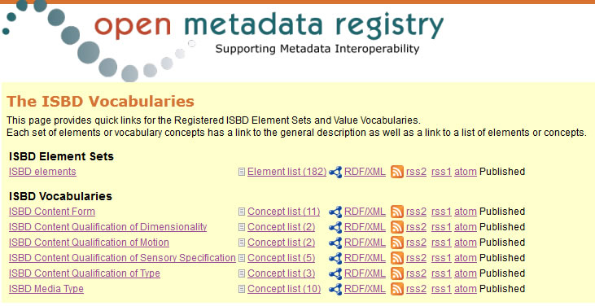
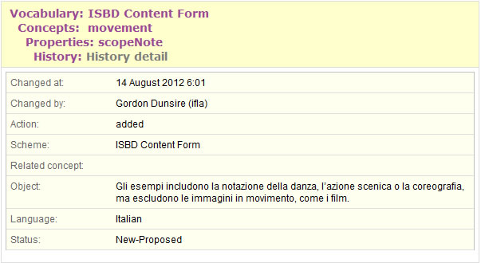
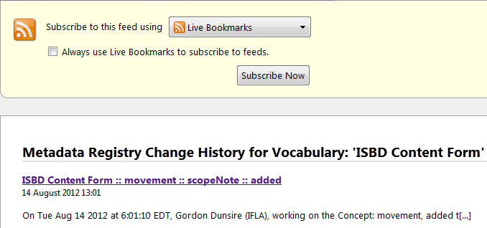
http://iflastandards.info/ns/isbd/

Slide 11
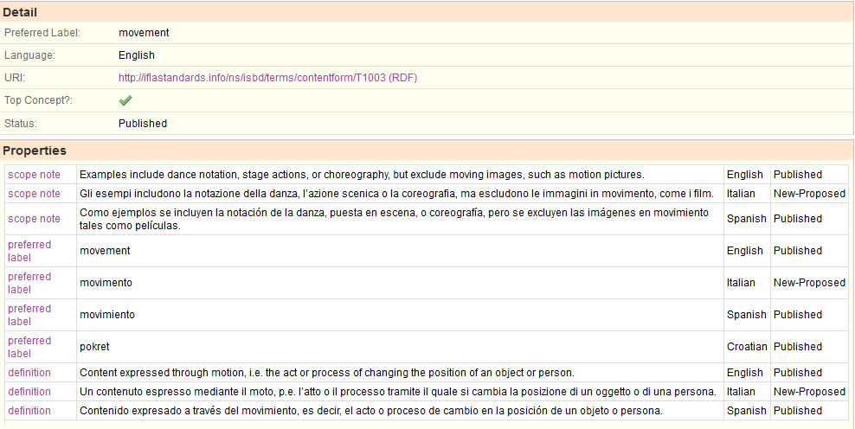
http://iflastandards.info/ns/isbd/terms/contentform/T1003

Slide 12
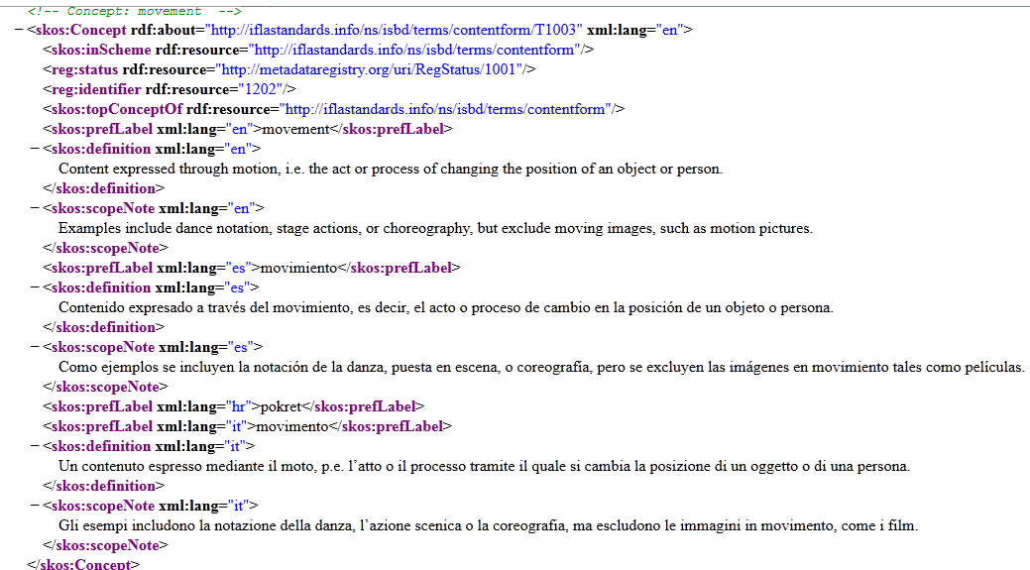
http://iflastandards.info/ns/isbd/terms/contentform/T1003.rdf

Slide 13
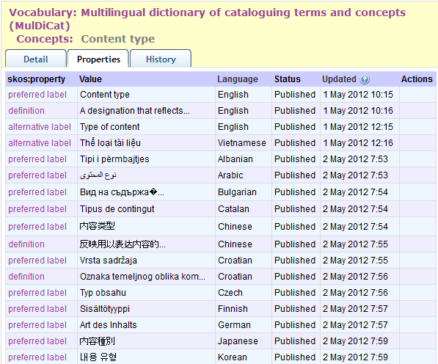

Slide 14
Current activity (1)
Monitor development of IFLA namespaces
FRBRer, FRBRoo, FRAD, FRSAD, ISBD, MulDiCat
Develop mappings/links between namespaces
Develop links to non-IFLA namespaces
Dublin Core, MARC21, RDA
Investigate “commons” namespaces for interoperability
Between domains (archives, libraries, museums, etc.) and their schema and data

Slide 15
Standards alignment => namespace mapping
MARC21
MulDiCat
RDA
ISBD
UNIMARC
EAD
FRBR
FRAD
VRA
FRSAD
…

Slide 16
Current activity (2)
Develop guidelines on translations of namespaces
Multilingual Semantic Web
Publish guidelines by end of 2012
Develop guidelines on use of IFLA namespaces
Extension and refinement for special requirements
Task for 2013

Slide 17
Strategic issues 1: Beyond bibliographic namespaces
E.g. education and training
RDF properties for “has curriculum”, “has accredited agent”, “has audience”, etc.
E.g. conservation of, and access to, special formats
Value vocabularies that can link to RDA/ONIX Framework, etc.

Slide 18
Strategic issues 2: What it means to be “semantic” and “linked”
Ur-standards need clear terminology and definitions
Ur-standards should explicitly identify entities, attributes, and relationships, for representation as RDF classes and properties (element sets)
IFLA namespaces should be ontologically mapped, and synchronized with changes in ur-standards

Slide 19
Strategic issues 3: What it means to be “open” and “linked”
Ur-standards should be freely available
Underpin trust in derived namespaces
Control and constraint discourage innovative application of IFLA schemas and members’ datasets
But control is necessary for standardization
IFLA standards in the global digital environment need to move further into the open ecology
E.g. “Commons” namespaces, semi-official web services, etc.

Slide 20
Thank you!
gordon@gordondunsire.com

