Slide 1
Granularity in Library Linked Open Data
Gordon Dunsire
Keynote presentation to Code4Lib 2013,
12-14 Feb 2013, Chicago, USA

Slide 2
Overview

Slide 3
Fractals
Self-similar at all levels of granularity
Cannot determine level: all levels are equal!

Slide 4
Multi-faceted granularity
What is described by a bibliographic record?
  Or a single statement?
What is the level of description?
  How complete is it?
How detailed is the schema used?
  How dumb?
Semantic constraints?
  Unconstrained?
AAA! OWA! Rumsfeld and the white light!

Slide 5
Resource Description Framework – Linked data
Triple:
This resource
has intended audience
Juvenile
Subject
Predicate
Object
has Granularity?
Coarse-grained systems consist of fewer, larger components than fine-grained systems [Wikipedia]

Slide 6
Subject: what is the statement about?
Consortium collection
RDF map
Library collection
Digital collection
coarser
Journals
Subjects
Access
Super-Aggregate
Journal title
Journal index
Aggregate
Issue
Festschrift
Focus
Article
Resource
Work
Component
Section
Graphics
Page
Sub-Component
Paragraph
Markup
finer
Word
RDF/XML
URI
Node

Slide 7
Predicate: what is the aspect described?
coarser
Membership category
Super-Aggregate
Access to resource
Aggregate
Access to content
Focus
Suitability rating
Component
Audience and usage
Sub-Component
Audience
finer
Audience of audio-visual material

Slide 8
Possible Audience map (partial)
unc:
“has note on use or audience”
unc: unconstrained version
rdfs:
subPropertyOf
isbd:
“has note on use or audience”
isbd: International Standard Bibliographic Description
unc:
“Intended audience”
dct: Dublin Core terms
dct:
“audience”
rdfs:
subPropertyOf
schema: Schema.org
schema:
“audience”
rda: Resource Description and Access
rda:
“Intended audience”
m21: marc21rdf.info
m21:
“Target audience”
frbrer:
“has intended audience”
frbrer: Functional Requirements for Bibliographic Records, entity-relationship model
rdfs:
subPropertyOf
m21:
“Target audience of …”

Slide 9
What is the aspect described?
coarser
Resource record
Super-Aggregate
Manifestation record
Aggregate
Title and s.o.r
Focus
Title statement
Component
Title of manifestation
Sub-Component
Title word
finer
First word of title

Slide 10
Possible Title semantic map
(partial)
sP: rdfs:subPropertyOf
d: rdfs:domain
r: rdfs:range
sP
dc:
“Title”
sP
dct:
“Title”
r
rdfs:
“Literal”
sP
eP
rdaopen:
“Title”
sP
isbd:
“has title”
sP
sP
rdagrp1:
“Title
(Manifestation)”
rdaopen:
“Title proper”
sP
isbd:
“has title proper”
sP
sP
d
d
d
rdagrp1:
“Title proper
(Manifestation)”
rdafrbr:
“Manifestation”
isbd:
“Resource”
d

Slide 11
Semantic reasoning: the sub-property ladder
Semantic rule:
If property1 sub-property of property2;
Then data triple: Resource property1 “string”
Implies data triple: Resource property2 “string”
dct:
“has title”
dct:title
Resource
“Physics”
rdfs:
subPropertyOf
coarser
machine
entailment
dumb-up
isbd:
“has title proper”
finer
isbd:
“has title proper”
isbd:
”Resource”
“Physics”

Slide 12
Data triples from multiple schema
frbrer:
”has intended audience”
ex:1
“Primary school”
isbd:
”has note on use or audience”
ex:2
“For ages 5-9”
rda:
”Intended audience (Work)”
ex:3
“For children aged 7-”
m21:
”Target audience”
m21terms:
commonaud#j
ex:4
“Juvenile”
skos:prefLabel

Slide 13
Data triples entailed from sub-property map
unc:”has note on use or audience”
ex:1
“Primary school”
unc:”has note on use or audience”
ex:2
“For ages 5-9”
unc:”has note on use or audience”
“For children aged 7-”
ex:3
unc:”has note on use or audience”
ex:4
“Juvenile”

Slide 14
Data triples entailed from property domains
ex:1
”is a”
frbrer:”Work”
ex:2
”is a”
isbd:”Resource”
”is a”
ex:3
rda:”Work”

Slide 15
What is the aspect described?
coarser
Super-Aggregate
Creator
Aggregate
Author
Focus
Screenwriter
Component
Animation screenwriter
Sub-Component
Children’s cartoon screenwriter
finer

Slide 16
dc:”Contributor”
?
s
marcrel:”Author”
dc:”Creator”
?
marcrel:”Author
of screenplay, etc.”
s
r
dct:”Creator”
dct:”Agent”
?
?
lcsh:
”Screenwriters”
rdaroles:”Creator”
d
s
r
d
r
rda:”Work”
rdaroles:”Author (Work)”
[rda:”Agent”]
d
s
r
rdaroles:”Screenwriter (Work)”
s: rdfs:subPropertyOf
d: rdfs:domain
r: rdfs:range

Slide 17
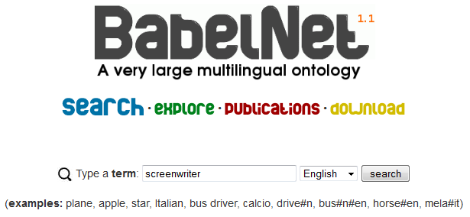
Machine-generated granularity
Full-text indexing: down to word level
A very large multilingual ontology with 5.5 millions of concepts • A wide-coverage "encyclopedic dictionary" • Obtained from the automatic integration of WordNet and Wikipedia • Enriched with automatic translations of its concepts • Connected to the Linguistic Linked Open Data cloud!

Slide 18
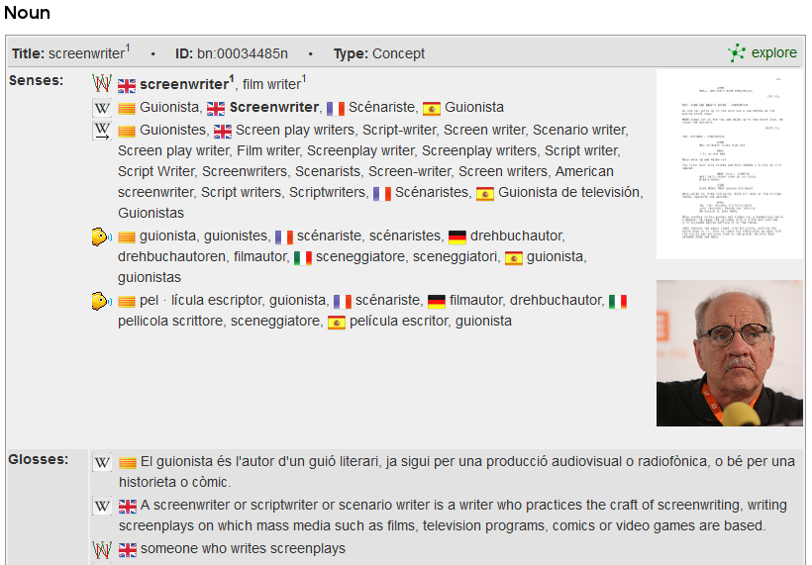

Slide 19
User-generated granularity
“OK for my kids (7 and 9)”
“Too childish for me (age 14)”
“Ideal for the child of ambitious parents”
“This sucks – for kids only”
“Great! Has cool stuff”

Slide 20
KISS
Keep it simple, stupid
Keep it simple and stupid?
The data model is very simple: triples!
The (meta)data content is complex
Resource discovery is complex
The Mandelbrot Set:
“an example of a complex structure arising from the application of simple rules” - Wikipedia

Slide 21
AAA
Anyone can say anything about any thing
Someone will say something about every thing
In every conceivable way
Linguistically

Slide 22
OWA
Open World Assumption: the absence of a statement is not a statement of non-existence
“There are known knowns. These are things we know that we know. There are known unknowns. That is to say, there are things that we know we don't know. But there are also unknown unknowns. There are things we don't know we don't know.”
- Donald Rumsfeld
Will all the gaps get filled?

Slide 23
!

