Slide 1
Future directions for RDA
Gordon Dunsire, Chair, RDA Steering Committee
Presented at the CIG Conference 2016, Swansea, Wales, 1 September 2016

Slide 2
RDA development
Strategy for extending RDA communities
International
Cultural heritage (archives, museums)
Linked data and Semantic Web
Consolidation of FRBR models in FRBR-LRM
Development of related standards, e.g. ISBD, ISSN
Re-organization of Toolkit structure and functionality

Slide 3
RDA content infrastructure
RDA Reference data is used in several RDA services, not just RDA Toolkit
RDA entities, relationships, designators, vocabulary encoding schemes + translations
RDA Reference content has open CC0 license
New development of content management infrastructure reduces duplicate updating in multiple services

Slide 4
RDA Reference data maintenance and flow
RDA editors:
Secretary
Translators
Open Metadata Registry
RDA/RDF
Developers
RDA Vocabularies
(GitHub)
Developers
RDA Toolkit
Glossary
RIMMF3
RDA
Vocabulary
Server
RDA Registry
Cataloguers
Trainers
Applications
Developers

Slide 5
RDA Reference in Toolkit
Expanded Glossary (from August 2016) is a listing of all entries, definitions, scope notes, and cross-references in RDA Reference
New vocabulary encoding scheme (RDA Terms) for terminology used in RDA instructions
Many terms included in previous Glossary

Slide 6
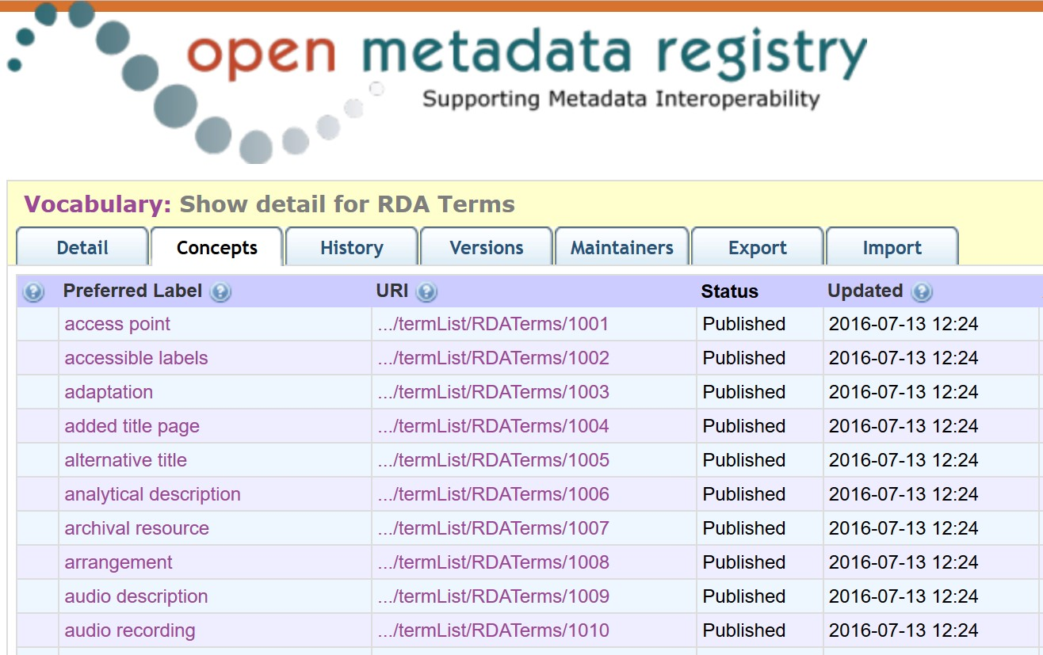
RDA Terms vocabulary encoding scheme

Slide 7
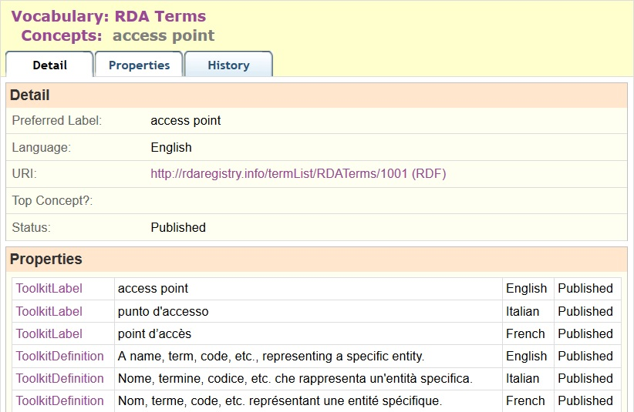
RDA Terms entry for "access point"

Slide 8
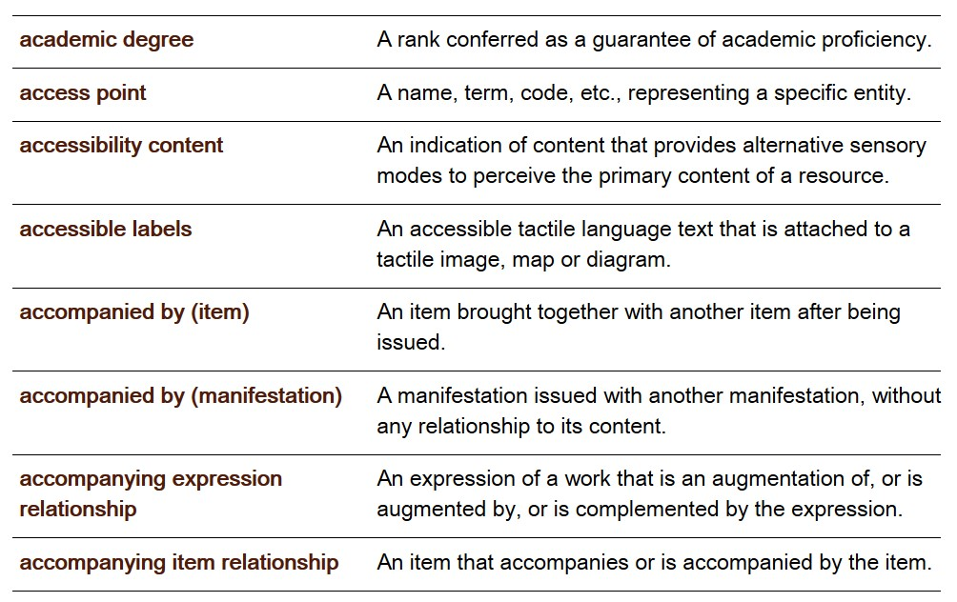
"access point" in Toolkit Glossary

Slide 9
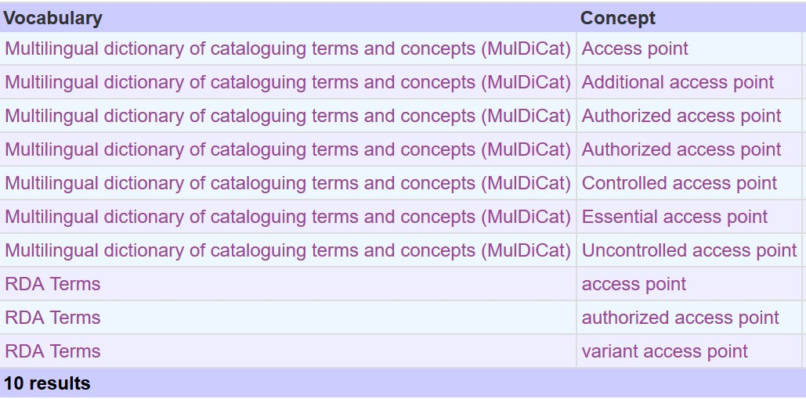
"access point" in Open Metadata Registry
Possibility of map between RDA Terms and MulDiCat

Slide 10
Impact of LRM
Additional entities (Nomen, Place, Time-span, Agent, Collective Agent)
From attributes to relationships
RDA as a refinement of LRM high-level entities, attributes, and relationships
The four-fold path
Unstructure description, structured description, identifier, URI: for related entities.

Slide 11
FRBR-LRM and RDA
LRM “a high-level conceptual model … intended as a guide or basis on which to elaborate cataloguing rules”
RDA guidance, instructions, elements
“operates at a greater level of generality than FRBRoo, which seeks to be comparable in terms of generality with CIDOC CRM”
RDA cultural heritage communities
LRM “this model is developed very much with semantic web technologies in mind”
RDA linked data communities

Slide 12
FRBR-LRM and RDA entities
Any Thing:
Covers all other types of thing
Res
has appellation
Nomen
is created by
W
E
Agent
M
is type of
Place
I
Collective
agent
is associated with
is modified by
Timespan
P
F
C

Slide 13
RDA refines LRM
Coarse/General
Res1
is associated with
Res2
W
A
has creator
has artist
Fine/Specific
is associated with
Res1
Res2
E
E
is derivative (E)
is adapted as (E)
is adapted as graphic novel (E)

Slide 14
From attributes to relationships
has manifestation
statement
Publication statement
Transcribed
has place of publication
Nomen
Place
has publisher’s name
M
C
Nomen
Recorded
Timespan
Nomen
has date of publication

Slide 15
The 4-fold path
The “4-fold path” supports catalogue cards, flat file schema, RDBMS, and linked data (RDA database implementation scenarios)
Describing a related entity:
Unstructured description
Structured description
Identifier
URI
General guidance and instructions:
Simple
Less duplication
Easier to translate

Slide 16
Conclusion
The new RDA Reference infrastructure provides a foundation for the development of RDA
The next 2-3 years will bring about many more changes
Implementation of LRM; Toolkit functionality
We hope you will work with us to make RDA Toolkit and other services the best they can be

Slide 17
Thank you!
rscchair@rdatoolkit.org
RDA Steering Committee
http://www.rda-rsc.org/
RDA Toolkit
http://www.rdatoolkit.org/
RDA Registry
http://www.rdaregistry.info/
Open Metadata Registry
http://metadataregistry.org/
RIMMF
http://www.marcofquality.com/wiki/rimmf3/

