Slide 1
The FRBR ontology
Gordon Dunsire
Presented at the special session “Application Profiles as an alternative to OWL Ontologies”
DC-2013, 3-5 September 2013, Lisbon, Portugal

Slide 2
FRBR Group 1
ontology
Work
1 and only 1
Expression
Mutually
disjoint
At least 1
Manifestation
1 and only 1
Item

Slide 3
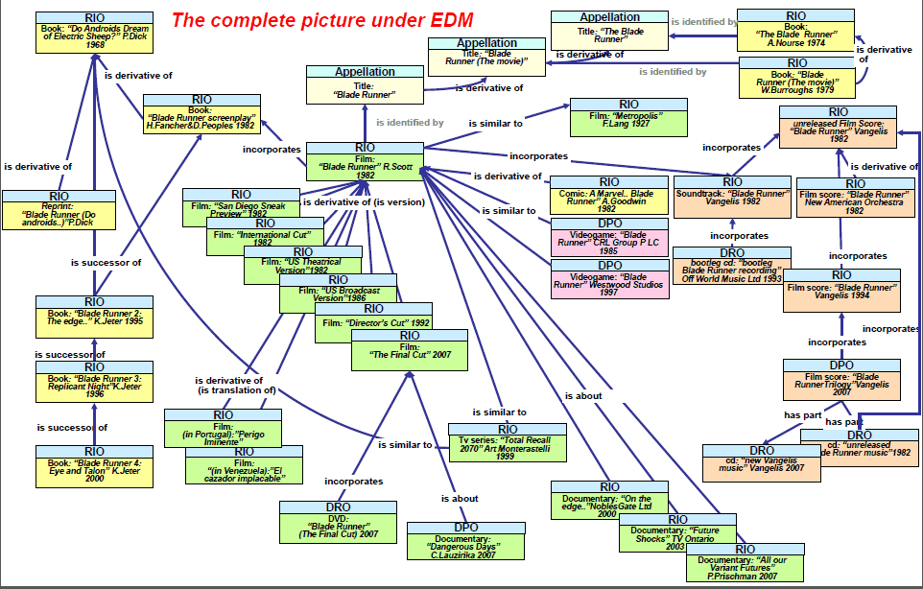
Bibliographic complexity: Bladerunner
(from Europeana Data Model)
?

Slide 4
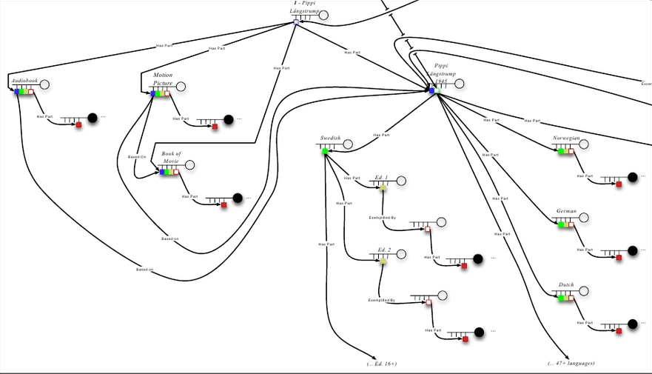
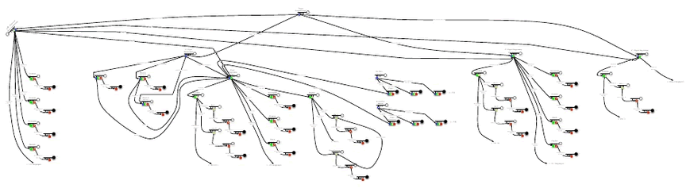
Bibliographic complexity: Pippi Longstocking
(from Ron Murray/Barbara Tillett)

Slide 5





Ontology constraints ensure coherency of
complex FRBR relationships
domain
range
It keeps us together,
like our shells
W
has adaptation
W
E
has adaptation
W
We are
the WEMI
stack;
We are
ttl graphs
E
has a translation
E
M
has a reproduction
M
I
has a reproduction
M

Slide 6
Intended users of FRBR ontology
End-users!
Find, Identify, Select, Obtain user tasks
Navigation through complex bibliographic relationships between multiple information resources
Complexity (mostly) concealed
Catalogue managers
Reduces duplication of data within “the record”
Researchers
Bibliography, Cultural history, Transmission of knowledge, etc.

Slide 7
RDA as a FRBR application
RDA has its own local FRBR classes
Not yet related to FRBR element set
No OWL constraints declared
RDA properties constrained by RDA/FRBR domain/range
Unconstrained properties with no domain/range will be published as super-properties
Development of AP(s) a goal of the “London” meeting in 2007
But RDA element set not yet “published”
And AP RDF representation …

Slide 8
Unconstrained
properties
rdaunc:
Designation of edition
rdfs:subPropertyOf
isbd:
Edition statement
rda:
Designation of edition
Relationship between isbd:Resource and frbr:WEMI?
Discussion paper tabled at IFLA 2013

Slide 9
Aggregated
statements
“Edinburgh : Scotsman Books, 2013”
rda:
Publication statement
???
rda:
Place of publication
rda:
Date of publication
rda:
Publisher's name
“Edinburgh”
“Scotsman Books”
“2013”

Slide 10
Application profile?
No published RDF representation of DC AP!
How does an AP assure better quality than OWL in an un-bounded universe?
Is there any real difference between AP and OWL?
AP encodes “rules” outside of element set
OWL encodes within element set
Same requirements/rules for processing algorithms?
Isomorphic?

Slide 11



Thank you!
That’s all, folks!
The Bog of RDA

Slide 12
Graphics
Turtle cartoon: Church House Clipart
http://www.churchhouseclipart.com/
Swamp640: Copyright Brian S. Kissinger
http://visualparadox.com/wallpapers/wallpaper_640x480.asp?wallpaper=swamp
Speech bubble: Free Stock Photos.biz
http://www.freestockphotos.biz/stockphoto/6969

