Slide 1
Extent in ISBD for Manifestation
Gordon Dunsire
Presented to NARDAC Update Forum, 13 November 2023

Slide 2
ISBD for Manifestation (ISBDM)
Align ISBD: International Standard Bibliographic Description with IFLA Library Reference Model (LRM)
Retain interoperability with RDA
Phase 1: Align with Manifestation entity
[Phase 2: Content standard for other LRM entities]
Prescriptive
Standalone ISBDM (entity-based cataloguing)
Backwards-compatibility and continuity not a priority
Online: https://www.iflastandards.info/ISBDM/

Slide 3
Kinds of extent
ALA: Quantitative value: Aspect, Quantity, Unit
Unit: Standard unit of measurement
Quantity: Number (integer)
Aspect: 4 broad kinds
Extent of unitary structure
Extent of unit
Extent of embodied content
Extent of aggregated content

Slide 4
Extent of unitary structure
The number of sub-units of the same category of carrier of the manifestation.
Sub-unit = physical part
Vocabularies for “extent unit”:
Carrier type
Extent of unitary structure (specific carrier/content units)
Examples: “4 audio discs”; “3 sheets”; “2 volumes”; “10 postcards”; “5 coins”; “4 audio discs + 1 volume”; “20 activity cards + 1 globe + 1 wallchart”

Slide 5
Extent of unit
A measurement of a component or characteristic of the manifestation or a sub-unit that is available to embody content.
Includes extent that does not actually carry content.
Terms for “extent unit” are standard measurement units plus specific terms related to carriers
Examples: “3600 feet” (length of tape); “14 leaves” (sheets bound in a volume)
Includes blank tape, blank sheets, etc.

Slide 6
Extent of embodied content
A measurement of the layout of content that is embodied in the manifestation.
Vocabularies for “extent unit”:
Layout of embodied content (specific arrangement of content in carrier)
Examples: “44 pages” (sides of leaves carrying content); “912 KB” (size of data file); “70 x 50 cm” (dimensions of reproduced image)

Slide 7
Extent of aggregated content
The number of expressions of the same kind that are embodied in the manifestation.
Vocabularies for “extent unit”:
Content type
Extent of aggregated content (specific kinds of content)
Examples: “4 texts”; “15 still images”; “10 performed songs”; “7 photographs”

Slide 8
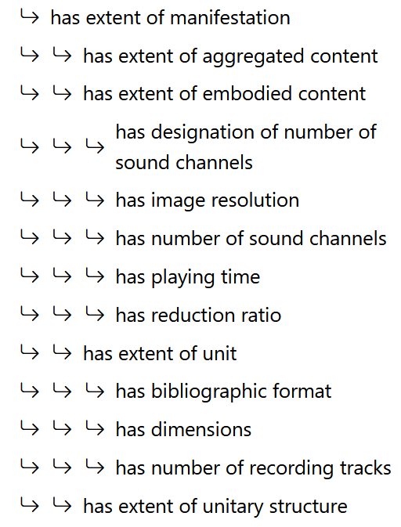
Element
hierarchies
Legacy elements reflect latent structure and fit into attribute hierarchies

Slide 9
Compound extent values
Use only broad “extent of manifestation” element.
Repeat elements for different values, or concatenate values with a string encoding scheme, or both
ISBDM SES: {has extent of unitary structure} + "(" + {has extent of unit} + "; " + {has extent of aggregated content} + " in " + {has extent of embodied content} + ")"
Examples: “3 volumes (124 leaves; 150 photographs in 200 pages)”; “1 volume (122 pages) + 1 audio disc (15 performed songs in 49 min 14 sec)”

Slide 10
Pagination and other statements
Pagination, etc. may be missing, incomplete, erroneous, or misleading as an indication of extent
Use “manifestation statement of extent” element to transcribe stated pagination
Use “note on physical characteristic” for detailed description of pagination, etc.
Total number of leaves in a volume, including blanks: “extent of unit”
Total number of pages of content in a volume: “extent of embodied content”

