Slide 1
Ethical issues in cataloguing
Gordon Dunsire
Presented at “Metadata: Create, Share and Enrich”,
CILIP Cataloguing & Indexing Group Conference 2018,
Edinburgh, Scotland, 5-7 September 2018

Slide 2
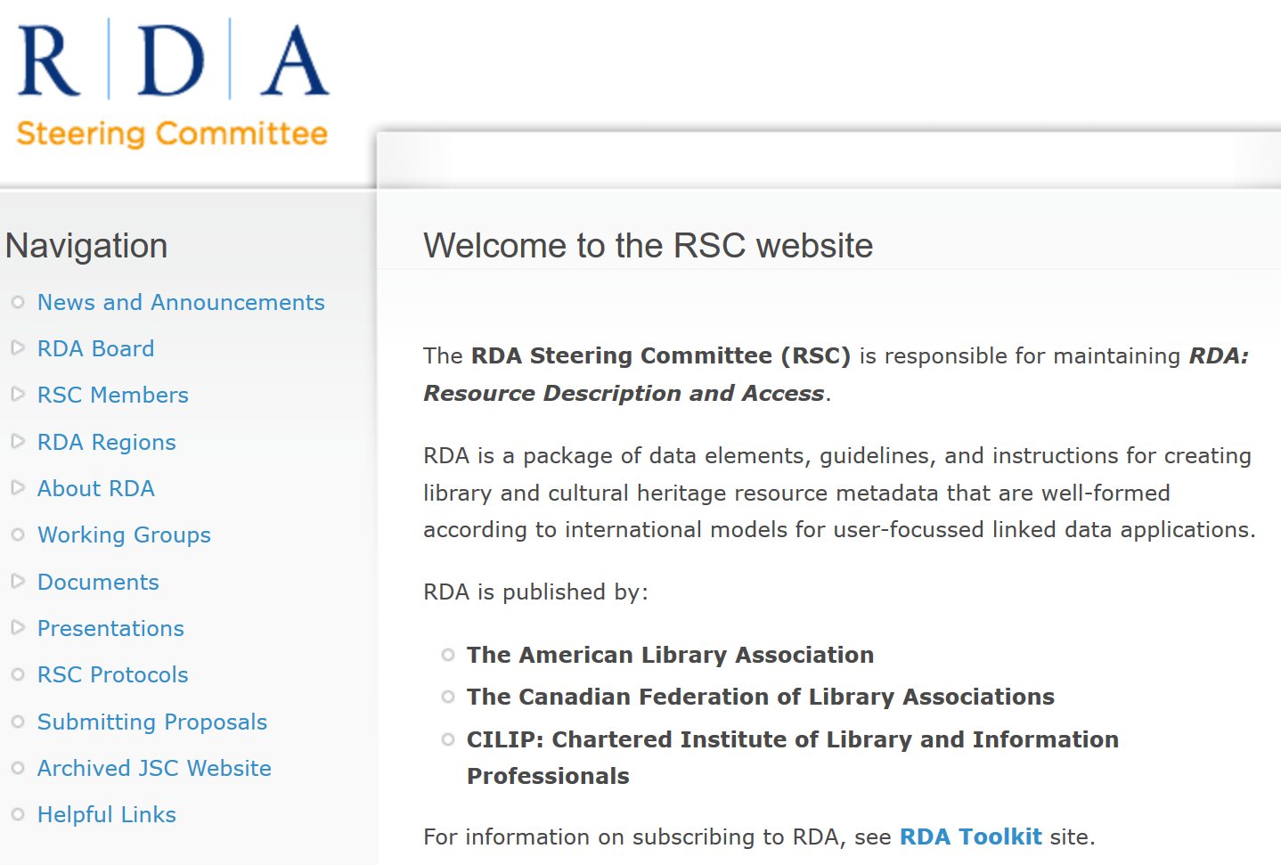

Slide 3
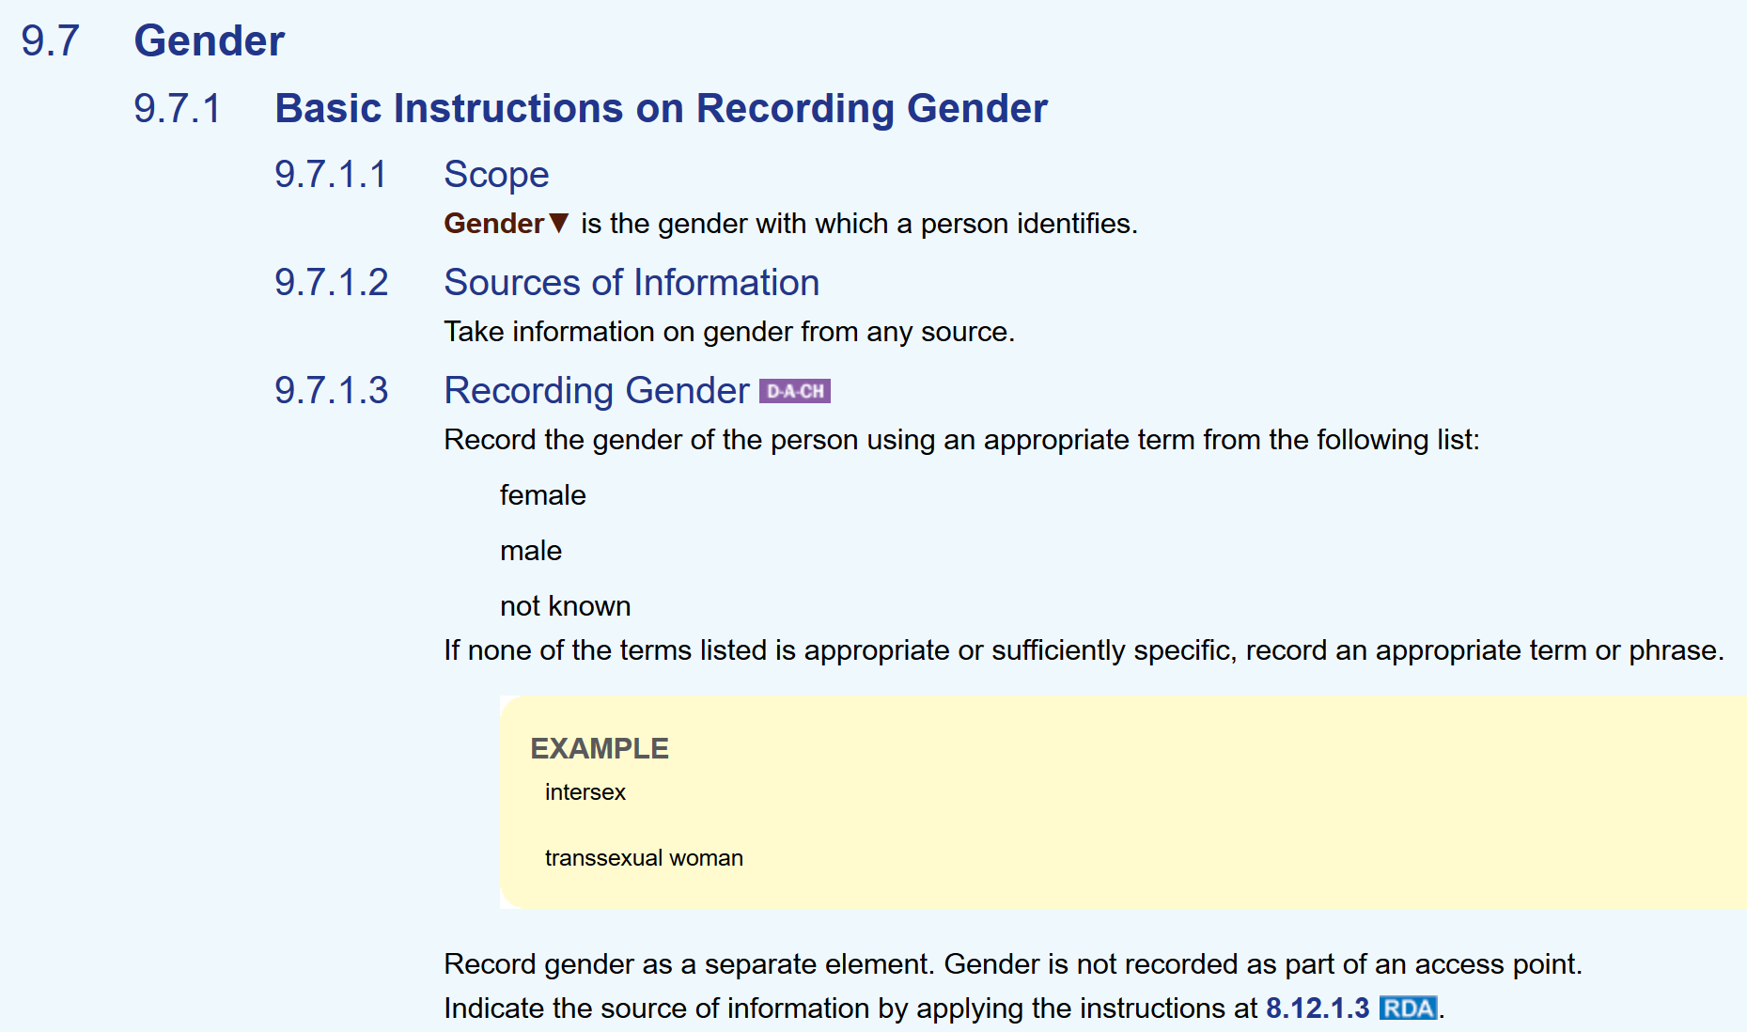
RDA Toolkit April 2015
Vocabulary encoding scheme
(controlled terminology)
Proposal: Add “transgender”

Slide 4
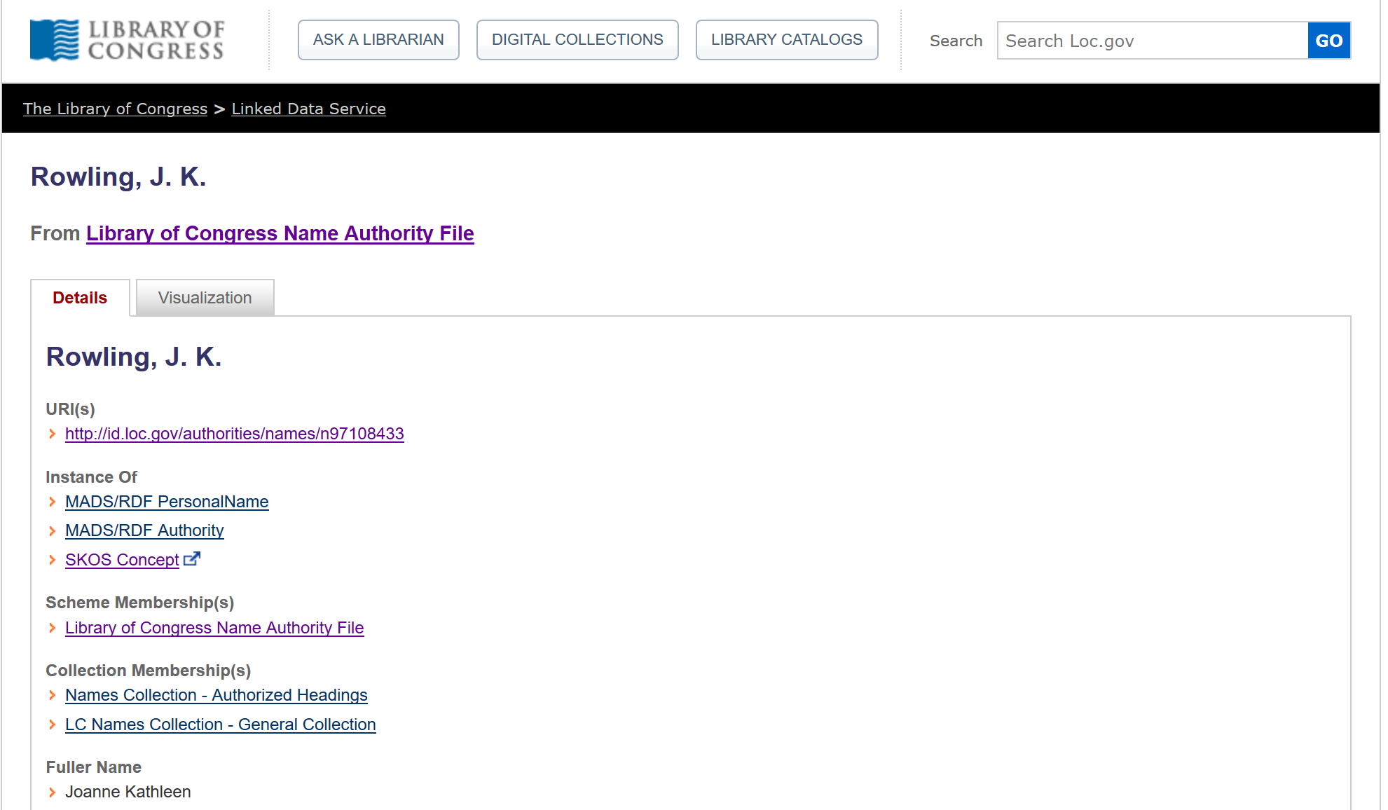
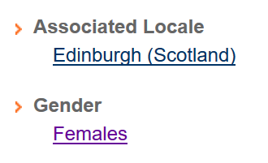

Slide 5
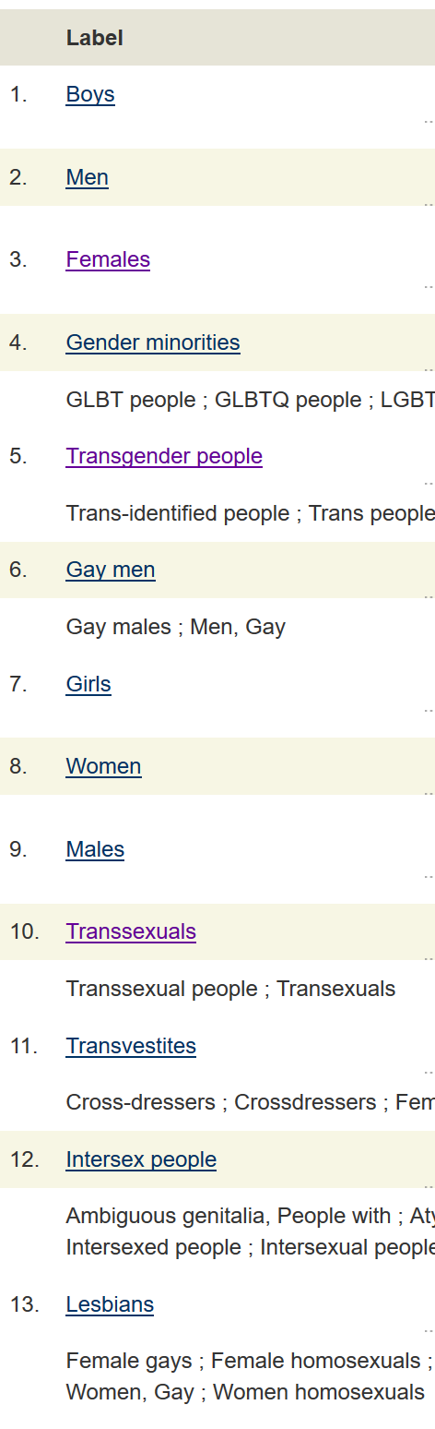
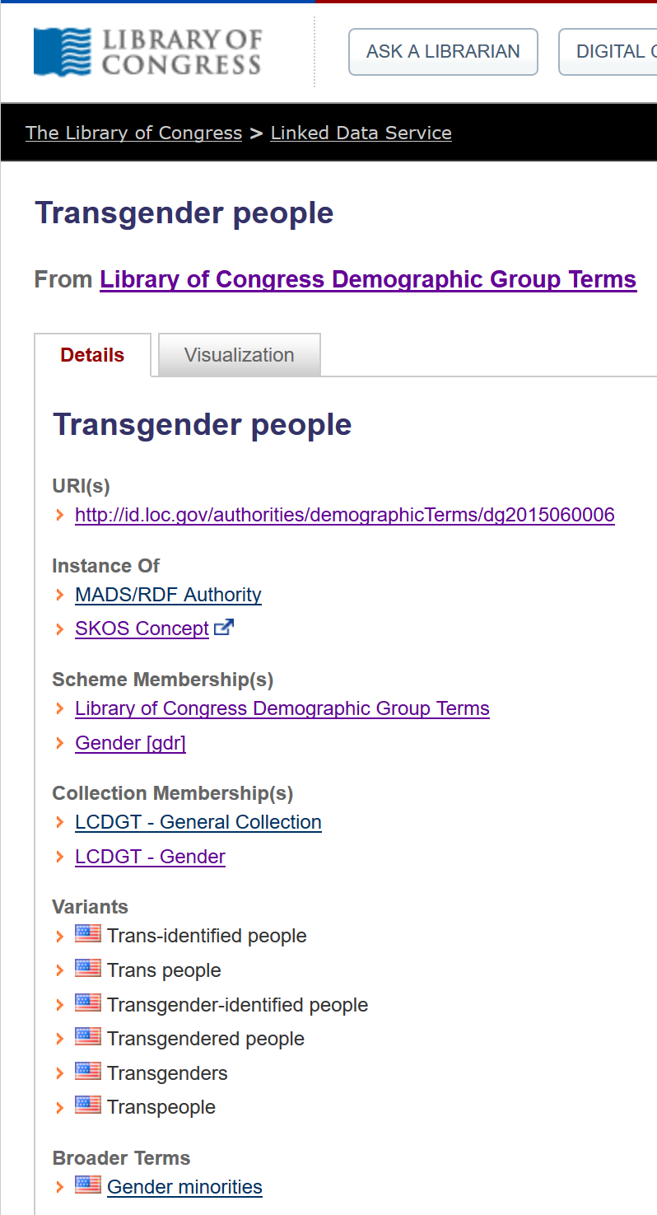
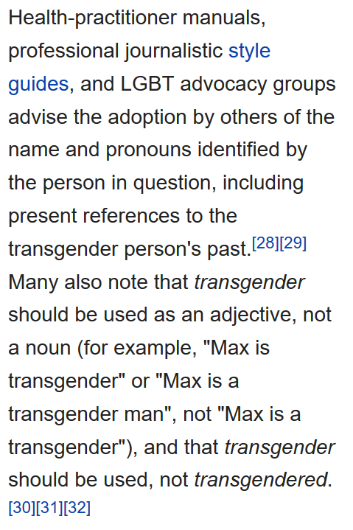
Wikipedia:

Slide 6
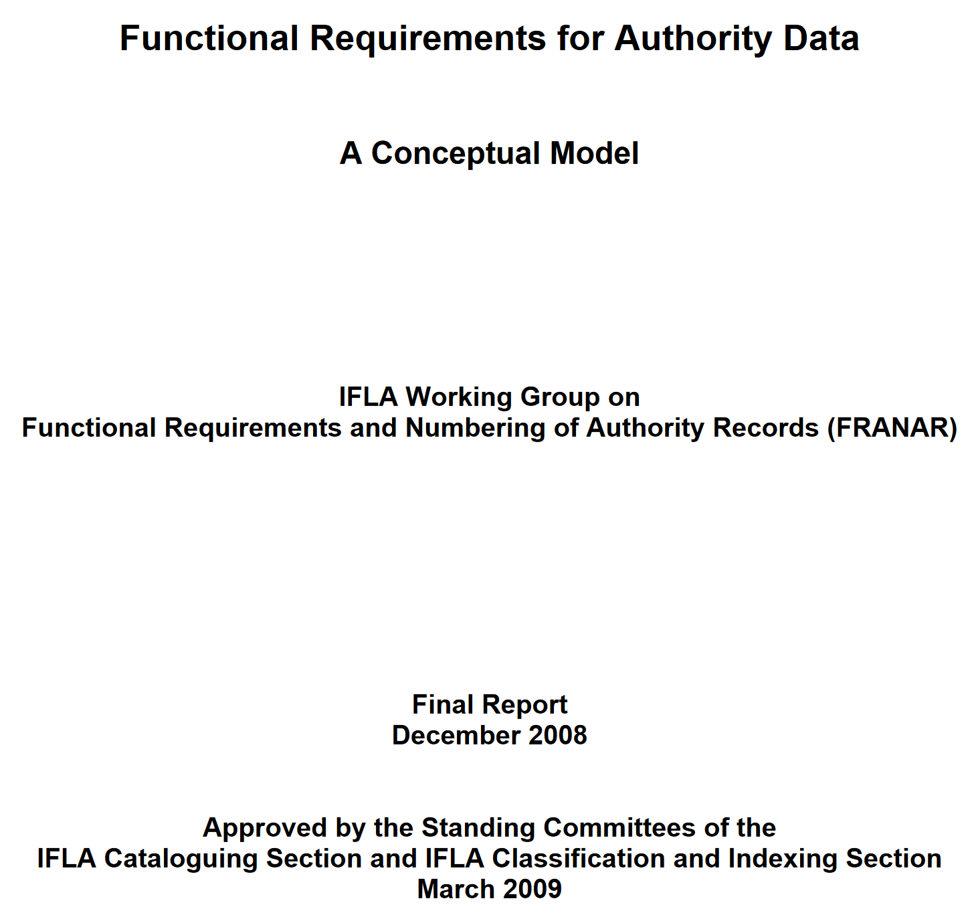
The origins of gender in modern cataloguing practice?

Slide 7
FRAD:
Assigned by “authority”
Assigned by self
RDA:

Slide 8
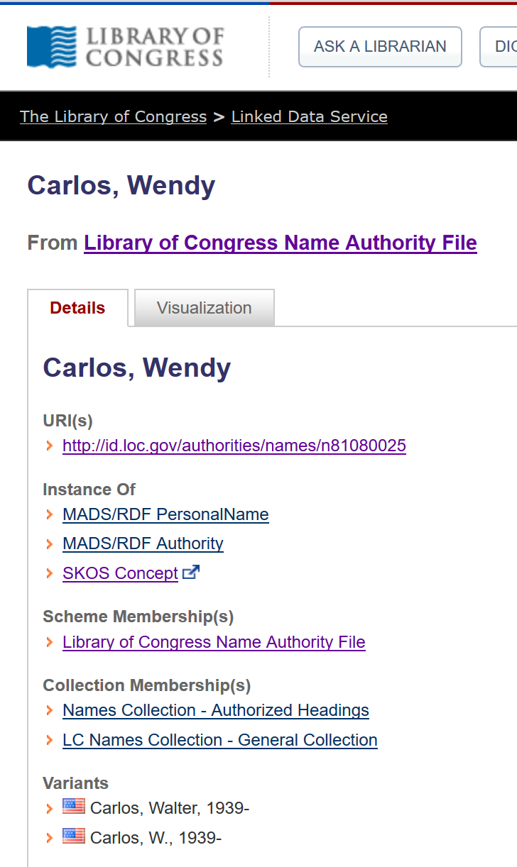
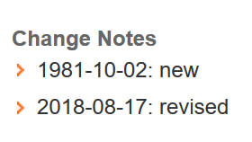
Gender
Females
Males
Transsexuals
Male-to-female transsexuals

Slide 9
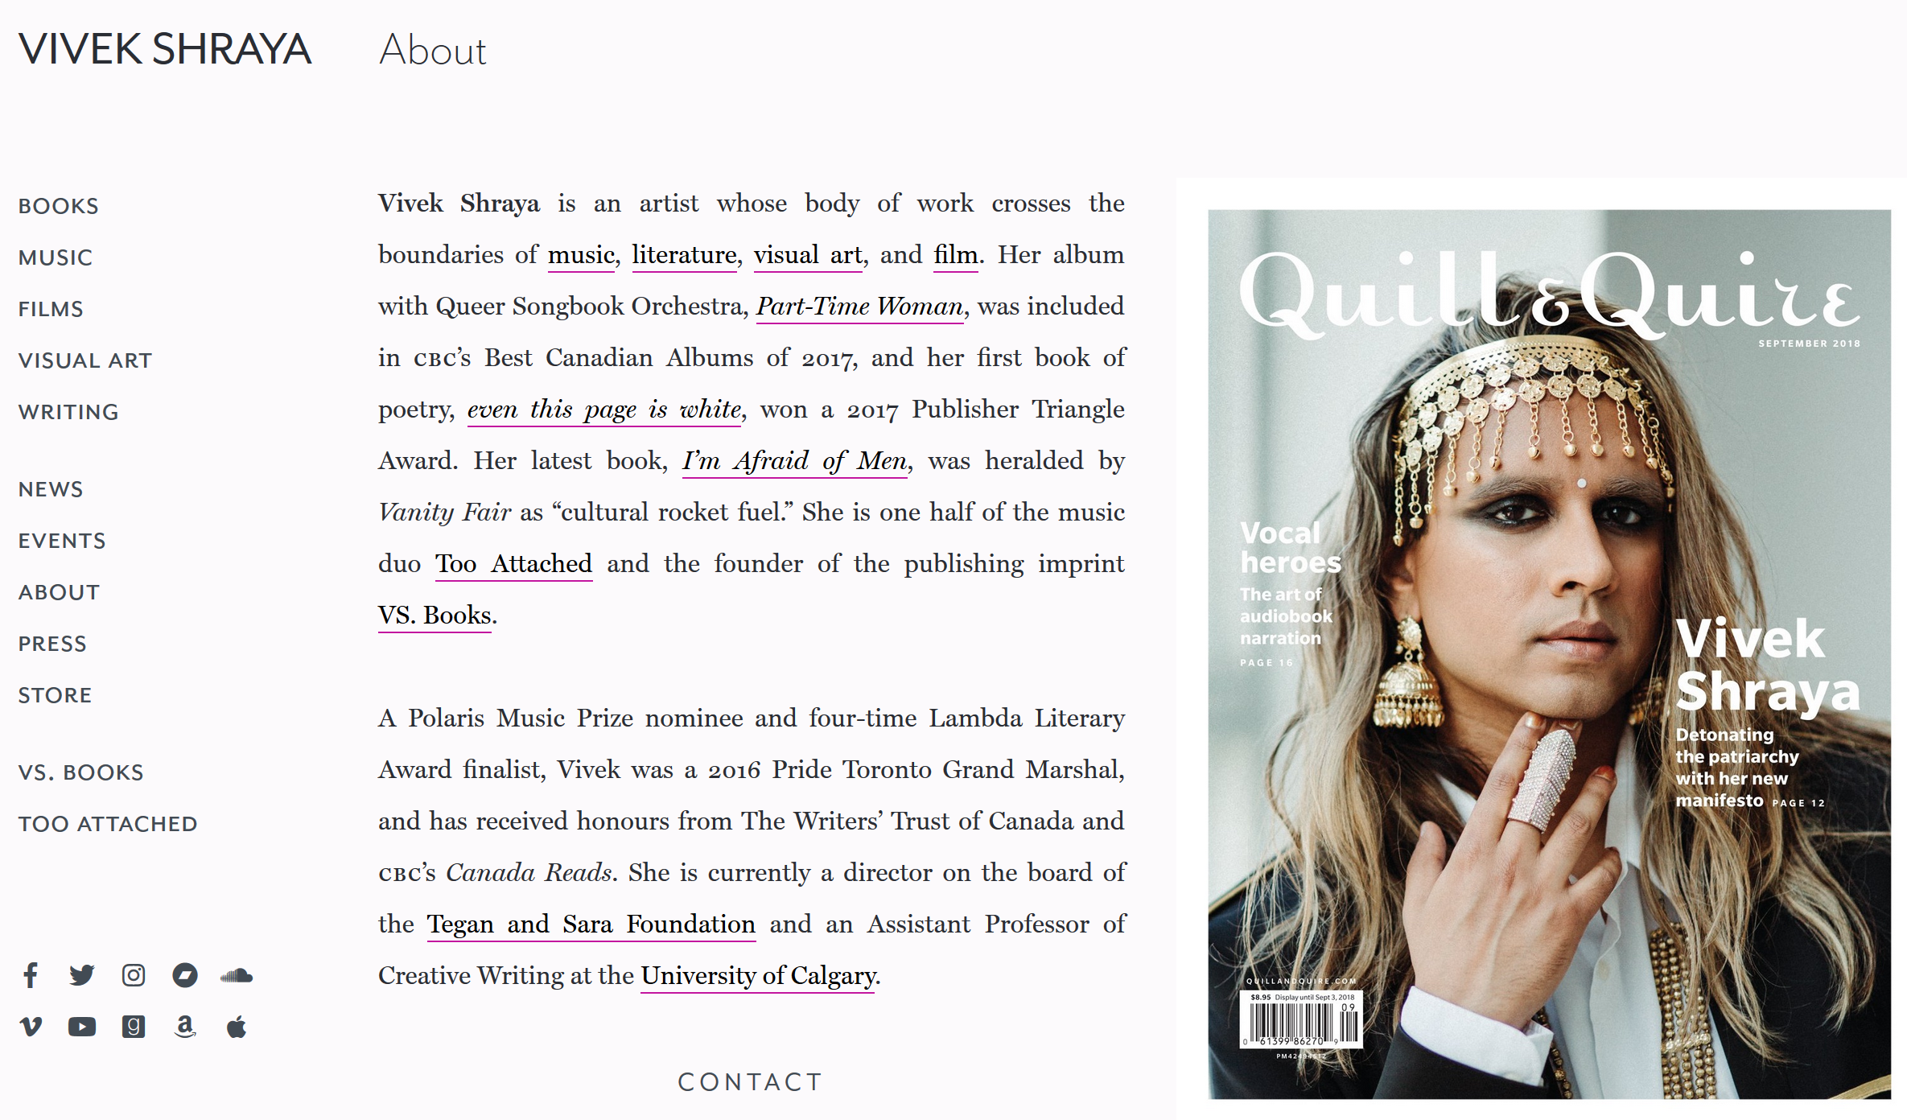



Slide 10
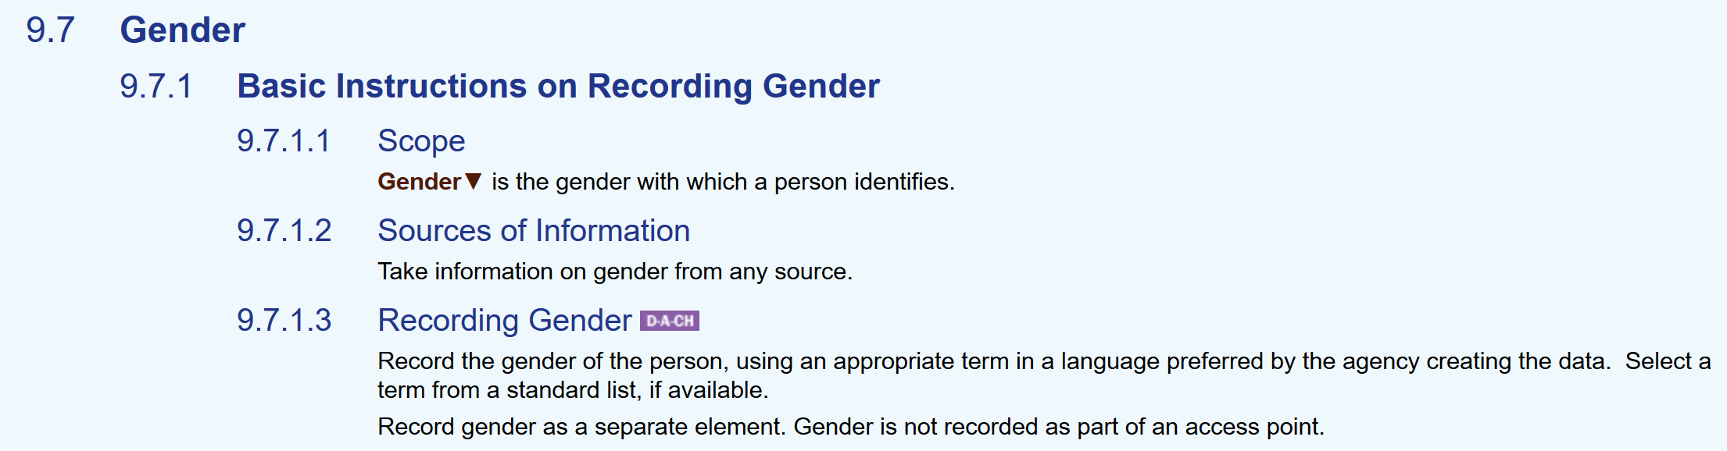
RDA Toolkit April 2016
Outcomes
Proposal: Add “transgender” – Rejected
RDA vocabulary encoding scheme removed
Element retained for legacy applications
Utility may be questioned in future
“Gender is not recorded as part of an access point”

Slide 11
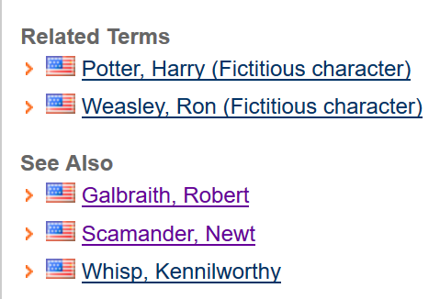
These are not initials; no space between them
Rowling does not want to identify a gender

Slide 12
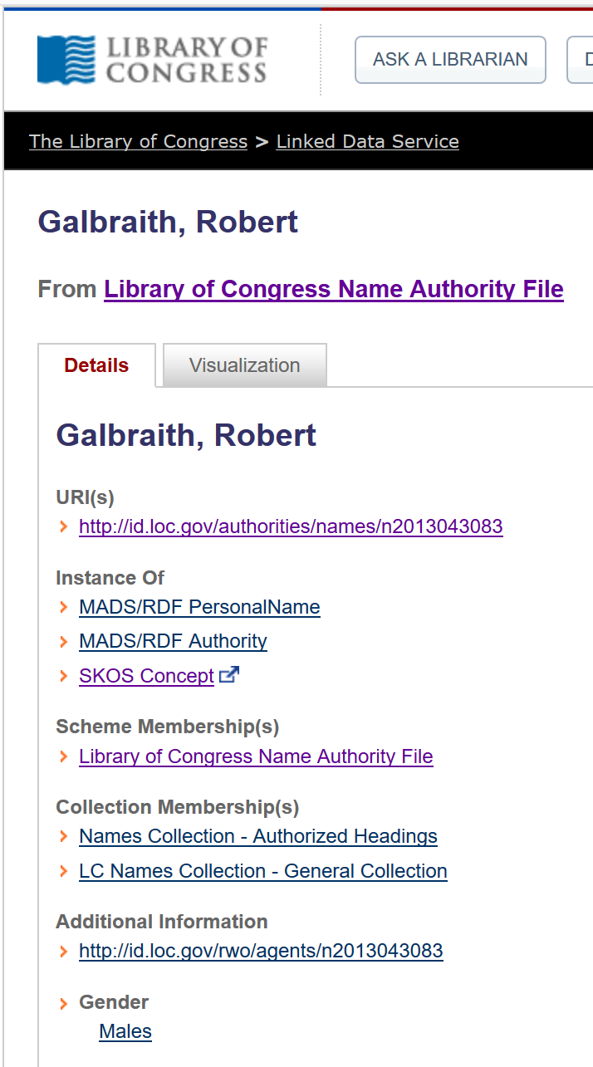


Slide 13
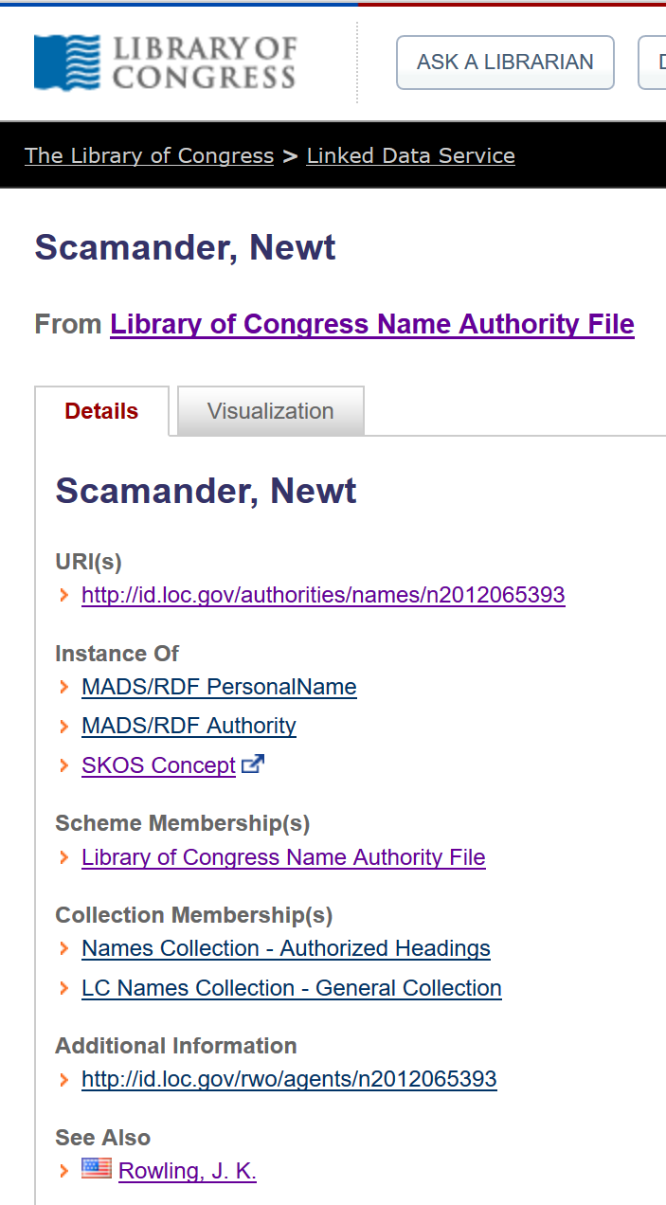
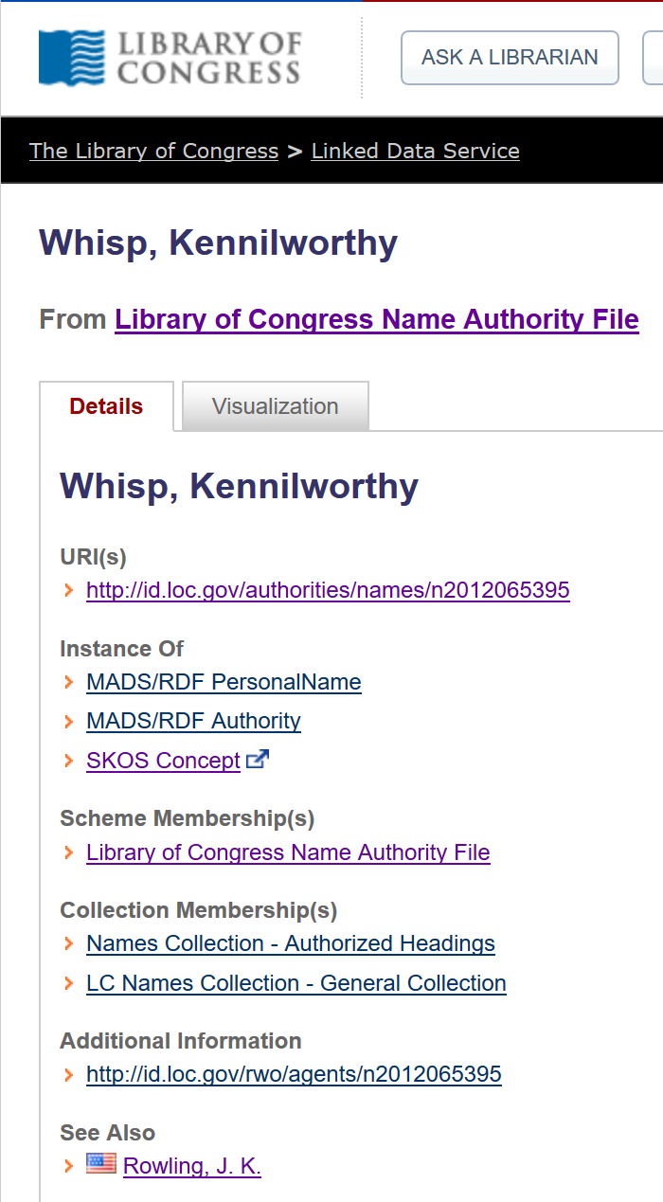
No sex, please
We have gender-free given names
Or, we are fictional

Slide 14

Who is responsible?
And what is their gender?
https://images-na.ssl-images-amazon.com/images/I/51gtwqlSMQL._SX324_BO1,204,203,200_.jpg

Slide 15
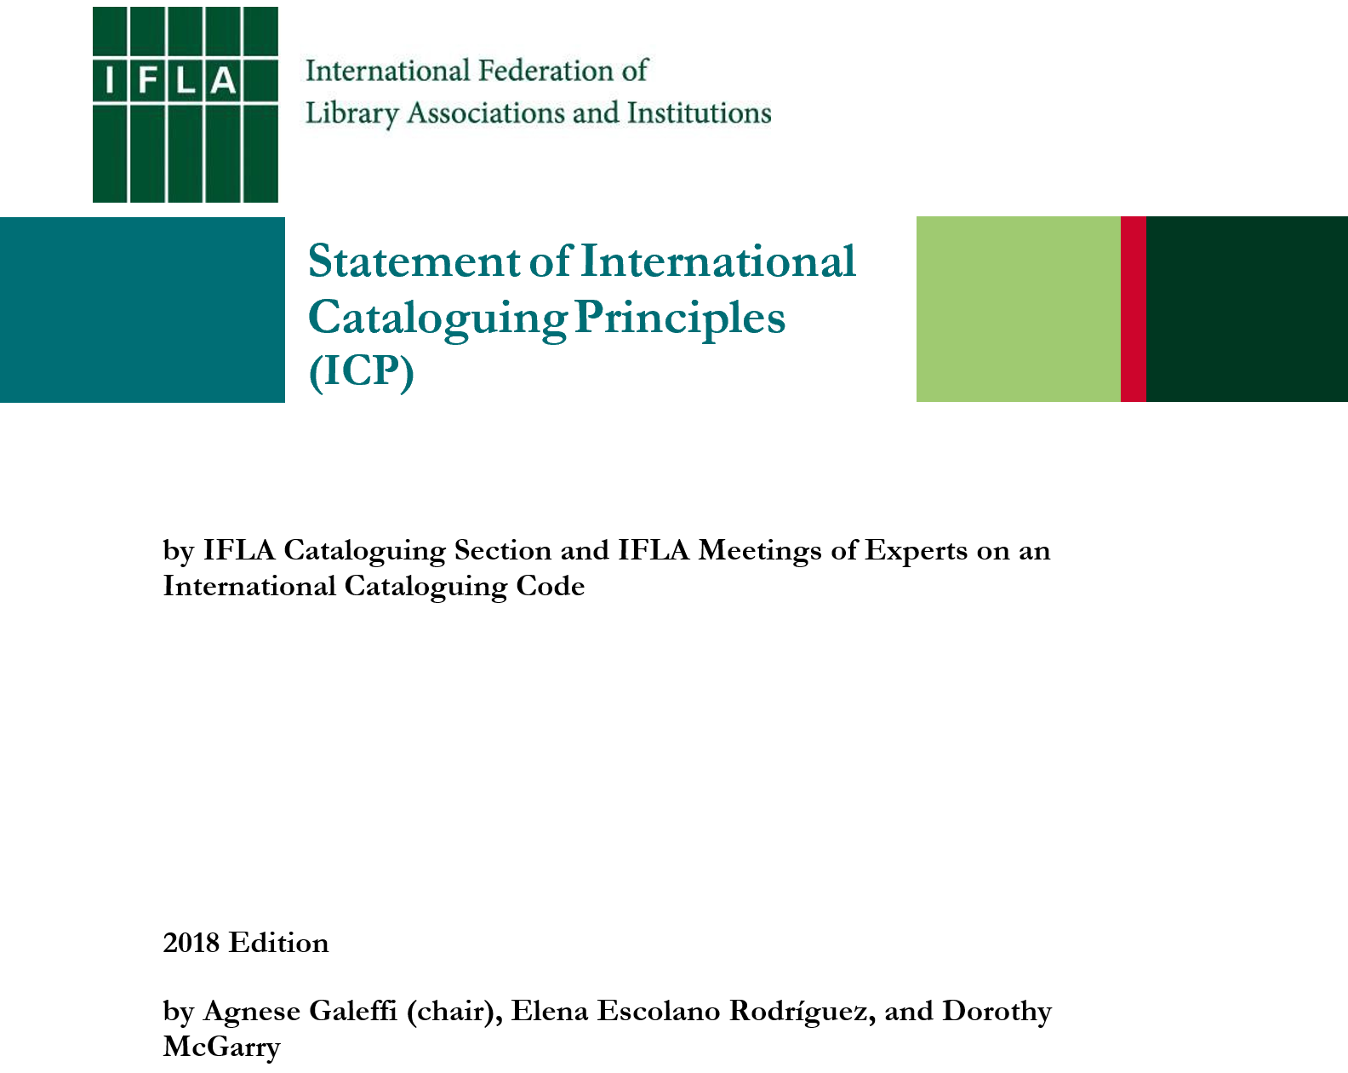
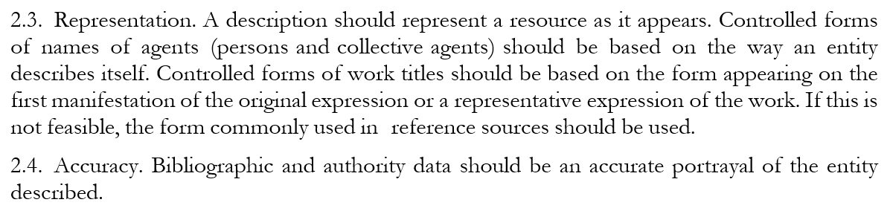

Slide 16
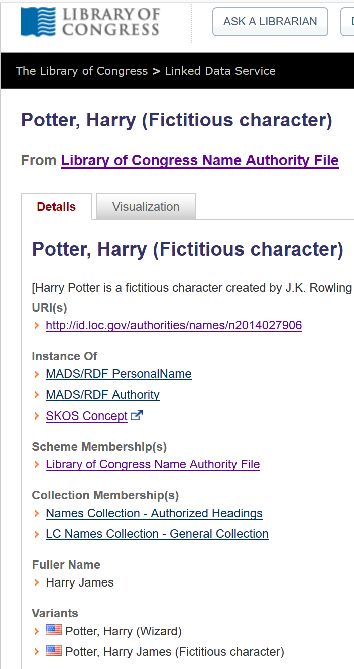
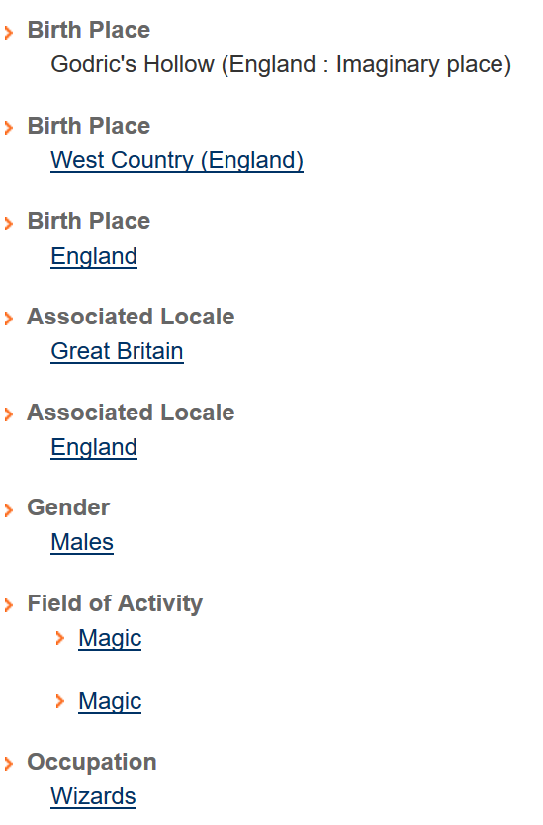

Slide 17
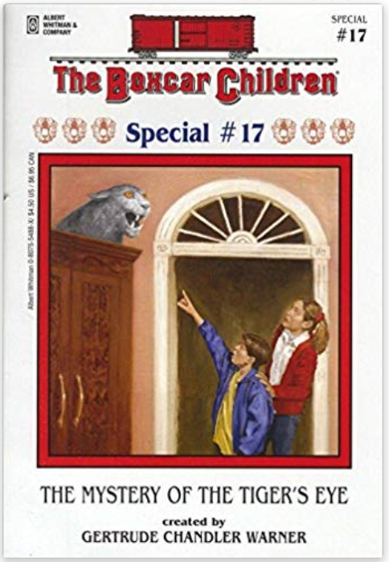
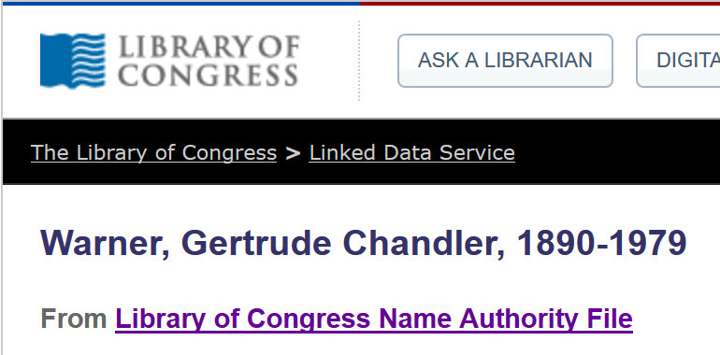
Boxcar Children specials 1993-

Slide 18
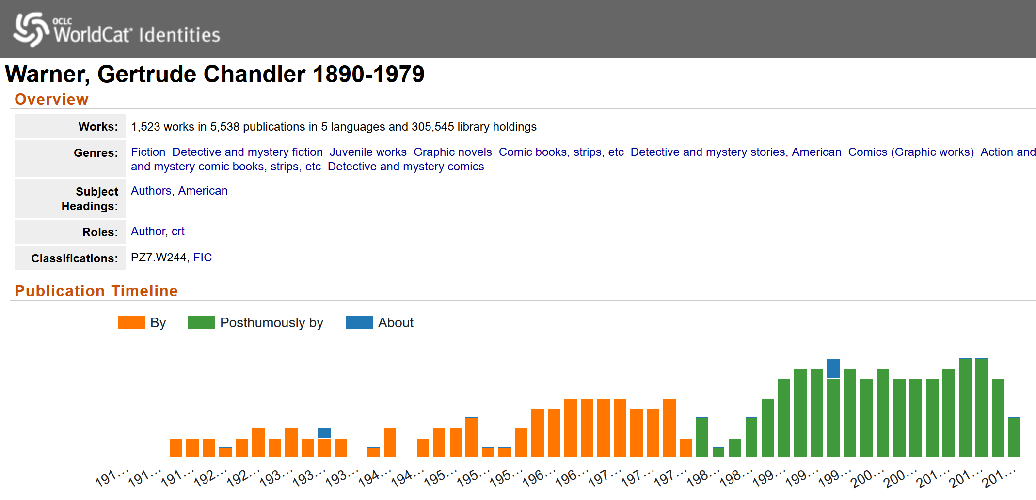
Posthumously by
= Published or created?

Slide 19
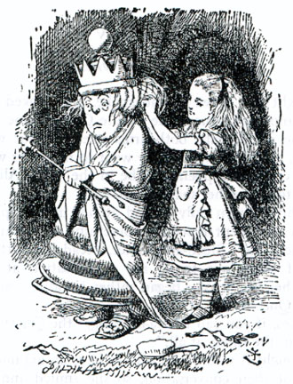
Cataloguing in Wonderland
Why, sometimes I've believed as many as six impossible things before breakfast.
Principle of representation!
It’s a poor sort of memory that only works backwards
Serials and other diachronic works!
The question is which is to be master – that’s all.
Authority control!
https://upload.wikimedia.org/wikipedia/commons/8/8a/A-dressing_the_White_Queen.jpg

Slide 20
Thank you!
RDA Steering Committee
http://www.rda-rsc.org/
RDA Toolkit
https://www.rdatoolkit.org/

