Slide 1
A deeper dive into application profiles and policy statements
Gordon Dunsire, RDA Technical Team Liaison Officer, and James Hennelly, Director, ALA Digital Reference
Presented at A Deeper Dive Into RDA, ALA Midwinter
January 28, 2019, Seattle, USA

Slide 2
Application profile
A specification of the metadata that is used in an application
A specification may include the entities, elements, and vocabulary encoding schemes that are used, and the mandatory and repeatable status of elements
May also include the preferred recording method

Slide 3
Utility of profile
Front-end to RDA Toolkit
Tell me what elements, etc. to use
Data input form
cf preconference workshop, RIMMF
Data validation
Metadata conformance
Data extraction
What to select from external metadata

Slide 4
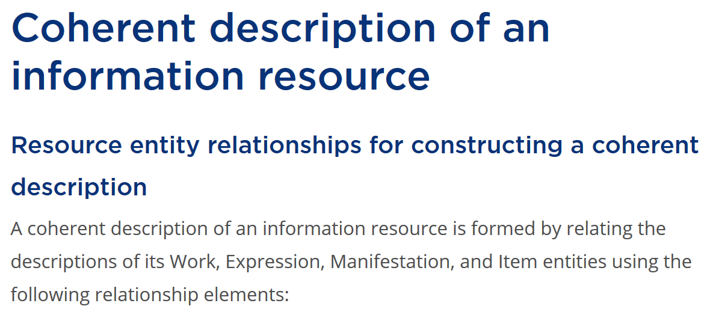
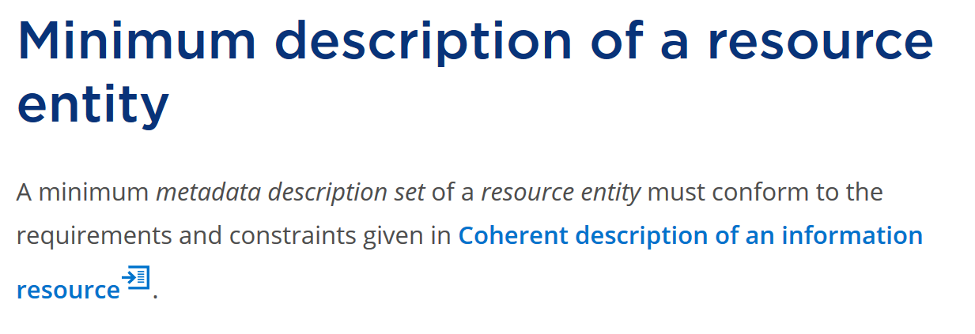
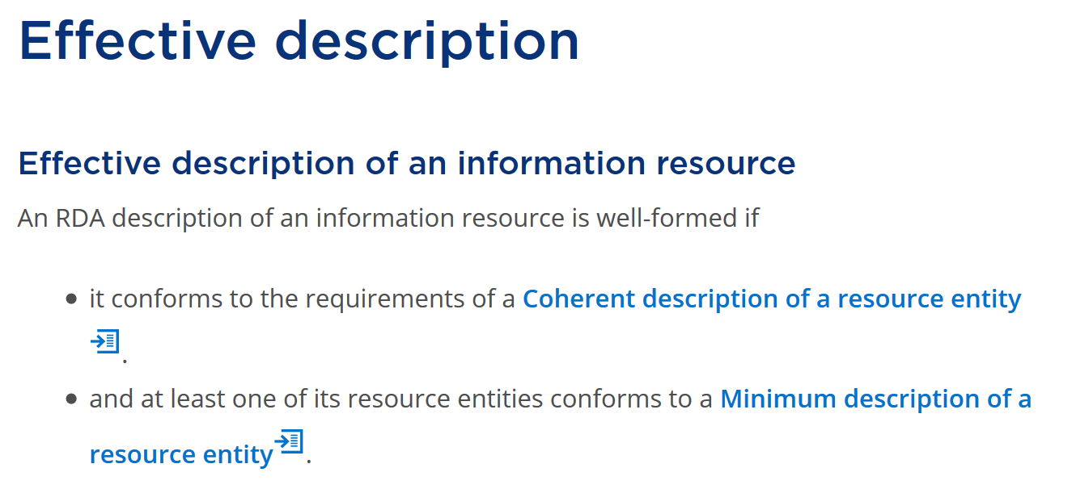
Layered (nested) profile
Effective description:
general and specialized elements
Minimum description: appellation elements
Coherent description: “primary” relationship elements

Slide 5
Profile inheritance
Effective description:
specialized elements
Effective description:
general (common) elements
Minimum description: appellation elements
Coherent description: “primary” relationship elements

Slide 6
Toolkit options
Each (optional) recording method and instruction option has a separate IRI and ID that can be referenced by an application profile
Functional overlap: profile can specify element vocabulary encoding scheme (VES) or string encoding scheme (SES); option allows RDA or other VES, and specifies SES for constructing access points and super-elements

Slide 7
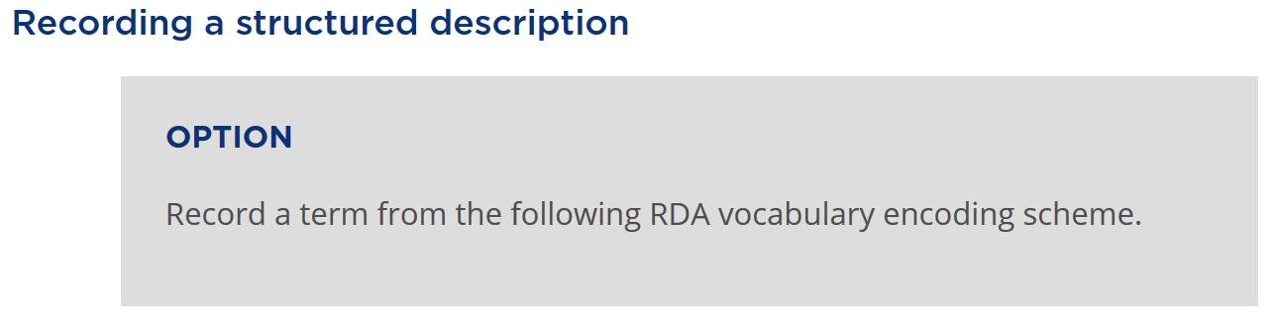
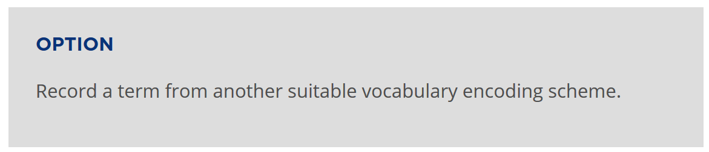
Specifying a VES
Profile: give option IRI, or just state RDA VES
Profile: link option + state VES, or just state VES

Slide 8
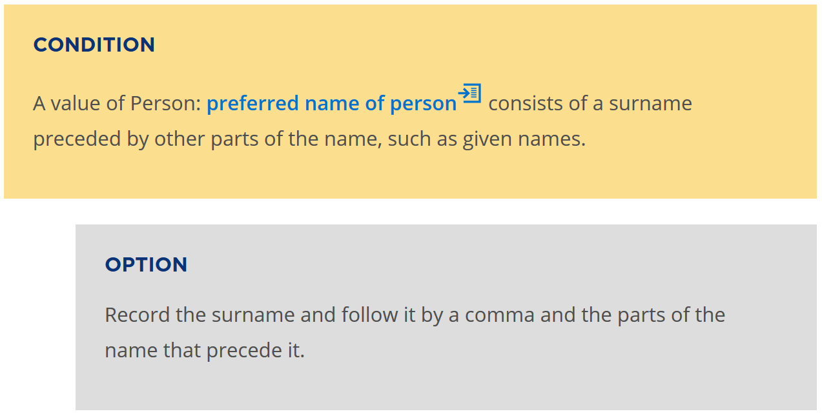
String encoding schemes
String Encoding Scheme

Slide 9
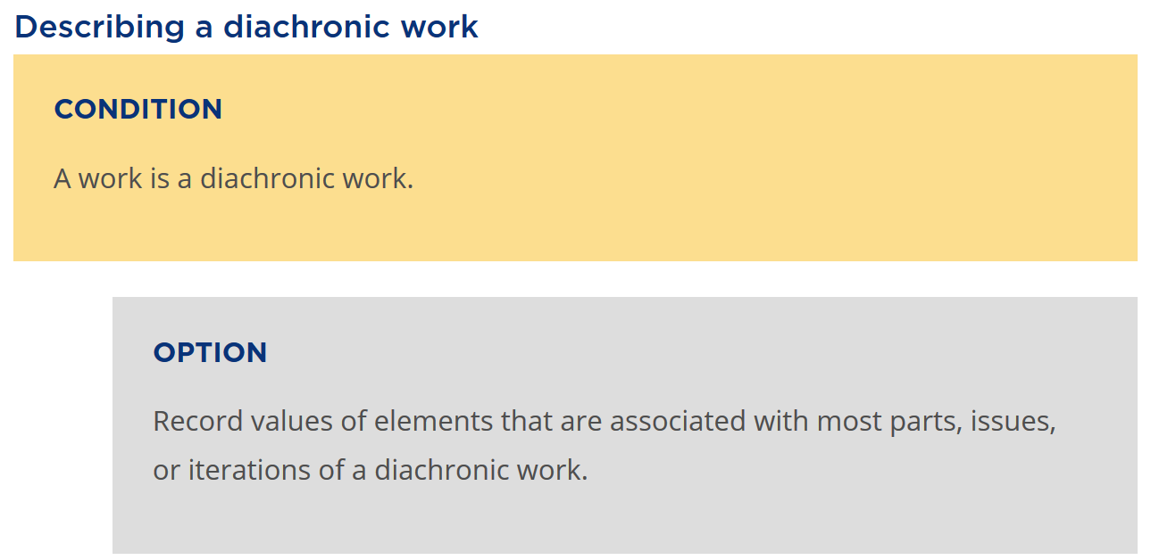
Conditions
Condition may be subsumed by an application profile for serials and series

Slide 10
Standard conditions
A work is a …
Diachronic work
Musical work
Official communication
…
A manifestation is a …
Aggregate
Part or iteration of a diachronic work
…
Condition databank?
☞Relate to specialized application profiles?
☞Basis of specialized manuals?

Slide 11
Application profile management
Community-led
Application-led
Synchronization with RDA development
Publish within Toolkit (behind paywall)
Publish outside Toolkit (in front of paywall)

Slide 12
Policy Statements
Planning Group
PS writers from British Library, Deutsche Nationalbibliothek, and Library of Congress
RSC Secretary and RSC Technical Team Liaison Officer
Toolkit Director

Slide 13
Goals of PS
Planning Group
Set requirements for both PS file and right rail display in RDA pages
Determine proper mark-up and functionality of PSs
Establish guidelines for PS placement and content

Slide 14
The “More Bang” Script
Create shell documents for all current PS
Duplicate RDA file directory for each PS
PS placeholders at
Headers
Subheaders
Options

Slide 15
Questions, comments

