Slide 1
Dates, approximately
Gordon Dunsire, Chair, RSC
Presented at “A Practical Introduction to the New RDA Toolkit”
June 22, 2018, New Orleans, USA

Slide 2
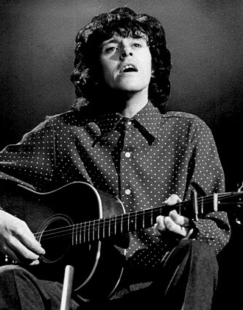
What are the options for recording a date of publication using RDA?
A case study from RDA-L …
The manifestation has no date, and the content has a “mid-sixties vibe”

Slide 3
“date of publication”
Search: Exact title = date of publication
Browse: Manifestation. Elements
Browse: RDA Glossary
Browse: Relationship matrix
Manifestation to Timespan
[visual browser real soon now]

Slide 4
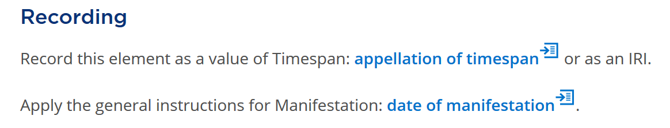
date of publication
Recording methods for a related entity
For date of distribution, manufacture, production, publication

Slide 5
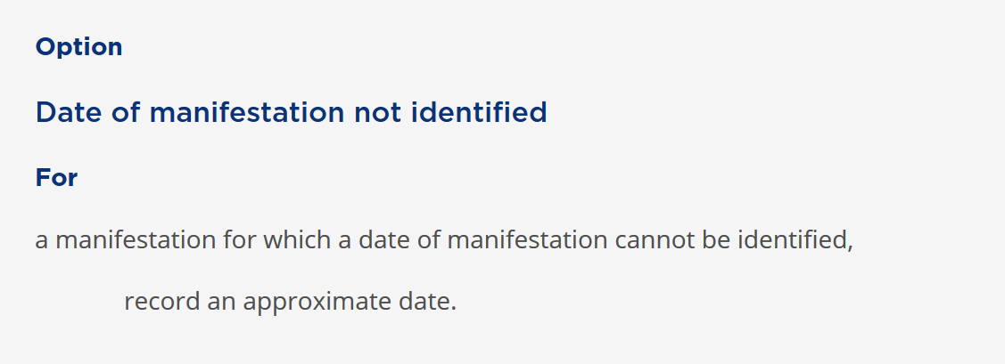
date of manifestation

Slide 6
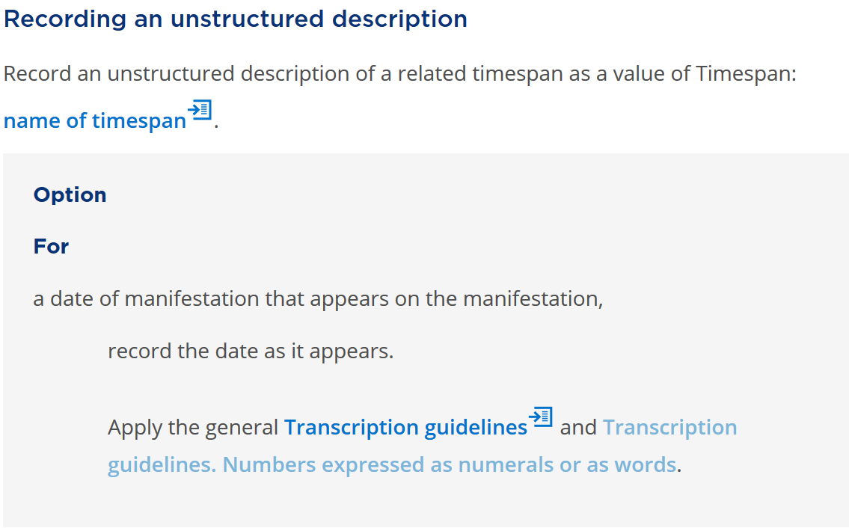
Unstructured description

Slide 7
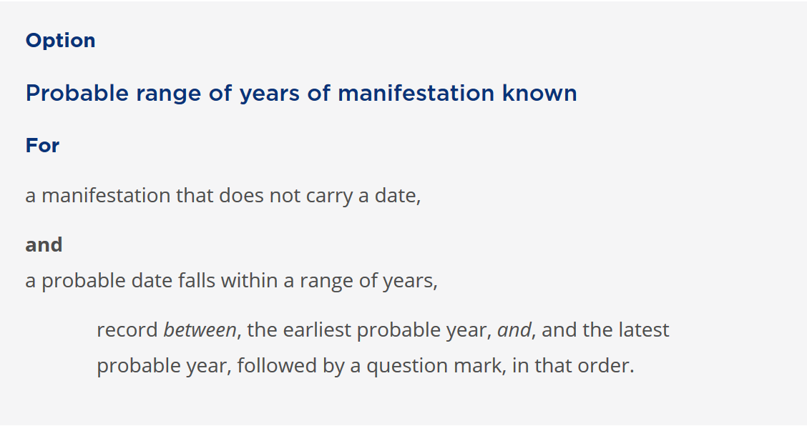
Unstructured description
Example: “between 1962 and 1969?”

Slide 8
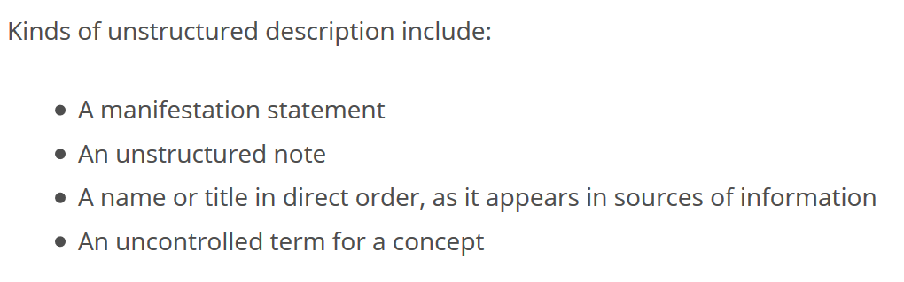
Unstructured description
“approximately 1965” is ok as an unstructured description of date of publication

Slide 9
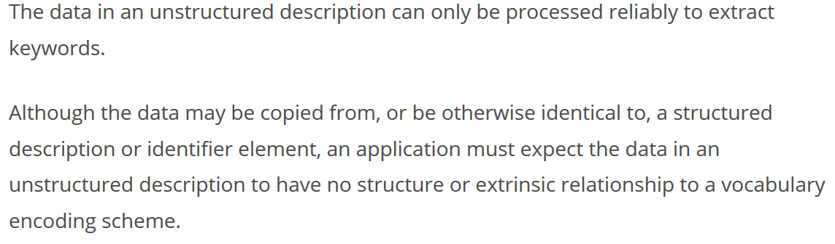
Unstructured description
“Published approximately 1965” has keyword “1965”
“Published in 1965 pieces ” has keyword “1965”
Is “1965” a date? Reliability depends on context = element

Slide 10
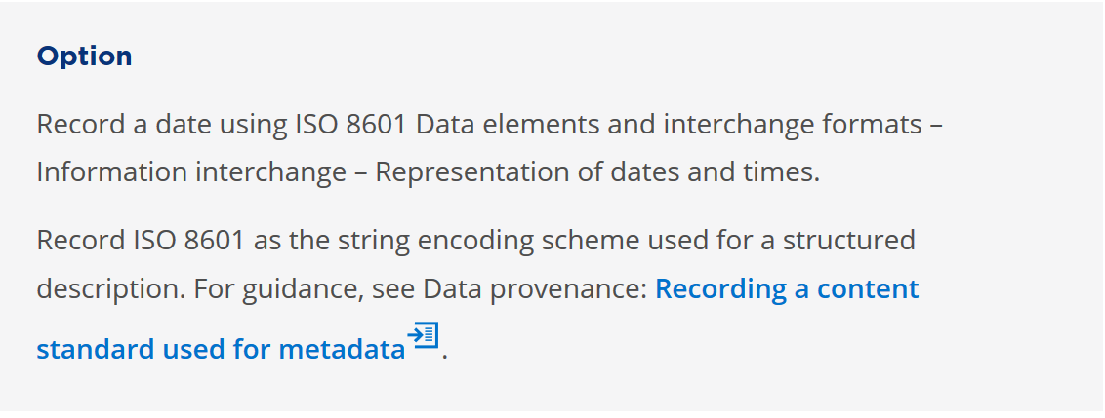
Structured description

Slide 11
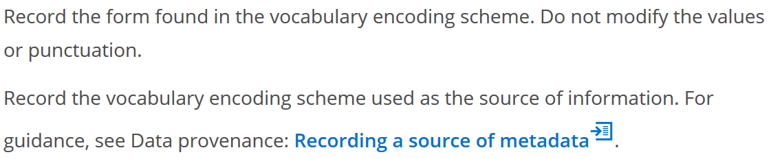
access point for timespan
Example: “1960s”
VES: Wikipedia List of decades

Slide 12
date of publication
Recording method | Value | Source
Unstructured | “approximately 1965” | Cataloguer
Unstructured | “1965?” | Cataloguer + syntax
Unstructured | “between 1962 and 1968?” | Cataloguer + syntax
Structured | “1960s” | Wikipedia
Identifier | “Q35724” | Wikidata
IRI | http://dbpedia.org/resource/1960s | dbPedia

