Slide 1
How to publish local metadata as linked data
Gordon Dunsire
Presented at Linked Open Data: current practice in libraries and archives (3rd Linked Open Data Conference), Edinburgh, 18 Nov 2013

Slide 2
Overview
Choosing and finding elements for publishing linked data
Losing data; dumbing down
Creating local elements
Case study: NLS DOD
Developing local elements and URIs
Extracting data triples
Demo of proof-of-concept interface

Slide 3
Choosing elements
Classes (types) and properties (attributes and relationships) that represent the context and scope of linked data
Elements should be available to applications
“Global” element >= local element [meaning/semantic]
< results in semantic incoherency + low trust/quality rating
> results in loss of precision, loss of information
“dumbing down” (Dublin Core)

Slide 4
Finding elements
Pick and mix
Many element sets for bibliographic data are available
General: Dublin Core, FOAF, SKOS …
Specific: BibO, FRBR, ISBD, RDA …
With significant overlap …
Shades of meaning = semantic granularity
Searchable registries: joinup, LOV, OMR …
Or grow your own

Slide 5
Creating elements
Structure of local records derived from a local schema
Home grown or modified standard
Simple methodology to define structure as a local element set
Use data dictionary/documentation as basis for element labels and definitions
Assign URIs to each element
Make element set available to applications

Slide 6
Case study: NLS DOD
Digital Object Database (National Library of Scotland)
Metadata for digitized resources
Local schema expressed in a relational database structure
Normalized (3rd form)
Standard method for linked data representation
Standard design template used to derive element labels
Element set for descriptive metadata published using Open Metadata Registry (OMR)

Slide 7
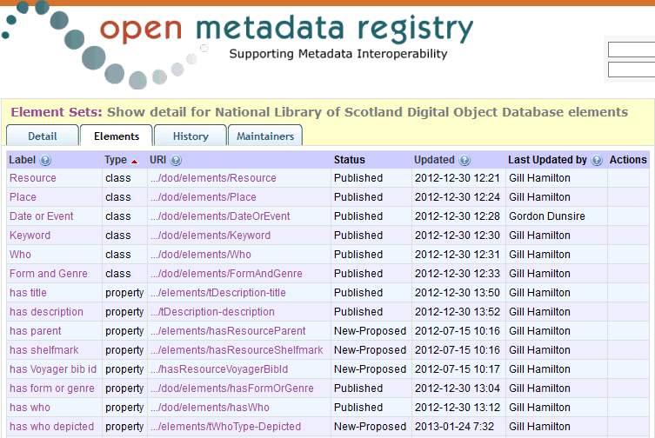
Some idiosyncrasy
URI namespace domain = http://nlsdata.info/dod/elements/

Slide 8
Extracting data triples
Process the metadata records to output data values
Values are the objects of data triples with predicates taken from the local element set
X nlsdod:hasTitle “Remarkable map”
X nlsdod:hasDescription “Map of an unknown island”
…
Subjects of triples are URIs for the individual thing being described
Derived from database “object” identifier

Slide 9
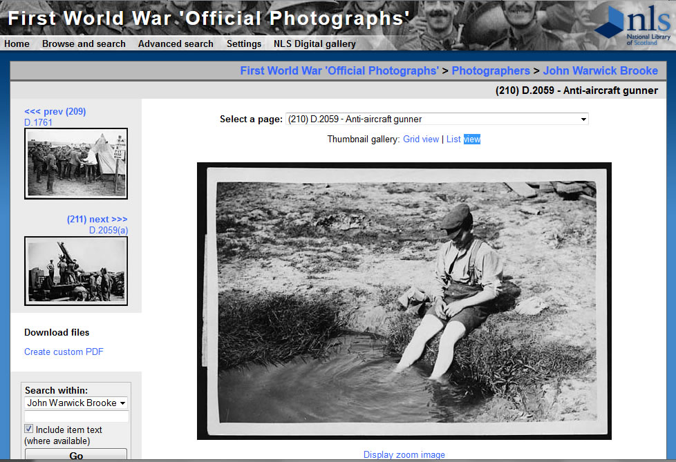
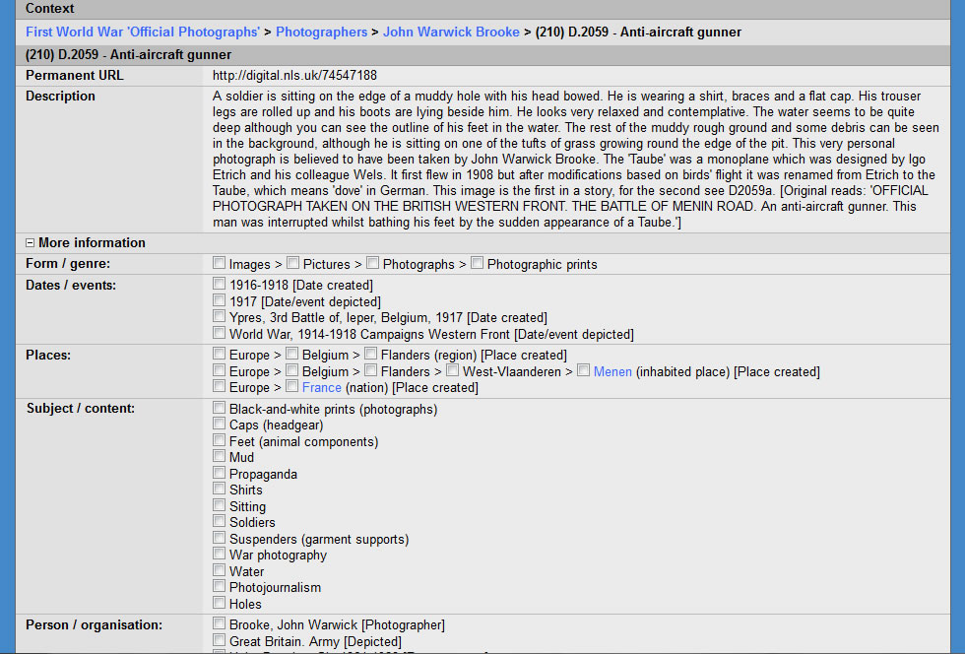
Test sample: Haig Photographs collection

Slide 10
Data triples extracted from the DOD
Subject | Predicate | Object
d:D74547188 | tDescription-title | “Anti-aircraft gunner”
d:D74547188 | tDescription-description | “A soldier is sitting on the edge of a …”
d:D74547188 | hasDateOrEvent | k:D3014
d:D74547188 | hasKeyword | k:D3764
k:D3014 | tKeyword-keyword | “Ypres, 3rd Battle of, Ieper, Belgium, 1917”
k:D3764 | tKeyword-keyword | “Holes”
Subject and object instance URIs derived from resource or record identifier
Internal links reflect database structure

Slide 11
“Authority” strings assigned local things (URIs)
local:rowURI
“stuff”
local:hasKeywordLabel
global:URI
Local things can then be matched to global things

Slide 12
External mappings
Mappings from local to global things stored as turtle files
Separate from extracted local triples
New mappings can be added ad hoc
When resources available
Prioritised by local usage/focus/context
E.g. “Haig, Douglas, Sir, 1861-1928”
E.g. “Ypres, 3rd Battle of, Ieper, Belgium, 1917”
dbPedia “Battle of Passchendaele”
Maps to external element sets support interoperability

Slide 13
Demo Interface
All data is stored and processed as RDF triples
Local data held in MySQL triple store (ARC2)
External data is accessed live online
PHP script uses ARC2 functions
Everything runs on a laptop, so here are some screenshots …

Slide 15
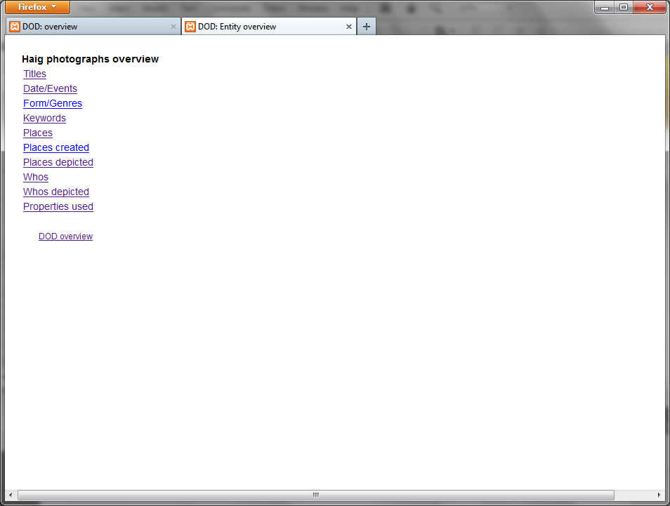

Slide 17
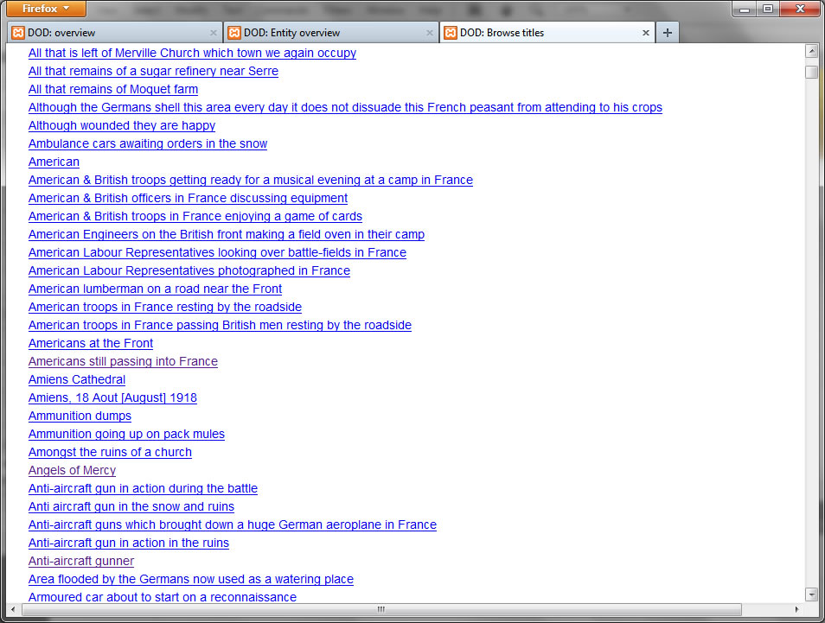

Slide 18
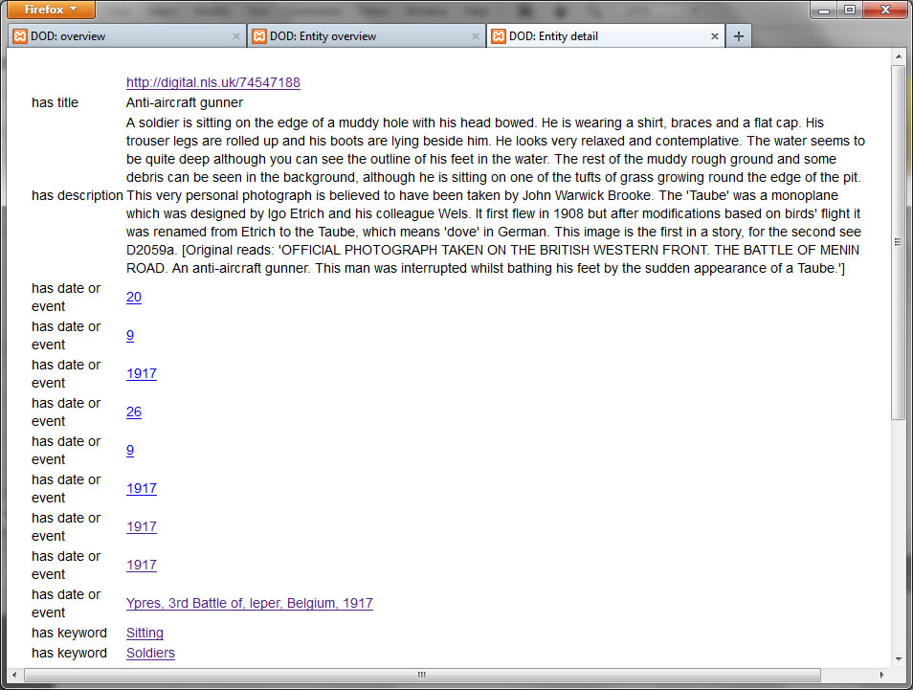

Slide 21
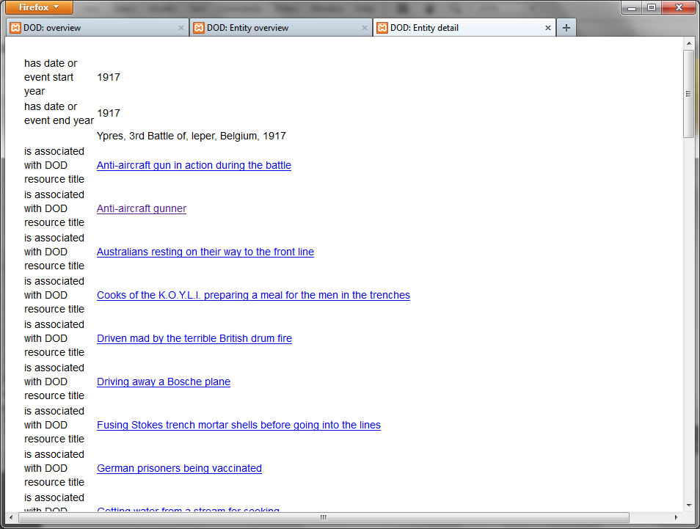

Slide 23
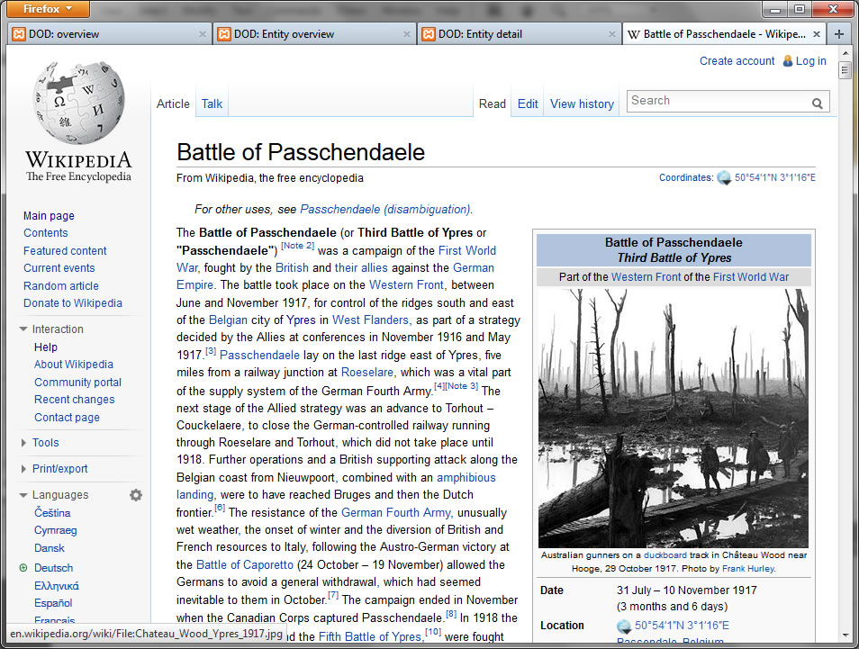

Slide 24
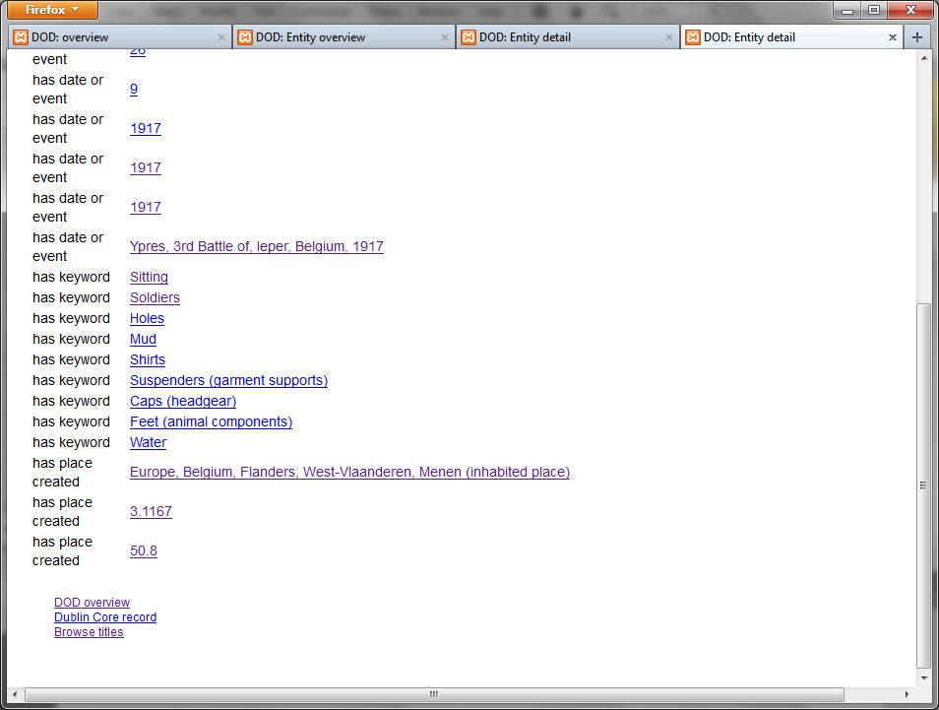

Slide 25
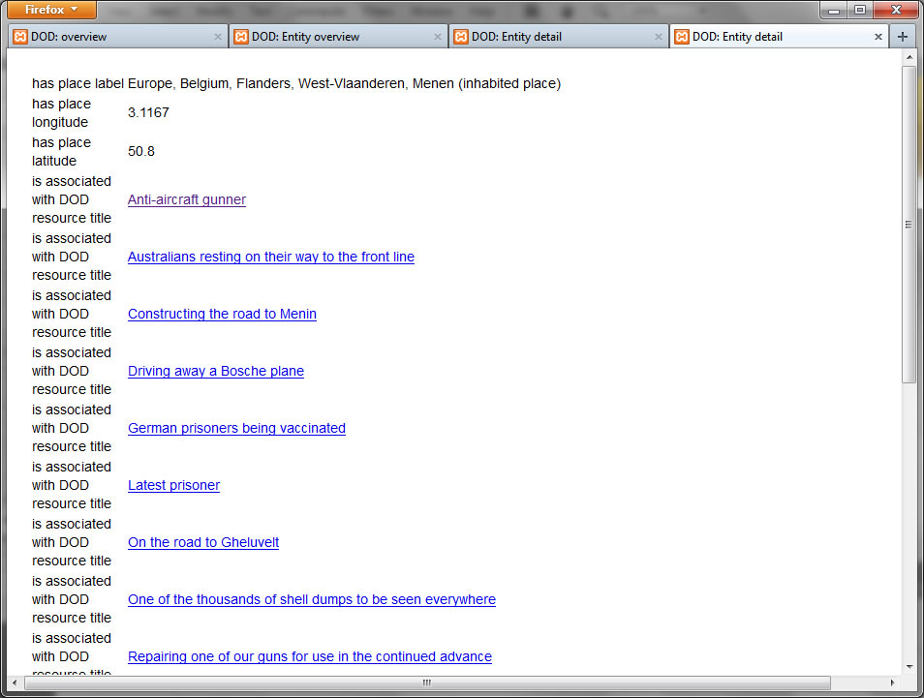

Slide 27
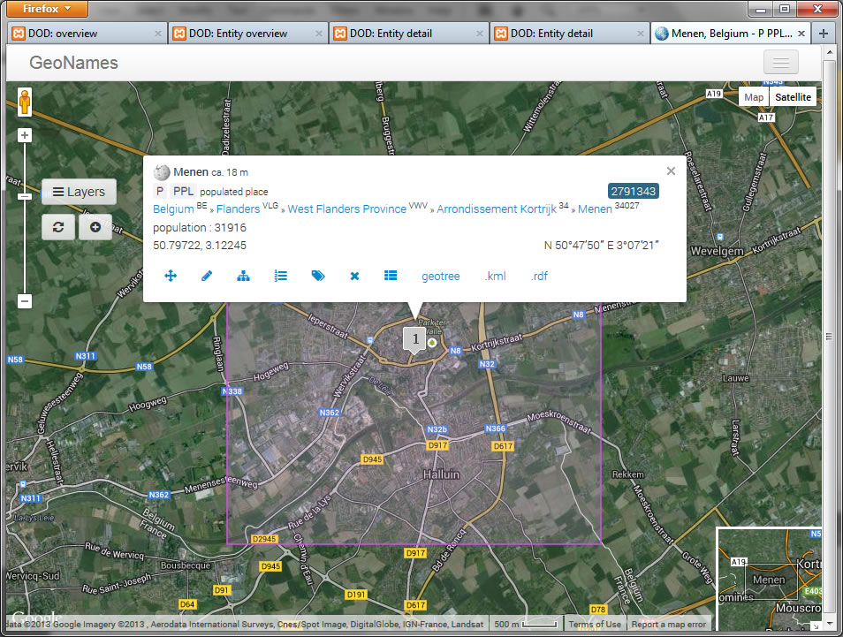

Slide 29
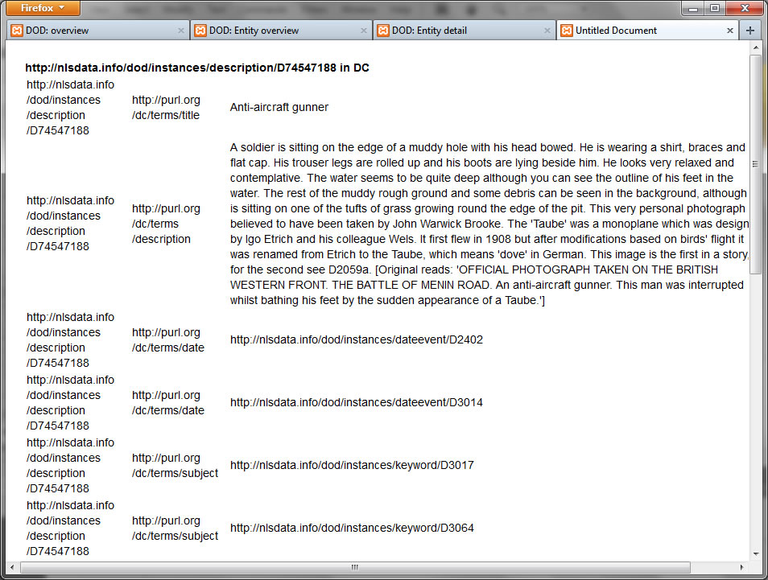

Slide 30
Thank you!
gordon@gordondunsire.com

