Slide 1
Customizing RDA for local applications
Gordon Dunsire, RDA Technical Team Liaison Officer
Presented at CC:DA Meeting, ALA Annual,
June 22, 2019, Washington, D.C.

Slide 2
Overview
Application profiles
Local vocabulary encoding schemes
Local string encoding schemes

Slide 3
Application profile
A specification of the metadata that is used in an application
A specification may include the entities, elements, and vocabulary encoding schemes that are used, and the mandatory and repeatable status of elements
May also include the preferred recording method

Slide 4
Format
Structured: tabular layout is common
Row = specified element
Column = profile characteristic of element
Element | Mandatory? | Repeatable? | VES | SES | Recording
Name of person | Yes | Yes | n/a | n/a | Unstructured (normalized)
Date of birth | Yes | No | n/a | ISO 8601 | Structured
Related RDA entity of person | Yes | Yes | See RDA Entity | See RDA entity | IRI

Slide 5
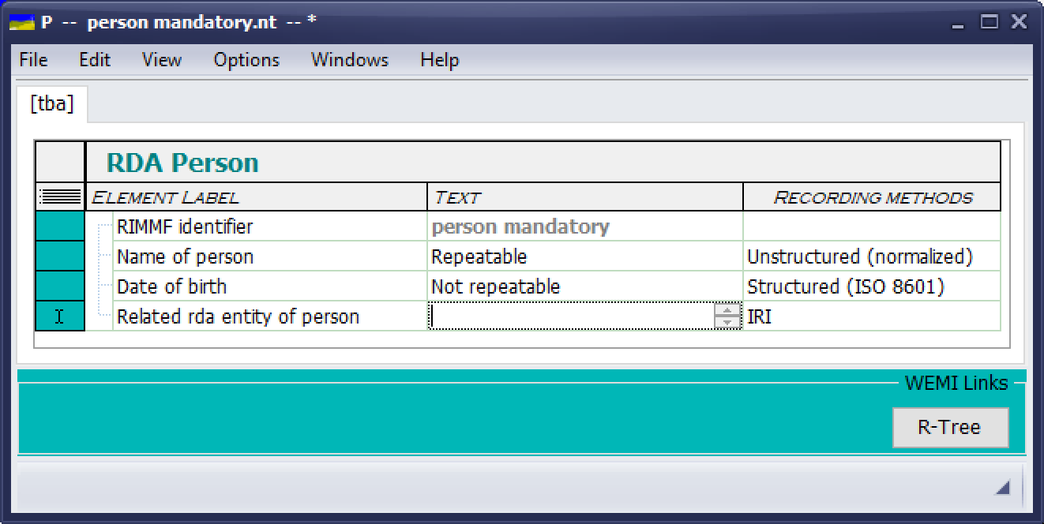
RIMFF4 template

Slide 6
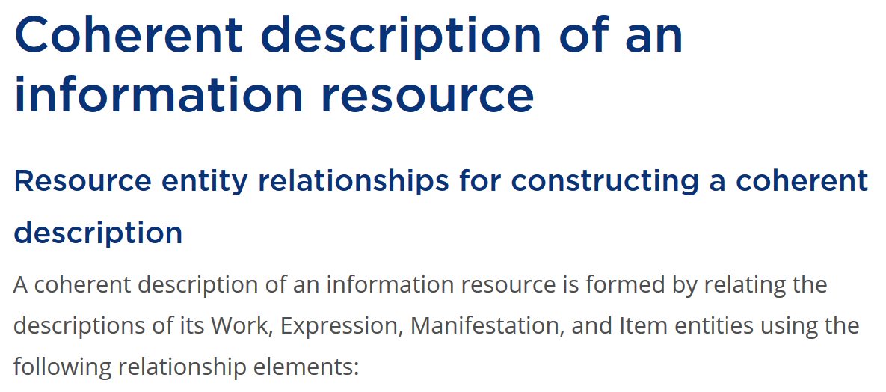
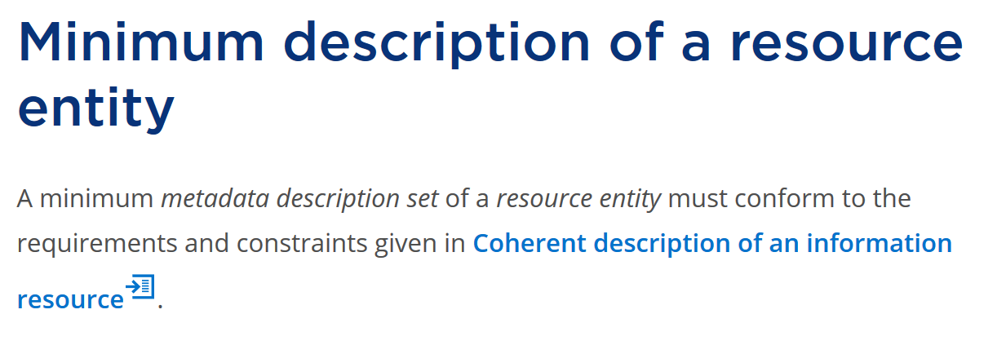
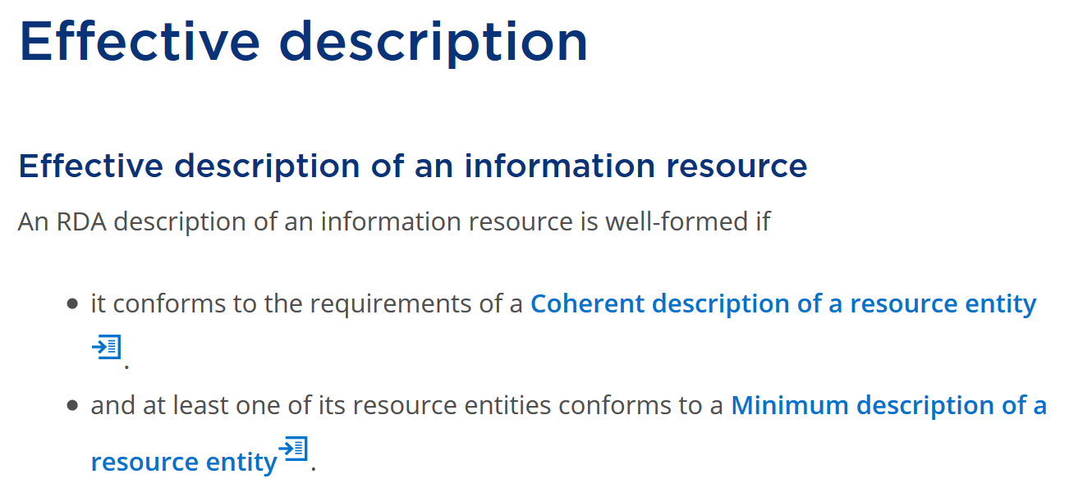
Layered (nested profile
Effective description:
general and specialized elements
Minimum description: appellation elements
Coherent description: “primary” relationship elements

Slide 7
Profile inheritance
This is not the only profile “genealogy”
Effective description:
specialized elements
Effective description:
general (common) elements
Minimum description: appellation elements
Coherent description: “primary” relationship elements

Slide 8
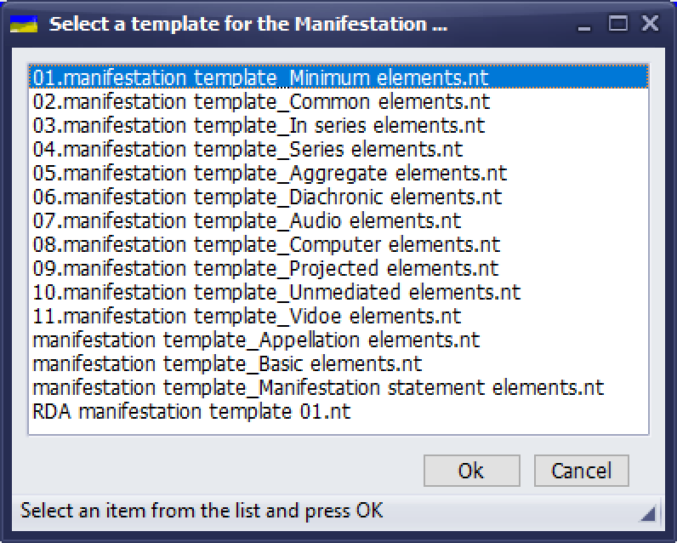
Profile management

Slide 9
Vocabulary encoding scheme
VES: Provides controlled values for an element
Preferred label (structured description)
Notation (identifier)
IRI

Slide 10
Local VES
Must be compatible with the semantics of the RDA element
Scope/coverage
Should be mappable to the RDA VES (if there is one)
Local term/concept is broader, narrower, or equivalent to RDA concept

Slide 11
String encoding scheme
SES: Specifies how a string value of an element is constructed
Values of other elements (variable)
Boilerplate (fixed)
Order (fixed)
Punctuation/delimiters (fixed)

Slide 12
String construction
Example: Authorized access point for place
“Main Street (Washington, D.C.)”
preferred name of place | “Main Street”
+ punctuation | “(“
+ authorized access point for place | “Washington, D.C.”
+ punctuation | “)”

Slide 13
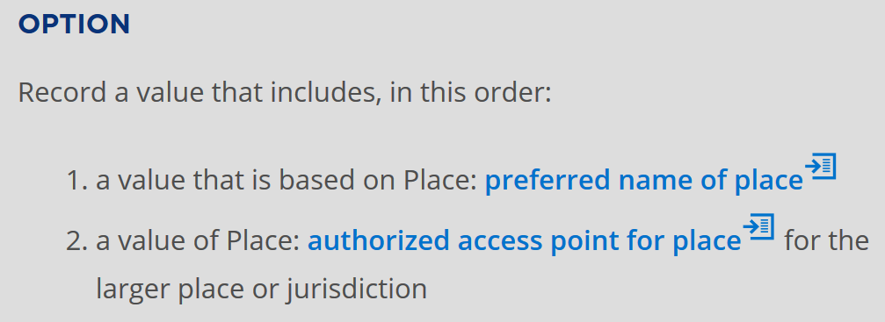
String encoding instructions

Slide 14
String de-construction
Each element is uniquely indicated
Can be ‘parsed out’ of the string to obtain original value of the element
Element indication may be:
Punctuation (e.g. comma before date of publication)
Not enough punctuation symbols?
Name/value pairs (e.g. date of publication: 2019)
User friendly? Browseable?

Slide 15
Local SES
May contain non-RDA elements
Output is just a string
May re-use a punctuation pattern
Or use a local pattern
May have a de-constructor
Round trip, or one way

Slide 16
Managing customization
Organization of development and maintenance
Documentation
Synchronization with changes in RDA
Now what?

