Slide 1
Cataloguing with RDA
Gordon Dunsire, Chair, RSC
Presented at First Colloquium on RDA in Latin America
Mexico City, Mexico, 14 November 2018

Slide 2
Overview
Library Reference Model
LRM and RDA Toolkit
Application profiles
Recording methods
Access and authority control
Aggregates
Diachronic works

Slide 3
Cataloguing with RDA
Library Reference Model

Slide 4
RDA
“RDA is a package of data elements, guidelines, and instructions for creating library and cultural heritage resource metadata that are well-formed according to international models for user-focussed linked data applications.”
RDA Toolkit provides the user-focussed elements, guidelines, and instructions.
RDA Registry provides the infrastructure for well-formed, linked, RDA data applications.
Notes:
The RDA data ecosystem is summed up in this sentence introducing the RDA Board’s announcement of RDA’s strategic directions.
The RDA package is delivered by an infrastructure of two interacting services.
The human-facing components, including the guidelines and instructions, are the Toolkit.
The data-facing components are contained in the Registry.
Applying the data capture and storage techniques in RDA Toolkit to the data architecture in the RDA Registry produces well-formed data for RDA applications.

Slide 5
LRM
2017: Library Reference Model
International Federation of Library Associations and Institutions (IFLA)
LRM consolidates the Functional Requirement family of models
1998: FR for Bibliographic Records (FRBR)
2009: FR for Authority Data (FRAD)
2010: FR for Subject Authority Data (FRSAD)
2011: Working Group on Aggregates report
Notes:
The IFLA Library Reference Model (LRM) is a recent consolidation of several models published over the past 20 years.
A significant shift of focus occurred in the middle of this period of development. This was indicated by a change in the title from “records” to “data”.

Slide 6
LRM and RDA
RDA was based on most of FRBR, some of FRAD, all of FRSAD (but mostly out of scope), and none of WGoA
LRM is the opportunity to fill in gaps and reconcile incoherencies
Notes:
The LRM is relevant to the development of RDA because RDA was based on the original FR family of models.
Not all of the models were fully adopted by RDA. The original Toolkit is based mainly on FRBR, with placeholders for the FRBR Group 3 entities. RDA only used parts of FRAD, and did not add specific elements for authority “headings”.
Detailed accommodation of subject data is out of scope for RDA, but RDA used FRSAD as the basis of high-level subject relationship elements.
RDA followed the advice given in the report of the Working Group on Aggregates and waited for the consolidation of the models before developing elements, guidance, and instructions for describing aggregates and serials.

Slide 7
Is LRM suitable for RDA?
LRM “a high-level conceptual model … intended as a guide or basis on which to elaborate cataloguing rules”
RDA guidance, instructions, elements
“operates at a greater level of generality than FRBRoo, which seeks to be comparable in terms of generality with CIDOC CRM”
RDA cultural heritage communities
LRM “this model is developed very much with semantic web technologies in mind”
RDA linked data communities
Notes:
There are several features of the LRM that make it suitable for use as the conceptual model behind RDA.
In particular, it supports the RDA Board strategy for improving the utility of RDA for international, cultural heritage, and linked data communities.

Slide 8
LRM as a model
High-level conceptual model
Entity-relationship structure
Intended for refinement by implementations
By sub-typing entities, relationships, and attributes
Notes:
The LRM only provides a high-level model for describing the resources found in library and related collections.
It uses an entity-relationship structure that specifies the entities that are useful to describe, the broad attributes that characterize each entity, and the broad relationships between entities.
The LRM is not intended to be applied directly. It needs to be refined for practical implementations of the model.
Refinements are specified by sub-types of the LRM entities, attributes, and relationships.
To develop RDA as a coherent implementation of the LRM, existing RDA entities and elements must be specified as entity or element sub-types.

Slide 9
LRM entities
Retained:
Work, Expression, Manifestation, Item, Person**
Added:
Agent, Collective Agent, Nomen, Place, Time-span
+ Res (super-class of other entities)
Notes:
The LRM retains the main “resource” entities from FRBR: Work, Expression, Manifestation, and Item.
The Person entity is also retained, but the definition is now confined to real human beings, and excludes bibliographic identities, fictional and legendary beings, and so on.
The LRM introduces several new entities, and an entity super-type labelled “Res”.
Res allows broad attributes and relationships to be cascaded down to, or inherited by, all other LRM entities.

Slide 10
IFLA LRM and RDA entities
Res
is sub-class of
RDA Entity = Any RDA Thing
Covers all other types of entity
RDA
Entity
has appellation*
Nomen
W
is created by
E
Agent
Place
is sub-class
of
is associated with
M
Collective
Agent
Time-span
I
is modified by
P**
F
C
Notes:
In RDA, the super-entity "RDA Entity" is used in place of Res for all other RDA entities. RDA Entity is a sub-type (sub-class in RDF) of Res.
This RDF graph shows new RDA entities taken from the LRM: Nomen, Place, Time-span, Collective Agent, and Agent. Current RDA entities are labelled only with their initials. The graph also shows the high-level relationships between the new and current entities.
* The “appellation” relationship does not normally apply to Nomen itself: Nomens do not have nomens.
** The only RDA entity which does not fit without significant modification is Person because of the narrower definition used by the LRM.
The integrated semantic structure of the LRM and RDA entities allows the RDA relationships to be refinements of the high-level LRM relationships, as element sub-types (sub-properties in RDF).

Slide 11
Cataloguing with RDA
LRM and RDA Toolkit

Slide 12
Beta RDA Toolkit
Foundational structure for the organization of elements, instructions, and guidance
Combines
The organization of entities, attributes, and relationships in the IFLA Library Reference Model (LRM)
The extension of RDA as an implementation of the LRM and resolution of gaps and inconsistencies in RDA
Explicit provision of recording methods to improve support for RDA data applications
Notes:
The beta release of RDA Toolkit provides the foundation for the distribution and amendment of original Toolkit guidance and instructions, and the development of guidance and instructions for new entities and elements.
The structure combines features of RDA as an implementation of the LRM, and explicit provision of a range of recording methods for RDA metadata.

Slide 13
Elements
Element is the unit of focus in the new Toolkit
e.g. “performer” has a “page” all to itself
New elements for access points
Distinction between attribute and relationship elements is dependent on the recording method
New entities  more relationships  more inverses
Many more elements
Notes:
While the original Toolkit focussed on two pairs of entities (work/expression, and manifestation/item), the new Toolkit uses the much finer granularity of an individual element.
Each element has a page of guidance and instructions, using a standard layout.
Like the LRM, then new Toolkit blurs the distinction between attribute elements and relationship elements.
Many former attribute elements have become relationships as a result of the new entities; for example, Date of birth is now a relationship between a Person and a Timespan.
With many new entities, and relationships requiring inverses, the number of RDA elements has increased.

Slide 14
The numbers
13 entities
1700+ elements
Work | 388 |  | Agent | 175
Expression | 291 |  | Person | 85
Manifestation | 282 |  | Collective Agent | 34
Item | 70 |  | Corporate Body | 84
Place | 45 |  | Family | 46
Timespan | 54 |  | Nomen | 169
RDA Entity | 27
Notes:
This table shows the number of elements assigned to each entity.
RDA entity reflects the basic elements available for every entity.

Slide 15
Modular structure
Instructions are grouped by element and recording method
Finer granularity is more flexible for a wider range of applications
Every element page has the same basic structure
RDA Reference data are maintained and displayed separately from guidance and instructions
Reference data are extracted from the RDA Registry
Notes:
The new RDA Toolkit has a modular structure based on the RDA elements.
Each element has a “page” in the Toolkit, and each element page has the same basic structure.
The structure separates the RDA Reference data from the guidance and instructions.

Slide 16
Element page structure
Definition and Scope
Element Reference
Prerecording
Recording
Recording an unstructured description
Recording a structured description
Recording an identifier
Recording an IRI
Instructions
RDA Reference
Related Elements
Notes:
This is an outline of the element page structure.
The RDA Reference data are displayed in the sections highlighted in gray.
All of these sections use content that has already been translated in the Open Metadata Registry.
The guidance and instructions are displayed in the sections highlighted in orange.
The content of these sections is translated in the Content Management System using Trados.
This allows translators to focus their work on specific areas of Toolkit content.

Slide 17
Cataloguing with RDA
Application profiles

Slide 18
Instructions
There are no rules!
Most instructions are now optional
Accommodates local practice in a global framework
Instructions assigned to recording methods
Much more choice
Flexibility ☺
How to choose? ☹
Notes:
There have never been any “rules” for describing resources in RDA.
This basic open approach was reflected in the assignment of “core” status to elements, which was advisory and not compulsory.
RDA is intended for use in an international global environment, and has to accommodate a diversity of local practices and policies. This means that most instructions are optional. Instructions are mandatory where required to ensure well-formed metadata that is coherent with the LRM.
Instructions are assigned to a specific recording method where appropriate, and which applicable recording method to use is determined by local policy.

Slide 19
Optional instructions
Internationalization
No “one way” of describing and accessing a resource
Two or more recording methods are valid for many elements
No element is mandatory [except “nomen string”]
Same as original Toolkit
Most instructions are optional
Application profile is required to manage choice
Notes:
To sum up, most RDA Toolkit instructions are now optional.
The Toolkit is intended to be used with an application profile that specifies which options should be used for a specific application of RDA metadata.

Slide 20
Application profile
What elements must be recorded?
What elements should be recorded?
What elements may be repeated?
What vocabularies are used?
What recording methods are used?
What options are used?
Notes:
An application profile specifies the components of a well-formed set of metadata to be used in a specific application.
The profile effectively “picks and mixes” the elements from one or more ontologies or element sets.
An RDA application profile selects which RDA elements, vocabularies, recording methods, and optional instructions to use for a specific application.

Slide 21
Application profiles in RDA Toolkit
Multiple ways:
Bookmarks and notes
Policy statements
Workflows and other user documentation External documents
Range of contexts, usage, and sharing
Notes:
The new RDA Toolkit provides a range of mechanisms for specifying a profile.
Bookmarks and notes can be used for simple, “personal” profiles.
User-generated documentation can be used for institution-wide applications.
Policy statements are applicable across multiple institutional subscriptions.
External documents that link to Toolkit instructions are suitable for widespread use.

Slide 22
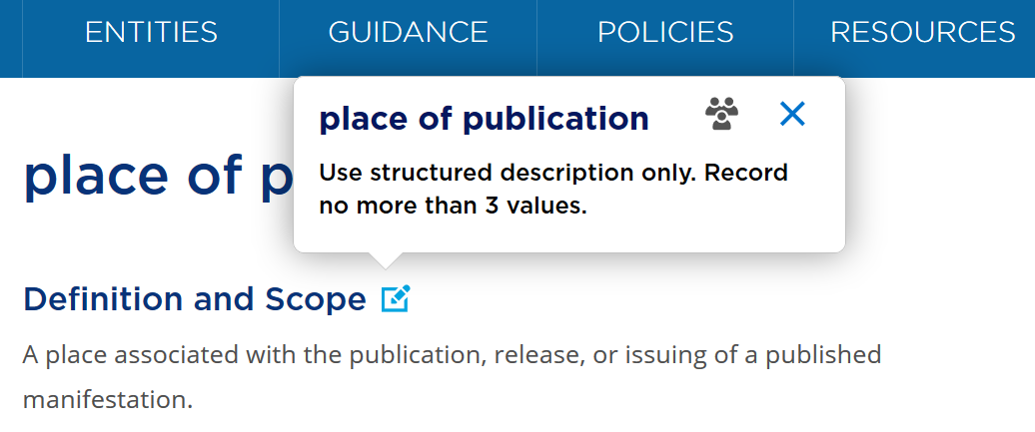
Note
Notes:
This is an example of a simple application profile using the Toolkit Bookmarks and notes facility.
The simple text box gives basic instructions on using the element, and the bookmark acts as an alert to the cataloguer.
This approach may be suitable for occasional use of the Toolkit for a small, local application.

Slide 23
Conditions
Many instructions apply only when one or more conditions is met
Kind of resource being described
Specific characteristic of resource being described
Existence of pre-recorded data
Etc.
“Alternative” = option for the same set of conditions
“Exception” = different set of conditions
Notes:
Optional instructions are often associated with one or more specific conditions.
These may include the type of material and special characteristics being described, or the existence of pre-recorded metadata.
The new Toolkit applies a uniform structure to the presentation of conditions.
This helps to clarify the context of alternatives and exceptions in the original Toolkit:
An alternative is just another option for the same set of conditions, and an exception is a specification of a different set of conditions, usually refined or narrowed.

Slide 24
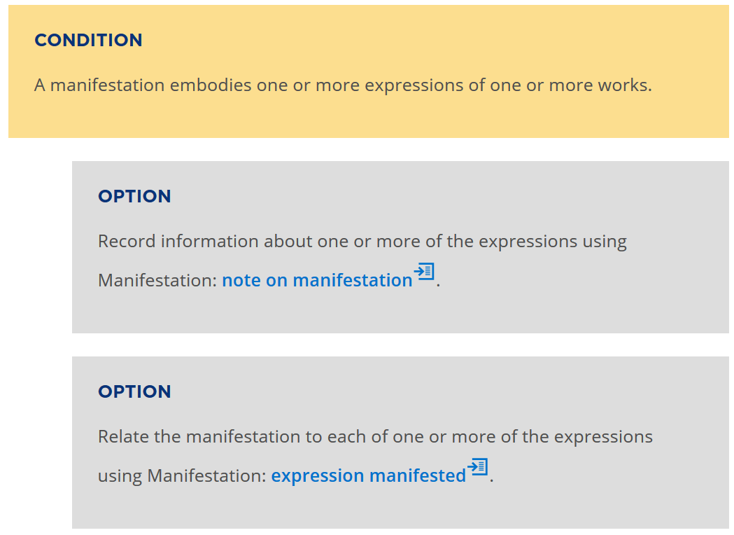
Notes:
Optional instructions are presented in a standard format and are linked to the conditions for which they can be applied.
This format allows policy statements and application profiles to be attached to individual options or groups of options with the same set of conditions.

Slide 25
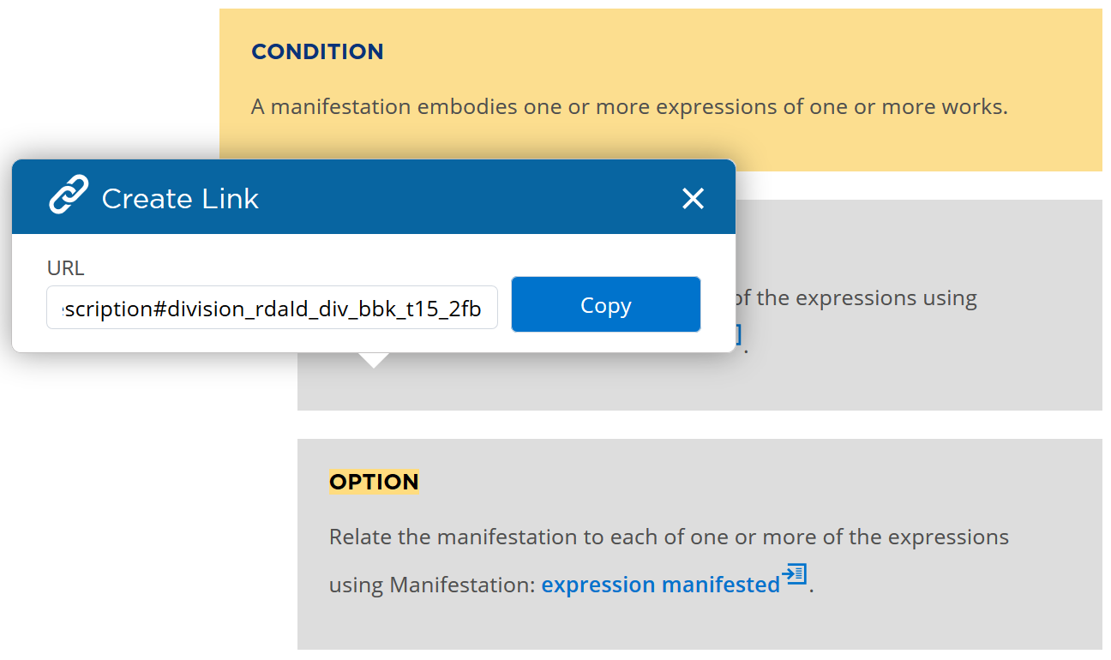

Slide 26
Using a Toolkit URL
External document:
Recording a manifestation that is an aggregate of expressions
Record the expressions separately and link.
Hyperlink with URL copied from Toolkit

Slide 27
Cataloguing with RDA
Recording methods

Slide 28
RDA database scenarios
Flat-file data
Catalogue cards, printed bibliographies, etc.
Description and access
Bibliographic and authority records
Relational databases
Linked data in the Semantic Web
Notes:
RDA has always accommodated a variety of scenarios for storing and processing RDA metadata.
The RDA Steering Committee is now developing RDA to accommodate linked data for Semantic Web applications.

Slide 29
Recording methods
4 methods = “4-fold path”
Unstructured description
Structured description
Identifier
IRI
Extended to all elements
Confined to relationships in original Toolkit
Linked data “method” now explicit
Notes:
The three recording methods for describing a related entity in the original Toolkit are extended to all elements in the new Toolkit.
A fourth recording method, for linked data, has been added.
These recording methods accommodate the implementation scenarios of the original Toolkit.

Slide 30
Unstructured description
Transcribed data: what you see is what you get
Free text notes
Uncontrolled terminology for description
Non-standard metadata from non-professional sources or lacking provenance (authority)
Notes:
An unstructured description is a data value that has no specific internal structure.
In general, the data can only be processed for keyword extraction and indexing.
An unstructured description can include data that is non-standard, not authenticated, or created by non-professional agents.

Slide 31
Structured description
Data recorded in regular, standard, structured formats for human consumers
Sources of data have "authority"
Authorized and variant access points, or controlled terminology
Data from authority files, vocabulary encoding schemes, and knowledge organization systems
Notes:
A structured description is usually composed of data with finer granularity that is assembled according to standard pattern.
The data can come from external authority file and other knowledge organizations systems, or be derived locally using RDA guidance and instructions.

Slide 32
Identifiers
Coded labels intended for machine identification
Identification and disambiguation within a local domain
Authority control numbers, standard identifier schemes, machine-readable database keys, terminology and vocabulary notations
Notes:
An identifier value can be taken from an external, authoritative source, or from a local database system.
Identifiers are generally intended for machine processing.

Slide 33
IRI/URI
Internationalized Resource Identifier > Uniform Resource Identifier
Identification within a global domain: the Semantic Web of linked data
Data for "smart" machine applications
Notes:
An IRI value can be processed by applications that are aware of the semantics of the metadata schema used for linked data.

Slide 34
Recording related data
"note or name of related entity"
"access point for related entity"
RDA Entity
1
is related to
"identifier for related entity"
RDA Entity
2
Notes:
This diagram shows all four recording methods in use to reference a related entity.
The diagram can be interpreted as an RDF graph for linked data, or as a relational schema for a local database.

Slide 35
Data integration
An RDA data element can (usually) accommodate all four types of data value
Multiple types can be assigned to a single element
Metadata from multiple sources can be used in integrated catalogues and other applications
Notes:
Most RDA elements will accommodate all four recording methods and types of value.
An example of an exception is a "note" element, which can only accept an unstructured description.
As shown in the previous diagram, a single element for a specific entity can take values from multiple recording methods.
This allows RDA applications to accommodate and integrate metadata values from multiple resources, ranging from "dumb" data of dubious provenance to "smart" semantic linked data.

Slide 36
Data applications
Unstructured: keyword extraction and indexing
Structured: authority and terminology control
Identifier: relational database applications
IRI: Semantic web and linked open data
RDA is for a smart future, not a dumb past
Notes:
This flexibility is intended to help libraries use metadata from a variety of sources to describe and access information resources of all types, and to store metadata for appropriate machine-processing.

Slide 37
Cataloguing with RDA
Access and authority control

Slide 38
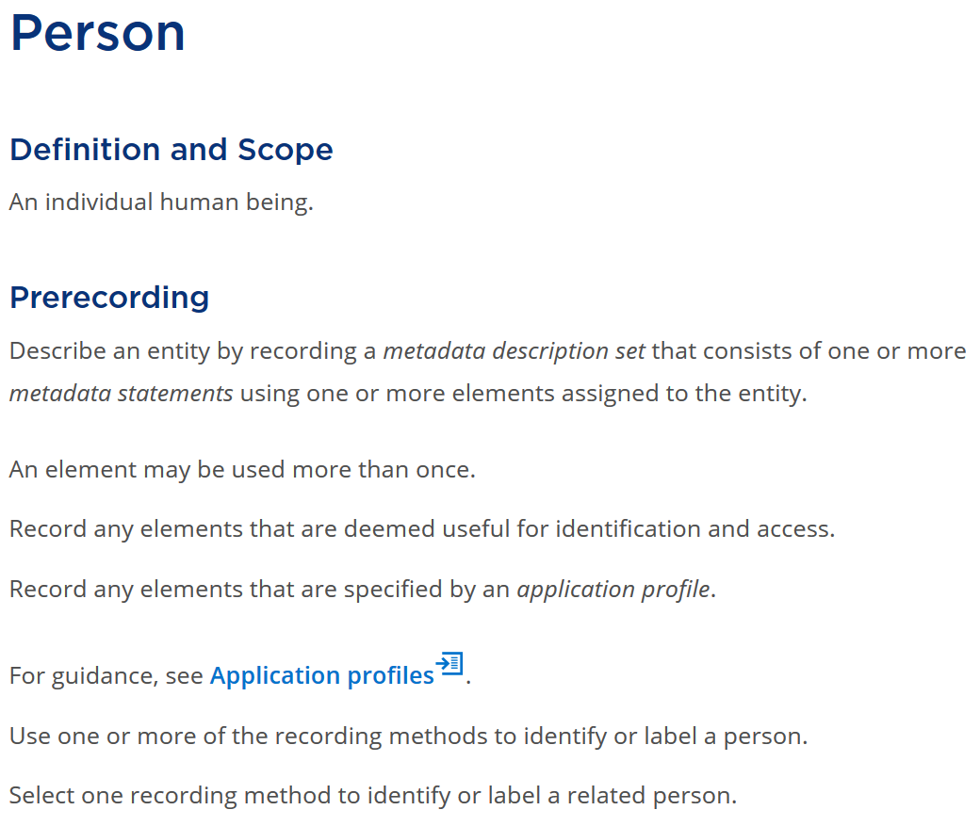
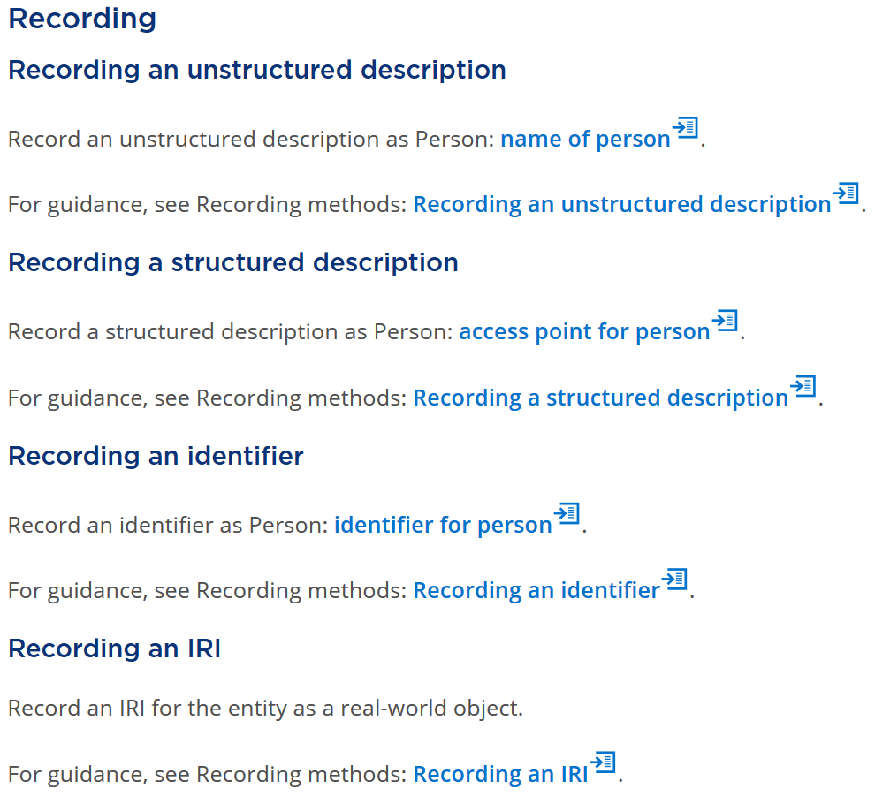

Slide 39
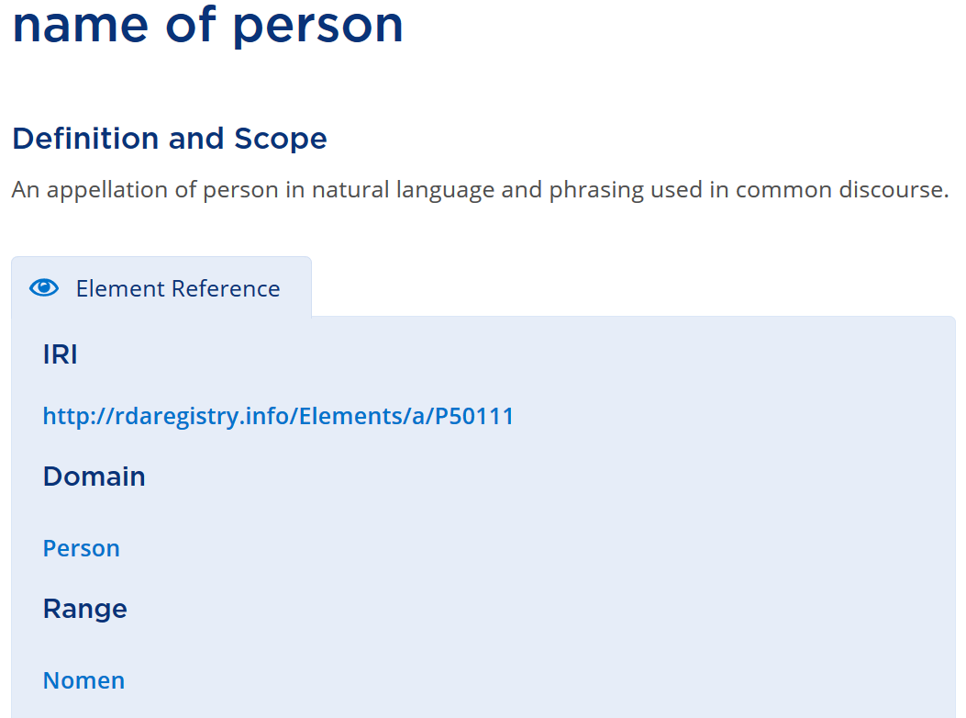
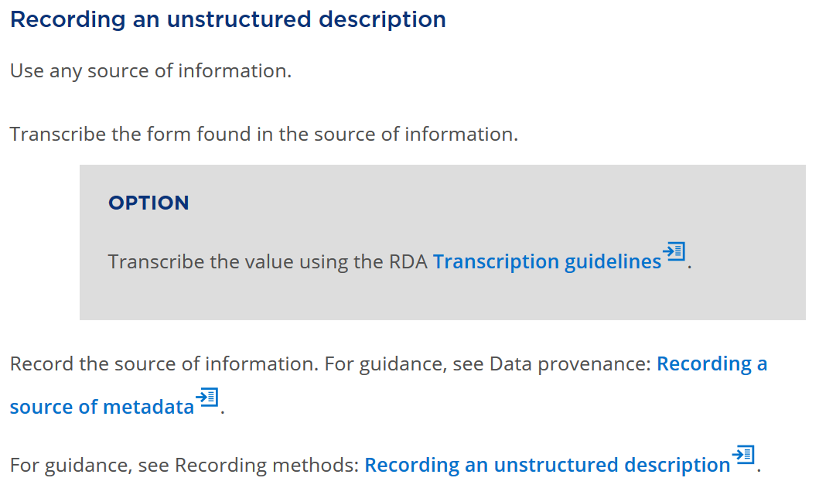

Slide 40
Recording an entity 1
Person
name of person: “Inés Arredondo”
preferred name of person: “Inés Arredondo”

Slide 41
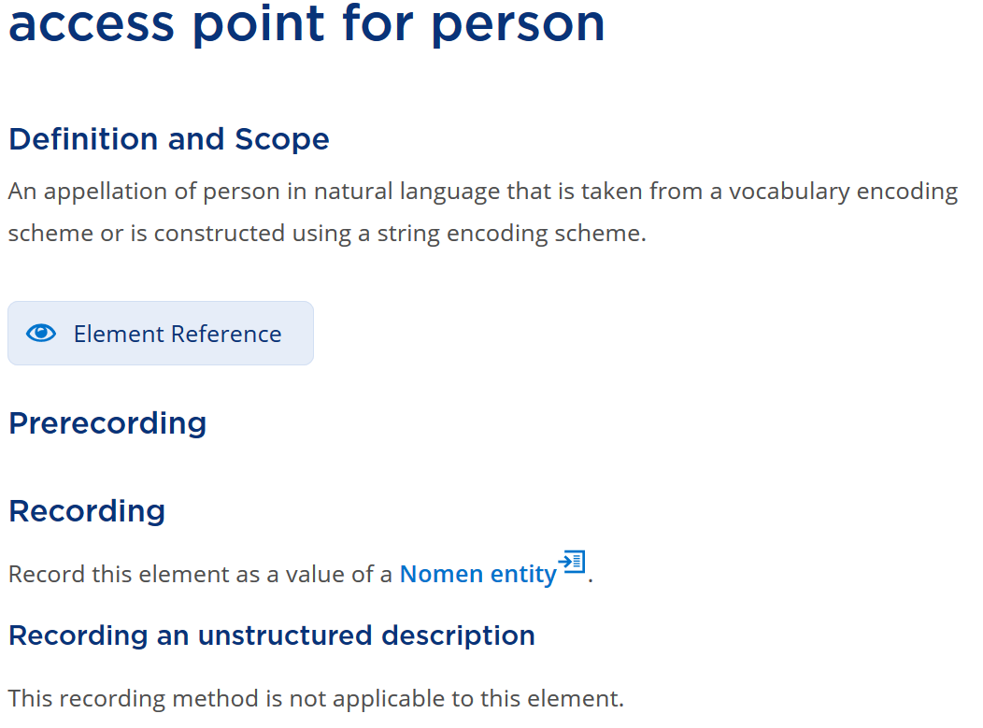
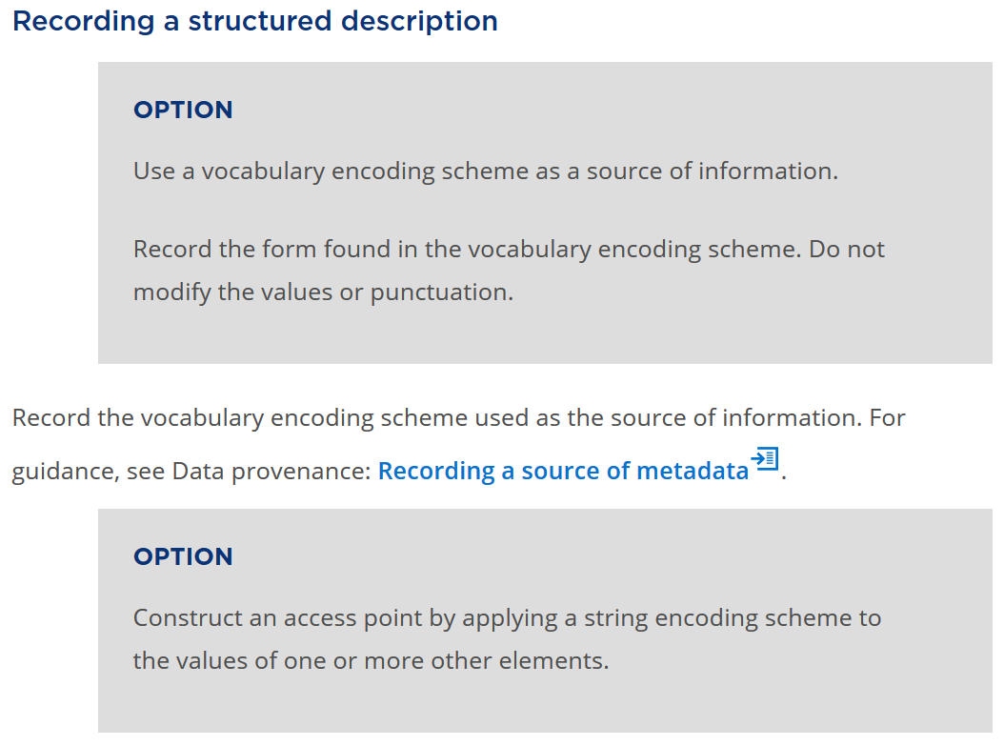
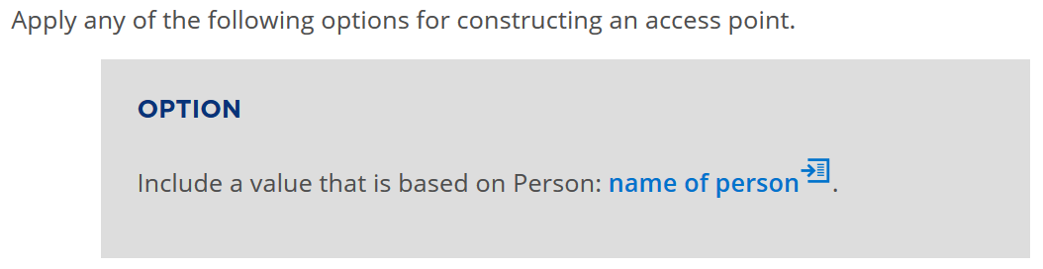

Slide 42
Recording an entity 2
Person
name of person: “Inés Arredondo”
preferred name of person: “Inés Arredondo”
access point for person: “Arredondo, Inés”

Slide 43
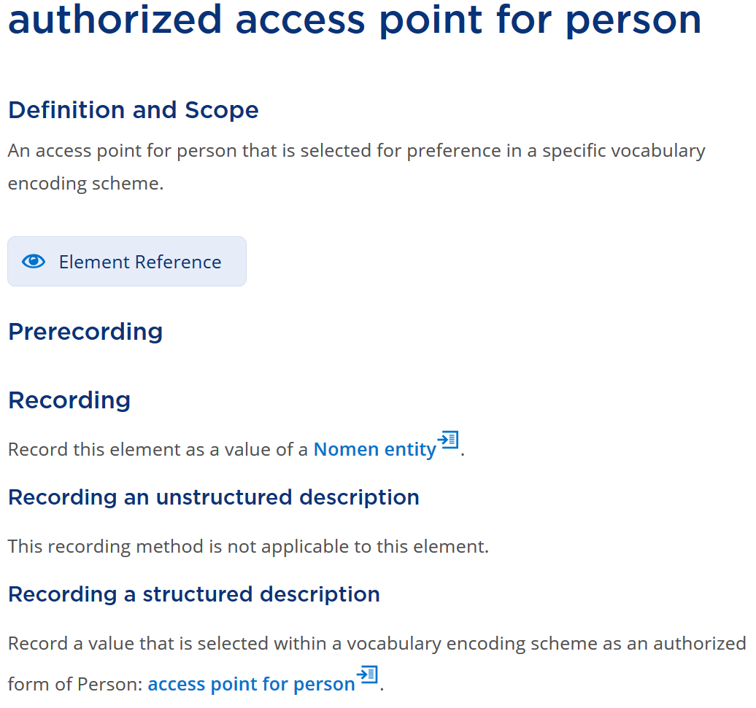
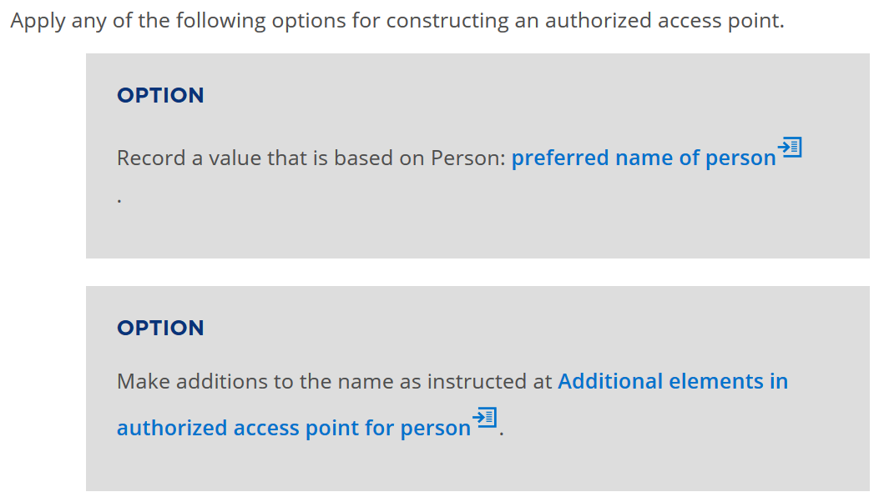

Slide 44
Recording an entity 3
Person
name of person: “Inés Arredondo”
preferred name of person: “Inés Arredondo”
access point for person: “Arredondo, Inés”
authorized access point for person:
“Arredondo, Inés 1928-1989” [BNE]

Slide 45
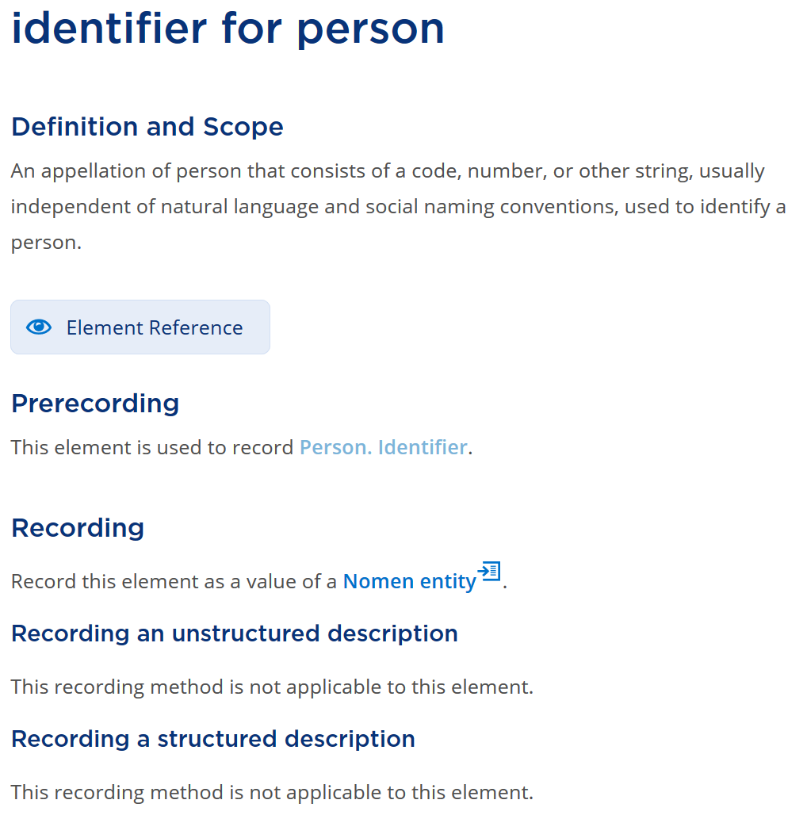
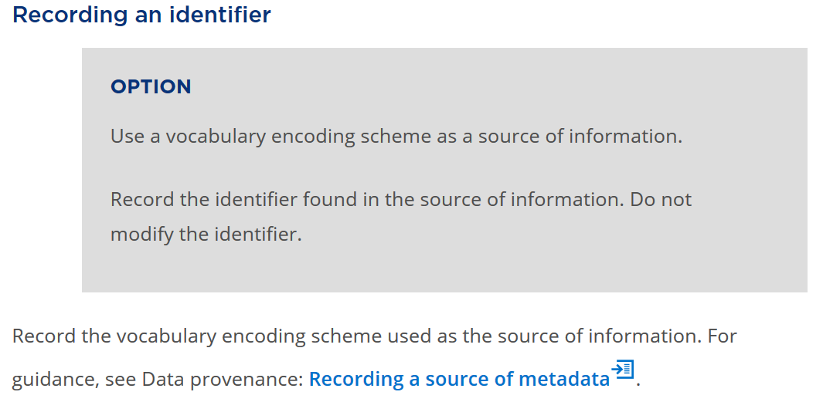

Slide 46
Recording an entity 4
Person
name of person: “Inés Arredondo”
preferred name of person: “Inés Arredondo”
access point for person: “Arredondo, Inés”
authorized access point for person:
“Arredondo, Inés 1928-1989” [BNE]
identifier for person: “32041488” [VIAF]
IRI: http://viaf.org/viaf/32041488

Slide 47
Resource access
Manifestation:
title proper: “Historia Verdadera de una Princesa”
statement of responsibility relating to title proper:
“Inés Arredondo ; ilustraciones Enrique Rosquillas”
Work:
author: “Arredondo, Inés 1928-1989”
structured
author: “32041488”
identifier
author: http://viaf.org/viaf/32041488
IRI

Slide 48
Cataloguing with RDA
Aggregates

Slide 49
Model for aggregates
2011: IFLA Working Group on Aggregates report
Do not implement before consolidation of FR models [2017]
LRM: “An aggregate is defined as a manifestation embodying multiple expressions … every aggregate manifestation also embodies an expression of the aggregating work”
Notes:
The development of the treatment of aggregates in RDA was set aside until the consolidation of IFLA’s Functional Requirements family of models for bibliographic description. This followed a recommendation of the IFLA Working Group on Aggregates that could not reach consensus without clarification and development of related aspects of the other models.
The delay lasted six years, although the RSC was able to see final drafts of the consolidated model, the IFLA Library Reference Model (LRM), well in advance of approval and publication in 2017 as a standard of the International Federation of Library Associations and Institutions (IFLA).
The LRM confirms the basic model proposed by the Working Group on Aggregates: aggregation is a characteristic the Manifestation entity.
The LRM specifically rejects the use of a whole/part relationship between the aggregated content and its component expressions.
Instead, the LRM refers to an aggregating work and its expression.

Slide 50
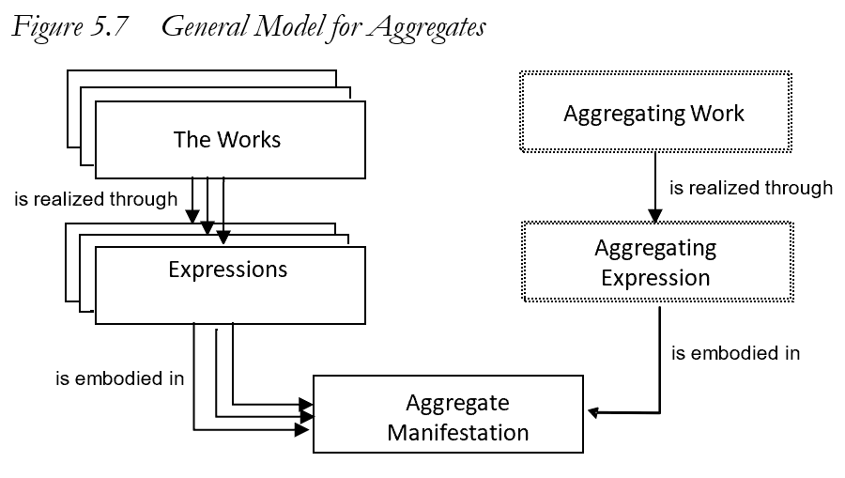
An aggregating work is a plan for aggregation
An aggregating expression realizes the plan by packaging the expressions that are aggregated
No whole/part relationships
Notes:
This is the general model for aggregates, taken from the LRM.
An aggregate manifestation embodies multiple expressions of one or more works plus a single expression of a single aggregating work.
Essentially, the aggregating work and its expression are the content of the aggregate manifestation that selects, organizes, and incorporates the content of the expressions that are aggregated in the manifestation.
There is no whole/part relationship between the Work entities or the Expression entities, and no corresponding whole/part structure in the Manifestation entity.

Slide 51
Aggregate
RDA: A manifestation that embodies an aggregating work and one or more expressions of one or more works that realize the plan for aggregation.
AW: Work plan for
Obras completas
W1: La señal
W2: Río subterráneo
realizes
realizes
E1: Text in
Spanish
E2:Text in
Spanish
AE: Expression of the plan …
aggregated
by
embodies
Obras completas
(Inés Arredondo)
embodies
Notes:
It is straightforward to implement this model in RDA.
This is the RDA label and definition for the LRM “aggregate manifestation”.
This example shows that an individual poem in an anthology is not “part of” the anthology. The poem was not originally conceived as being a part of any future anthology.
The example also shows that it is not necessary to record every distinct Work and Expression. There is no need to describe the aggregating work or expression for many applications, if the individual expressions are recorded. Conversely, as perhaps in this example, it may be sufficient to describe the aggregating work and expression and ignore all of the numerous individual poems.
It does not matter if different agencies and applications record different components at different times; when the data are brought together, they will be coherent, although some redundancy or duplication will be expected.
The LRM provides a specific relationship between the aggregating expression and the expressions that are aggregated. It is not a type of whole/part relationship. This is a new RDA relationship element, labelled “aggregated by” (with inverse “aggregates”).
The terminology will be confusing until we become familiar with the new RDA Toolkit.

Slide 52
3 types of aggregation
Collection of expressions
e.g. Works of Inés Arredondo
Augmentation
e.g. Historia Verdadera de una Princesa, with illustrations
Parallel expressions of the same work
e.g. Río subterráneo in Spanish and English
An aggregate may consist of more than one type
Notes:
The LRM identifies three distinct categories of aggregate that are based on the relationships between the expressions selected by the aggregating work and expression.
In a collection aggregate, the expressions realize works that are intended by their creators to stand alone.
In an augmentation aggregate, one of the expressions realizes a work that is intended by its creator to stand alone, and the other expressions realize works that are intended to augment the stand alone work.
In a parallel aggregate, all of the expressions realize the same work in translations or different scripts.
It is possible for an aggregate to combine different types. For example, an anthology of poems with a commentary and translation of each poem is a combination of all three types.

Slide 53
Cataloguing with RDA
Diachronic works

Slide 54
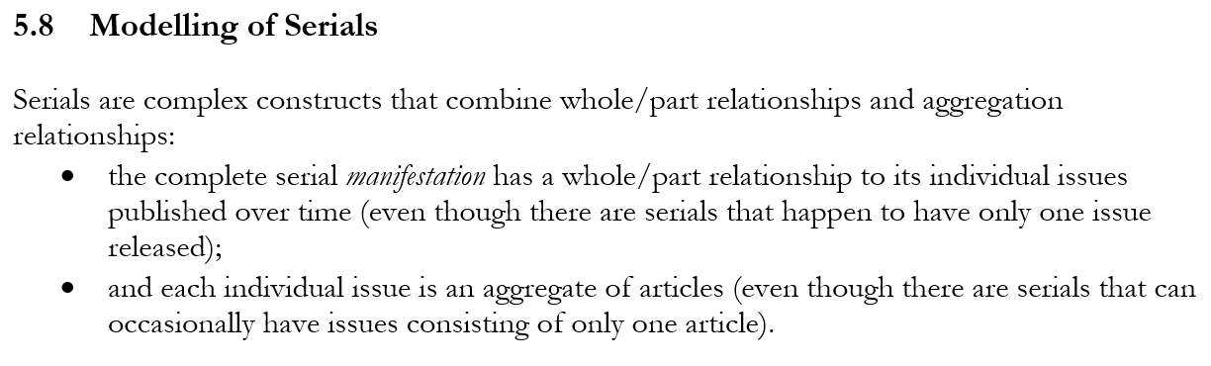

RDA:
RDA/ONIX Framework provides a sub-ontology for how content changes over time
e.g. succession vs integration
Notes:
The LRM describe a “serial” as a complex combination of whole/part and aggregation relationships between manifestations.
RDA implements a generalization of the model of a serial manifestation being “published over time”.
This is the concept of a diachronic work.
If the content is embodied in a manifestation over a timespan, then the content changes during that timespan.
The RDA/ONIX Framework for Resource Categorization provides a model of basic attributes of a resource, described in RDA using the Work, Expression, Manifestation, and Item entities. The Framework is the underlying ontology of the RDA carrier, content, and media types.
The Framework offers three attributes that categorize how content changes over time. For example, the Extension mode distinguishes succession, where content is accumulated over time, and integration, where content is replaced over time.

Slide 55
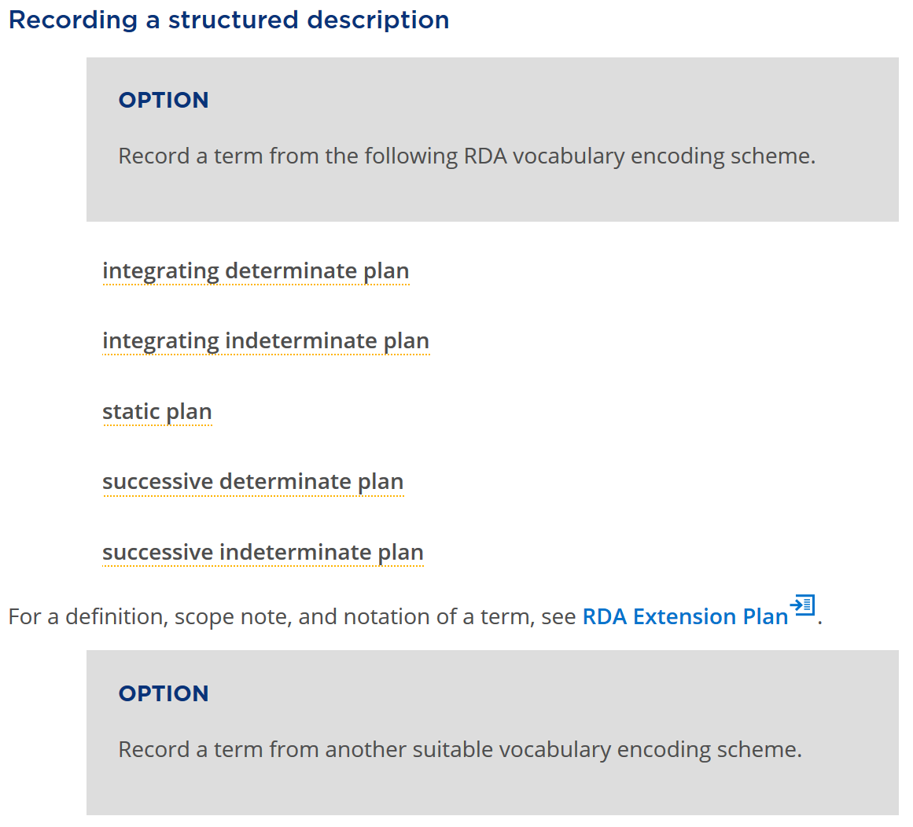
Notes:
RDA has a new Work element for “extension plan” that has a related RDA vocabulary encoding scheme based on the RDA/ONIX Framework.
The vocabulary terms distinguish a serial work from a static work, and distinguish serials works by their extension mode and extension termination.
A typical “serial” is a diachronic work with a “successive indeterminate plan” for extension of its content: the content will be added over time, and the timespan is open-ended.

Slide 56
The WEM stack (FRBR)
Work
1 and only 1
At least 1
Expression
At least 1
At least 1
Manifestation
1 and only 1
At least 1
Item
Notes:
A well-formed RDA description is coherent if it complies with the RDA ontology, as represented in the RDA Registry. The RDA ontology is now compatible with the ontology of the LRM.
In particular, the LRM retains the cardinality restrictions between the FRBR entities. The scope of the Item entity is further clarified: all characteristics that are common to all items that exemplify a manifestation are recorded as characteristics of the manifestation, even if there is only one item (for example, a manuscript).

Slide 57
The WEM lock (diachronic)
Work
1 and only 1
1 and only 1
Expression
1 and only 1
1 and only 1
Manifestation
A plan for diachronic content is locked into all three entities: a change in characteristic is a change in plan, and therefore a new Work
Notes:
This diagram shows the additional cardinality restrictions that apply to serial works.
A serial work is realized by only one expression embodied in only one manifestation. Any change in any of these entities results in a new serial work; for example, a serial published in two different carrier types is modelled as two separate serial works.
This is known as the WEM lock.
The essential fact behind these restrictions is that no plan can predict the future. A publisher may decide to stop publication on a specific carrier, or terminate the publication altogether.
The creator of a serial work may decided to split the content into two separate works from a specific point in time, or merge works, etc. These types of change are familiar to serials librarians. The LRM and RDA now provide a clearer approach for recording these changes as they occur.
The new approach requires a significant change in the context of describing serials and other diachronic works, but the data to be recorded remains the same.

Slide 58
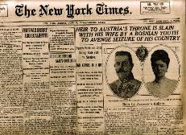



The New York times (print)
The New York times (CD-Rom)
The New York times (online)
Work
The New York times (print)
The New York times (CD-Rom)
The New York times (online)
Expression
Manifestation
If one of the carrier types ceases publication, it cannot imply that all carrier types have ceased.
58
Notes:
This example shows three “editions” of the New York Times, each issued on a different carrier type.
Following the LRM, these are described as three separate serial works. This allows each description to maintain accuracy. For example if the CD-Rom edition ceases, a user will not assume that a later issue is available in that format; if the content of the print and online editions diverges, the user will not assume that either format will contain the information required.

Slide 59
Work groups
A set of works that are identified as a whole
has appellation of work group
“Appellation of work group”
“Authorized access point for work group”
e.g. “New York Times …”
Work
has authorized access point
for work group
“Identifier for work group”
e.g. ISSN-L
has identifier for work group
Notes:
This diagram shows how RDA can be used to collocate serial works in the same “family”.
Any set of works may be assigned a common appellation with the same nomen string.
RDA provides three sub-types of appellation element for a “work group appellation” that can be assigned to each work in the group. Only a single nomen string is required, so there is no provision for variant access points, or unstructured description; the method only works for authorized access points or an associated identifier. The general appellation element is provided as a catch-all, and as a data gathering mechanism.
This approach is already used by the ISSN Network: an ISSN-L functions as an identifier for work group, so all editions of the New York Times can be collocated in an information retrieval application.

Slide 60
Serial work
A work intended to be realized in multiple distinct expressions embodied during a timespan with no ending.
Work-Work relationships
LRM-R19 precedes [logical, not chronological]
LRM-R22 was transformed into [by policy, etc.]
Expression-Expression relationship:
LRM-R25 was aggregated by
Notes:
A serial work is diachronic work that is issued successively with no intended termination.
The LRM offers three high-level relationships that can be used to model the complexity of a serial work and its issues.
LRM-R19 is used to place the works that are the individual issues in sequence according to their numerical and chronological enumeration, even if an issue is embodied in a different chronological order.
LRM=R22 is used to relate serial works that undergo a change of issuance plan, for example if the carrier type of the embodied issue changes from printed volume to online resource.
LRM-R25 is used to relate the expressions of individual issues to the expression of the serial work.
These relationships have been implemented as elements in RDA. The Work-Work elements are used in the hierarchical organization of existing, more refined RDA elements.
If each “issue” of a serial work is itself an aggregate, then the serial becomes an aggregate of aggregates.

Slide 61
DiachronicW
1
transformed into
DiachronicW
2
DiachronicE
1
DiachronicE
2
aggregated by
aggregated by
IssueW
1A
IssueE
1A
IssueE
1B
IssueW
1B
precedes
precedes
IssueW
2A
IssueE
2A
IssueE
2B
IssueW
2B
AggregateM
AggregateM
61
Notes:
In this diagram, a serial work is transformed into a new, separate serial work.
Each work has an expression that aggregates the expressions of its issues.
Each work realized by an expression of an issue is related to the next issue in the sequence of enumeration.
The diagram does not indicate the structure of the aggregate manifestations. For example, both serial works may be embodied as a single online resource.
A serial work is one of the most complex information resources that is found in most library collections.

Slide 62
Other changes to RDA
Data provenance: When is changing, diachronic data valid?
scope of validity; date of validity
Some elements moved from Manifestation to Work
frequency; ISSN
Ongoing liaison with ISSN International Centre and ISBD Review Group
Notes:
RDA now clarifies how to record the provenance of metadata created with RDA. This includes the agents responsible for creating metadata, when the data is created, the source of the data, and so on.
RDA provides two provenance elements that are useful for recording changes in the metadata describing a diachronic work. Scope of validity can record a range of “issues” of a diachronic work for which metadata are valid, for example the title proper of the diachronic manifestation. Date of validity records the timespan for which metadata is valid.
Some elements have been moved from the Manifestation to Work entities. Frequency is really part of the plan for issuing a diachronic work, and is certainly not a characteristic of the manifestation of an individual issue. The WEM lock means that ISSN can identify any of the Work, Expression, or Manifestation entities, but it is more appropriate as a Work identifier.
The impact of the LRM on the ISSN Manual and the International Standard Bibliographic Description are now under review by the ISSN International Centre and the ISBD Review Group, respectively.
Liaison on harmonizing RDA, ISSN, and ISBD has been ongoing for many years. The new RDA treatment of serials and aggregates is based on joint meetings, discussions, and papers between these groups, as well as cross-membership of each standards body.
The work continues.

Slide 63
Conclusion
RDA is a package of data elements, guidelines, and instructions ...
A package that meets the resource description and access needs of the 21st century

Slide 64
Muchas gracias!
RDA Steering Committee
http://www.rda-rsc.org/
RDA presentations
http://www.rda-rsc.org/node/560
RDA Toolkit
https://www.rdatoolkit.org/

