Slide 1
Current initiatives in developing library linked data
Gordon Dunsire
Presented at the Cataloguing and Indexing Group Scotland seminar “Linked data and the Semantic Web: what have libraries got to do with it?”, Edinburgh, National Library of Scotland, 17 June 2011

Slide 2
Overview
IFLA standards: FR family, ISBD, UNIMARC
Other standards: RDA, MODS/MADS
Case study: Digital objects at the National Library of Scotland

Slide 3
IFLA standards
RDF representations of standards for “universal” bibliographic control are being developed
“FR” (Functional Requirements) family of models
  For Bibliographic Records (FRBR)
  For Authority Data (FRAD)
  For Subject Authority Data (FRSAD)
International Standard Bibliographic Description (ISBD)
  Record structure and content
UNIMARC
  Encoding for ISBD records (Bibliographic) and FRAD (Authorities)

Slide 4
Representation in RDF
Entities => RDF classes
  E.g. FRBR “Person”
Attributes, tags, (sub)fields, relationships => RDF properties
  E.g. ISBD “title proper”
  E.g. UNIMARC “200 $a” (title proper)
  E.g. FRBR “title of the manifestation”
Controlled term values => SKOS vocabularies
  E.g. ISBD Area 0 (content and media type)

Slide 5
Other library standards in RDF (1)
RDA: resource description and access
  Content standard based on FR models
  Refines the FR properties
  Many more controlled vocabularies than AACR
MODS/MADS (Metadata Object/Authority Description Schema)
  Metadata structure based on MARC21
  RDF representation just beginning ...

Slide 6
Other library standards in RDF (2)
BIBO: Bibliographic Ontology
  Classes and properties for citations and bibliographic references
DCMI Metadata Terms (Dublin Core)
  High-level common-denominator classes and properties for memory institution metadata
Lots of controlled vocabularies
  LCSH, DDC summaries, RDA vocabularies, etc.

Slide 7
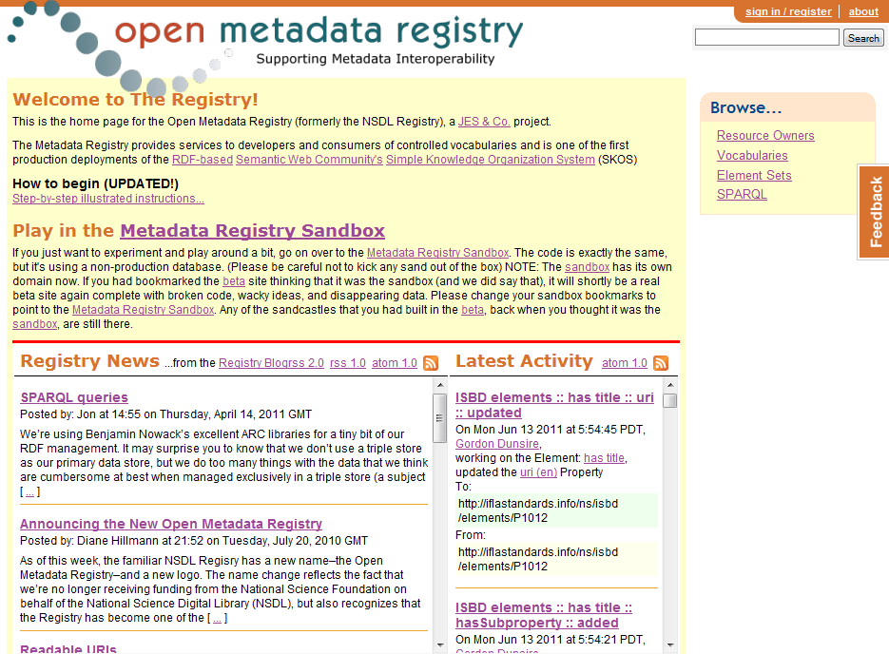

Slide 8
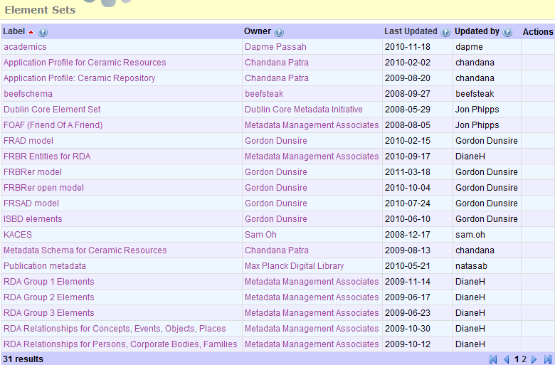

Slide 9
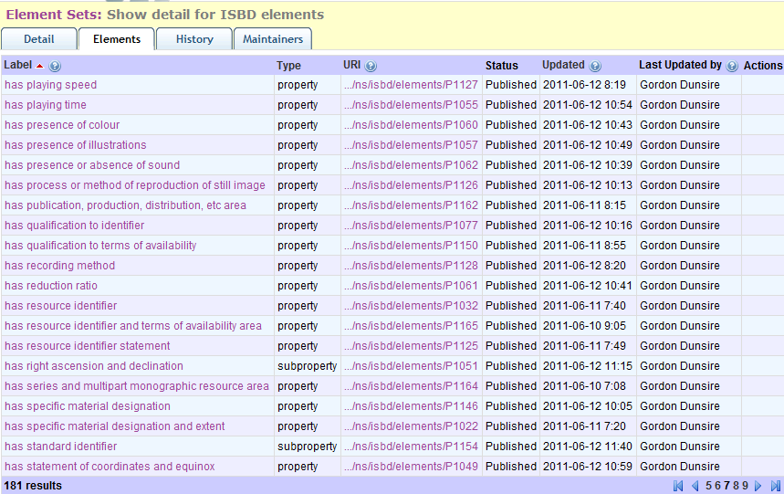

Slide 10
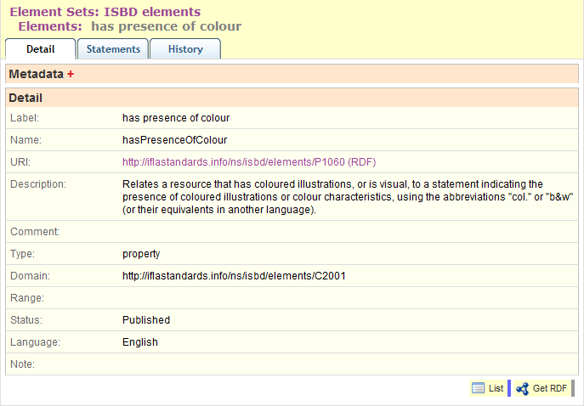

Slide 11
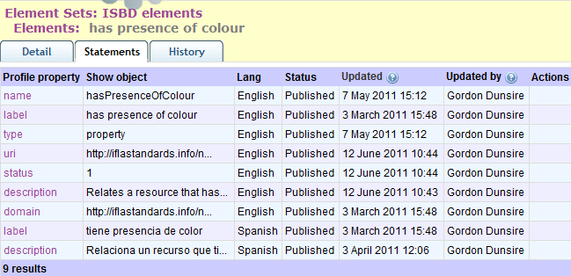

Slide 12
Case study: National Library of Scotland Digital Object Database
Digitized versions of items from the collections

Slide 13
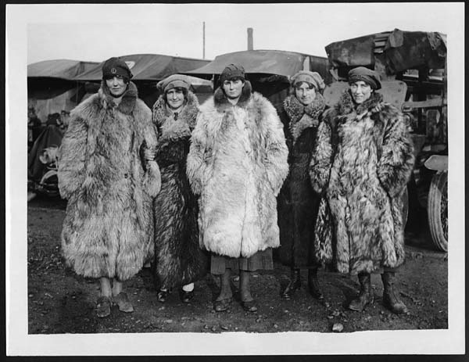

Slide 14
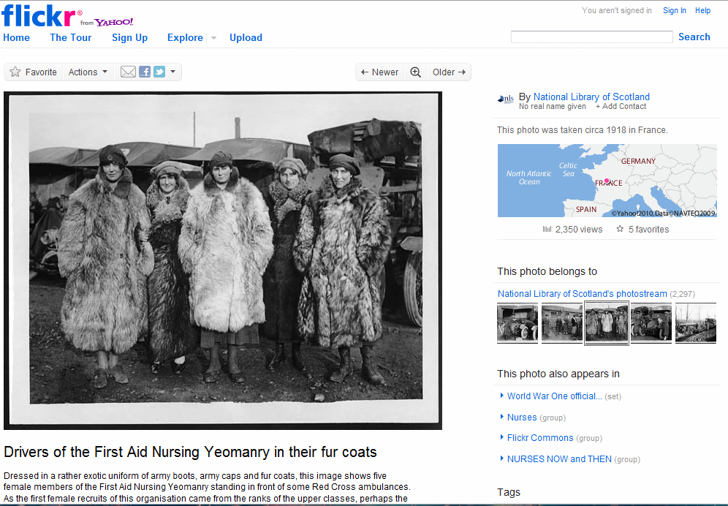
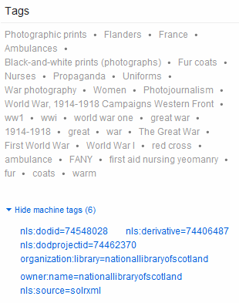

Slide 15
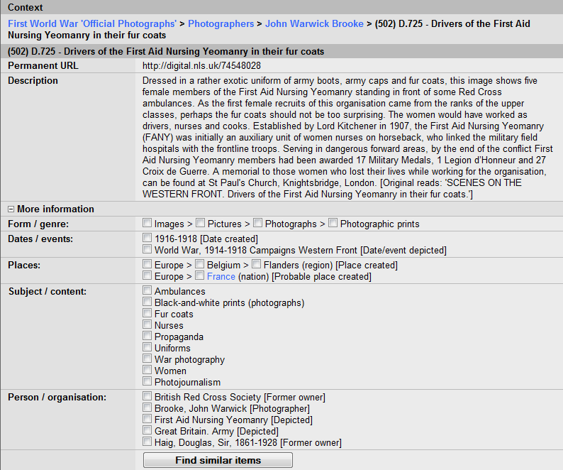

Slide 16
Representing the record in RDF (1)
The record is about the digitized photograph
The record needs to be broken down into individual statements to form triples
So a URI for the digitized photograph will be the object of each triple
A convenient way of determining the URI is to use the ID of the record, prefixed by a namespace
  Placeholder namespace abbreviation: nlsdod

Slide 17
Representing the record in RDF (2)
The subject of each triple is known
  = The value of the record field or attribute
  Need to determine if it has a URI
    Good for linking data!
The art is in choosing the property (predicate) of each triple
  Similar properties in different namespaces
  E.g. FRBR, ISBD, RDA, DCTerms, etc.

Slide 18
Title (1)
dct:title
  A name given to the resource.
isbd:P1004 (has title proper)
  Relates a resource to the title proper (the chief name of a resource, i.e. the title of a resource in the form in which it appears on the preferred source of information for the resource).

Slide 19
Title (2)
frbr:P3020 (has title of the manifestation)
  Relates a manifestation to the word, phrase, or group of characters naming the manifestation.
rda:titleManifestation
  A word, character, or group of words and/or characters that names a resource or a work contained in it.

Slide 20
Title (3)
Alert: FRBR and RDA properties have a domain of Manifestation
  And DOD records are not FRBRized, so the subject URI is an instance of a Bibliographic Resource, not a Work, Expression, Manifestation or Item
So isbd:P1104 (has title proper) is probably the best choice
  More specific than dct:title, so retains more information

Slide 21
But for some other fields ...
Range can help retain information
  E.g. When a URI is required for the object of a triple – to allow it to be linked to other triples
E.g. Subjects
  Specific property such as “has LCSH” can have range which specifies the object as a Library of Congress Subject Heading
  Such properties are not yet developed in standard library models
    Waiting for FRSAD ...

Slide 22
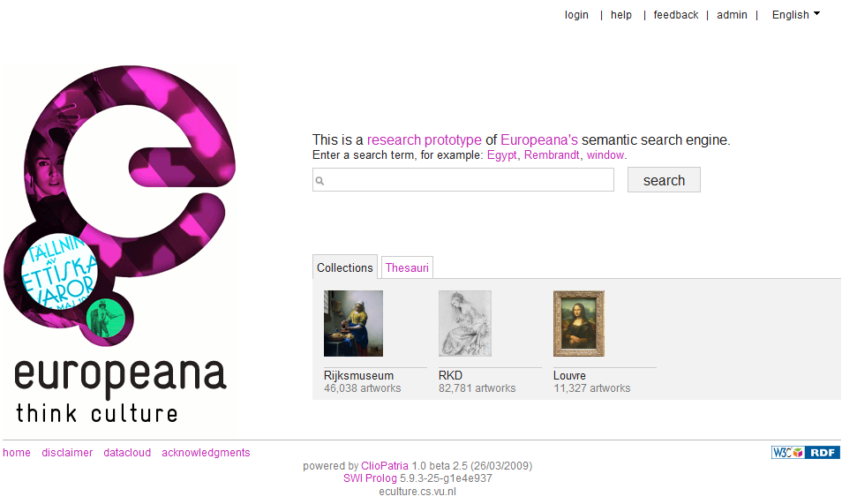
http://eculture.cs.vu.nl/europeana/session/search

Slide 23
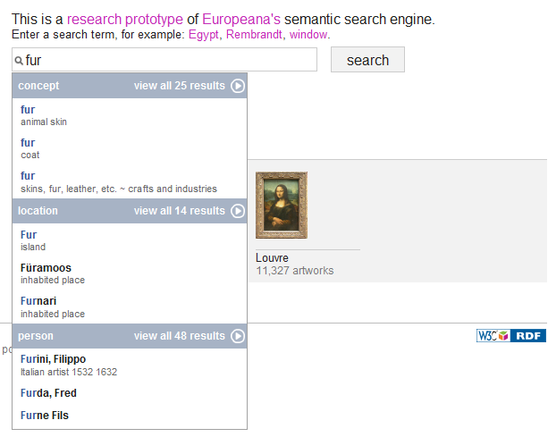
☹

Slide 24
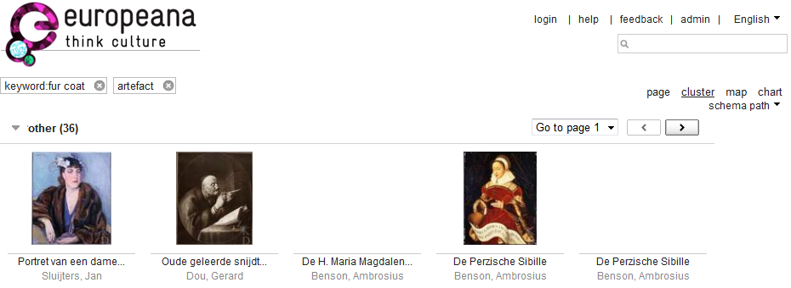

Slide 25
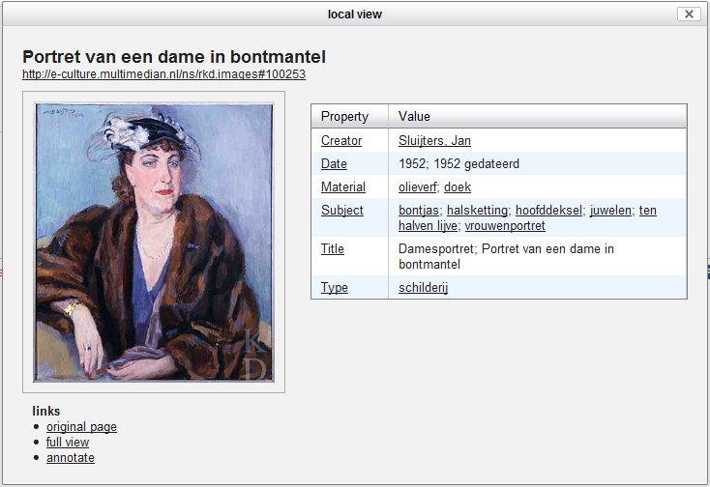
bontjas = fur coat

Slide 26
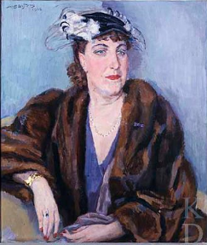
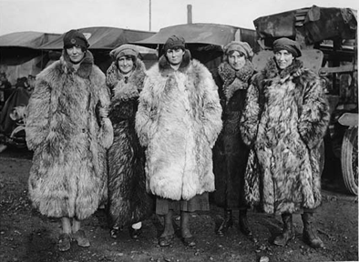
Fur coats!
Thank you!

