Slide 1
RDA data, linked data, and benefits for users
Gordon Dunsire
Presented to the CIGS seminar Metadata and Linked Data: projects, experiments and services in libraries, Edinburgh, Scotland, 12 Sep 2016

Slide 2
Overview
This presentation will use examples of RDA data from the RDA Toolkit to show how it is transformed into linked data, and discusses the benefits for users.
It is based on a presentation given at the American Library Association 2016 conference.

Slide 3
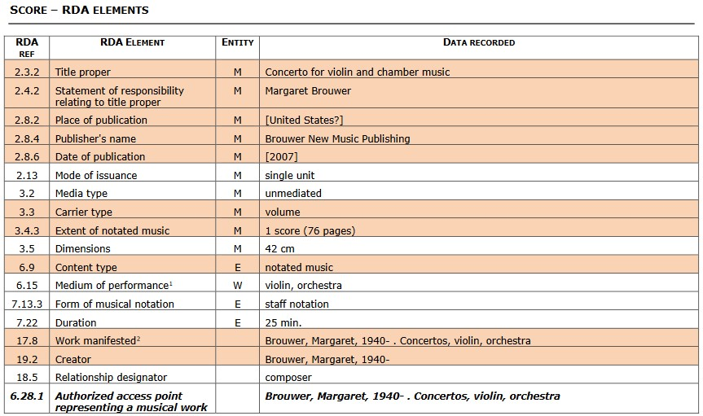
Toolkit full example: flat file (no links)

Slide 4
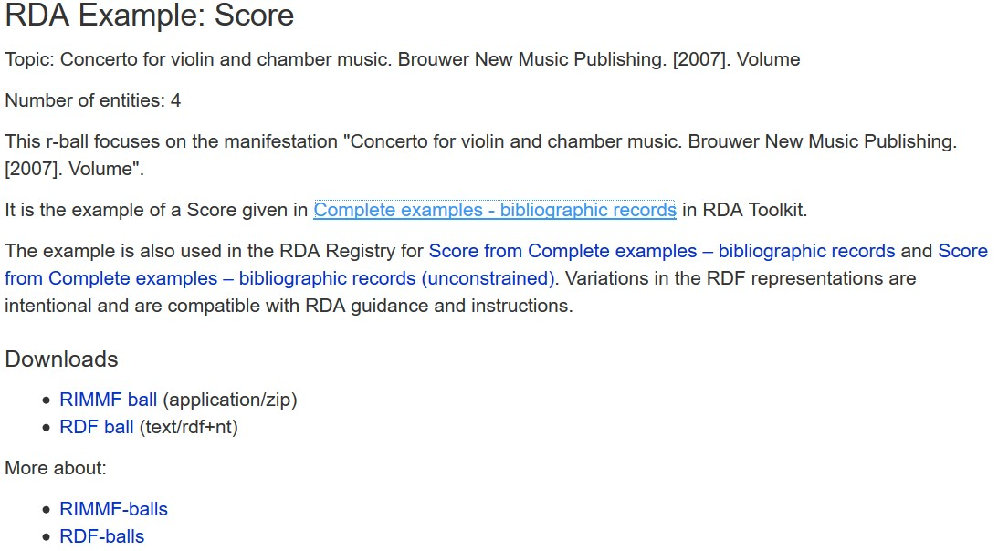
Toolkit full example: r-balls (linked data)

Slide 5
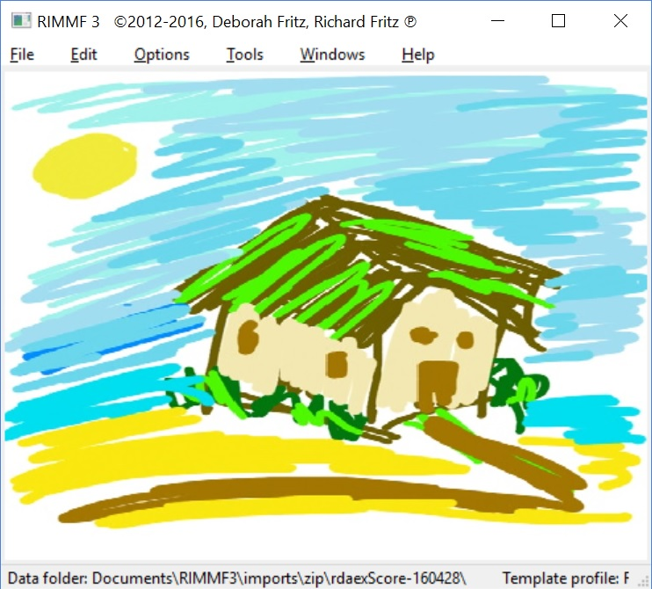
RIMMF (RDA in many metadata formats)
RDA data editor
Free download
Online tutorials
http://www.marcofquality.com/wiki/rimmf3/

Slide 6
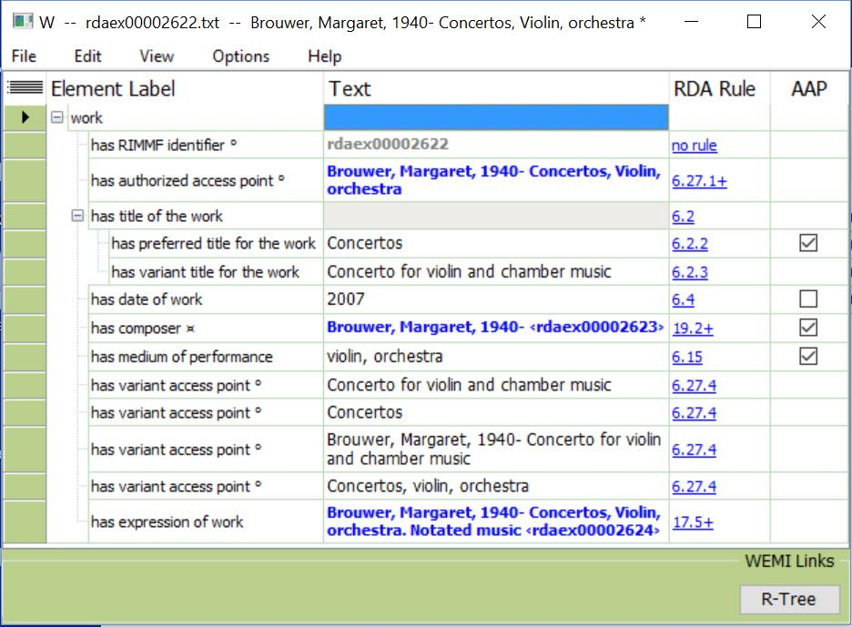
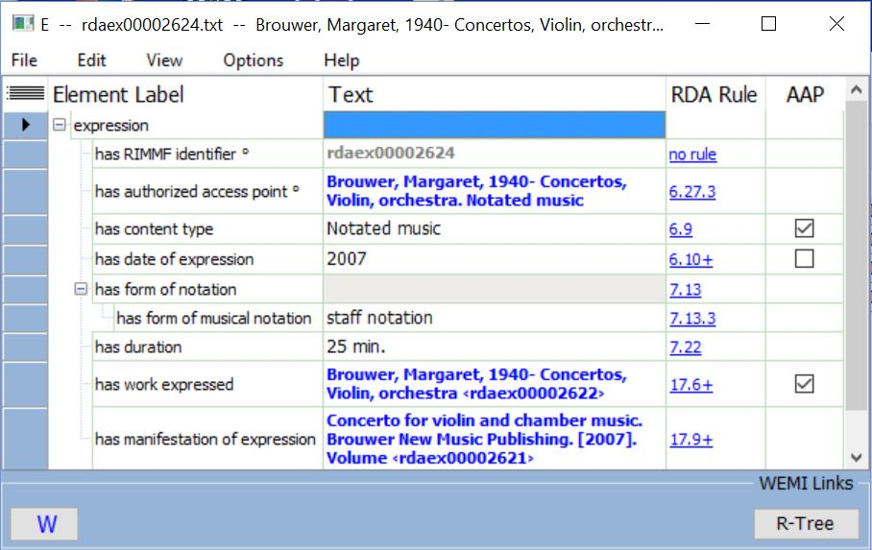
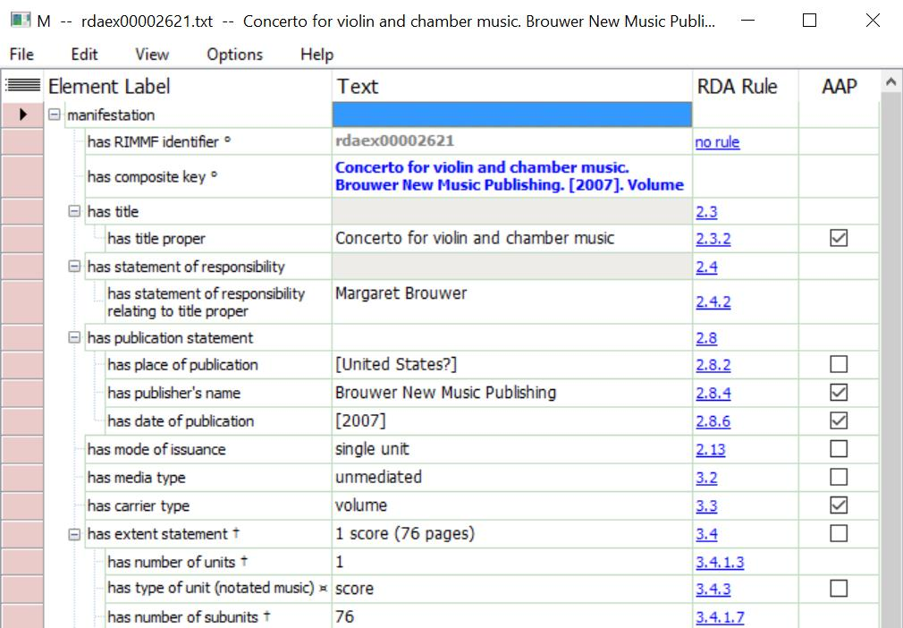
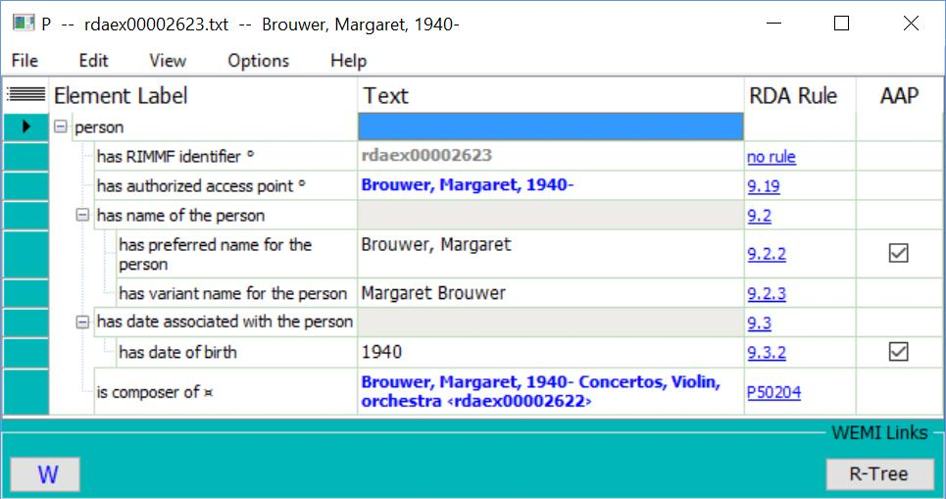
Toolkit full example: RIMMF (linked data)

Slide 7
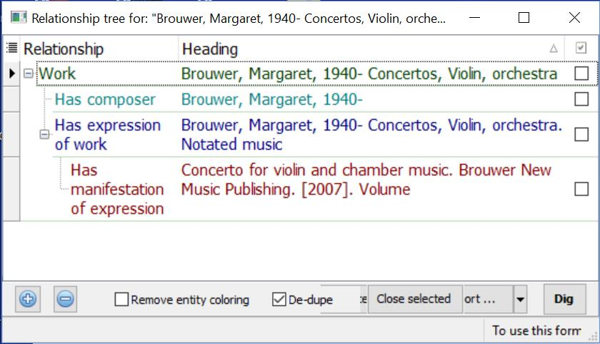
Toolkit full example: RIMMF (linked view)

Slide 8
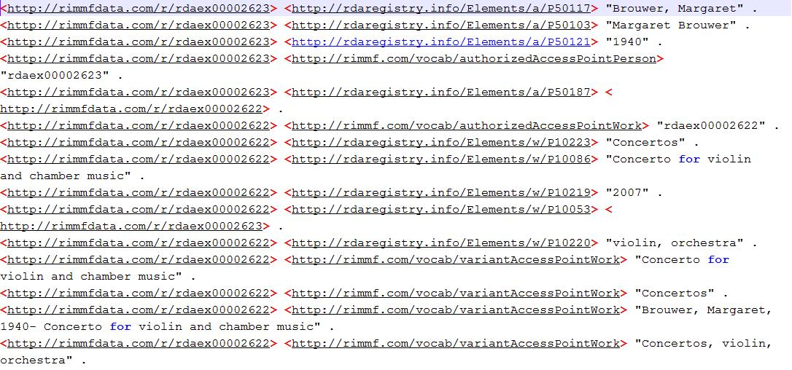
Toolkit full example: RIMMF RDF

Slide 9
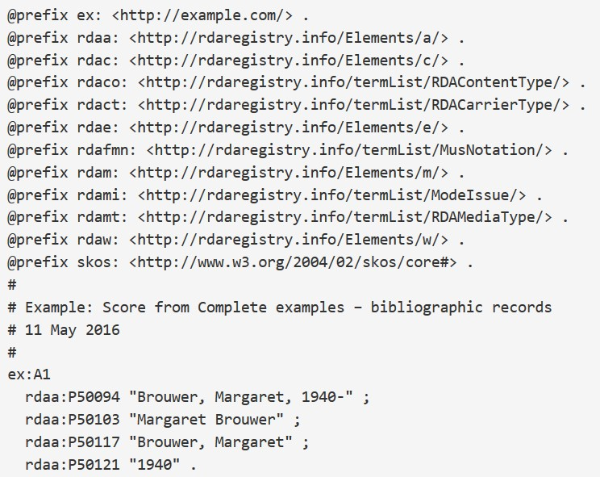
Toolkit full example: RDF turtle (semantic linked data)

Slide 10
Work linked data cluster
rdaw:P10002
"Brouwer, Margaret, 1940- . Concertos, violin, orchestra"
rdaw:P10086
"Concerto for violin and chamber music"
Work:1
rdae:P20231
"Concertos"@en
rdaw:P10223
"violin, orchestra"@en
rdaw:P10220
Expression:1
Agent:1
rdaw:P10053

Slide 11
Expression linked data cluster
Work:1
rdae:P20219
rdae:P20231
"25 min."
Expression:1
rdaco:1010
rdam:P30139
rdae:P20001
"notated music"@en
skos:prefLabel
rdafmn:1007
rdae:P20064
Manifestation:1
"staff notation"@en
skos:prefLabel

Slide 12
Manifestation linked data cluster
"Concerto for violin and chamber music"
Expression:1
"Margaret Brouwer"
rdam:P30139
"Brouwer New Music Publishing"
Manifestation:1
"[United States?]"
"2004"
"42 cm"
rdam:P30135
Work:1
rdact:1049
"volume"@en
rdamt:1007
"unmediated"@en
rdami:1001
"single unit"@en

Slide 13
Agent linked data cluster
rdaa:P50094
"Brouwer, Margaret, 1940-"
rdaa:P50103
"Margaret Brouwer"
Agent:1
"Brouwer, Margaret"
rdaa:P50117
"1940"
rdaa:P50121

Slide 14
Multilingual labels, etc.
skos:prefLabel
"notated music"@en
"Noten"@de
"música notada"@es
Expression:1
"nuottikirjoitus"@fi
rdaco:1010
"musique notée"@fr
rdae:P20001
"תווי מוסיקה"@he
"musica notata"@it
"muzieknotatie"@nl
"乐谱"@zh

Slide 15
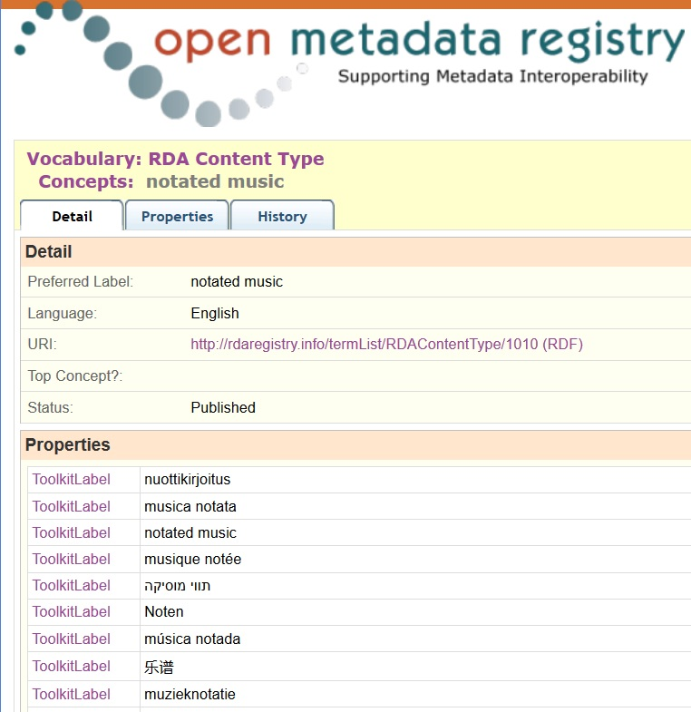

Slide 16
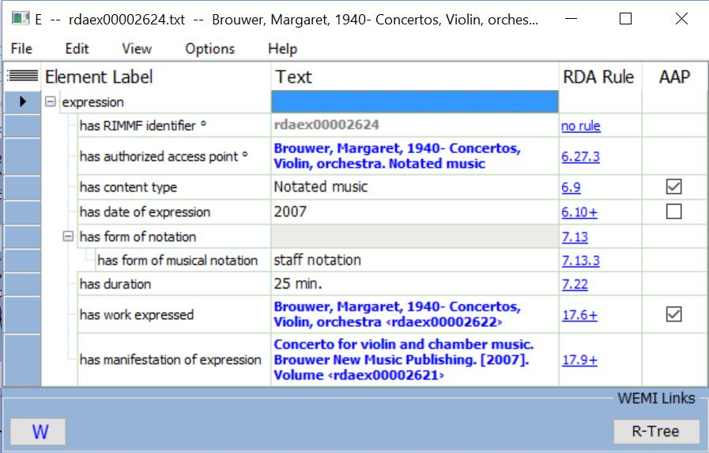
RIMMF in English

Slide 17
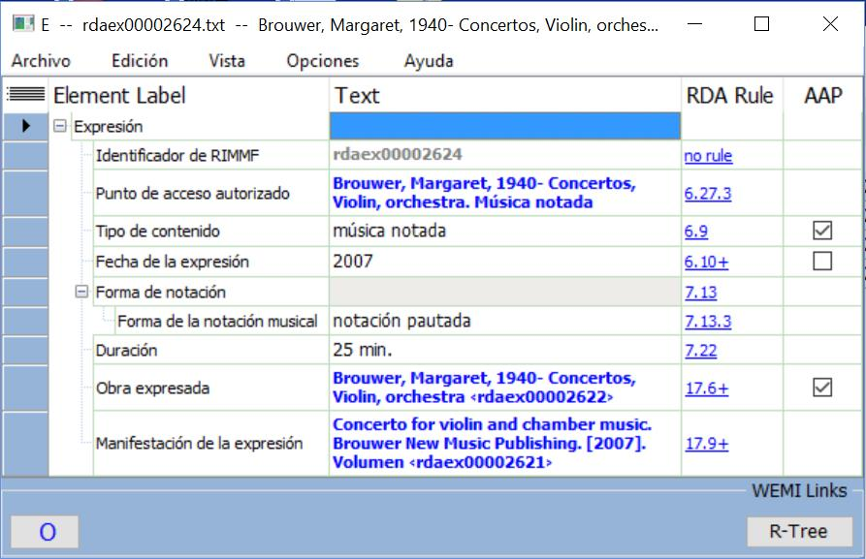
RIMMF in Spanish

Slide 18
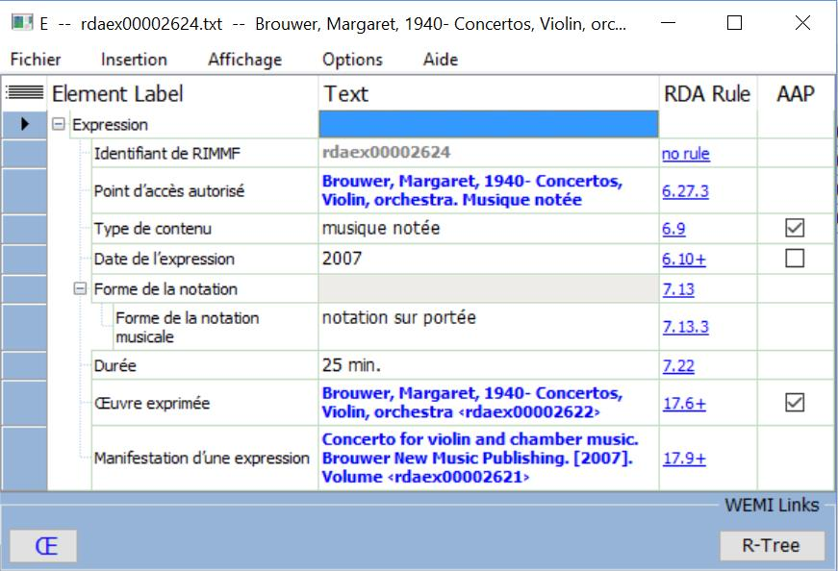
RIMMF in French

Slide 19
Manifestation linked data cluster in RDA/RDF
rdam:P30156
"Concerto for violin and chamber music"
Expression:1
rdam:P30105
"Margaret Brouwer"
rdam:P30139
rdam:P30176
"Brouwer New Music Publishing"
Manifestation:1
"[United States?]"
rdam:P30088
"2004"
rdam:P30011
"42 cm"
rdam:P30135
rdam:P30169
Work:1
rdact:1049
skos:prefLabel
"volume"@en
rdam:P30001
rdamt:1007
skos:prefLabel
"unmediated"@en
rdam:P30002
rdami:1001
skos:prefLabel
"single unit"@en
rdam:P30003

Slide 20
A record?
“LabelW1”
W1
P1
“LabelP1”
“DescriptionP1”
“DescriptionW1”
E1
P2
“LabelP2”
“Description…”
“DescriptionE1”
M1
I1
C1
“LabelC1”
“Description…”
“LabelM1”
F1
“LabelF1”
“Description…”
“DescriptionM1”
“LabelI1”
W2
E2
M2
I2
P3
W3
E3
M3
I3
“LabelW3”
“DescriptionW3”
Notes:
We can look at a typical simple case.
* This is the WEMI stack for a single resource; there is an Item, and therefore a Manifestation, Expression, and Work.
* The Work has two attribute values, for a label such as the Preferred title or Authorized access point and for a descriptive element such as Intended audience.
* The Manifestation and Item have label attributes; the Expression and Manifestation have descriptive attributes.
* Is this set of values the record for the resource?
* The Work is related to a Person such as its creator. In linked data applications, the entity is identified with a URI.
* The Expression is related to a different Person such as a translator, the Manifestation to a Corporate Body such as a publisher, and the Item to a Family such as a donor. The Work is also related to another Work such as an abridgment, and the Expression is related to yet another Work such as a review.
* Do we extend the set of values to include the identifiers of the related entities?
* Each of the related entities has its own label, and related WEMI entities are components of other WEMI stacks.
* Do we extend the record to include the labels of related entities?
* Each of the related entities has its own descriptive attributes.
* Do we extend the record to include other information about related entities?
* Each of the related entities may be related to other entities, such as the Person who is producer of the manuscript that abridges the original Work. Where does the record end?

Slide 21
RDA benefits for users
Choice of language of labels and controlled terminologies
Ability to expand or contract the detail displayed
Choice of flat-file, related description and authority data, and graphical display of data
Fine granularity supporting interoperability with all coarser-grained schema
Linked data! (navigation through nodes and relationships)

Slide 22
Thank you!
rscchair@rdatoolkit.org
RSC website
  http://www.rda-rsc.org/
RDA Toolkit
  http://www.rdatoolkit.org/
RDA Registry
  http://www.rdaregistry.info/
RDA data, Jane-athons, etc.
  http://www.rballs.info/
RIMMF
  http://www.marcofquality.com/wiki/rimmf3/

Slide 23
Example data sources
RDA Toolkit
  http://www.rdatoolkit.org/sites/default/files/rsc_rda_complete_examples_bibliographic_april2016.pdf
RDA Registry
  http://www.rdaregistry.info/Examples/exRSCFullScore.html
R-Balls
  http://rballs.info/topics/m/rdaex/rdaexScore.html

