Slide 1
Blade runner: my first R-Ball
Gordon Dunsire
Presented to the first Jane-athon, January 30, 2015 at ALA MidWinter in Chicago, USA
Notes:
I originally set aside a morning to explore RIMMF3, version 3 of RDA in Many Metadata Formats. I forced myself to stop three days later – I was having so much fun, cataloguing instincts took over, and I wanted to see if FRBR really worked with the RDA instructions across the modern diversity of information resources.

Slide 2
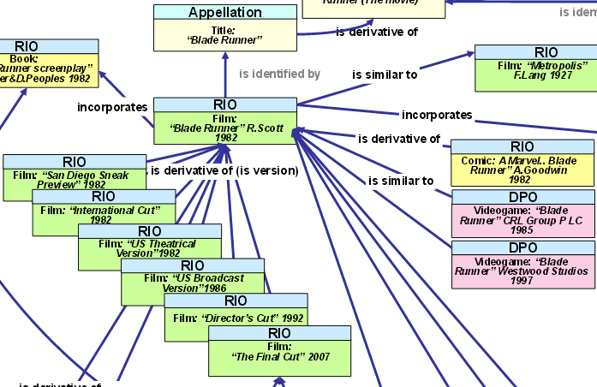
Part of the complete picture
according to Europeana Data Model
Notes:
Why Blade Runner
Well, you have to start somewhere …
And I was familiar with this diagram used to illustrated the Europeana Data Model
Plus I like the movie, the novel, and the soundtrack!

Slide 3
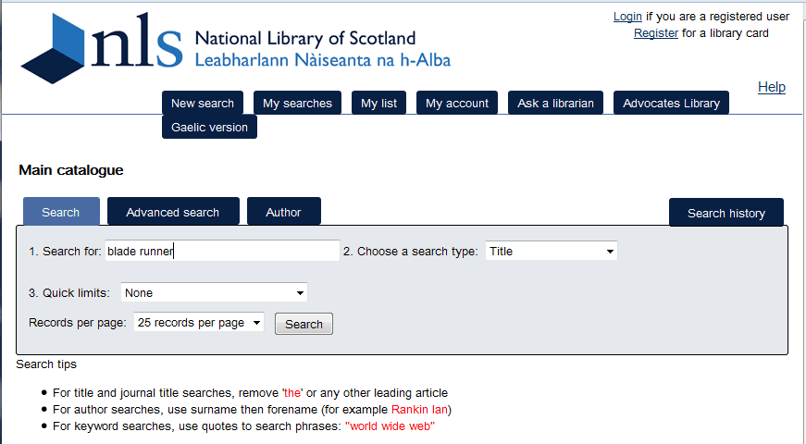
http://main-cat.nls.uk/vwebv/searchBasic
Simple search
Notes:
As soon as I open RIMMF3, I dive straight in after a cursory glance at tutorials, documentation, etc.
I start from close to home. The National Library of Scotland (a 30 minute walk from where I live) has an open license policy for its metadata, and makes it easy to download MARC21 records.
* I use the search in beginner mode …
* I just enter “blade runner” into the default search form.

Slide 4
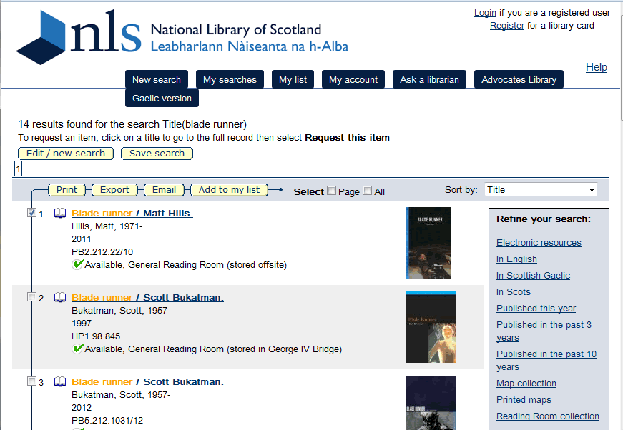
Notes:
I get 14 hits. I am going to export them one at a time until I get familiar with the data flow.
The first hit looks promising. (I go to the “full” display and the summary indicates this is a work about the movie “Blade Runner”.)
* I select the record by clicking its box.
* Then I export the selected record using the Export option.
* Note that I can also email the record or add it to a personal list.

Slide 5
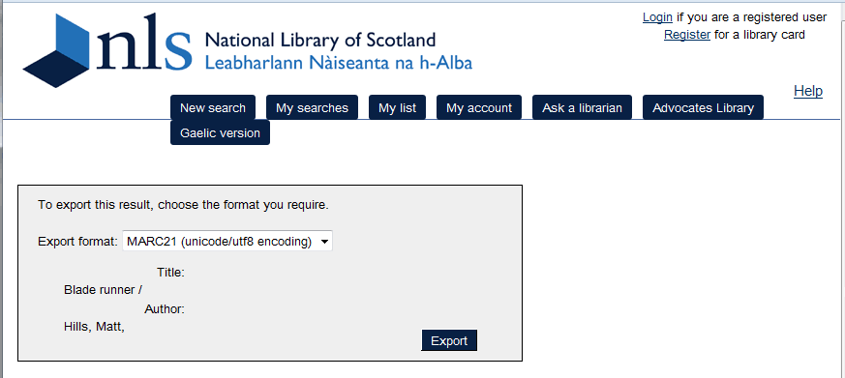
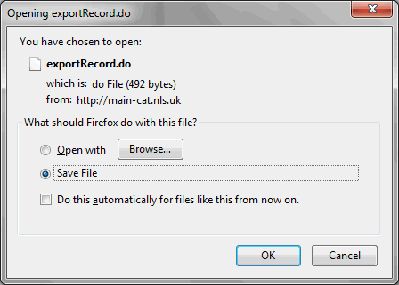
Notes:
The Library offers a choice of formats for exporting records.
* I select the MARC21 Unicode export format.
(MARC21 Latin 1, and “Raw MARC21” are also available.)
* Then I use the Export option to export the MARC21 record.
* I save the file on my computer.

Slide 6
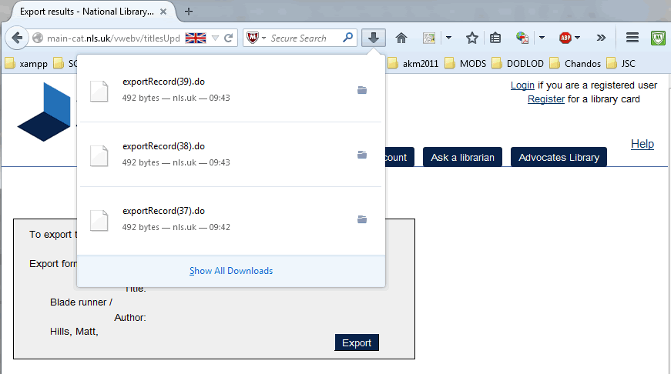
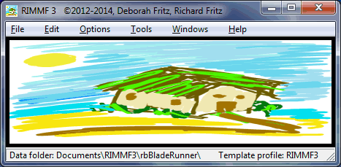
Notes:
* I use the download access option on my web browser to display recent files.
* Then I just drag and drop the downloaded MARC21 export file onto RIMMF.

Slide 7
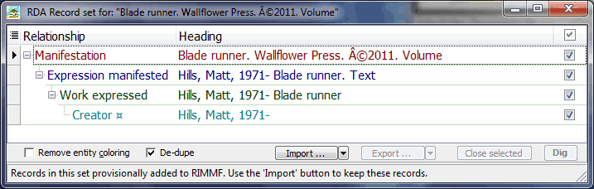
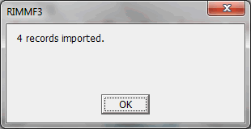
Notes:
RIMMF tells me it has created a set of 4 RDA entity records from the MARC21 record.
The set includes a Work-Expression-Manifestation (WEM) stack, and the Person with primary responsibility for the Work.
RIMMF has pre-selected all 4 records. That is good enough for me.
* I use the import option to import all the selected records.
RIMMF notifies me that all 4 records have been imported.
* Then I click on the Manifestation record to open it up in the RIMMF editor.

Slide 8
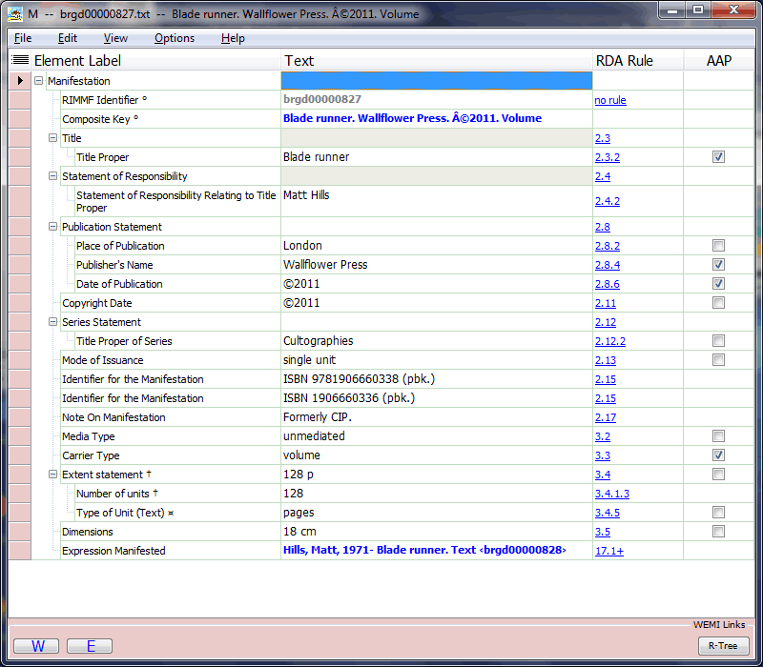
Notes:
The Manifestation record looks basically correct according to the RDA instructions.
The Media type and Carrier type values are correct.
* These elements seem to contain data outside of their scope.
The copyright symbol should be removed from Date of publication.
The format qualifiers should be removed from Identifier for the Manifestation.
The metadata about the record should be removed from Note on Manifestation.
These are simple to delete inside the value boxes or by using <F6> when the element is highlighted.
The other elements and values seem to be compatible with RDA, but the Item is not in hand.
* Then I (double) click on the Expression Manifested link to open the Expression record in the RIMMF editor.
Note that I could also click on the “E” button at the bottom of the Manifestation record.

Slide 9
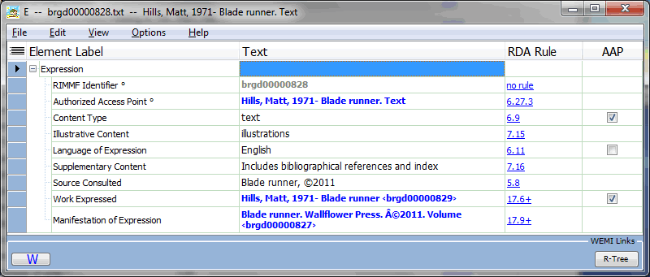
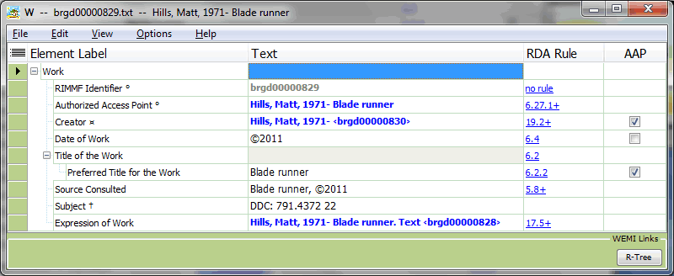
Notes:
The Expression record looks fine. The content type is correct.
* I am not sure about the Source consulted element …
* Then I click on the Work Expressed link to open the Work record in the RIMMF editor.
It looks basically correct.
* But there’s another Source Consulted element …
* And another copyright symbol to remove.
* Then I click on the Creator link to open the Person record in the RIMMF editor.
Note that I could refine the Creator element by selecting the relationship designator for Author.

Slide 10
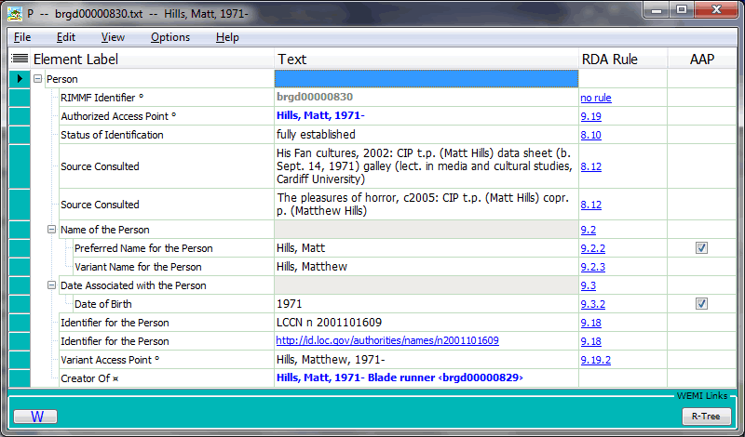

Notes:
The Person record looks fine.
* I have successfully imported and FRBRized a MARC21 record!

Slide 11
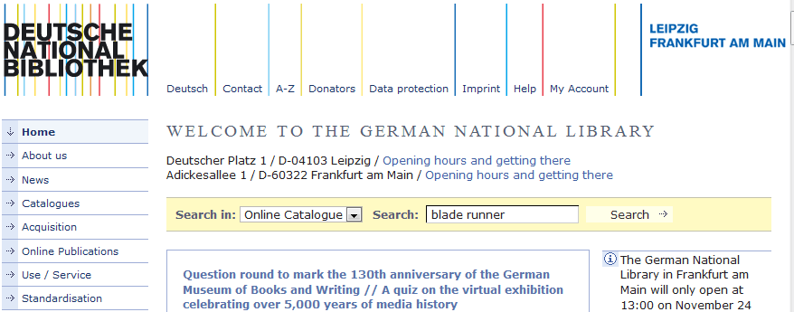
http://www.dnb.de/EN/
Notes:
Next I want to try the Deutsche Nationalbibliothek, the German National Library. It also makes it easy to download MARC21 records.
As before, I use the search in beginner mode …
* I just enter “blade runner” into the default search form.

Slide 12
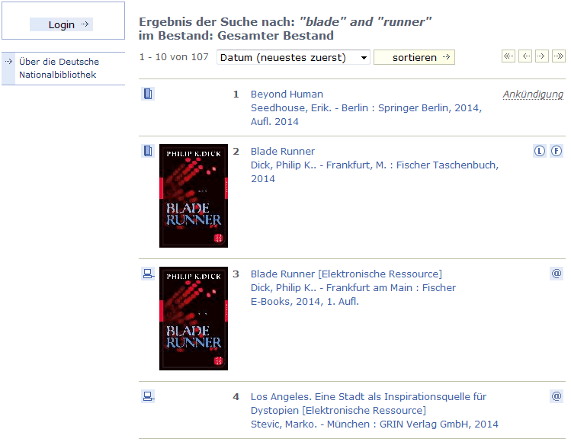
Notes:
I get 107 hits. I am going to export them one at a time because not all of the metadata is available in MARC21 format.
I go to the “full” display for the first two hits, and see that they do not have a MARC download.
* I select the third record by clicking its brief display.

Slide 13
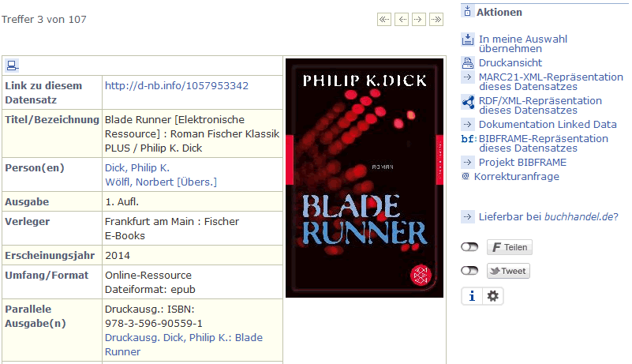
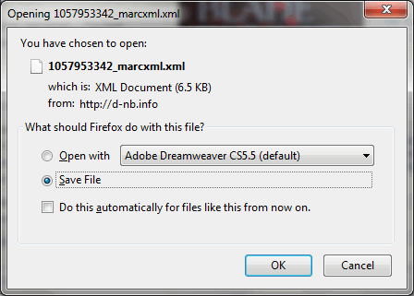
Notes:
The record is available in MARC21 XML format.
I note also that it is available in RDF/XML and BIBFRAME formats, but these are lossy, do not use the RDA namespace, and cannot be imported into RIMMF.
* I click on the MARC21-XML option.
* And choose to save the download file.

Slide 14
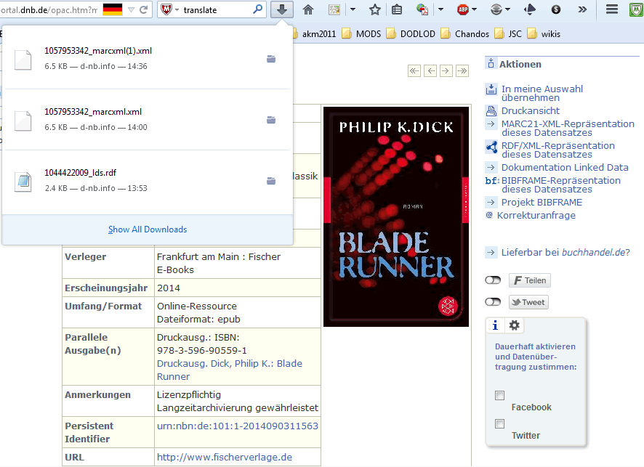
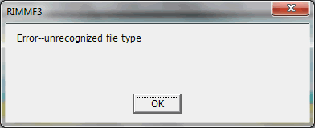
Notes:
As before, I use the download access option on my web browser to display recent files.
* Then I just drag and drop the downloaded MARC21 export file onto RIMMF.
* But this time RIMMF displays an error message: it does not recognize the file type.

Slide 15
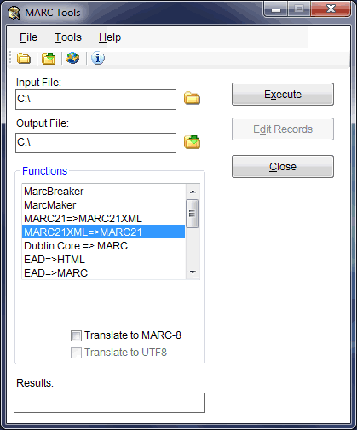
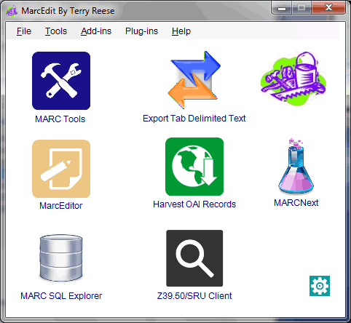
Notes:
This is not a problem.
* I know that I can convert the file format using MarcEdit.
* MarcEdit is a suite of components.
* The MARC Tools component of MarcEdit converts various file formats.
* I just drag and drop the downloaded MARC21 export file onto the MARC Tools Input File box, make sure the MARC21XML=>MARC21 function is selected, and use the Execute option.

Slide 16
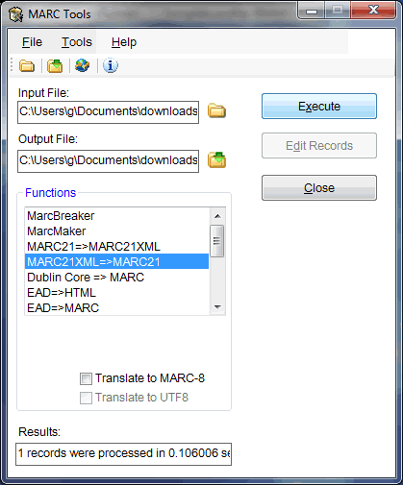
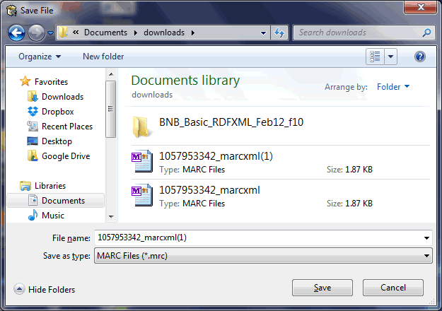
Notes:
MARC Tools converts the file containing the MARC21 record.
* I can find the converted file by using the folder icon beside the Output File box.
MARC Tools assumes the output file is in the same folder as the input file, and knows that it is a MARC (.mrc) file.
* Now I can drag and drop the file onto RIMMF.

Slide 17

Now fixed!
Notes:
RIMMF3 has been updated and now allows drag and drop of the xml file type.
But MarcEdit can be used to convert other sources to MARC for loading into RIMMF.

Slide 18
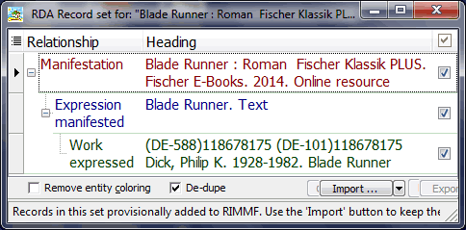
Notes:
RIMMF tells me it has created a set of 3 RDA entity records from the MARC21 record.
The set includes a Work-Expression-Manifestation (WEM) stack. Unlike before, there is no record for the Person with primary responsibility for the Work.
I note that the AAP for the Work starts with what looks like an identifier; maybe this is why RIMMF cannot find Philip K. Dick!
RIMMF has pre-selected all 3 records. That is good enough for me.
I use the import option to import all the selected records, etc. and open up the Manifestation record.

Slide 19
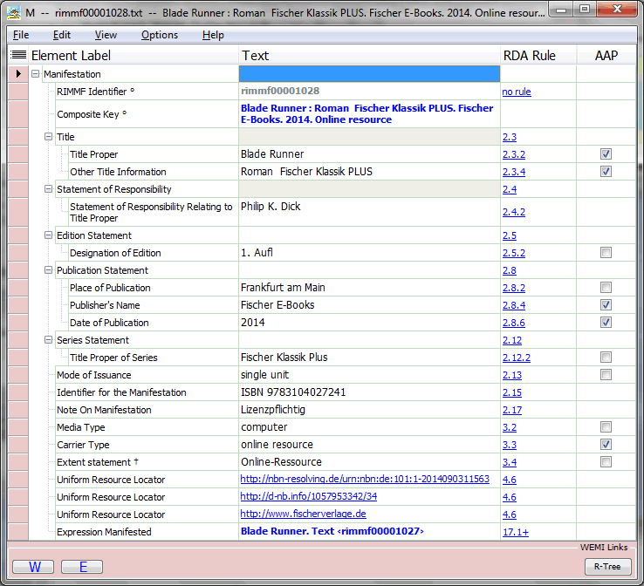
Notes:
This looks fine, from what I can read in English.
The Media Type and Carrier Type are correct.
* Other Title Information has a double space – not sure about that. “Roman” and the series title should perhaps be split between two repeats of the element.
* Google Translate outputs “Rights” for “Lizenzpflichtig”. I guess this should be removed from Note on Manifestation: either discarded or moved to Restrictions on use.

Slide 20
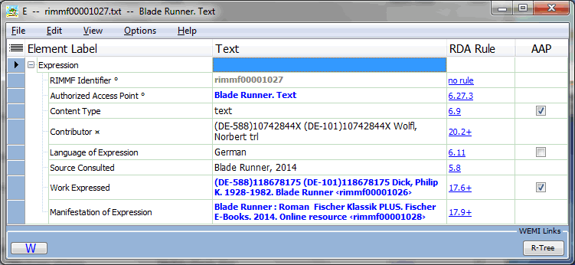
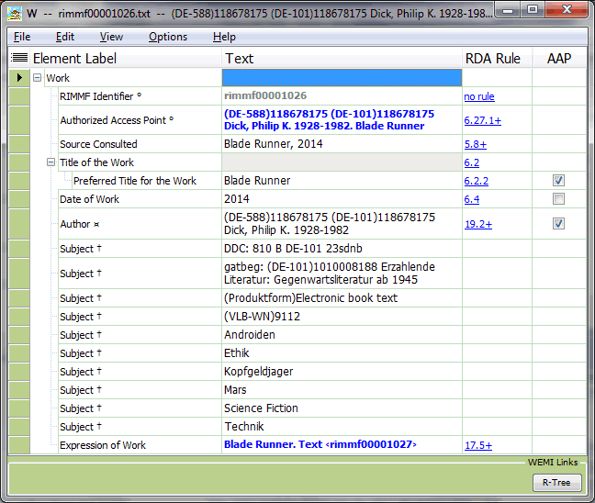
Notes:
I open the Expression and Work records. They are also basically correct.
* The problem noted about the Work record can be seen more clearly. The Author data is a mix of identifier and name”
* The same problem is found in the Contributor element of the Expression record. It did not show up earlier because this element is not used as part of the AAP for an Expression.

Slide 21
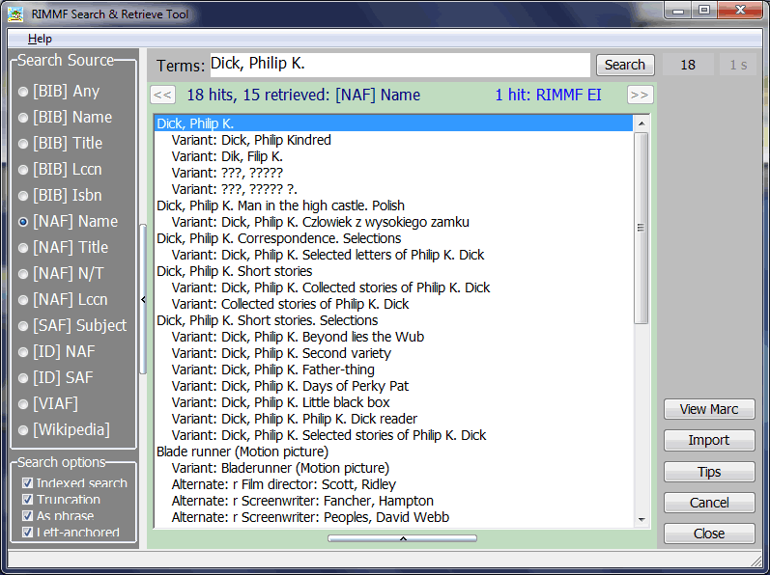
Notes:
I’m going to find Dick’s Person record in the Name Authority File, using the Search and Retrieve option on the RIMMF Tools menu.
* I copy and paste the inverted name from the Work record data. The correct record is the first hit.
* I import it into RIMMF using the Import option.

Slide 22
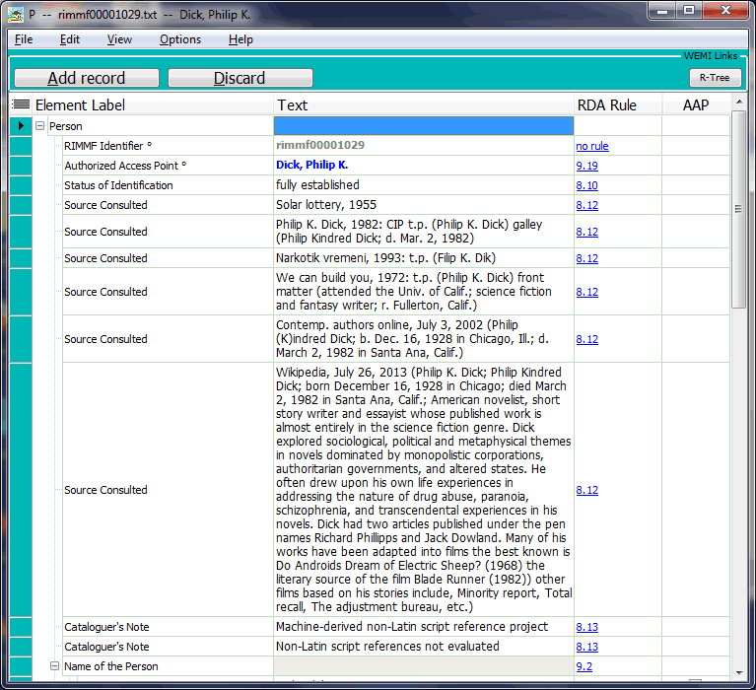
Notes:
The new Person record looks correct.
There are a couple of strange values towards the end of the record, consisting of strings of question marks. They can be removed later.
* I add it to RIMMF using the Add record option.

Slide 23
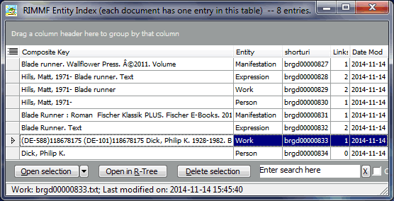
Notes:
Now I can go back to the Work record with the erroneous AAP.

Slide 24
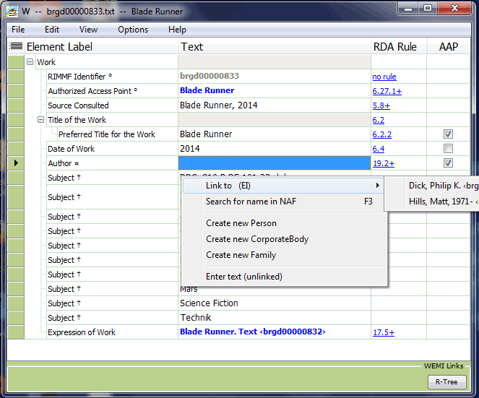
Notes:
RIMMF clears the value of the Author element when I start to edit it. Right-clicking brings up a menu allowing me to link the Work record to a Person, Family, or Corporate Body record already in the Entity Index.
* There are two, and I choose the record for Dick.
When I save the Work record, RIMMF automatically updates the AAP of the Work record and cascades the change to the AAP for the Expression record.

Slide 25
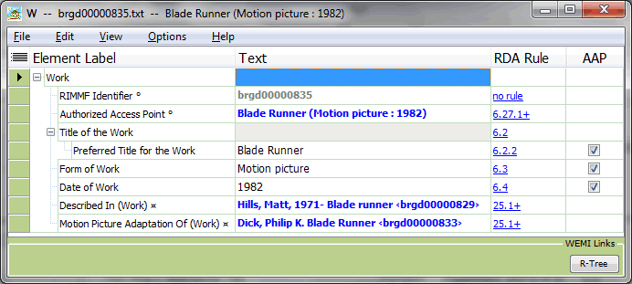
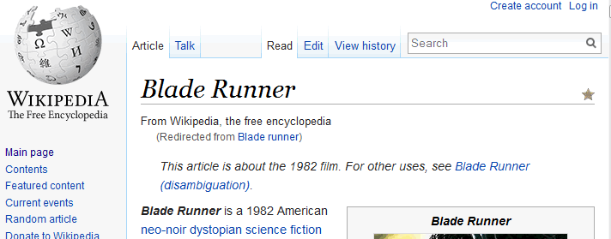
Notes:
Finally, I know I need a Work record for the motion picture so that I can link the two Works I have imported into RIMMF.
I create a new Work record from scratch, filling in just what I know or can easily verify in reference works.
* I check Wikipedia for the Date of Work …
* I add a Related Work for the resource about the motion picture, linking directly using the Entity Index. Then I refine the relationship using a designator.
* I add another Related Work for the resource that the motion picture is adapted from, again using the Entity Index and a relationship designator.

Slide 26
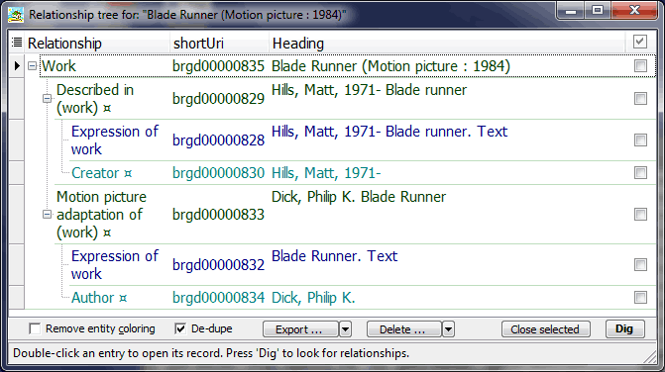
Notes:
The I display the R-Tree for the motion picture Work.
Everything is connected. I have created my first R-Ball!

Slide 27



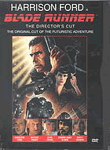





Notes:
After I recover from creating an R-Ball, I return to those lists of hits, and search other sources of MARC records, and other metadata about resources closely related to Blade Runner, the motion picture …
* Graphic novel adaptations (in RDA Toolkit as of October 2014!)
* Sequels!
* More works about the motion picture, in many languages!
* Translations of the original novel! Compilations!
* Reprints!
* Different motion picture cuts!
* Soundtracks!
Maybe I should go and work through those great RIMMF3 tutorials and read the online documentation to make it better next time.
Gotta keep that r-ball rollin’ …

