Slide 1
Beyond Thing-athon: RDA in the field
Gordon Dunsire and Diane Hillmann
Presented at the Thing-athon, Lamont Library, Harvard University, Cambridge, Mass., USA, 7 January 2016

Slide 2
General topics for discussion
The impact of digitization
The RDA Gender vocabulary
Identity management
Please interrupt, ask questions, give answers!

Slide 3
The impact of digitization
Effectiveness, efficiency, and integration

Slide 4
RDA data structure for digitized manifestations
Work
Expression
Manifestation
(print)
Manifestation
(digitized)
has electronic
reproduction
Manifestation
(DAISY)
Item
Copy cataloging
Manifestation
(PDF)

Slide 5
NLS MARC 21 record before import to RIMMF
=LDR 00696cam a22002175 4500
=001 3188314
=035 \\$a3188314
=856 41$uhttp://digital.nls.uk/pageturner.cfm?id=80498194$zDigital version created by National Library of Scotland
=005 20150709150844.0
=008 990428s1889\\\\enk\\\\\\\\\\\000\\\eng\d
=035 \\$aCAT1-0906468
=035 \\$a150520
=040 \\$aNLS
=100 1\$aStevenson, Robert Louis,$d1850-1894.
=240 10$aMaster of Ballantrae.$f1889
=245 14$aThe master of Ballantrae. A winter's tale.
=260 \\$aLondon,$c1889.
=300 \\$c8vo.
=591 \\$gC1SAZ
=594 \\$aSCO$bTHIS IS A TEMPORARY CATALOGUE 1 RETROCONVERTED RECORD
=955 \\$aH.S.858$xH.S$y2H.S.$zH.S.858

Slide 6
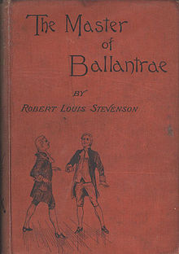
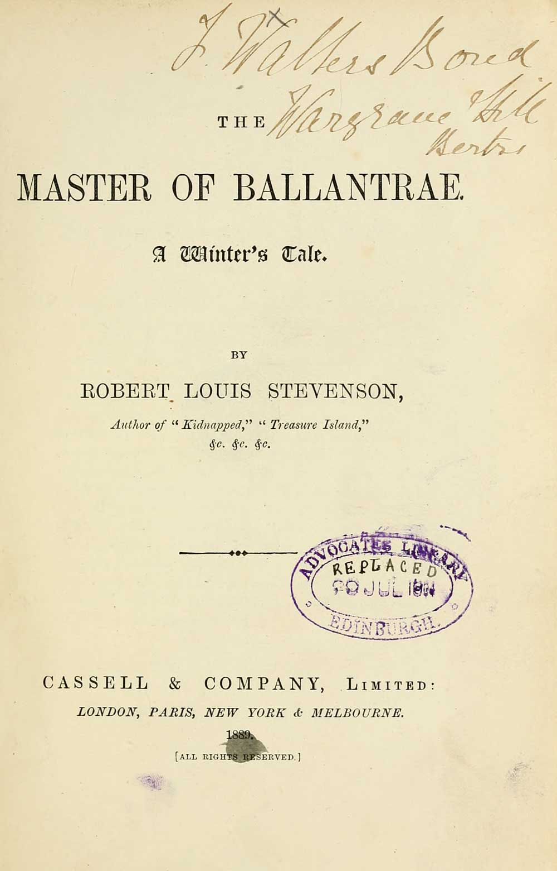

Slide 7
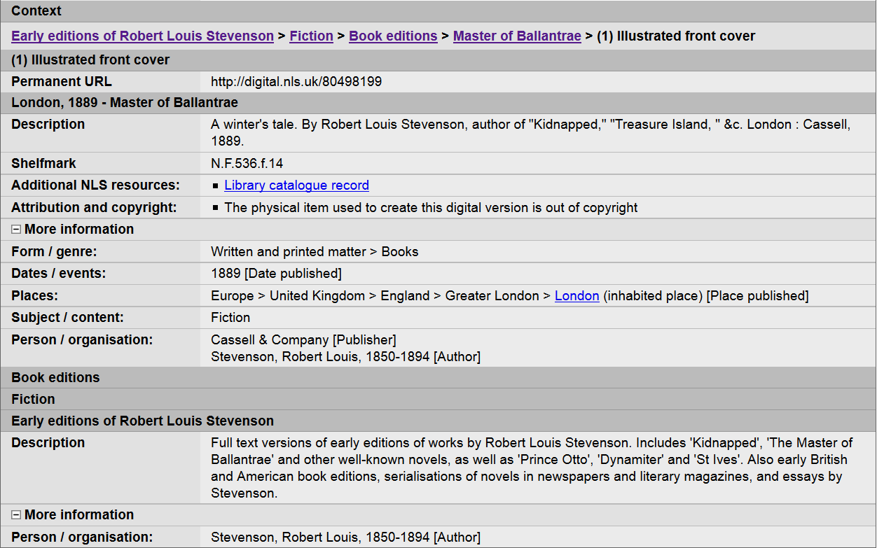
NLS digital collection metadata

Slide 8
MARC 21 record export from RIMMF
=LDR 01484nam a2200337 4500
=001 rlsgd00002044
=005 20151007101903.0
=008 151007\1889\\\\\\\\\\\\\\\\\\\\\\\\\\\\d
=040 \\$beng$erda
=245 10$aThe Master of Ballantrae :$bA winter's tale.
=264 \1$aLondon ;$aNew York :$bCassell & Company,$c1889.
=337 \\$aunmediated$2rdamedia
=338 \\$avolume$2rdacarrier
=340 \\$m8vo.
=300 \\$aviii, 332 pages.
=336 \\$atext$2rdacontent
=240 10$aThe master of Ballantrae.
=100 1\$aStevenson, Robert Louis,$d1850-1894.
=700 2\$aStevenson, Robert Louis.$tThe master of Ballantrae rlsgd00002028,$d1850-1894,$e$iAdapted as a motion picture (work).
=700 2\$aStevenson, Robert Louis.$tThe master of Ballantrae rlsgd00002028, 1850- 1894,$e$iAdapted as a motion picture (work).
=700 2\$tThe master of Ballantrae,$e$iAdapted as a motion picture (work).
=700 2\$aStevenson, Robert Louis.$tThe master of Ballantrae rlsgd00002028, 1850- 1894$aFitch, Ken$aDresser, Lawrence T.,$e$iAdapted as graphic novel (work).
=050 \\$aPR5484.M2 I7 1938
=650 \0$aScotland -- History -- 18th century -- Fiction.
=650 \0$aAbsence and presumption of death -- Fiction.
=650 \0$aInheritance and succession -- Fiction.
=650 \0$aBrothers -- Fiction.
=650 \0$aRevenge -- Fiction.
=650 \0$aPsychological fiction.
=650 \4$aHistorical fiction.
=700 2\$iElectronic Reproduction (Manifestation):$arlsgd00002346.

Slide 9
Digitize = Itemize: Connecting library and archive
Manifestation
(archive)
E
W
Work
is contained in
Manifestation
(fonds)
Expression
Aggregates!
is contained in
Manifestation
(digitized)
Manifestation
(print)
is electronic
reproduction of
Item

Slide 10
The RDA Gender vocabulary
A case study in vocabulary management issues

Slide 11
Add “transgender”?

Slide 12
Subjective
Private
Local
Culturally influenced
Changeable

Slide 13
Identified => managed
Vocabulary management system
e.g. Open Metadata Registry

Slide 14
Change and persistent chaos
All linked data persists forever
There is
no truth
out there
Nothing is forgotten
Nothing is deleted
(but statements can be deprecated)
Every statement is copied
Every statement is linked to another statement
Change should be well-audited to minimize chaos
Notes:
The aim of linked open data and the Semantic Web is to link every statement to at least one other statement, to form a web of connected data.
Re-use is encouraged, and every statement must be copied for it to be used in an application, like a webpage downloaded to a browser. In any case, it is certain that all data transmitted via the Internet is copied for security reasons.
It is therefore considered bad practice to delete a statement. Instead, a statement should be deprecated; that is, flagged to say that it is no longer considered useful.
Nothing is forgotten. Information retrieval services may “forget” statements by ignoring their links, but it is easy to remember them by resurrecting the links.
Therefore it must be assumed that all linked data will persist forever.
Furthermore, there is no inherent test of validity in RDF. Anybody can say anything about any thing. Relative truth can only be determined from the provenance of the statements.
It is therefore essential that publishers and maintainers of linked open data audit changes to their published statements with these factors in mind. Applications will try to choose statements that reflect the current intentions of their publisher, and discard data that is known to be out-of-date or incorrect.

Slide 15
Who maintains the identifiers (URIs)?
 | Local | Global
Unique things in datasets |  | 
Common things in datasets |  | 
Local value vocabularies |  | 
External value vocabularies |  | 
Local element sets |  | 
Global element sets |  | 
Linked
Open
Data
Persistence requires commitment
Global requires availability
Trust requires provenance
Notes:
The quality of linked data is thus dependent on the management of URIs as well as the vagaries of human-readable (and therefore human-created) data.
The Semantic Web requires RDF linked data to be published openly so that it can be accessed and re-used globally.
It makes sense for local applications to re-use as much global data as possible. This includes value vocabularies and element sets. But in many circumstances global vocabularies will be too general and broad to meet the needs of local users. Local applications will usually need a mix of local and global vocabularies to meet functional requirements.
What is “local” is relative: the entire output of universal bibliographic control, including MARC, AACR, RDA, FRBR, ISBD, etc., schemas, terminologies, and, indeed, the billions of dataset triples locked in OCLC’s WorldCat, is but a local raindrop in the ocean of linked data now being created.
The publishers and maintainers of linked open data must show due commitment and diligence if they are to be entrusted with the consistent, competent, and coherent representation of linked data for their communities and the rest of the world.

Slide 16
Closed and open data
Closed applications
(e.g. local database)
Open applications
(e.g. Semantic web)
URIs not required
(blank nodes ok)
All things must have a URI
(blank nodes not ok)
Permanent sets of triples
(aka records)
Triples stand on their own
What is not recorded
does not exist
What is not recorded
has not been recorded yet
Notes:
The difference between “local” and “global” is more clear-cut in the context of applications using linked data in general, including relational databases.
Closed applications are by definition local relative to global open linked data. They make certain assumptions about the nature of the data they use.
Identifiers do not need to be globally unique, and in many cases not needed at all. So-called blank nodes are things without identifiers (which are in reality incorporated in the local database structures). They are effective only when the data is always processed in the same (local) way. Every thing must have at least one URI in open applications; without a URI, the data cannot link to the global graph.
Closed applications treat sets of triples as units, to preserve the local context. An example is the treatment of catalogue records as indivisible sets of data about a single thing. In linked open data, each triple must stand on its own, so that it can be combined with other triples to form new graphs and pathways.
Closed applications often make the Closed World Assumption: the absence of evidence is evidence of absence (data not recorded does not and will not exist). Open applications must make the Open World Assumption: the absence of evidence is not evidence of absence, and new statements may be made about any thing in the future.

Slide 17
Having your cake and eating it
Think globally, act locally
No global element or value
that matches your data?
Avoid dumb-down!
Publish your own element or value
Maintain your local things
for persistent global use
(act professionally)
Publish your local datasets with local elements and values
in a global framework with due diligence
Use open tools
Develop and publish maps
from your element or value
to the nearest global-but-dumber one
Notes:
RDF data triples can be published by anyone. In the early days of the World-wide Web of documents, a webpage could be written using a text editor. It is possible to write data triples with the same software – after all, the Semantic Web is built on top of the World-Wide Web. It just takes a long time.
Publishing a website has become so easy that many users of social media do not realize that this is what they are effectively doing. In the same way, publishing linked data is easier than ever. If a dataset publisher wants to avoid losing any information, but cannot find a suitable external or global vocabulary, then it is quite feasible to publish local vocabularies using global RDF tools.
Now, more and more open and free tools are available to develop and maintain element sets and value vocabularies. Publishing semantic maps from the local element set or value vocabulary will ensure that your data can be dumbed-down for non-local applications while being preserved intact for their original application.
This is a form of having your cake and eating it. But there is a professional cost, because the local act must be accompanied by global commitment to encourage the Semantic Web to make the information prominent, rather than relegate it to the outer reaches of bad, mad, and sad metadata.

Slide 18
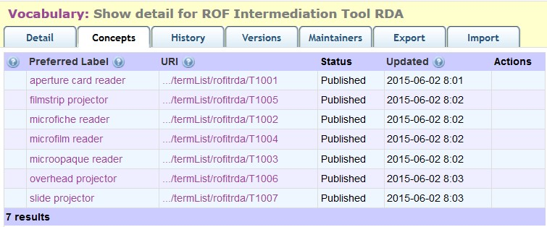
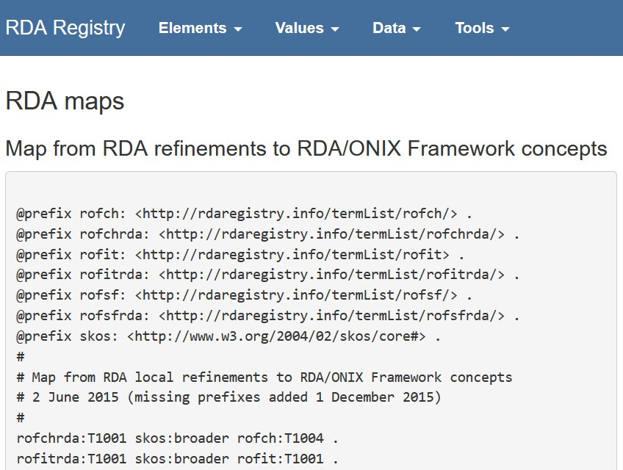

Slide 19
Vocabulary management issues
Machine-readable identifiers are required to link data.
How are these identifiers created and assigned?
Who is responsible?
What about long-term availability/preservation?
When is it best to act local (assign local identifiers) and think global (map local to global), or act global (re-use global identifiers) and think local (what happens if the global disappears)?
What about human-readable identifiers (aka authority control)?

Slide 20
Identity management
Strings ‘n’ things for human and machine identification

Slide 21
Things (and strings)
Libraries have always managed the identity of ‘things’ using strings (with string matching and access points as management tools). This strategy was used for most things: values, series, people (& corporate bodies of all kinds) and works
The transition from strings as identity to real identity based on URIs brings up all kinds of new issues, which force us to look carefully at the process of creating, managing, and using identities with URIs
The advantage is that URIs allow a level of precision impossible to replicate with strings and allows machines do most of the work, saving our human capital to operate where it is most needed

Slide 22
Growing and Extending RDA
In addition to adding multilingual capabilities, RDA is eager to address the needs of other cultural heritage communities, primarily through extension strategies
Local extension can be used to develop new elements to be used alongside RDA, but also to extend existing elements in a manner useful to other communities
There are still unresolved issues around publication, mapping, maintenance and best practices, but an extension strategy seems likely to lower the bar for meaningful cooperation between descriptive communities
Image shows how extension can be useful without incurring dependence on RDA FRBR model

Slide 23
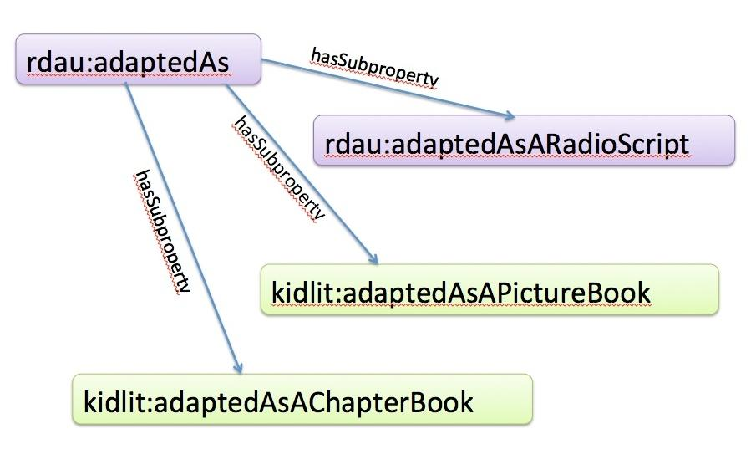

Slide 24
Global or Local?
Assumption has been that everyone will use public vocabularies and their identifiers. Downside of that strategy:
Makes users dependent on the public vocabulary managers, who may have other priorities (or disappear from the public entirely)
Makes local extension more difficult, as public vocab owners may not choose to recognize extensions (global vocabularies must be lowest common denominator)
Global public vocabularies should be reserved for public metadata distributed globally. Local vocabularies should be used for local metadata and mapped to global public vocabularies (even if the mapping is lossy) when published.

Slide 25
Supporting Multilingual Usage
Opaque URIs (numbers) address the volatile reality of vocabularies
Canonical URIs based on a label are fixed forever even if the labels on which they are initially based change. But vocabularies change over time. Labels change over time
Lexical Aliases can be recreated as labels change and legacy aliases can continue to redirect to the original canonical opaque URI, maintaining optimal stability
Opaque canonical URIs combined with lexical aliases addresses needs of both human and machine users

Slide 26
The Long View
Whether using strings or things, good management strategies need to focus on:
Transparency: appropriate versioning that data managers can use
Cost consciousness: decision-making based on knowledge of stakeholder needs
Inclusiveness: providing services to non-English users and bringing their concerns to the fore
Responsiveness: using technology [GitHub Issues] to maintain contact with users

Slide 27
Clarifying Best Practices
NISO Bibliographic Roadmap: new effort to take a hard look at the environment, and develop best practices around use/reuse, documentation and preservation
Use/Reuse includes licensing, management policies, as well as discovery/selection issues
Documentation includes information about the vocabulary and its management, as well as updating practices
Preservation includes strategy for abandoned vocabularies, support of sustainability practices, and cross-vocabulary information gathering.

Slide 28
Be Prepared
To comment during a public review period for the NISO work in the coming year
To consider whether communities you know would like to hear more about these issues
Both Gordon & Diane are working with NISO on this project and would welcome the opportunity to hear your concerns

Slide 29
End
rscchair@rdatoolkit.org
metadata.maven@gmail.com

