Slide 1
The Web of Data for Archival Materials: Semantic Web and Linked Open Data
Gordon Dunsire
Presented at RAMS Conference and School on Records, Archives and Memory Studies, 6-10 May 2013, Zadar, Croatia

Slide 2
Outline
Basic concepts of RDF (Resource Description Framework)
RDF representations of archival data
Methodology for publishing archival metadata and making it interoperable
Relationship with linked data for library and other resources
Collections, context, provenance

Slide 3
Semantic Web
“machine-readable metadata”
  Faster! 24/7/365! Global!
In a standard machine-processable format
  Resource Description Framework (RDF)
RDF supports simple, single metadata statements known as triples
  Each statement is in 3 parts

Slide 4
RDF triple
The title of this archive is “Beverley Skinner Collection”
  Subject of the statement = Subject: This archive
  Nature of the statement = Predicate: (has) title
  Value of the statement = Object: “Beverley Skinner Collection”
This archive – has title – “Beverley Skinner Collection”
  subject – predicate – object
This archive – has origination – Beverley Skinner
This archive – has level – Fonds

Slide 5
Identifiers
Need unambiguous way of identifying each part of the triple for efficient machine-processing
  Human labels (“This archive”, “has title”) no good
    Same thing, different labels; different things, same label
Exploit the utility of the URL
  Machine-readable, regular syntax, unambiguous, global
Uniform Resource Identifier (URI)

Slide 6
Uniform Resource Identifier
Can be any unique combination of numbers and letters
  No intrinsic meaning; it’s just an identifying label
Can look like a URL
  http://iflastandards.info/ns/isbd/elements/P1004
  But does not lead to a Web page (in principle ...)
RDF requires the subject and predicate of triple to be URIs
  Object can be a URI, or a literal string (“Beverley Skinner Collection”)

Slide 7
Identifying archival metadata
Represent archival schema attributes and relationships as RDF properties (= predicates)
  Each property has own URI
    E.g. http://data.archiveshub.ac.uk/def/origination
Assign URIs to specific archival resources
  The things described in finding aids
    Fonds, collections, items, digital surrogates, etc.
    People, families, subjects, etc.

Slide 8
AR1URI
hasTitleURI
“Beverley Skinner Collection”
AR1URI
hasOrginationURI
Name1URI
Name1URI
hasNameURI
“Beverley Skinner”
Name1URI
hasBirthYearURI
“1938”
AR1URI
hasLevel
FondsURI
FondsURI
hasLabel
“Fonds”
This archive
has title
“Beverley Skinner Collection”
has origination
Beverley Skinner

Slide 9
AR1URI
hasTitleURI
“Beverley Skinner Collection”
“드퐁”
label
level
Fonds
“Materials created or accumulated ...”
definition
title
This archive
“Beverley Skinner Collection”
name
origination
“Beverley Skinner (1938-1999)
Beverley Skinner
“1938”
year of birth
“Skinner, Beverley”
normalised name

Slide 10
From record to triples (in 9 stages)
Very large numbers of records
  Catalogue records, finding aids, etc.
  300 million; 1 billion; 300 billion?
High quality metadata
  In comparison with many other communities
Each record may generate many triples
  30 “raw” triples (no inferences) per simple (single fonds) EAD record?
Very, very large numbers of triples
  Billions? Trillions?

Slide 11
1. Take a record
Field/attribute | Value
Record ID | gb1086skinner
Title | Beverley Skinner Collection
Creator | Beverley Skinner (1938-1999)
Extent | 1 box and 15 slides
Scope | The collection consists of: newscuttings …
Level | Fonds

Slide 12
2. Disaggregate to single statements
Record | Attribute | Value
gb1086skinner | (has) title | Beverley Skinner Collection
gb1086skinner | (has) creator | Beverley Skinner (1938-1999)
gb1086skinner | (has) extent | 1 box and 15 slides
gb1086skinner | (has) scope | The collection consists of: newscuttings …
gb1086skinner | (has) level | Fonds

Slide 13
3. Create URI for record
Must be unique, so “gb1086skinner” is (probably) ok
  Archives tend to be unique!
http URIs are a good (“cool”) thing (W3C)
So add record ID to a unique http domain
  E.g. http://MyArchives.com
    unique to the archives
  + gb1086skinner
  http://MyArchives.com/gb1086skinner
  (or http://MyArchives.com#gb1086skinner)
This is not a URL!

Slide 14
4. Replace record ID with URI
URIC | Attribute | Value
ma:gb1086skinner | (has) title | Beverley Skinner Collection
ma:gb1086skinner | (has) creator | Beverley Skinner (1938-1999)
ma:gb1086skinner | (has) extent | 1 box and 15 slides
ma:gb1086skinner | (has) scope | The collection consists of: newscuttings …
ma:gb1086skinner | (has) level | Fonds
“ma” = qname (xmlns) = shorthand for “http://MyArchives.com/”

Slide 15
5. Find URIs for attributes
Attributes are modelled as RDF properties (predicates) in “element set” namespaces
  E.g. Dublin Core terms (dct); Friend of a Friend (foaf); CIDOC Conceptual Reference Model (crm); RDA (rdaxxx); Archives Hub (ah); etc.
Choose namespace, find a property with the same (or closest) “meaning” (e.g. definition) as the attribute
  Nearest property minimises loss of information
Get URI for property
If no suitable property, choose another namespace
  Properties do not have to come from single namespace
  OR: Create your own
    Avoids any loss of information
Match and mix, or create your own!

Slide 16
6. Replace attributes with URIs
URI | Attribute | Value
ma:gb1086skinner | dct:title | Beverley Skinner Collection
ma:gb1086skinner | ah:origination | Beverley Skinner (1938-1999)
ma:gb1086skinner | ah:extent | 1 box and 15 slides
ma:gb1086skinner | ah:scopecontent | The collection consists of: newscuttings …
ma:gb1086skinner | ah:level | Fonds

Slide 17
7. Find URIs for values
If object of a triple is a URI, it can link to the subject of another triple with the same URI
  Linked data!
Values from controlled vocabularies may have URIs
  Possible vocabularies: agents, subjects, levels, etc.
  NOT: titles, dates
For agents: Virtual International Authority File (VIAF), etc.
For subjects: Library of Congress Subject Headings, etc.
For local vocabularies, e.g. levels, create your own!

Slide 18
8. Replace values with URIs
URI | Attribute | Value
ma:gb1086skinner | dct:title | “Beverley Skinner Collection”
ma:gb1086skinner | ah:origination | ahagent:gb1086/beverleyskinner1938-1999
ma:gb1086skinner | ah:extent | “1 box and 15 slides”
ma:gb1086skinner | ah:scopecontent | “The collection consists of: newscuttings …”
ma:gb1086skinner | ah:level | ahlevel:fonds

Slide 19
9. Publish triples (linked data)
ma:gb1086skinner | dct:title | “Beverley Skinner Collection”
  ma:gb1086skinner | ah:origination | ahagent:gb1086/beverleyskinner1938-1999
ma:gb1086skinner | ah:extent | “1 box and 15 slides”
ma:gb1086skinner | ah:scopecontent | “The collection consists of: …”
ma:gb1086skinner | ah:level| ahlevel:fonds

Slide 20
Paradigm shift?
For libraries:
  Focus changes from the catalogue record to the statement (triple)
    Record is a constructed set of statements (triples)
  There is no “perfect” set of statements
  Provenance changes from implicit to explicit
  User- and machine-generated statements are part of amix with cataloguer-generated statements
For archives?

Slide 21
Specific issues for archive linked data
Multiple levels in a single archive
  Collections, fonds, sub-fonds, items
    Collection-level description?
Maintaining context
Dynamic provenance

Slide 22
Aggregation
Context
A Collection
is part/sub-collection of;
is contained in
has part/sub-collection;
contains
A Fonds
is part/sub-collection of;
is contained in
has part/sub-collection;
contains
A Sub-fonds
is part/sub-collection of;
is contained in
has part/sub-collection;
contains
An Item
Digital
surrogate

Slide 23
Provenance
The archival record as provenance
  The archive as provenance
The provenance of the archival record
  Who said that?
  In what context?
  Using what archival model or paradigm?

Slide 24
Provenance of linked data
Similar issues in general and library linked data
  Who said that?
    Professional (cataloguer), amateur (user, crowd), or machine?
  Using what rules for description (and access)?
Various approaches continue to be developed
  “Named graphs” = identifying a whole triple or set of triples with a URI
    Allows statements about the triple(s)

Slide 25
Archival record as serial
Content and context changes over time
  Like a serial, journal, website
    Continuing resources (library jargon)
Event-based models
  CIDOC Conceptual Reference Model (CRM)
   Functional Requirements for Bibliographic Records (object-oriented): FRBRoo
     PRESSoo (for serials) – version 1.0

Slide 26
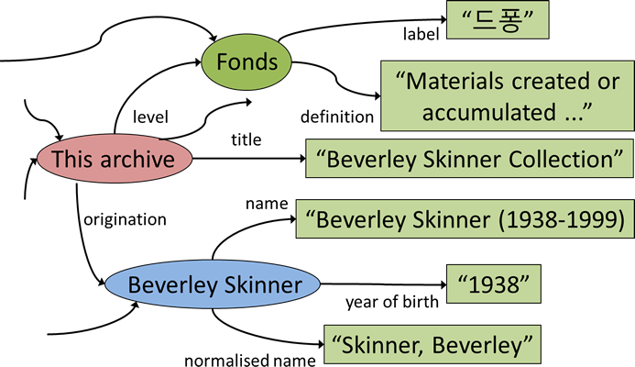
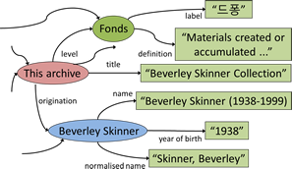
Outer limits of the “Giant Global Graph” (Berners-Lee)
“드퐁”
label
Fonds
“Materials created or accumulated ...”
level
definition
title
This archive
“Beverley Skinner Collection”
name
origination
“Beverley Skinner (1938-1999)
Beverley Skinner
“1938”
Is the G3 the real context of cultural heritage and archives?
year of birth
“Skinner, Beverley”
normalised name

Slide 27
Thank you!
gordon@gordondunsire.com
Acknowledgement:
  LOCAH project (http://data.archiveshub.ac.uk/)
  Pete Johnston
Forthcoming book:
  Bibliographic Information Organization in the Semantic Web / Mirna Willer and Gordon Dunsire
    Chandos, Oct 2013

