Slide 1
Application profiles and cataloging a manifestation
Gordon Dunsire, RDA Technical Team Liaison Officer
Presented at RDA Toolkit Redesign Workshop
Seattle, USA, 25 January 2019

Slide 2
Application profiles

Slide 3
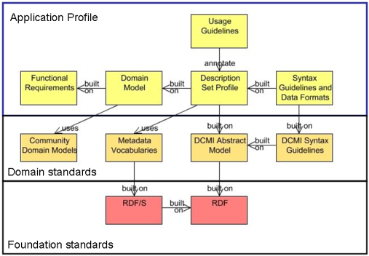
Singapore framework (DCMI)
LRM
RDA toolkit

Slide 4
Application profile
A specification of the metadata that is used in an application
A specification may include the entities, elements, and vocabulary encoding schemes that are used, and the mandatory and repeatable status of elements
May also include the preferred recording method

Slide 5
Toolkit profiles
Elements specified by:
ID (local):
ala-0dd63c0d-066f-3ddc-885a-ff83c25cf752
URL (global):
https://beta.rdatoolkit.org/RDA.Web/Content?externalId=en-US_ala-0dd63c0d-066f-3ddc-885a-ff83c25cf752
IRI (global):
http://rdaregistry.info/Elements/m/P30001

Slide 6
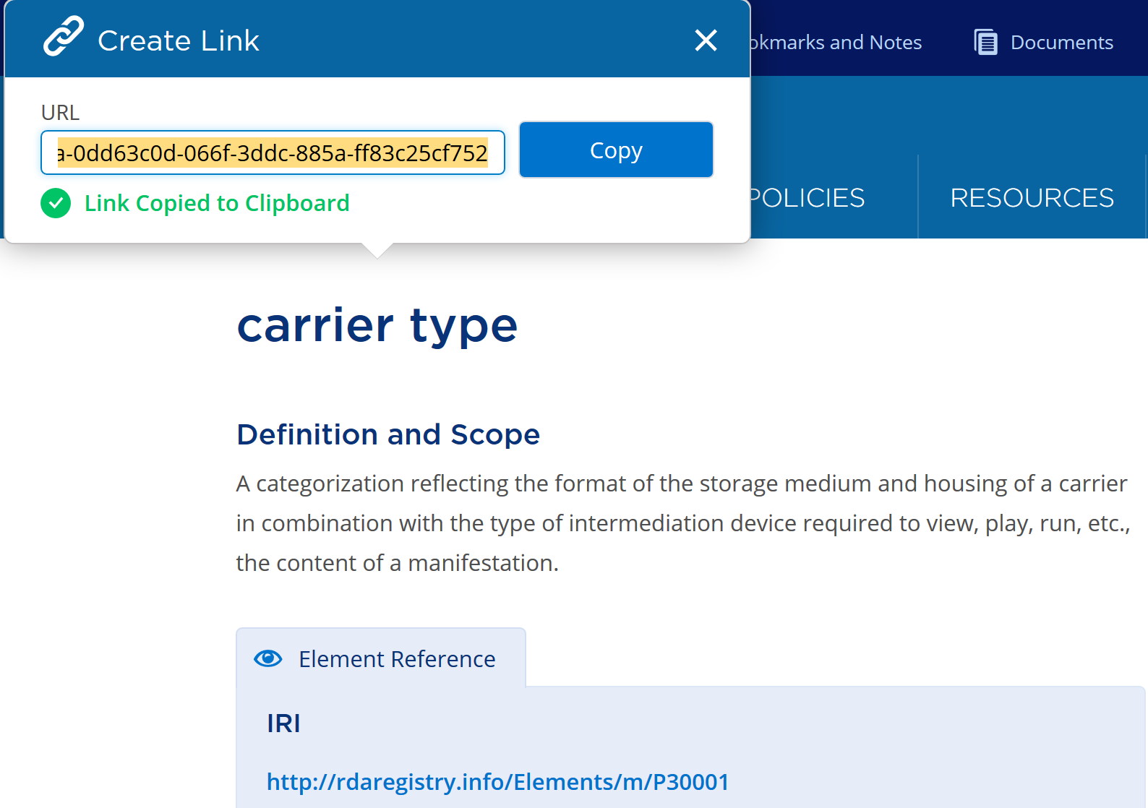

Slide 7
Toolkit identifiers
Toolkit option IDs and URLs can also specify:
Recording method
RDA Vocabulary encoding scheme
Policy statements and Toolkit option IDs and URLs can also augment and specify:
Options
Non-RDA Vocabulary encoding scheme

Slide 8
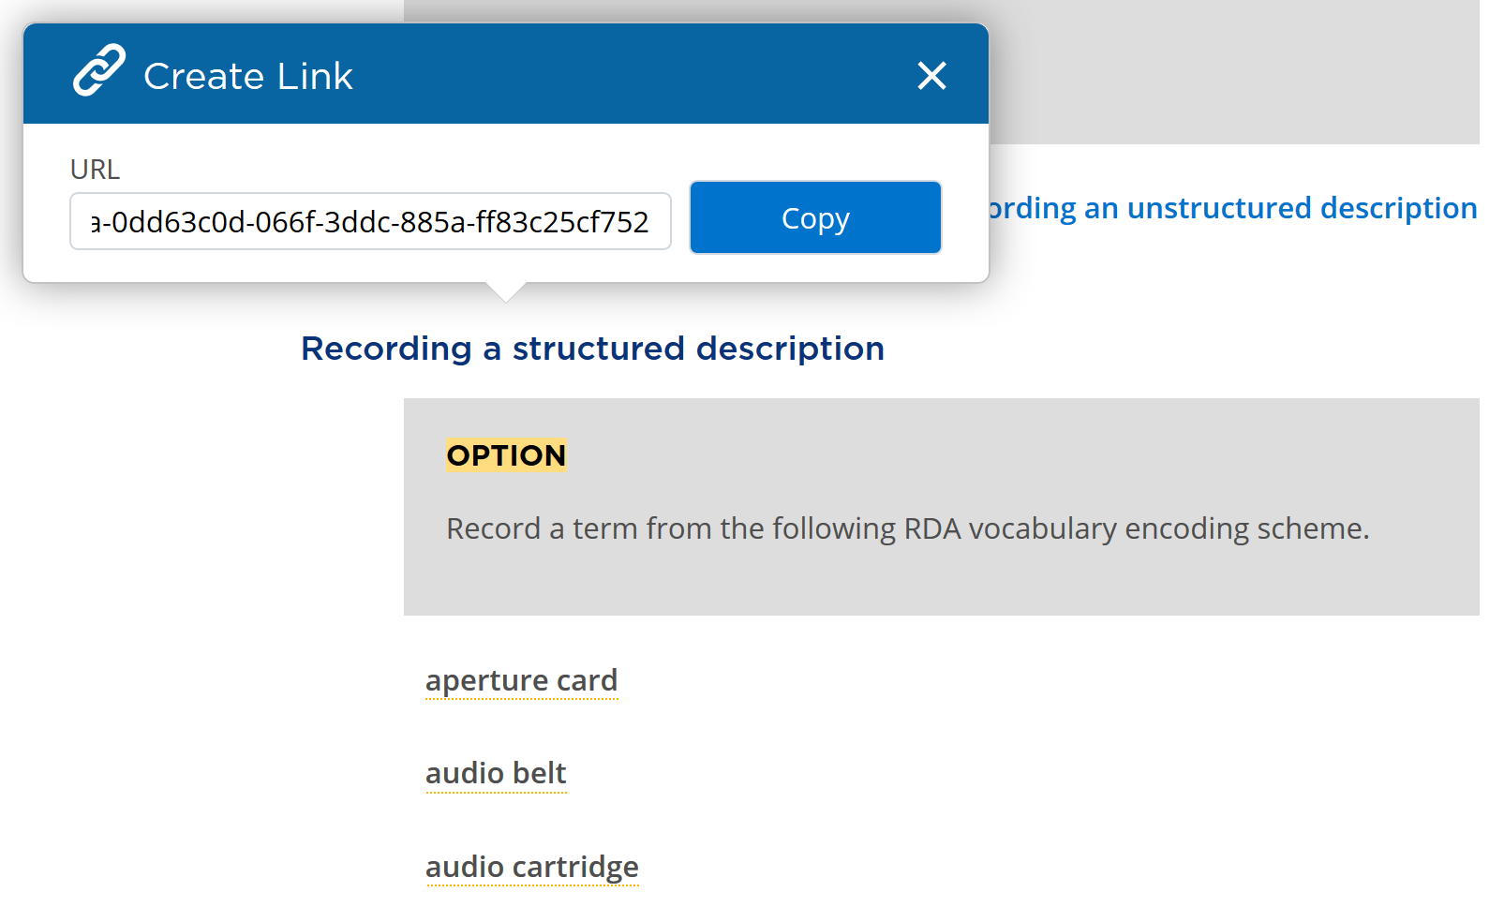

Slide 9
Workshop templates and worked example

Slide 10
Workshop application profiles
Document: Google spreadsheet
Profiles for various types of resource
“Monograph”, “Aggregate”, “Serial”, etc.
Standard layout

Slide 11
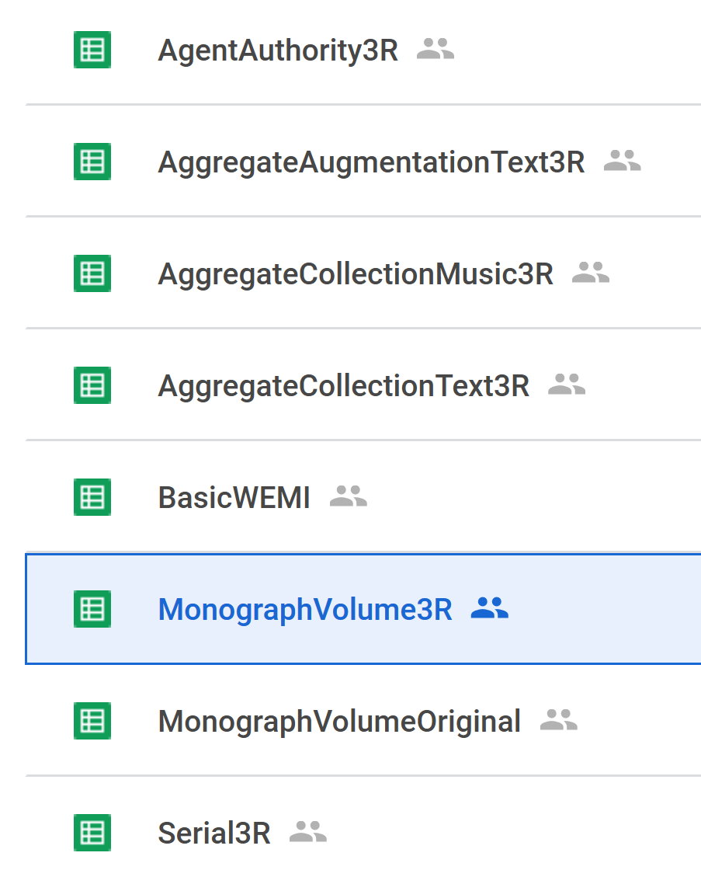
3R: uses new manifestation elements
Original: uses original manifestation elements

Slide 12
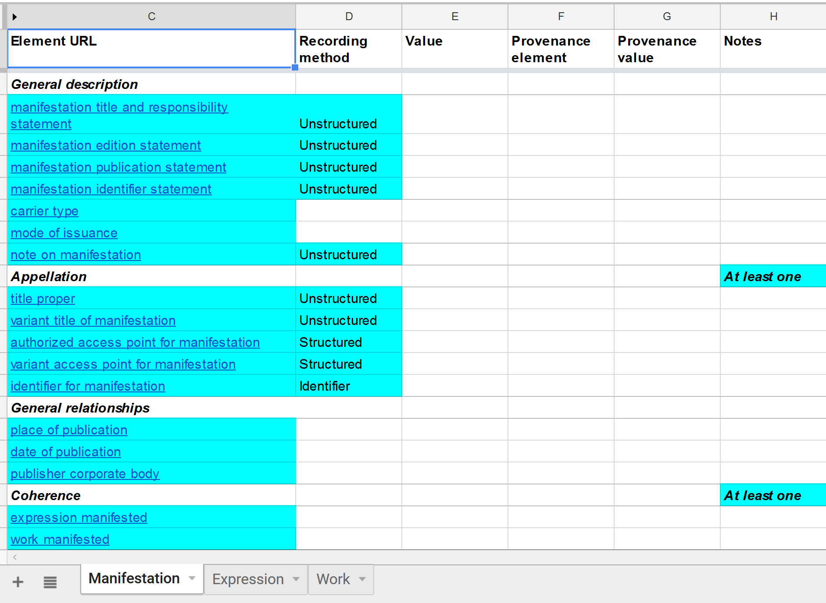

Slide 13
Template columns
Column | Header | Contents
A | Element label | Hidden
B | Element ID | Hidden
C | Element URL | Formula: Hyperlink to Toolkit element
D | Recording method | Method used to record element value
E | Value | Value of the element for entity being described
F | Provenance element | Element used to record data provenance
G | Provenance value | Value of data provenance
H | Notes | Additional information
Can be ignored

Slide 14
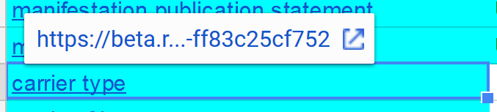
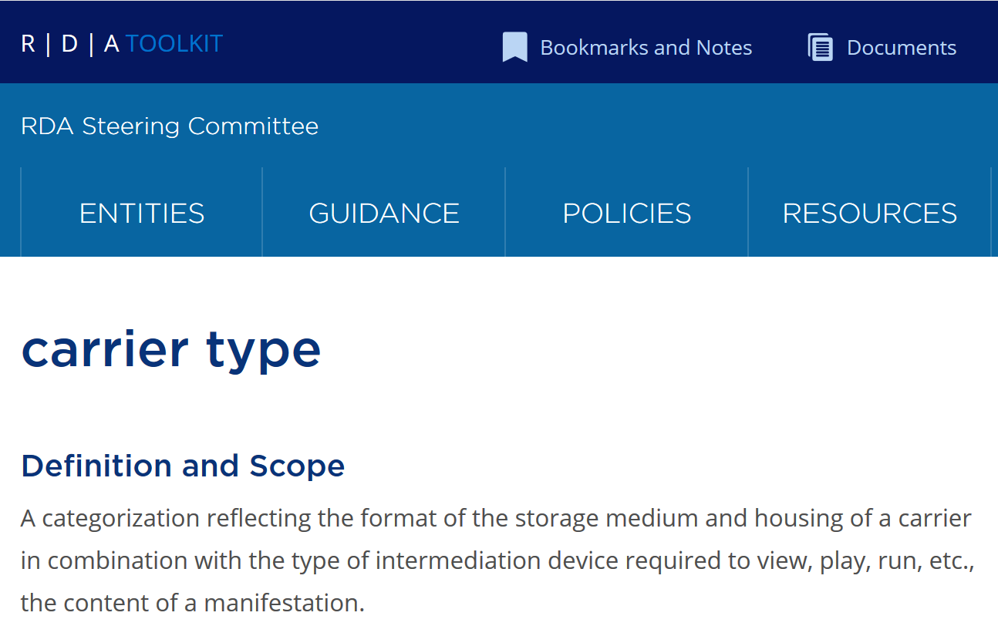
Element URL
Log-in to Toolkit before using link.
Link opens new window

Slide 15
Element categories
Category | Definition
General description | Common elements used to describe the entity [base application profile]
Appellation | Elements used to identify (name) the entity
General relationships | Common elements used to describe relationships of the entity [base application profile]
Special description | Specialized elements used to describe the entity
Special relationships | Specialized elements used to describe relationships of the entity
Coherence | “Primary relationship” elements required for coherent WEMI metadata

Slide 16
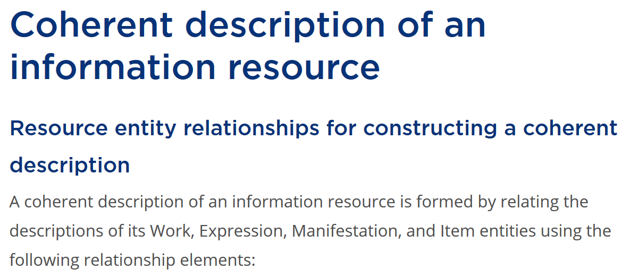
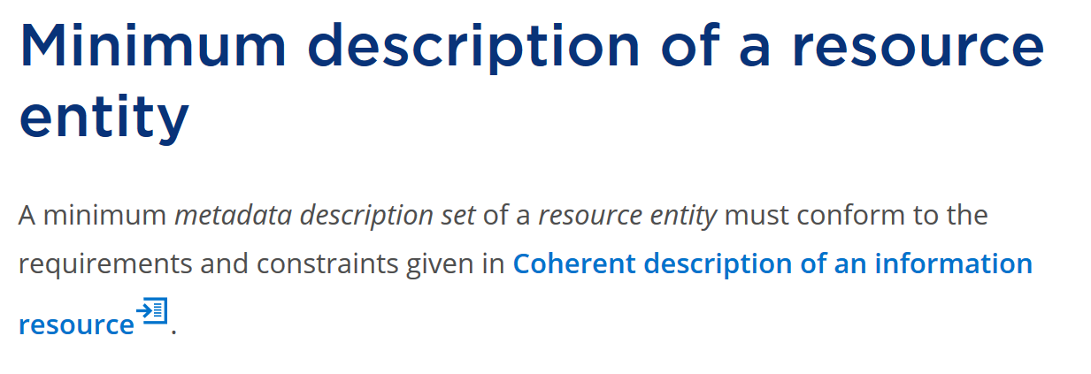
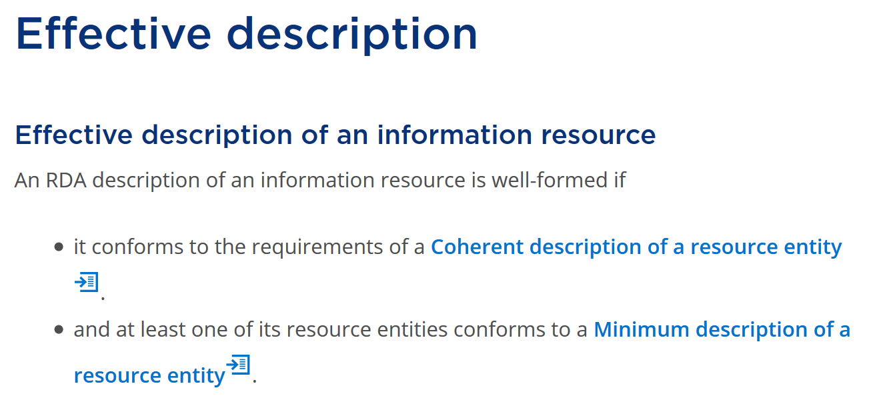
Layered (nested) profile
Effective description:
general and specialized elements
Minimum description: appellation elements
Coherent description: “primary” relationship elements

Slide 17
Profile template selects elements and indicates recording method and cardinality (mandatory, repeatable)

Slide 18
Data input fields
Insert new or duplicate element row
Delete or leave blank unused elements
Entity set
Insert new or duplicate entity sheet
Delete or leave blank unused entities

Slide 19
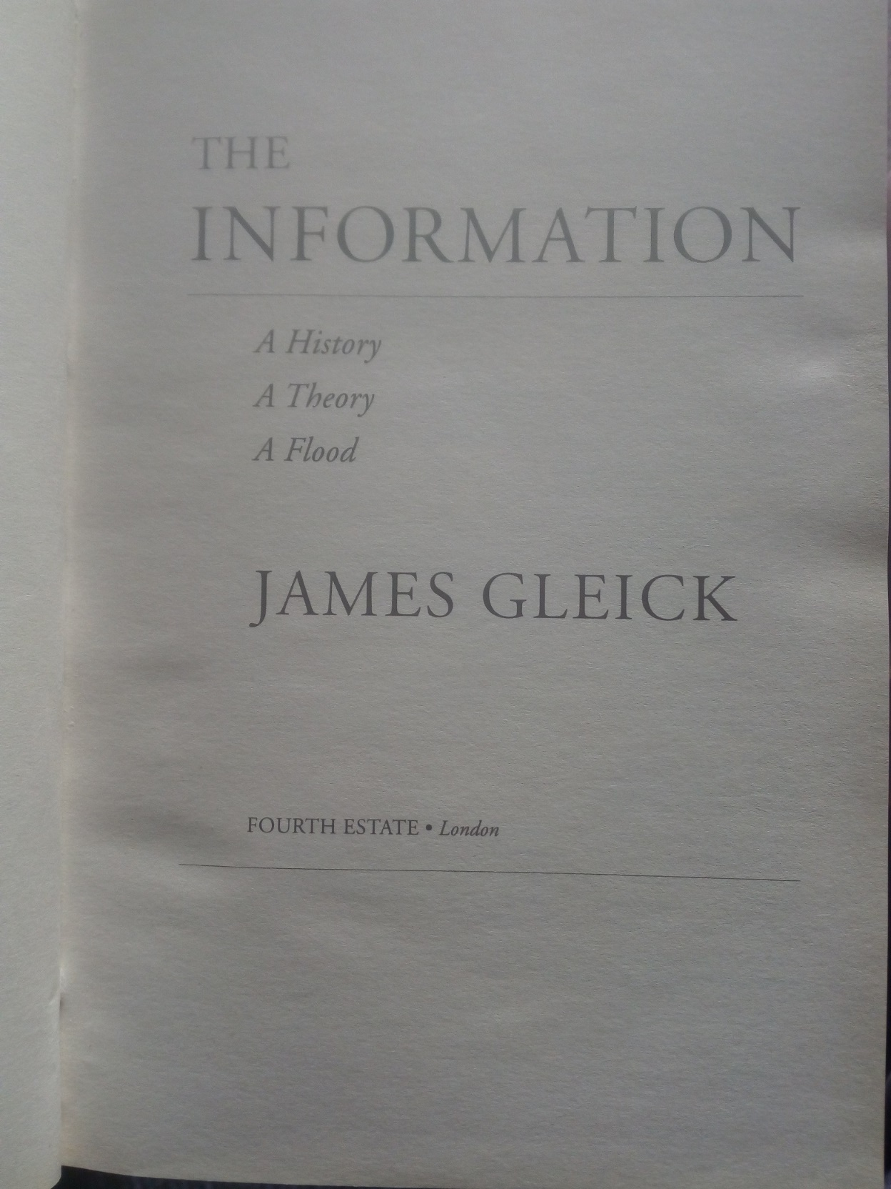
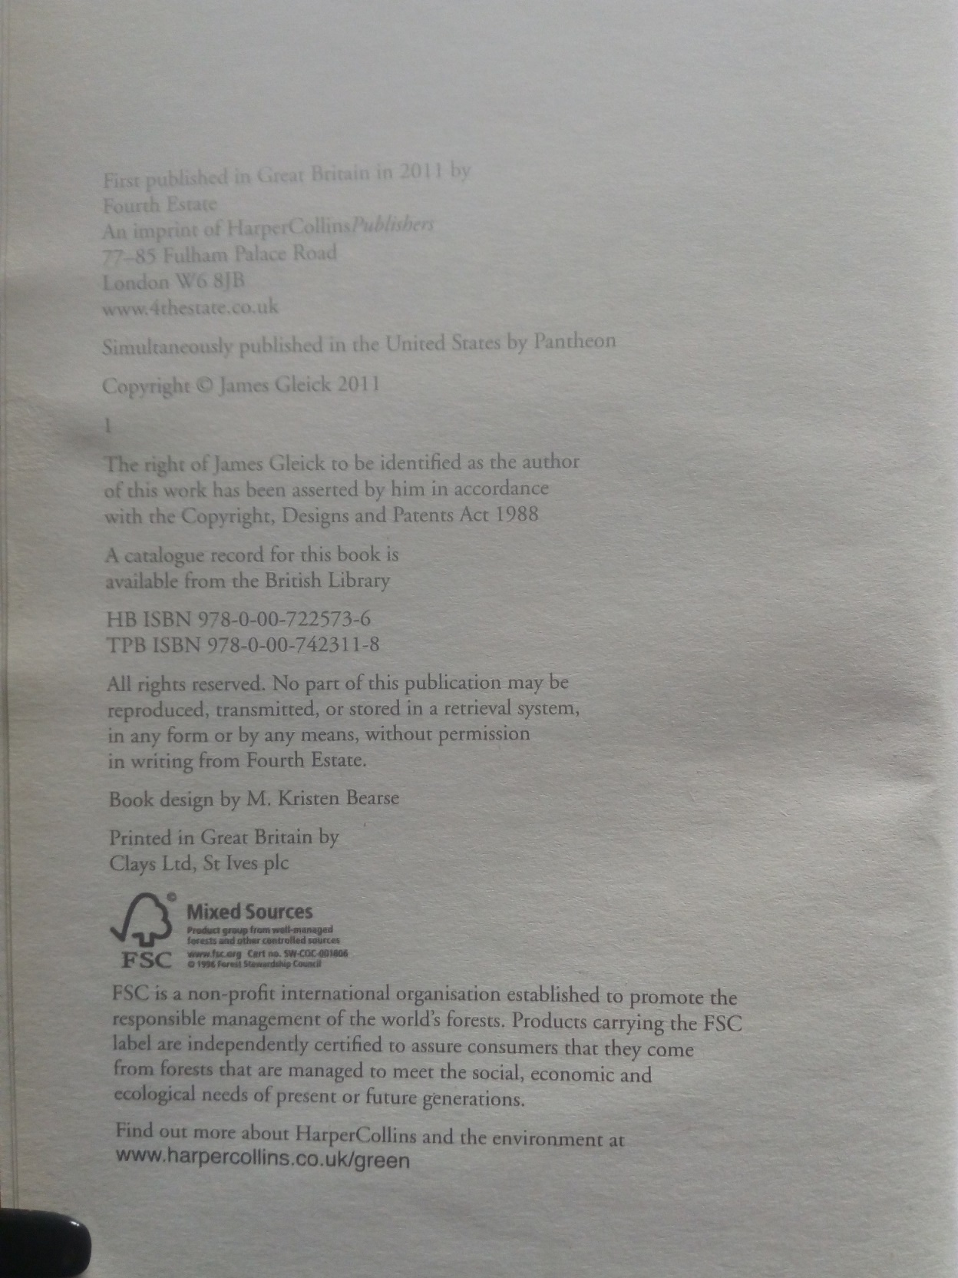
Example: Gleick
The information
Manifestation title page
(front and back)

Slide 20
Select a profile template and make a copy

Slide 21
Application context:
Use basic transcription rules for manifestation statements

Slide 22
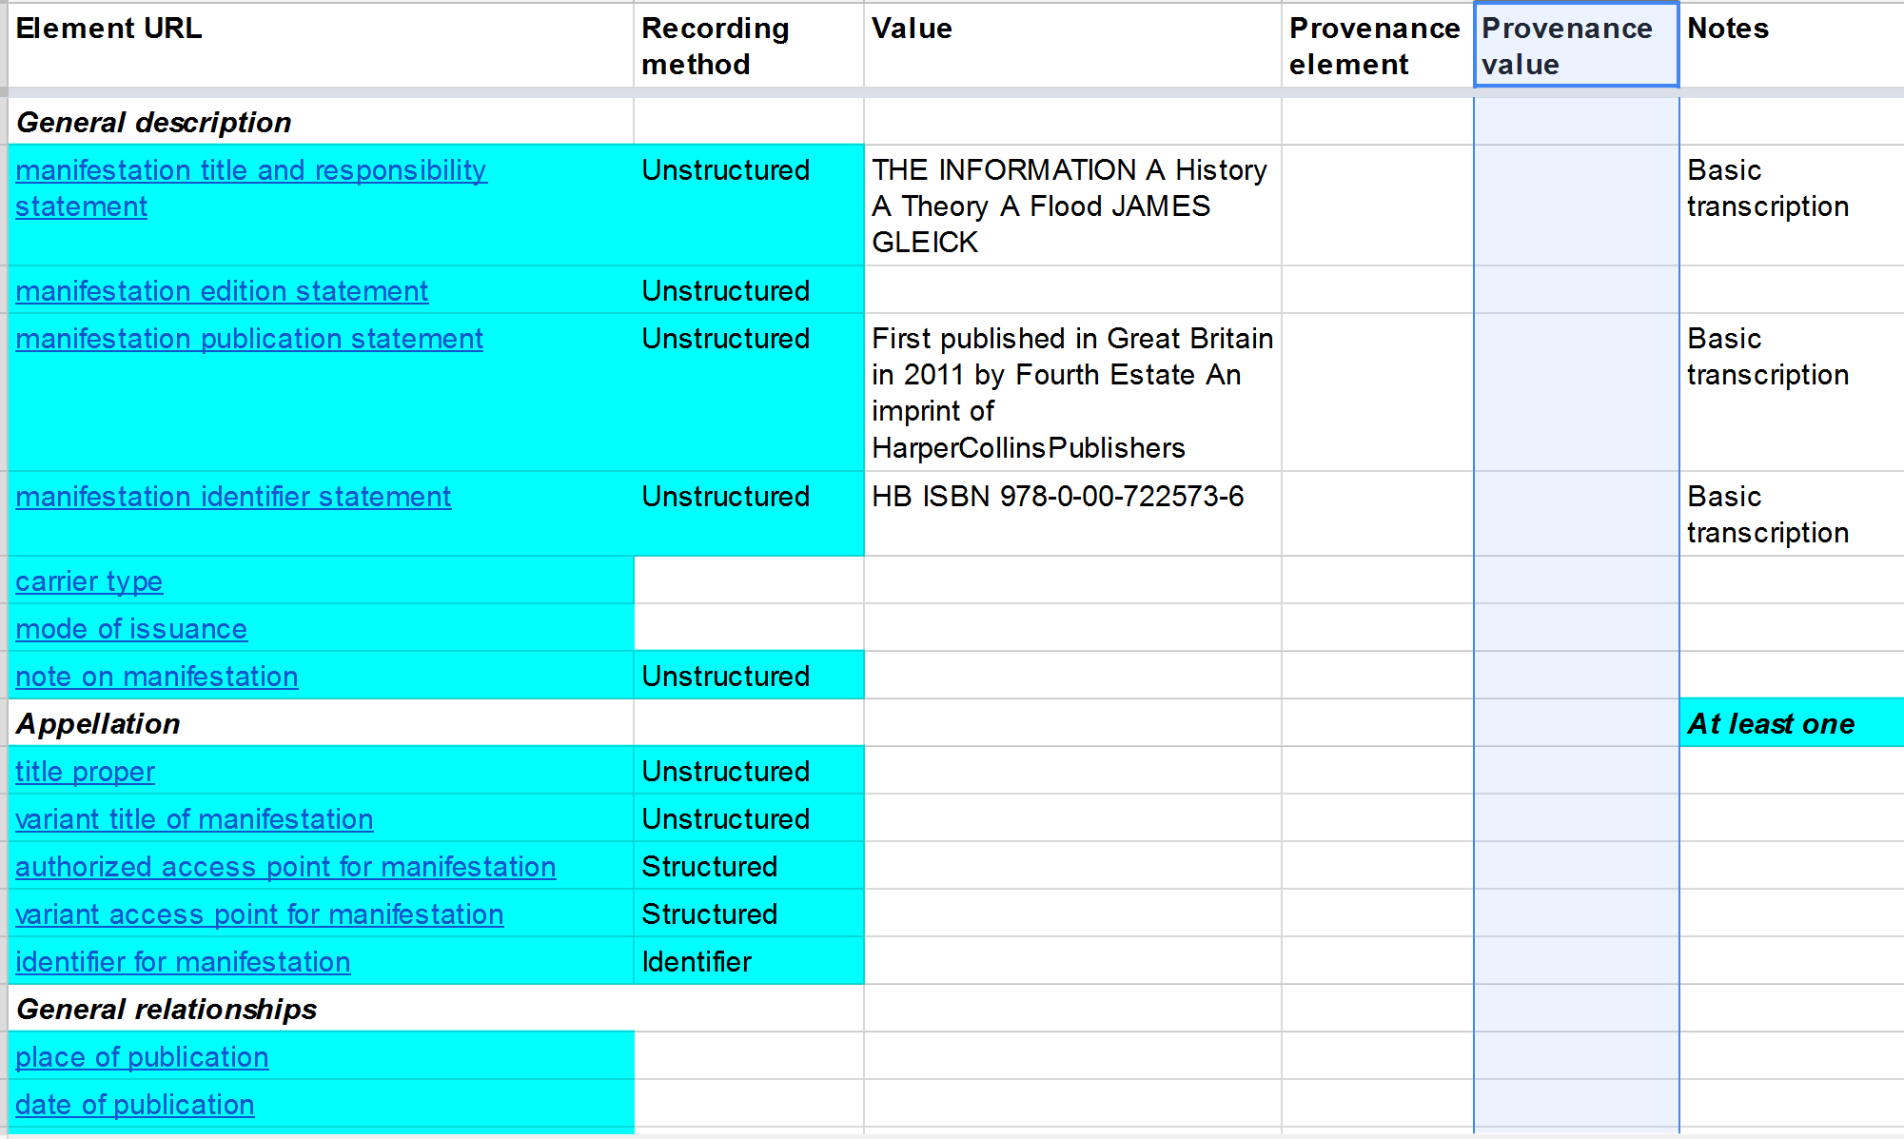

Slide 23
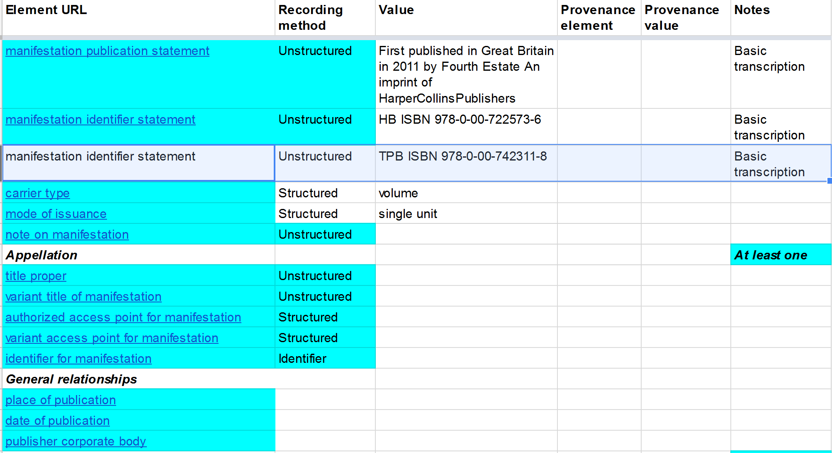

Slide 24
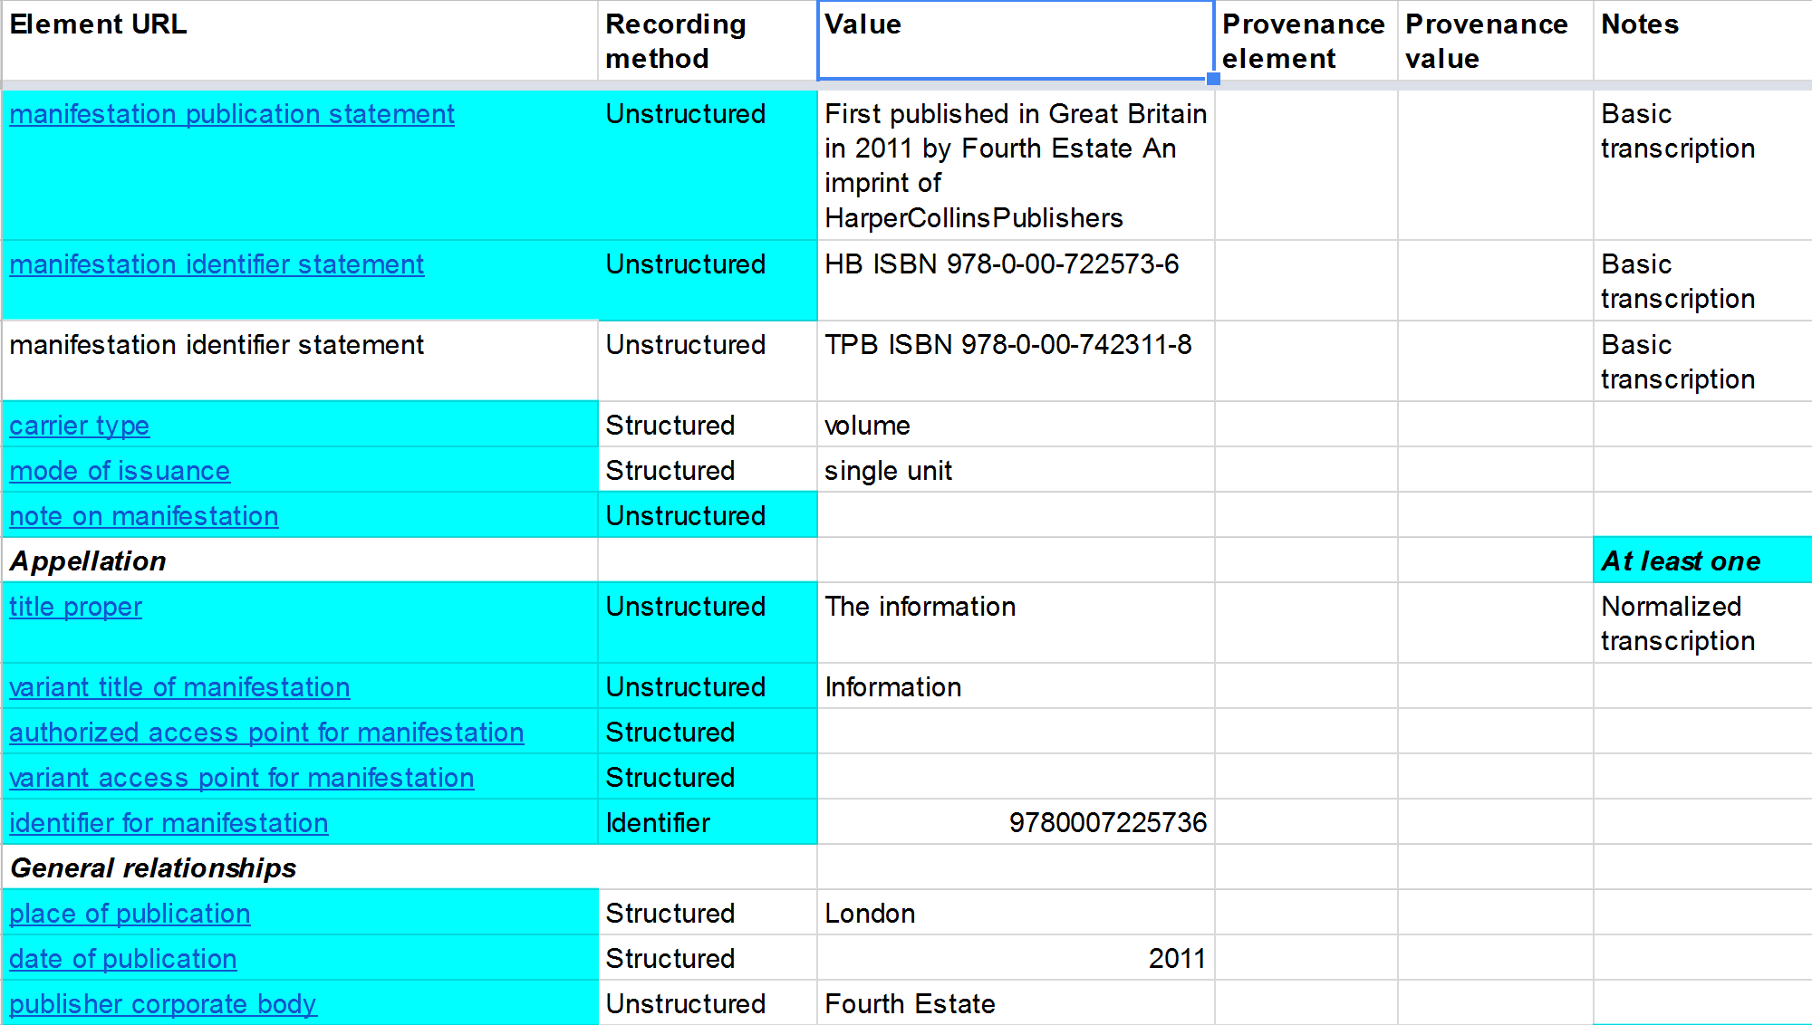

Slide 25
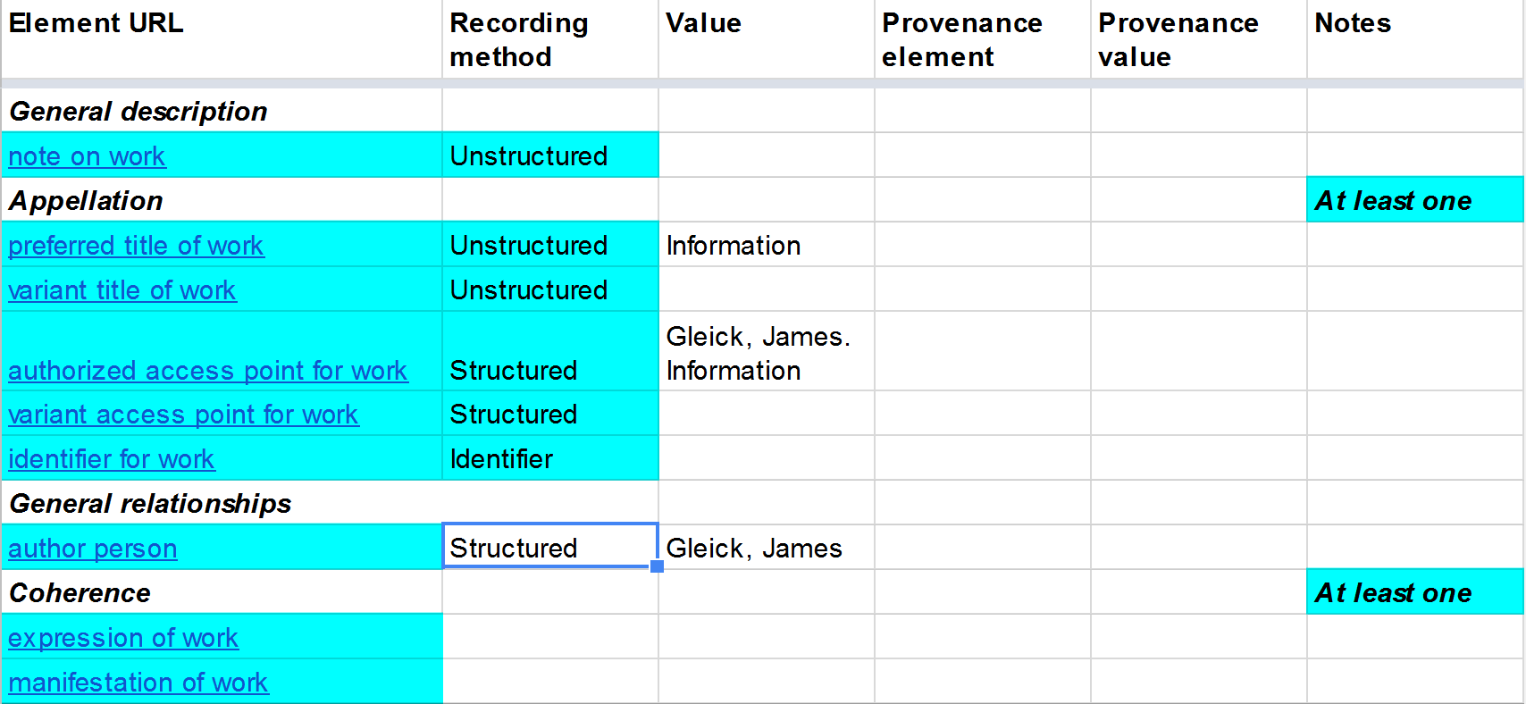

Slide 26
Relating entities
Element: author person
Recording method | Value | Source VES
Unstructured | James Gleick | n/a
Structured | Gleick, James | LCNAF
Identifier | n86031600 | LCNAF
IRI | http://viaf.org/viaf/51721740 | VIAF

Slide 27
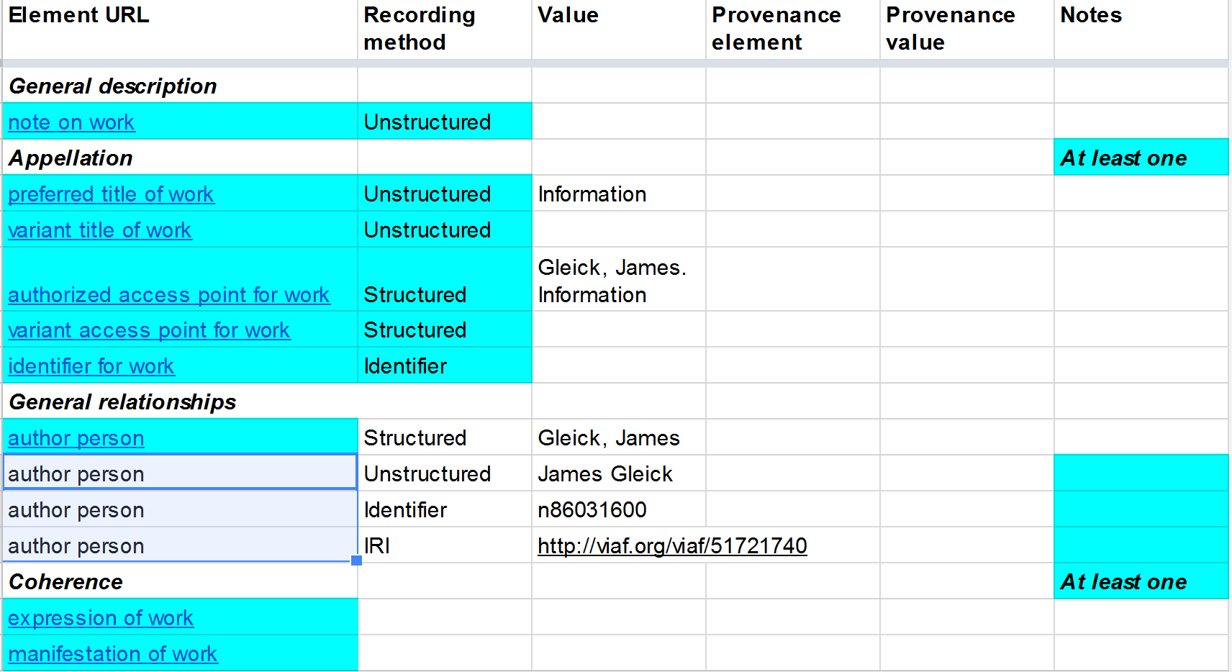

Slide 28
Data provenance
A single statement of element + value, or a set of such statements (“record”), is treated as a (metadata) Work
Data provenance is a statement about the statement
= a statement about the (metadata) Work
☞ a Work element + value

Slide 29
Provenance elements
Metadata statement Work
Provenance element | Provenance value example | Usage
Recording source | Title page | Transcription from manifestation
Source consulted | LCNAF | Value from VES
Related manifestation of work | ISBD | Applied content standard
Related work of work | ISO 8601 | Applied string encoding scheme

Slide 30
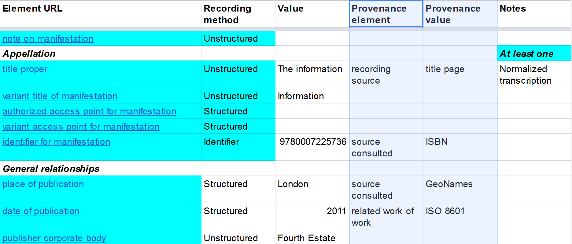

Slide 31
Coherence
Linking the resource entities (WEMI) of a single information resource using “primary” relationships
Reliable linking values:
Authorized access point (local to a VES)
Identifier (local to a VES)
IRI (global, de-referencing gives provenance)
Good
Better
Best

Slide 32
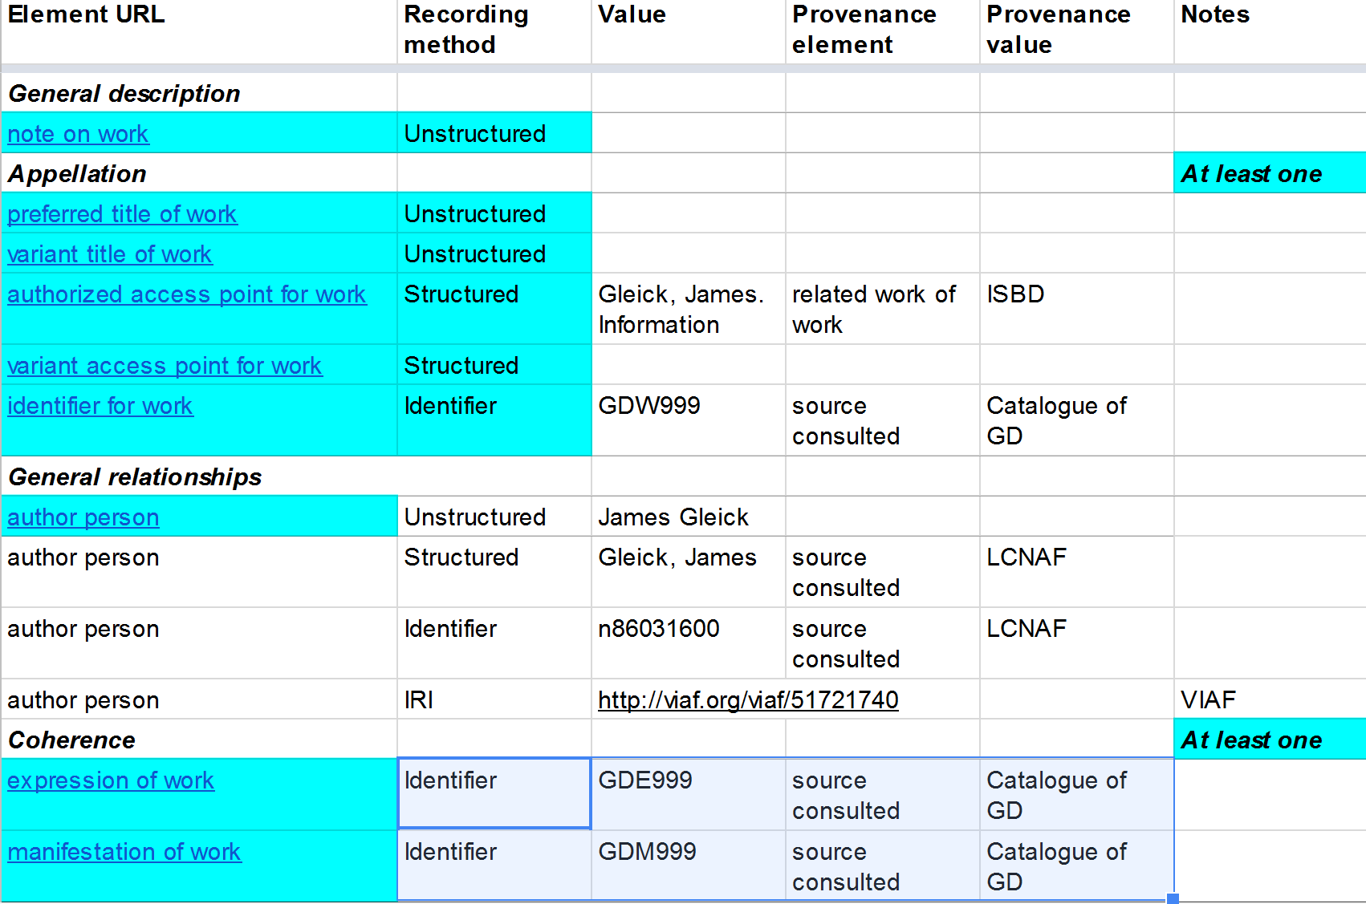

Slide 33
Workshop

Slide 34
Workshop goals
Explore the layout and functionality of the new RDA Toolkit
Identify issues in the use of application profiles
Obtain feedback to improve the Toolkit
Have fun!

Slide 35
Workshop activities
“Jane-athon” style
Collaborative working at tables
Leaders and roving experts
Morning session: we all catalogue the same examples of a simple monograph
Afternoon session: free selection from simple, special examples

Slide 36
Using profile templates
Make a copy of a blank template
Name it your way
Augment or customize template
Add elements and entities
Choose recording methods
Mash-up parts of templates
E.g. Copy agent entity to WEM template

Slide 37
Hints and tips
There is more than one way of creating an effective description
Not all entities or elements need to be used
Use appropriate recording methods
Try some alternative approaches
See the Toolkit guidance on “Resource description”

Slide 38
Alarums and excursions
Broken links in Related elements ☹
Break-out of Agent role elements
Specific elements for Collective Agent, Corporate Body, Family, and Person ☺

Slide 39
Morning session examples
Manfred (Lord Byron)
A more noble cause (Emanuel & Tureaud)

Slide 40
Thank you!
☺ Have fun! ☺

