Slide 1
Aligning RDA with the LRM
Gordon Dunsire
Presented to the EURIG seminar, Florence, Italy, 8 May 2017

Slide 2
Overview
Methodology for aligning RDA with LRM
4-fold path for data capture and format
Nomens
Manifestation statements and transcription
Examples, and what to do about Martians

Slide 3
Any RDA Thing:
Covers all other types of entity
FRBR-LRM and RDA entities
Res
is sub-class
of
RDA
Entity
has appellation
Nomen
W
is created by
Place
E
Agent
is associated with
is sub-class
of
M
Time-span
Collective
Agent
I
is modified by
RDA refines LRM relationships as element sub-types (RDF sub-properties)
P*
F
C
Notes:
The LRM uses a super-entity, "Res", to model high-level relationships and attributes for all other entities. In RDA, the super-entity "RDA Entity" is used in place of Res for all other RDA entities. RDA Entity is a sub-type (sub-class in RDF) of Res.
This RDF graph shows new RDA entities taken from the LRM: Nomen, Place, Time-span, Collective Agent, and Agent. Current RDA entities are labelled only with their initials. The graph also shows the high-level relationships between the new and current entities.
The only RDA entity which does not fit without significant modification is Person. In the LRM, the definition of this entity restricts it to a human being, and non-humans including animals, fictitious and legendary beings, and natural phemomena, are excluded.
The integrated semantic structure of the LRM and RDA entities allows the RDA relationships to be refinements of the high-level LRM relationships, as element sub-types (sub-properties in RDF).

Slide 4
Refinements
RDA Entity
1
is associated with
RDA Entity
2
Coarse/General
has creator
has artist
RDA Entity
1
is associated with
RDA Entity
3
Fine/Specific
is derivative (E)
is adapted as (E)
is adapted as graphic novel (E)
Notes:
For example, the high-level "is associated with" relationship between and two types of Res becomes a relationship between two types of RDA Entity.
The RDA "has creator" relationship is a refinement of the "is associated with" relationship between a Work and Agent, and is refined in turn by the RDA "has artist" relationship designator.
Refinement results in a more specific or finer granularity relationship.
Another example shown here refines the high-level "is associated with" relationship between two Expressions with, successively, the RDA "is derivate of", "is adapted as", and "is adapted as graphic novel" relationships.

Slide 5
Nomens and appellations
RDA Entity
has appellation
Nomen
has title proper
has nomen string
M1
N1
“My title”
has title proper
has identifier …
has nomen string
M1
N2
“0123-4567”
has identifier …
Notes:
Nomen is a new LRM entity for RDA, and represents the class of strings used to label and identify any other entity. The high-level relationship between RDA Entity and Nomen is "has appellation". This essentially says "All things have names".
The current RDA relationships between an entity and an identifying label are refinements of the high-level relationships. So "[has] title proper" is a refinement of the "has appellation" relationship between a Manifestation and a Nomen.
The Nomen entity is always associated with the string of characters, symbols, etc. that constitutes the "name" or other label by which the entity is known or called. The "has nomen string" relationship associates the Nomen with its string. The chain of relationships "has title proper" + "has nomen string" can be short-cut to give the current RDA model of "appellation" attributes.
Similarly, the RDA "[has] identifier for …" attributes are also refinements of "has appellation". Note that the nomen string is this example may look like an ISSN, but it could be some other kind of identifier. More information about the Nomen is needed; this is one reason for treating such string labels as an entity or class that can have other attributes and relationships.

Slide 6
4-fold path for related entities
“[Unstructured description]”
has nomen string
“[Structured description]”
RDA Entity
1
has related entity
“[Identifier]”
N1
RDA Entity
2
N2
has appellation
Notes:
The current RDA instructions allow an related entity to be described using three distinct types of string: an unstructured description, a structured description, or an identifier. In addition, RDA implicitly allows a related entity to be identified by an Internationalized Resource Identifier (IRI) or URI; the related entity is represented as a thing, not a string.
But all things have names: the related entity represented as a thing may have each of the equivalent strings as a nomen string of some related Nomen.
RDA's 4-fold path is thus an extension of LRM's "has appellation" relationship.

Slide 7
4-fold path for attributes
LRM blurs the distinction between attributes and relationships – an echo of the 4-fold path
A relationship with string data (unstructured or structured description, or identifier) is like an attribute
An attribute with "thing" data (IRI), e.g. SKOS concept, is like a relationship
Notes:
The 4-fold path accommodates both string and thing data.
This is compatible with the LRM which allows attributes to be treated as relationships, and relationships to be treated as attributes.

Slide 8
Identifier (path 3)
"A nomen consisting of a code, number, or other string, usually independent of natural language and social naming conventions." (Draft)
Identifier is distinct from language-based "identifiers"
Identifier is "local": not unique at global level
Path 4:
International Resource Identifier (IRI) or URI is unique at global level
Notes:
RDA does not currently distinguish between general identifiers and IRIs. Such a distinction is required for the 4-fold path to be recorded as RDA data in a well-formed way.
The distinction lies in the guaranteed global uniqueness of an IRI required for machine-processing. Other identifiers cannot be guaranteed to be unique at global level, including international identifiers such as ISBNs and ISSNs. For example, the same ISBN is often used for different Manifestations.
There is also a requirement to distinguish an identifier from other forms of Nomen; they all "identify" an entity. The distinction is linguistic: identifiers are usually coded and intended for machine processing, and can be considered distinct from language-based labels, even if they carry hints of human or social labelling.

Slide 9
Nomen granularity and hierarchies
Current RDA elements form categories of nomens
Titles: essentially unstructured descriptions with no "authority"; hierarchical (sub-types)
Names: essentially structured labels (descriptions) with "authority"; hierarchical (sub-types)
Identifiers; no sub-types
No elements for access points: structured descriptions
Notes:
The concept of "identifying" or "known by" labels is already present in RDA.
Resources, described as Works, Expressions, Manifestations, and Items, have Nomens usually referred to as "titles"; Agents, described as Persons, Families, and Corporate Bodies, have Nomens referred to as "names". RDA has sets of elements for titles and names, arranged in hierarchies of element sub-types.
RDA also covers identifiers; there are no sub-types.
RDA does not, however, currently represent structured descriptions, in the form of access points, as elements.

Slide 10
4-fold path
1: Unstructured
2: Structured
3: Identifier
Work to Nomen relationships
[has] related nomen
(work)
[has] represented
name of creator
(work)
[has] subject
(nomen)
[has] appellation of
work
[has] identifier for
work
[has] title of
work
[has] access point of
work
3
[has] preferred
title of
work
[has] variant
title of
work
[AAP]
[VAP]
1
2
Notes:
This diagram shows the RDA relationship elements between Works and Nomens. The diagram can be interpreted as an RDF graph of the relationship ontology if the connectors are assumed to be the RDFS sub-property relationship, or as a relationship hierarchy if the connectors are treated as element sub-type relationships. Nodes with solid outlines are existing RDA elements; nodes with dashed outlines are new RDA elements.
The "title" elements form a hierarchical cluster. But there is also the current relationship "[has] identifier for work": this is not a "title", so there is a requirement for a higher-level relationship of which both are sub-types or sub-properties; this is the high-level "has appellation" relationship between a Work and a Nomen.
And there is also the new relationship "[has] subject (nomen)" required for consistency with similar RDA relationships; this is not a refinement of the "has appellation of work" relationship, requiring an even higher-level relationship that is equivalent to the LRM's "has associated entity" relationship between two entities.
This allows the possibility of other new relationships, for example to link names found in a statement of responsibility directly with a Work.

Slide 11
LRM-E4-A4 Manifestation statements
A statement appearing in the manifestation and
deemed to be significant for users to understand
how the resource represents itself.
… normally transcribed from a source … in a
manifestation. Transcription conventions are
codified by each implementation.
Principle of representation
Notes:
The LRM attribute for Manifestation statement supports the principle of representation – how a resource (manifestation) describes itself.
The data is usually transcribed from an exemplar of the manifestation.

Slide 12
Basic transcription requirements
Support only user task Identify: match source to data
Applicable in general to any sequence or layout of the text
Independent of languages and scripts, and compatible with transliteration instructions
Simple enough for mechanical transcription
Basic enough to support “local” additions and extensions
Notes:
A manifestation statement supports the user task Identify, allowing a user to match an exemplar of a manifestation with the transcribed data. The data is not intended for any further processing except keyword extraction.
Basic transcription should be applicable to a wide range of manifestation text and graphical representations of text.
An important practical requirement is that transcription can be carried out by machine, through optical character recognition. This is cheaper and more accurate than transcription keyed in by human operators.
There will always be a need for special additions and extensions to any basic transcription rules, to take account of local requirements.

Slide 13
Transcription in RDA
Transcribed data = unstructured description
WYSIWYG transcription (machine/clerical)
Basic, simple transcription rules
Conventional transcription (cataloguer)
Current RDA transcription rules
Other transcription rules (e.g. ISBD)
Notes:
This is one way of distinguishing simple, mechanical transcription from current RDA and ISBD approaches.

Slide 14
Basic transcription rules (draft)
Omission: use mark of omission "…"
White-space: collapse new lines, indentations, and other layout features to a single space
Transcribe in order of presentation
Delimiters: use double back-slash "\\" to delimit sub-elements (option)
De-duplicate contiguous interpolations
Notes:
This draft of possible basic transcription rules will be discussed at the RSC meeting in Chicago in May 2017.

Slide 15
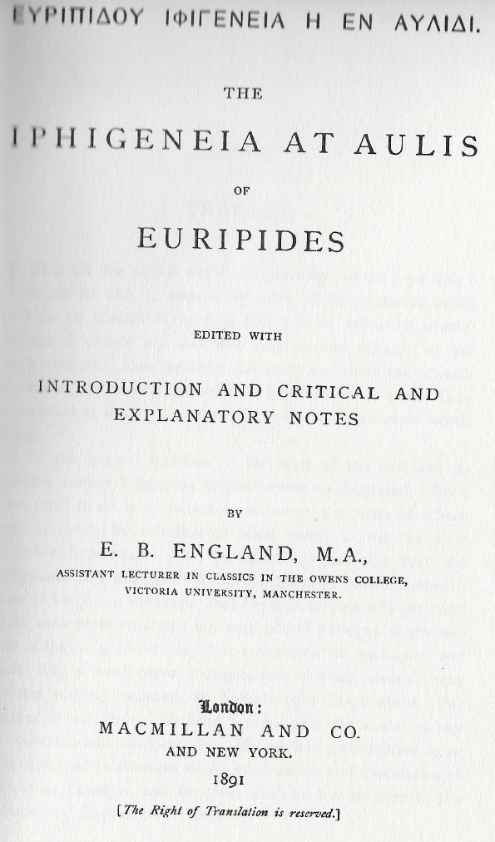
Manifestation statement (ms) element (new!) | Transcribed data
Title and statement of responsibility (ms) | ΕΥΡΙΠΙΔΟΥ ΙΦΙΓΕΝΕΙΑ Η ΕΝ ΑΥΛΙΔΙ. \\ THE IPHIGENEIA AT AULIS OF EURIPIDES \\ EDITED WITH INTRODUCTION AND CRITICAL AND EXPLANATORY NOTES BY E. B. ENGLAND
> Title proper (ms) | ΕΥΡΙΠΙΔΟΥ ΙΦΙΓΕΝΕΙΑ Η ΕΝ ΑΥΛΙΔΙ.
> Title proper (ms) | THE IPHIGENEIA AT AULIS OF EURIPIDES
> Statement of responsibility relating to title proper (ms) | EDITED WITH INTRODUCTION AND CRITICAL AND EXPLANATORY NOTES BY E. B. ENGLAND
Publication statement (ms) | London: MACMILLAN AND CO. AND NEW YORK. 1891
Notes:
Here is an example of applying the draft rules.
It shows new RDA elements for basic transcription of manifestation statements, marked "(ms)". The greater-than sign (>) indicates a sub-element.

Slide 16
Recorded element | Data | 4-fold notes
Title proper | Ευριπιδου Ιφιγενεια η εν Αυλιδι | Unstructured
Title proper | The Iphigeneia at Aulis of Euripides | Unstructured
Variant title | Euripidou Iphigeneia ē en Aulidi | Structured: transliteration derived from title proper via transliteration scheme
Place of publication | London (UK) | Structured: preferred label from VES/authority
Place of publication | New York (USA) | Structured: preferred label from VES/authority
Publisher’s name | Macmillan and Co. | Structured: preferred label from VES/authority
Date of publication | 1891 | Structured: year in date-time format from SES
Publication statement | London ; New York : Macmillan and Co., 1891 | Structured: ISBD SES
Related person | England, E. B. | Structured nomen from VES: “creator of expression” responsibility designator
SES: Syntax/string encoding scheme
VES: Vocabulary Encoding Scheme
Notes:
This is what might be recorded in the current RDA that correspond to manifestation statements.
Transcriptions that use additional transcription rules, for example on capitalization, are accommodated as unstructured descriptions.
Elements that are aggregated from sub-element values are accommodated as structured descriptions using a specific syntax/string encoding scheme for selection, sequence, and punctuation of the sub-elements.
The example shows the 4-fold path data for a specific sub-element.

Slide 17

Non-human agents
Title and statement of responsibility (ms) | Geronimo Stilton \\ THE CHEESE EXPERIMENT
> Title proper (ms) | THE CHEESE EXPERIMENT
> Statement of responsibility relating to title proper (ms) | Geronimo Stilton
Title proper | The cheese experiment
Represented name of creator (work) | Stilton, Geronimo
Notes:
To return to the issue of non-human persons (Martians?) being named in a statement of responsibility, this is an example of how it might be resolved.
This approach has been discussed by the RSC Fictitious Entities Working Group, and will be discussed further during the RSC meeting and outreach event in Chicago in May 2017.

Slide 18
Thank you!
rscchair@rdatoolkit.org
http://access.rdatoolkit.org/
http://www.rdaregistry.info/
http://www.rda-rsc.org/

