Slide 1
Aggregates and Diachronic Works
Gordon Dunsire, Chair, RSC
Presented at “The redesigned RDA Toolkit: what you need to know to get ready”,
Montréal, Québec, Canada, 22 October 2018

Slide 2
Model for aggregates
2011: IFLA Working Group on Aggregates report
Do not implement before consolidation of FR models [2017]
LRM: “An aggregate is defined as a manifestation embodying multiple expressions … every aggregate manifestation also embodies an expression of the aggregating work”
Notes:
The development of the treatment of aggregates in RDA was set aside until the consolidation of IFLA’s Functional Requirements family of models for bibliographic description. This followed a recommendation of the IFLA Working Group on Aggregates that could not reach consensus without clarification and development of related aspects of the other models.
The delay lasted six years, although the RSC was able to see final drafts of the consolidated model, the IFLA Library Reference Model (LRM), well in advance of approval and publication in 2017 as a standard of the International Federation of Library Associations and Institutions (IFLA).
The LRM confirms the basic model proposed by the Working Group on Aggregates: aggregation is a characteristic the Manifestation entity.
The LRM specifically rejects the use of a whole/part relationship between the aggregated content and its component expressions.
Instead, the LRM refers to an aggregating work and its expression.

Slide 3
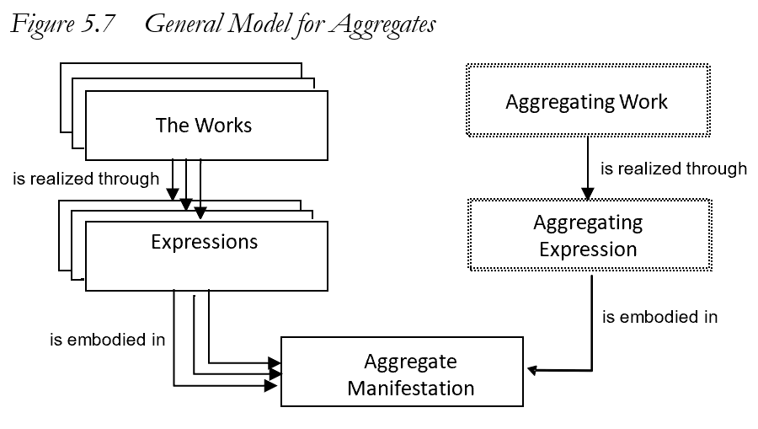
An aggregating work is a plan for aggregation
An aggregating expression realizes the plan by packaging the expressions that are aggregated
No whole/part relationships
Notes:
This is the general model for aggregates, taken from the LRM.
An aggregate manifestation embodies multiple expressions of one or more works plus a single expression of a single aggregating work.
Essentially, the aggregating work and its expression are the content of the aggregate manifestation that selects, organizes, and incorporates the content of the expressions that are aggregated in the manifestation.
There is no whole/part relationship between the Work entities or the Expression entities, and no corresponding whole/part structure in the Manifestation entity.

Slide 4
Aggregate
RDA: A manifestation that embodies an aggregating work and one or more expressions of one or more works that realize the plan for aggregation.
AW: Work plan for
Selected poetry of Lord Byron
W1: She walks in beauty
W2: To Belshazzar
realizes
realizes
E1: Text in
English
E2:Text in
English
AE: Expression of the plan …
aggregated
by
embodies
Selected poetry
of Lord Byron
(Modern Library, 2001)
embodies
Notes:
It is straightforward to implement this model in RDA.
This is the RDA label and definition for the LRM “aggregate manifestation”.
This example shows that an individual poem in an anthology is not “part of” the anthology. The poem was not originally conceived as being a part of any future anthology.
The example also shows that it is not necessary to record every distinct Work and Expression. There is no need to describe the aggregating work or expression for many applications, if the individual expressions are recorded. Conversely, as perhaps in this example, it may be sufficient to describe the aggregating work and expression and ignore all of the numerous individual poems.
It does not matter if different agencies and applications record different components at different times; when the data are brought together, they will be coherent, although some redundancy or duplication will be expected.
The LRM provides a specific relationship between the aggregating expression and the expressions that are aggregated. It is not a type of whole/part relationship. This is a new RDA relationship element, labelled “aggregated by” (with inverse “aggregates”).
The terminology will be confusing until we become familiar with the new RDA Toolkit.

Slide 5
3 types of aggregation
Collection of expressions
e.g. 3 novels of Jane Austen
Augmentation
e.g. Emma, with introduction and commentary
Parallel expressions of the same work
e.g. Emma in English and French
An aggregate may consist of more than one type
Notes:
The LRM identifies three distinct categories of aggregate that are based on the relationships between the expressions selected by the aggregating work and expression.
In a collection aggregate, the expressions realize works that are intended by their creators to stand alone.
In an augmentation aggregate, one of the expressions realizes a work that is intended by its creator to stand alone, and the other expressions realize works that are intended to augment the stand alone work.
In a parallel aggregate, all of the expressions realize the same work in translations or different scripts.
It is possible for an aggregate to combine different types. For example, an anthology of poems with a commentary and translation of each poem is a combination of all three types.

Slide 6
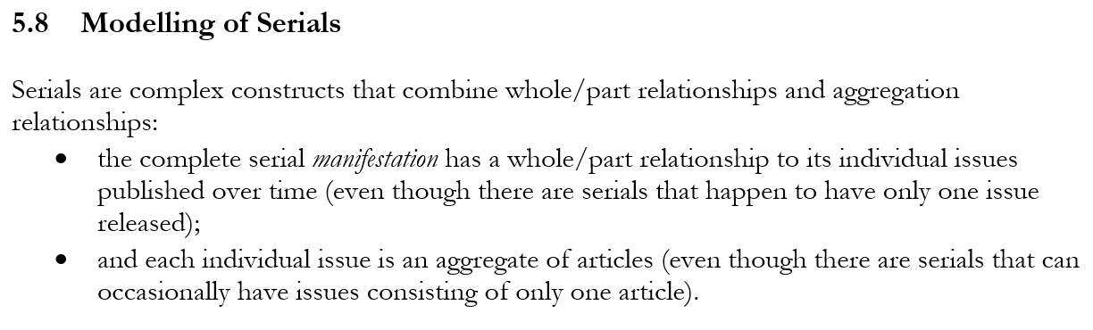

RDA:
RDA/ONIX Framework provides a sub-ontology for how content changes over time
e.g. succession vs integration
Notes:
The LRM describe a “serial” as a complex combination of whole/part and aggregation relationships between manifestations.
RDA implements a generalization of the model of a serial manifestation being “published over time”.
This is the concept of a diachronic work.
If the content is embodied in a manifestation over a timespan, then the content changes during that timespan.
The RDA/ONIX Framework for Resource Categorization provides a model of basic attributes of a resource, described in RDA using the Work, Expression, Manifestation, and Item entities. The Framework is the underlying ontology of the RDA carrier, content, and media types.
The Framework offers three attributes that categorize how content changes over time. For example, the Extension mode distinguishes succession, where content is accumulated over time, and integration, where content is replaced over time.

Slide 7
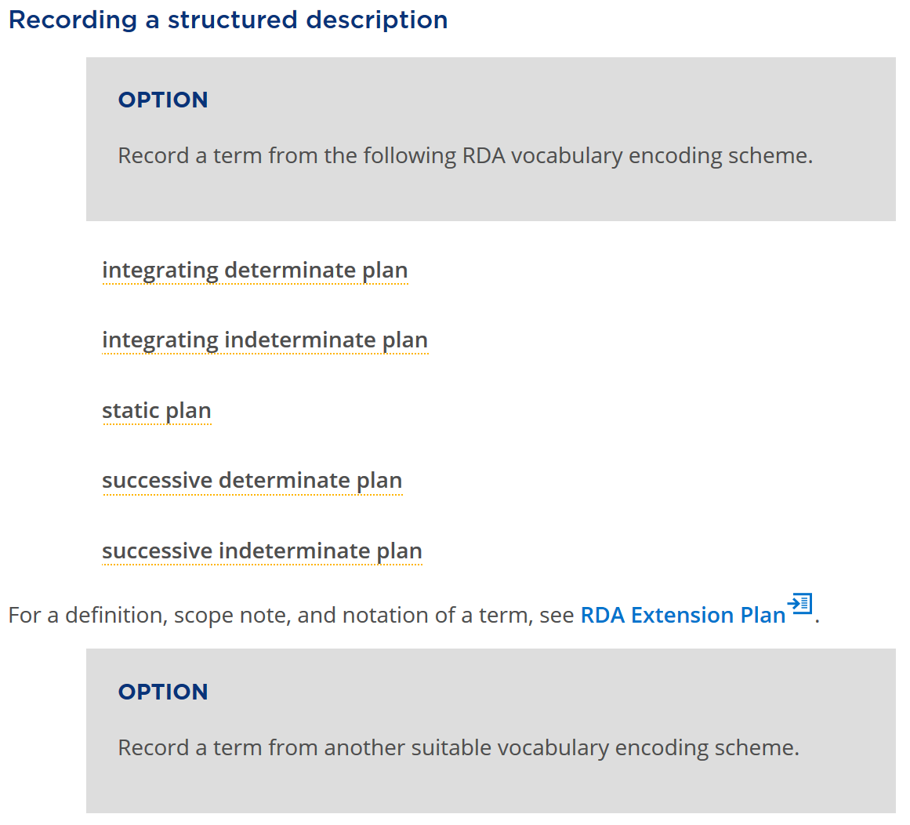
Notes:
RDA has a new Work element for “extension plan” that has a related RDA vocabulary encoding scheme based on the RDA/ONIX Framework.
The vocabulary terms distinguish a serial work from a static work, and distinguish serials works by their extension mode and extension termination.
A typical “serial” is a diachronic work with a “successive indeterminate plan” for extension of its content: the content will be added over time, and the timespan is open-ended.

Slide 8
The WEM stack (FRBR)
Work
1 and only 1
At least 1
Expression
At least 1
At least 1
Manifestation
1 and only 1
At least 1
Item
Notes:
A well-formed RDA description is coherent if it complies with the RDA ontology, as represented in the RDA Registry. The RDA ontology is now compatible with the ontology of the LRM.
In particular, the LRM retains the cardinality restrictions between the FRBR entities. The scope of the Item entity is further clarified: all characteristics that are common to all items that exemplify a manifestation are recorded as characteristics of the manifestation, even if there is only one item (for example, a manuscript).

Slide 9
The WEM lock (diachronic)
Work
1 and only 1
1 and only 1
Expression
1 and only 1
1 and only 1
Manifestation
A plan for diachronic content is locked into all three entities: a change in characteristic is a change in plan, and therefore a new Work
Notes:
This diagram shows the additional cardinality restrictions that apply to serial works.
A serial work is realized by only one expression embodied in only one manifestation. Any change in any of these entities results in a new serial work; for example, a serial published in two different carrier types is modelled as two separate serial works.
This is known as the WEM lock.
The essential fact behind these restrictions is that no plan can predict the future. A publisher may decide to stop publication on a specific carrier, or terminate the publication altogether.
The creator of a serial work may decided to split the content into two separate works from a specific point in time, or merge works, etc. These types of change are familiar to serials librarians. The LRM and RDA now provide a clearer approach for recording these changes as they occur.
The new approach requires a significant change in the context of describing serials and other diachronic works, but the data to be recorded remains the same.

Slide 10
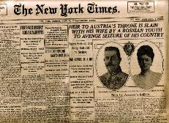



The New York times (print)
The New York times (CD-Rom)
The New York times (online)
Work
The New York times (print)
The New York times (CD-Rom)
The New York times (online)
Expression
Manifestation
If one of the carrier types ceases publication, it cannot imply that all carrier types have ceased.
10
Notes:
This example shows three “editions” of the New York Times, each issued on a different carrier type.
Following the LRM, these are described as three separate serial works. This allows each description to maintain accuracy. For example if the CD-Rom edition ceases, a user will not assume that a later issue is available in that format; if the content of the print and online editions diverges, the user will not assume that either format will contain the information required.

Slide 11
Work groups
A set of works that are identified as a whole
has appellation of work group
“Appellation of work group”
“Authorized access point for work group”
e.g. “New York Times …”
Work
has authorized access point
for work group
“Identifier for work group”
e.g. ISSN-L
has identifier for work group
Notes:
This diagram shows how RDA can be used to collocate serial works in the same “family”.
Any set of works may be assigned a common appellation with the same nomen string.
RDA provides three sub-types of appellation element for a “work group appellation” that can be assigned to each work in the group. Only a single nomen string is required, so there is no provision for variant access points, or unstructured description; the method only works for authorized access points or an associated identifier. The general appellation element is provided as a catch-all, and as a data gathering mechanism.
This approach is already used by the ISSN Network: an ISSN-L functions as an identifier for work group, so all editions of the New York Times can be collocated in an information retrieval application.

Slide 12
Serial work
A work intended to be realized in multiple distinct expressions embodied during a timespan with no ending.
Work-Work relationships
LRM-R19 precedes [logical, not chronological]
LRM-R22 was transformed into [by policy, etc.]
Expression-Expression relationship:
LRM-R25 was aggregated by
Notes:
A serial work is diachronic work that is issued successively with no intended termination.
The LRM offers three high-level relationships that can be used to model the complexity of a serial work and its issues.
LRM-R19 is used to place the works that are the individual issues in sequence according to their numerical and chronological enumeration, even if an issue is embodied in a different chronological order.
LRM=R22 is used to relate serial works that undergo a change of issuance plan, for example if the carrier type of the embodied issue changes from printed volume to online resource.
LRM-R25 is used to relate the expressions of individual issues to the expression of the serial work.
These relationships have been implemented as elements in RDA. The Work-Work elements are used in the hierarchical organization of existing, more refined RDA elements.
If each “issue” of a serial work is itself an aggregate, then the serial becomes an aggregate of aggregates.

Slide 13
DiachronicW
1
transformed into
DiachronicW
2
DiachronicE
1
DiachronicE
2
aggregated by
aggregated by
IssueW
1A
IssueE
1A
IssueE
1B
IssueW
1B
precedes
precedes
IssueW
2A
IssueE
2A
IssueE
2B
IssueW
2B
AggregateM
AggregateM
13
Notes:
In this diagram, a serial work is transformed into a new, separate serial work.
Each work has an expression that aggregates the expressions of its issues.
Each work realized by an expression of an issue is related to the next issue in the sequence of enumeration.
The diagram does not indicate the structure of the aggregate manifestations. For example, both serial works may be embodied as a single online resource.
A serial work is one of the most complex information resources that is found in most library collections.

Slide 14
Other changes to RDA
Data provenance: When is changing, diachronic data valid?
scope of validity; date of validity
Some elements moved from Manifestation to Work
frequency; ISSN
Ongoing liaison with ISSN International Centre and ISBD Review Group
Notes:
RDA now clarifies how to record the provenance of metadata created with RDA. This includes the agents responsible for creating metadata, when the data is created, the source of the data, and so on.
RDA provides two provenance elements that are useful for recording changes in the metadata describing a diachronic work. Scope of validity can record a range of “issues” of a diachronic work for which metadata are valid, for example the title proper of the diachronic manifestation. Date of validity records the timespan for which metadata is valid.
Some elements have been moved from the Manifestation to Work entities. Frequency is really part of the plan for issuing a diachronic work, and is certainly not a characteristic of the manifestation of an individual issue. The WEM lock means that ISSN can identify any of the Work, Expression, or Manifestation entities, but it is more appropriate as a Work identifier.
The impact of the LRM on the ISSN Manual and the International Standard Bibliographic Description are now under review by the ISSN International Centre and the ISBD Review Group, respectively.
Liaison on harmonizing RDA, ISSN, and ISBD has been ongoing for many years. The new RDA treatment of serials and aggregates is based on joint meetings, discussions, and papers between these groups, as well as cross-membership of each standards body.
The work continues.

Slide 15
Thank you!
RDA Steering Committee
http://www.rda-rsc.org/
RDA presentations
http://www.rda-rsc.org/node/560
RDA Toolkit
https://www.rdatoolkit.org/

