Slide 1
Agrégats et œuvres diachroniques
Gordon Dunsire, Président du RSC
Présenté lors de la conférence « Le RDA Toolkit repensé : ce qu’il faut savoir pour s’y préparer »,
Montréal, Québec, Canada, 22 octobre 2018

Slide 2
Modèle pour les agrégats
2011: Rapport du Groupe de travail de l’IFLA sur les agrégats
Ne pas mettre en œuvre avant l’intégration des modèles FR [2017]
LRM : « Un agrégat est défini comme une manifestation matérialisant plusieurs expressions … chaque manifestation agrégative matérialise aussi une expression de l’œuvre agrégatrice »
Notes:
The development of the treatment of aggregates in RDA was set aside until the consolidation of IFLA’s Functional Requirements family of models for bibliographic description [famille des modèles de fonctionnalités requises de l’IFLA pour la description bibliographique]. This followed a recommendation of the IFLA Working Group on Aggregates [Groupe de travail de l’IFLA sur les agrégats] that could not reach consensus without clarification and development of related aspects of the other models.
The delay lasted six years, although the RSC was able to see final drafts of the consolidated model, the IFLA Library Reference Model (LRM) [modèle de référence de l’IFLA (LRM)], well in advance of approval and publication in 2017 as a standard of the International Federation of Library Associations and Institutions (IFLA) [Fédération internationale des associations et institutions de bibliothèques (IFLA)].
The LRM confirms the basic model proposed by the Working Group on Aggregates: aggregation is a characteristic of the Manifestation entity [entité Manifestation].
The LRM specifically rejects the use of a whole/part relationship [relation tout/partie] between the aggregated content and its component expressions [expressions composantes].
Instead, the LRM refers to an aggregating work and its expression.

Slide 3
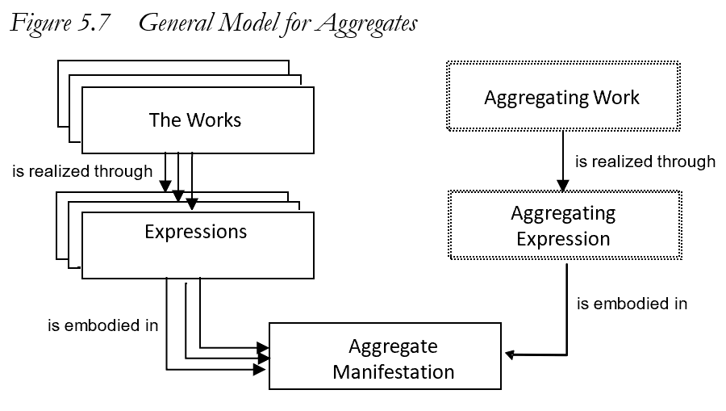
Une œuvre agrégatrice est un plan d’agrégation
Une expression agrégatrice réalise le plan en incorporant les expressions qui sont agrégées
N’est pas une relation tout/partie
Notes:
This is the general model for aggregates, taken from the LRM.
An aggregate manifestation embodies multiple expressions of one or more works plus a single expression of a single aggregating work. [Une manifestation agrégative matérialise plusieurs expressions d’une ou plusieurs œuvres accompagnées d’une expression unique d’une œuvre agrégatrice.]
Essentially, the aggregating work and its expression are the content of the aggregate manifestation that selects, organizes, and incorporates the content of the expressions that are aggregated in the manifestation.
There is no whole/part relationship between the Work entities or the Expression entities, and no corresponding whole/part structure in the Manifestation entity.

Slide 4
Agrégat
RDA : Manifestation qui matérialise une œuvre agrégatrice et une ou plusieurs expressions d’une ou plusieurs œuvres qui réalisent le plan d’agrégation.
OA : Plan d’agrégation pour Selected poetry of Lord Byron
O1 : She walks in beauty
O2 : To Belshazzar
réalise
réalise
E1 : Texte en
anglais
E2 :Texte en
anglais
EA : Expression du plan…
agrégé par
matérialise
Selected poetry
of Lord Byron
(Modern Library, 2001)
matérialise
Notes:
It is straightforward to implement this model in RDA.
This is the RDA label and definition for the LRM “aggregate manifestation”.
This example shows that an individual poem in an anthology is not “part of” the anthology. The poem was not originally conceived as being a part of any future anthology.
The example also shows that it is not necessary to record every distinct Work and Expression. There is no need to describe the aggregating work or expression for many applications, if the individual expressions are recorded. Conversely, as perhaps in this example, it may be sufficient to describe the aggregating work and expression and ignore all of the numerous individual poems.
It does not matter if different agencies and applications record different components at different times; when the data are brought together, they will be coherent, although some redundancy or duplication will be expected.
The LRM provides a specific relationship between the aggregating expression and the expressions that are aggregated. It is not a type of whole/part relationship. This is a new RDA relationship element, labelled “aggregated by” [agrégé par] (with inverse “aggregates” [réciproque “agrège”]).
The terminology will be confusing until we become familiar with the new RDA Toolkit.

Slide 5
3 types d’agrégation
Assemblage d’expressions
p. ex. 3 romans de Jane Austen
Augmentation
p. ex. Emma, avec introduction et commentaire
Expressions parallèles de la même œuvre
p. ex. Emma en anglais et en français
Un agrégat peut être constitué de plus d’un type
Notes:
The LRM identifies three distinct categories of aggregate that are based on the relationships between the expressions selected by the aggregating work and expression.
In a collection aggregate, the expressions realize [réalise] works that are intended by their creators to stand alone.
In an augmentation aggregate, one of the expressions realizes a work that is intended by its creator to stand alone, and the other expressions realize works that are intended to augment the stand alone work.
In a parallel aggregate, all of the expressions realize the same work in translations or different scripts.
It is possible for an aggregate to combine different types. For example, an anthology of poems with a commentary and translation of each poem is a combination of all three types.

Slide 6
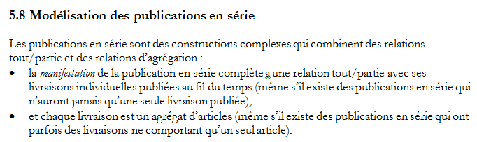
œuvre diachronique
Œuvre qui est destinée à être matérialisée au fil du temps
RDA :
Le cadre RDA/ONIX fournit une sous-ontologie sur la façon dont le contenu varie au fil du temps
p. ex. succession vs intégration
Notes:
The LRM describe a “serial” [publication en série] as a complex combination of whole/part and aggregation relationships between manifestations.
RDA implements a generalization of the model of a serial manifestation [manifestation en série] being “published over time”.
This is the concept of a diachronic work.
If the content is embodied in a manifestation over a timespan, then the content changes during that timespan.
The RDA/ONIX Framework for Resource Categorization [cadre RDA/ONIX pour la catégorisation des ressources] provides a model of basic attributes of a resource, described in RDA using the Work, Expression, Manifestation, and Item entities. The Framework is the underlying ontology [ontologie] of the RDA carrier, content, and media types [types de support matériel, de contenu et de média].
The Framework offers three attributes that categorize how content changes over time. For example, the Extension mode [mode d’extension] distinguishes succession, where content is accumulated over time, and integration, where content is replaced over time.

Slide 7
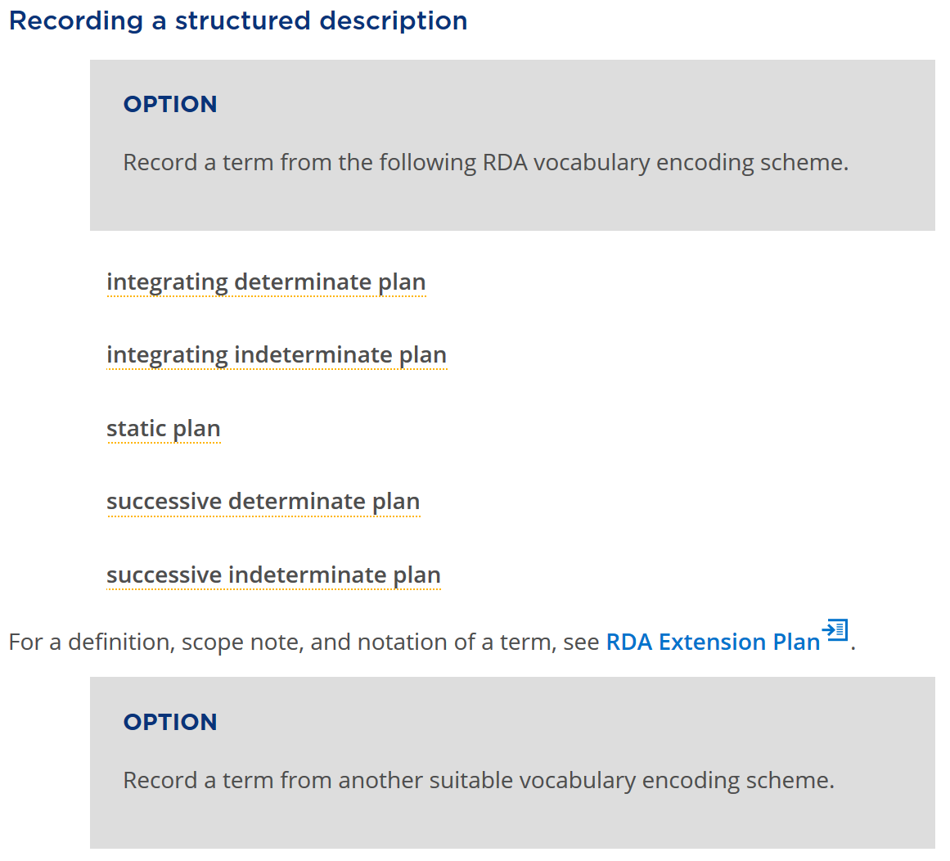
Notes:
RDA has a new Work element for “extension plan” [plan d’extension] that has a related RDA vocabulary encoding scheme [schéma d’encodage de vocabulaire RDA] based on the RDA/ONIX Framework.
The vocabulary terms distinguish a serial work from a static work, and distinguish serials works by their extension mode and extension termination.
A typical “serial” is a diachronic work with a “successive indeterminate plan” for extension of its content: the content will be added over time, and the timespan is open-ended.

Slide 8
Pile OEM(FRBR)
Œuvre
1 et seulement 1
Au moins 1
Expression
Au moins 1
Au moins 1
Manifestation
1 et seulement 1
Au moins 1
Item
Notes:
A well-formed RDA description is coherent if it complies with the RDA ontology, as represented in the RDA Registry [registre RDA]. The RDA ontology is now compatible with the ontology of the LRM.
In particular, the LRM retains the cardinality restrictions between the FRBR entities. The scope of the Item entity is further clarified: all characteristics that are common to all items that exemplify a manifestation are recorded as characteristics of the manifestation, even if there is only one item (for example, a manuscript).

Slide 9
Verrou OEM (diachronique)
Œuvre
1 et seulement 1
1 et seulement 1
Expression
1 et seulement 1
1 et seulement 1
Manifestation
Un plan pour un contenu diachronique est verrouillé dans les trois entités : un changement de caractéristique équivaut à un changement de plan et donc à une nouvelle œuvre
Notes:
This diagram shows the additional cardinality restrictions that apply to serial works.
A serial work is realized by only one expression embodied in only one manifestation. Any change in any of these entities results in a new serial work; for example, a serial published in two different carrier types is modelled as two separate serial works.
This is known as the WEM lock [verrou OEM].
The essential fact behind these restrictions is that no plan can predict the future. A publisher may decide to stop publication on a specific carrier, or terminate the publication altogether.
The creator of a serial work may decided to split the content into two separate works from a specific point in time, or merge works, etc. These types of change are familiar to serials librarians. The LRM and RDA now provide a clearer approach for recording these changes as they occur.
The new approach requires a significant change in the context of describing serials and other diachronic works, but the data to be recorded remains the same.

Slide 10
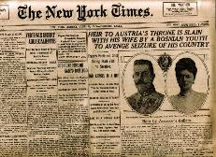



The New York times (imprimé)
The New York times (CD-ROM)
The New York times (en ligne)
Œuvre
The New York times (imprimé)
The New York times (CD-ROM)
The New York times (en ligne)
Expression
Manifestation
Si l’un des types de support matériel cesse d’être publié, cela ne peut sous-entendre que tous les types de support matériel ont cessé d’être publiés.
Notes:
This example shows three “editions” of the New York Times, each issued on a different carrier type [type de support matériel].
Following the LRM, these are described as three separate serial works. This allows each description to maintain accuracy. For example if the CD-Rom edition ceases, a user will not assume that a later issue is available in that format; if the content of the print and online editions diverges, the user will not assume that either format will contain the information required.

Slide 11
Groupe d’œuvres
Ensemble d’œuvres identifiées comme un tout
a pour appellation de groupe d’œuvres
« Appellation de groupe d’œuvres »
« Point d’accès autorisé de groupe d’œuvres »
p. ex. « New York Times … »
Œuvre
a pour point d’accès autorisé
de groupe d’œuvres
« Identifiant de groupe d’œuvres »
p. ex. ISSN-L
a pour identifiant de groupe d’œuvres
Notes:
This diagram shows how RDA can be used to collocate serial works in the same “family”.
Any set of works may be assigned a common appellation with the same nomen string [chaîne de nomen].
RDA provides three sub-types of appellation element [élément appellation] for a “work group appellation” that can be assigned to each work in the group. Only a single nomen string is required, so there is no provision for variant access points [variantes de point d’accès], or unstructured description [description non structurée]; the method only works for authorized access points or an associated identifier. The general appellation element is provided as a catch-all, and as a data gathering mechanism.
This approach is already used by the ISSN Network [réseau ISSN]: an ISSN-L functions as an identifier for work group, so all editions of the New York Times can be collocated in an information retrieval application.

Slide 12
Œuvre en série
Œuvre destinée à être réalisée en plusieurs expressions distinctes matérialisées durant un laps de temps sans fin.
Relations Œuvre-Œuvre
LRM-R19 précède [logique, pas chronologique]
LRM-R22 a été transformé en [par le biais de
  politiques , etc.]
Relation Expression-Expression :
LRM-R25 a été agrégé par
Notes:
A serial work is diachronic work that is issued successively with no intended termination.
The LRM offers three high-level relationships that can be used to model the complexity of a serial work and its issues.
LRM-R19 is used to place the works that are the individual issues [livraisons] in sequence according to their numerical and chronological enumeration, even if an issue is embodied in a different chronological order.
LRM-R22 is used to relate serial works that undergo a change of issuance plan, for example if the carrier type of the embodied issue changes from printed volume to online resource.
LRM-R25 is used to relate the expressions of individual issues to the expression of the serial work.
These relationships have been implemented as elements in RDA. The Work-Work elements are used in the hierarchical organization of existing, more refined RDA elements.
If each “issue” of a serial work is itself an aggregate, then the serial becomes an aggregate of aggregates.

Slide 13
ODiachronique
1
transformé en
ODiachronique
2
EDiachronique
1
EDiachronique
2
agrégé par
agrégé par
OLivraison
1A
ELivraison
1A
ELivraison
1B
OLivraison
1B
précède
précède
OLivraison
2A
ELivraison
2A
ELivraison
2B
OLivraison
2B
MAgrégative
MAgrégative
Notes:
In this diagram, a serial work is transformed into a new, separate serial work.
Each work has an expression that aggregates the expressions of its issues.
Each work realized by an expression of an issue is related to the next issue in the sequence of enumeration.
The diagram does not indicate the structure of the aggregate manifestations. For example, both serial works may be embodied as a single online resource.
A serial work is one of the most complex information resources that is found in most library collections.

Slide 14
Autres changements
Provenance des données : Quand les données diachroniques changeantes sont-elles valides?
domaine de validité; date de validité
Certains éléments ont été déplacés depuis la Manifestation vers l’Œuvre
périodicité; ISSN
Liaison permanente avec le Centre international ISSN et le Groupe de révision de l’ISBD
Notes:
RDA now clarifies how to record the provenance of metadata created with RDA. This includes the agents responsible for creating metadata, when the data is created, the source of the data, and so on.
RDA provides two provenance elements that are useful for recording changes in the metadata describing a diachronic work. Scope of validity can record a range of “issues” of a diachronic work for which metadata are valid, for example the title proper of the diachronic manifestation. Date of validity records the timespan for which metadata is valid.
Some elements have been moved from the Manifestation to Work entities. Frequency is really part of the plan for issuing a diachronic work, and is certainly not a characteristic of the manifestation of an individual issue. The WEM lock means that ISSN can identify any of the Work, Expression, or Manifestation entities, but it is more appropriate as a Work identifier.
The impact of the LRM on the ISSN Manual and the International Standard Bibliographic Description [Description bibliographique internationale normalisée] are now under review by the ISSN International Centre and the ISBD Review Group [Groupe de révision de l’ISBD], respectively.
Liaison on harmonizing RDA, ISSN, and ISBD has been ongoing for many years. The new RDA treatment of serials and aggregates is based on joint meetings, discussions, and papers between these groups, as well as cross-membership of each standards body.
The work continues.

Slide 15
Merci!
Comité directeur de RDA
http://www.rda-rsc.org/
Présentations sur RDA
http://www.rda-rsc.org/node/560
RDA Toolkit
https://www.rdatoolkit.org/

