Slide 1
Authority versus authenticity: the shift from labels to identifiers
Mirna Willer and Gordon Dunsire
Presented at APAE 2016 Conference and School, Zadar, Croatia, 25 October 2016

Slide 2
RDF: Resource Description Framework
A method for storing and linking data at global level; the basic syntax of the Semantic Web, the web of (meta)data
RDF implemented as an extension of the Internet and World-Wide Web (the web of documents).
Data is stored as single atomic statements using the syntax subject – predicate – object:
This book – has author – J.K. Rowling
J.K. Rowling – is the author of – this book

Slide 3
RDF graphs
RDF syntax can be represented as a mathematical graph of nodes and connectors.
has author
This book
J.K. Rowling
is author of

Slide 4
URI: Uniform Resource Identifier
RDF is intended for machine-processing, but machines are too dumb to use ambiguous (human) labels for the statement or graph; e.g. "This book", "author", etc.
Machine-readable identifiers are used. Each identifier must be unique at global level (the Semantic Web).
The URI builds on the established protocols and services of the World-Wide Web: http, URL, content negotiation for browsers, etc.

Slide 5
Identifying the components of a triple
RDF requires the subject and predicate of a statement (triple) to be identified with URIs; the object may be the data value to be stored, or identified by a URI.
SubjectURI
Predicate URI
Object data value
Human-readable!
SubjectURI
Predicate URI
Object URI

Slide 6
Linking triples; weaving the Semantic Web
URIs can be matched by machine to form clusters and chains of triples.
ObjectURI
Common
SubjectURI
ObjectURI
Data value
Object URI
= Subject URI
SubjectURI
URI
Data value
URI
URI

Slide 7
AAA: Anybody can say Anything about Any thing
There is no intrinsic test of "truth"
Semantic logic can detect contradictions in a set of two or more statements:
(1) This thing – is a – cat
(2) This thing – is a – dog
(3) Cat – is disjoint with – dog
[A thing cannot be dog AND cat]
One or more statements is "false" – but which one(s)?
Provenance provides a measure of reliability

Slide 8
OWA: Open World Assumption
Absence of data is not data of absence
The "record" is never complete:
There is always something more to say about any thing.
Non-identical statements are separate statements, even if they record the "same" data.
In a "closed world", absence of data (blanks) can indicate that the aspect/element is not applicable.

Slide 9
Provenance and cataloguing content rules
Provenance: Who said that?; When was it said? Why was it said?
The values used for bibliographic content as the data of a triple's object are determined by the application of library cataloguing codes.
Codes have converged to a common basis (a result of the attempted imposition of top-down global standards as part of "Universal Bibliographic Control"), but still diverge in interpretation, context, and culture, leading to different values from different codes and cataloguers.

Slide 10
IFLA Library Reference Model
The LRM is the most recent library bibliographic standard, and provides a high-level model on which cataloguing codes and finer metadata structure can be built. The model is optimized for Semantic Web technologies.
In particular, the LRM provides two controversial ideas that impact on identity, authority, and provenance.

Slide 11
"Authority" in the LRM
Only human beings can "author", or be responsible for, a bibliographic resource. Fictitious or legendary entities that are claimed to be authors are assumed to be pseudonyms of a person or group of persons.
Text-based resources (especially print) describe themselves in manifestation statements. Descriptive data values may be transcribed from the physical instantiation of a resource (a manifestation).

Slide 12
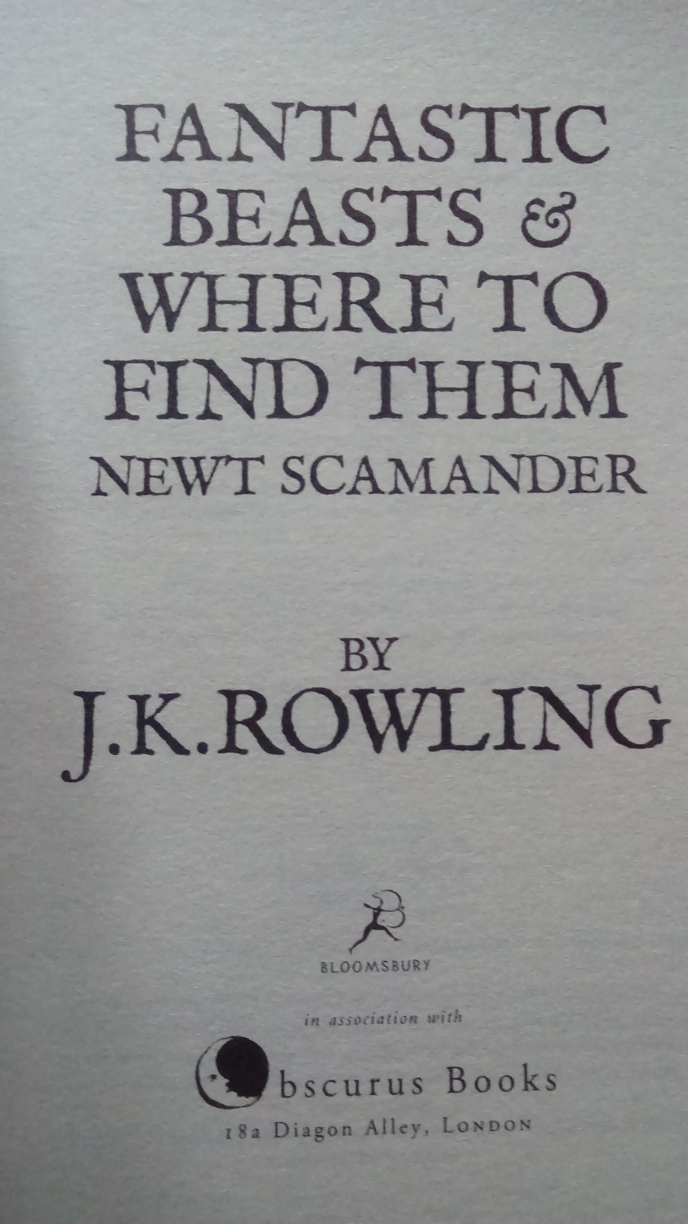
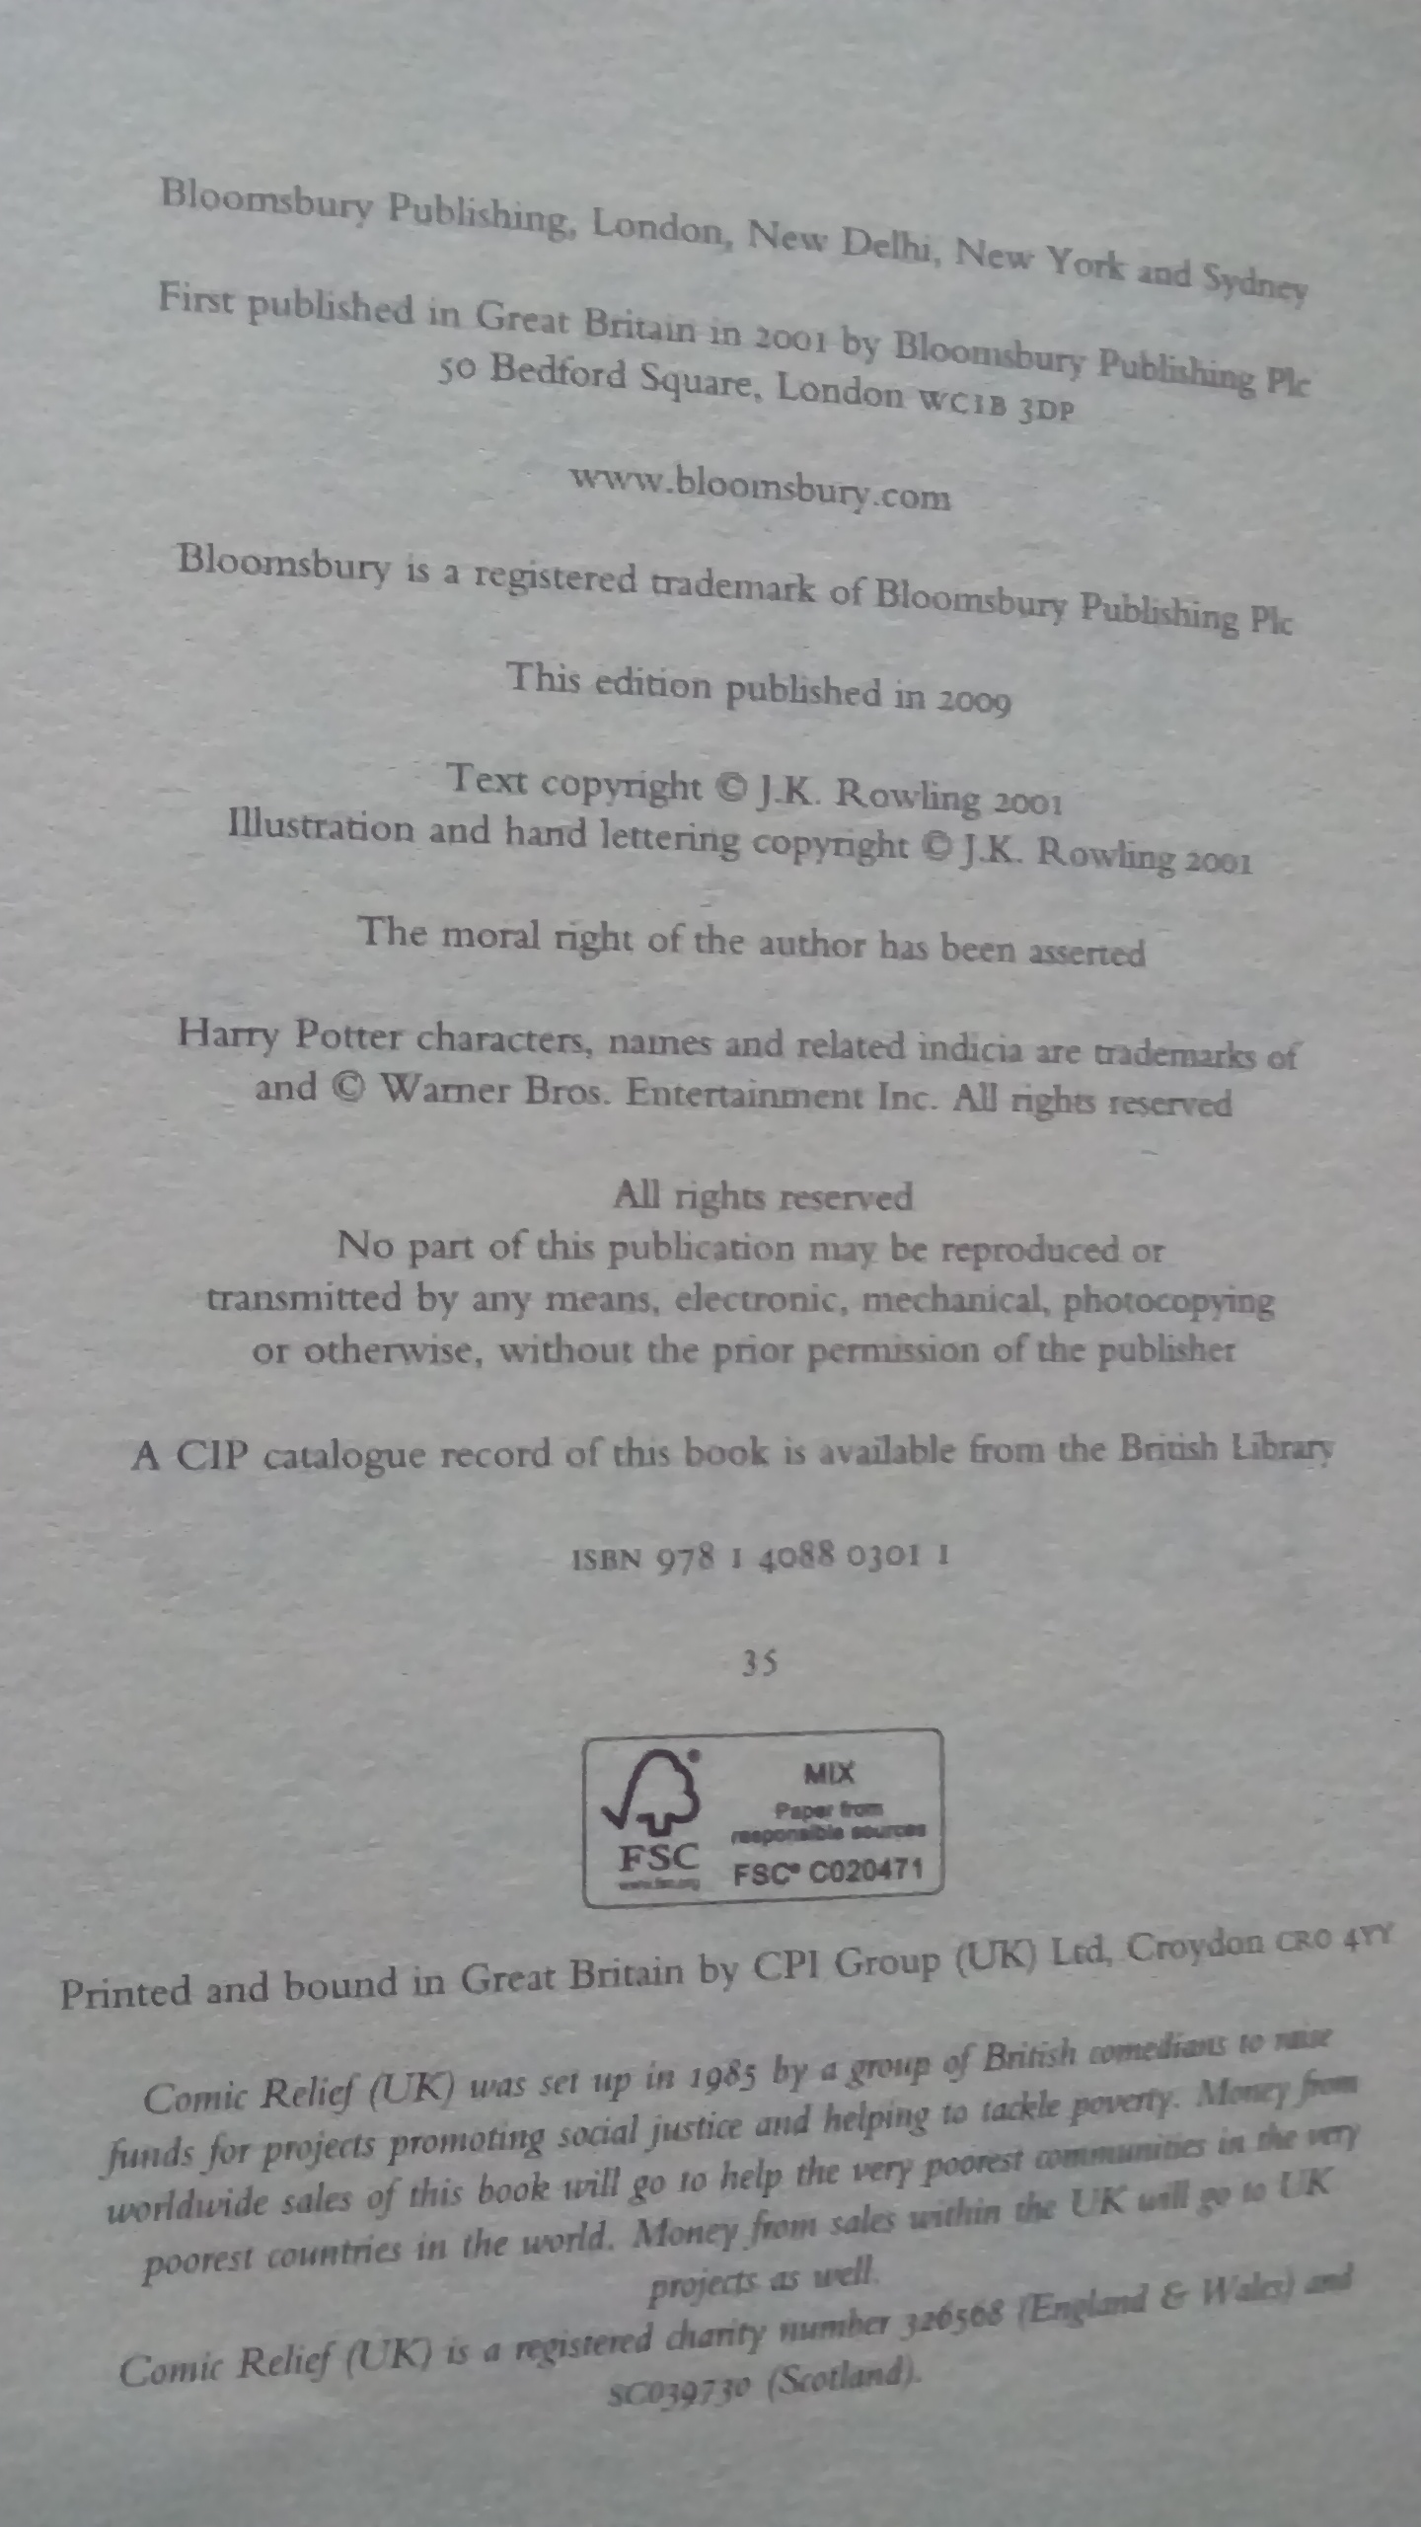
Case study

Slide 13
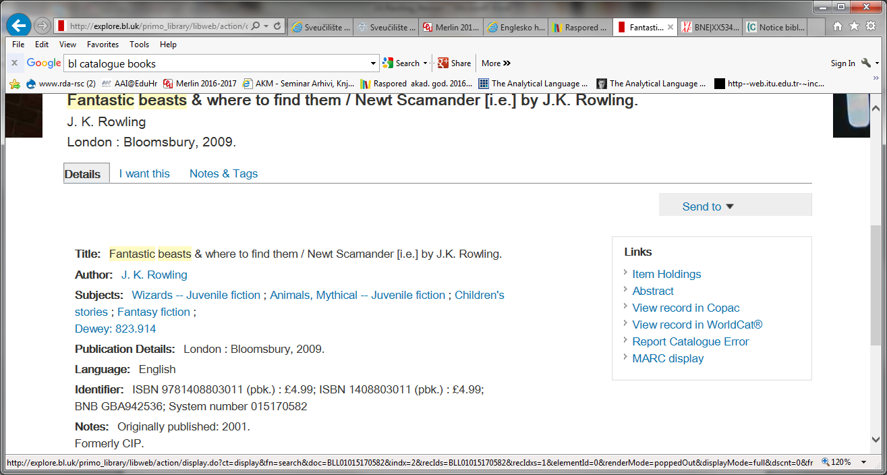
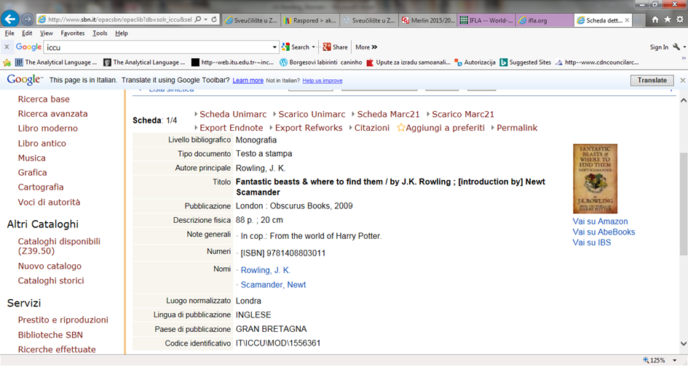
Title statement:
"Fantastic beasts & where to find them"
Statement of responsibility (British catalogue):
"Newt Scamander [i.e.] by J. K. Rowling"
Statement of responsibility (Italian catalogue):
"by J. K. Rowling ; [introduction by] Newt Scamander"

Slide 14
Catalogue | Manifestation statement | Primary Access Point | Additional Access Point
UK | [i.e.] by J. K. Rowling | Rowling, J. K.
Italy | [introduction by] Newt Scamander | Rowling, J. K. | Scamander, Newt
Translations:
Germany | Newt Scamander | Scamander, Newt
Italy (2010) | [di] Newt Scamander ; J. K. Rowling | Rowling, J. K.
Italy (2015) | di J. K. Rowling ; Newt Scamander | Rowling, J. K. | Scamander, Newt
Spain | Newt Scamander ; por J. K. Rowling | Scamander, Newt (1897-)
France | Newt Scamander [i.e. J. K. Rowling] | Rowling, Joanne Kathleen (1965-)
Croatia | Newt Scamander | Rowling, Joanne Kathleen

Slide 15
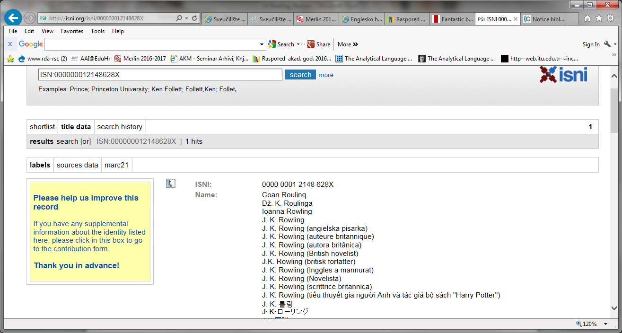
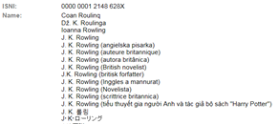
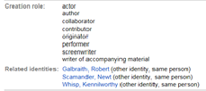
ISNI: International Standard Name Identifier

Slide 16
Authority control
Creation and maintenance of a unique "authorized access point" (name, label, heading) for an entity.
Rowling, J. K.
Joanne Kathleen
1965 July 31-
novelist
Normalized name
Expanded initials
Date of birth
Profession
has profession
http://isni.org/isni/000000012148628X
Heading (d)evolves to metadata record
Or set of triples

Slide 17
Manifestation statement
Manifestation statements are social constructs:
"Published" manifestations are products of industrial and commercial processes.
They are influenced by branding and other commercial issues – dependent on cultural contexts.
Translations, derivations, etc. may have different social context.
Transcription is rarely exact: What I see is what you get.
What about non-print materials, or text content online?

Slide 18
Current and future knowledge
What is recorded now, may change in the future
What is recorded now should not be regarded as absolute or fixed (OWA). Future knowledge may lead to adjustment of current data.
But the future cannot be anticipated, including future requirements of users. The needs of the present should take precedence over needs of the future.
Present records are fixed – RDF good practice never
deletes data (deprecation) – AAA! All adjustments are additions (not replacements).

Slide 19
Conclusion
The shift from labels to global identifiers:
Provides more effective (less ambiguous) identifiers
Provides stable identifiers
Provides identifiers required for the Semantic Web
Allows "labels" or "access points" to be treated as entities: data recorded for labels are data records of entities
Improves interoperability of data recorded for different contexts
Focuses authority on the authenticity and provenance of metadata statements

Slide 20
Thank you!
gordon@gordondunsire.com
mwiller@unizd.hr
isni.org

