Slide 1
Toolkit Development
James Hennelly

Slide 2
Getting Started
3R Project
  rdatoolkit.org/3RProject
RDA Toolkit Beta site
  beta.rdatoolkit.org
RDA Toolkit channel on YouTube

Slide 3
September Release
Improvements to HTML editor
Updates to Tools
Improvements to search
Changes to the home page
Removal of subdvisions in element lists
Improvements to MARC Mapping

Slide 4
End of Year Goals
Accessibility – working toward AA rating on W3C guidelines
Graphic Browser – for browsing of entities and elements
Relationship Matrix – improvements to presentation of relationship designators
AACR2 – included without links
Citation Numbers – for referencing RDA text when linking is not an option

Slide 5
Community Feedback
Feedback has already spurred improvements to beta Toolkit
Submit feedback at…
  rdatoolkit.org/form/3r-feedback
  rdatoolkit@ala.org

Slide 6
RDA Toolkit Content
Gordon Dunsire, Chair, RDA Steering Committee

Slide 7
Beta release
Foundational structure for the organization of elements, instructions, and guidance
Combines
The organization of entities, attributes, and relationships in the IFLA Library Reference Model (LRM)
The extension of RDA as an implementation of the LRM and resolution of gaps and inconsistencies in RDA
Explicit provision of recording methods to improve support for RDA data applications

Slide 8
Modular structure
Instructions are grouped by element and recording method
Finer granularity is more flexible for a wider range of applications
Every element page has the same basic structure
RDA Reference data are maintained and displayed separately from guidance and instructions
Reference data are extracted from the RDA Registry
Notes:
The new RDA Toolkit has a modular structure based on the RDA elements.
Each element has a “page” in the Toolkit, and each element page has the same basic structure.
The structure separates the RDA Reference data from the guidance and instructions.

Slide 9
Element page structure
Definition and Scope
Element Reference
Prerecording
Recording
Recording an unstructured description
Recording a structured description
Recording an identifier
Recording an IRI
Instructions
RDA Reference
Related Elements
Notes:
This is an outline of the element page structure.
The RDA Reference data are displayed in the sections highlighted in gray.
All of these sections use content that has already been translated in the Open Metadata Registry.
The guidance and instructions are displayed in the sections highlighted in orange.
The content of these sections is translated in the Content Management System using Trados.
This allows translators to focus their work on specific areas of Toolkit content.

Slide 10
Boilerplate
Guidance, instruction, and navigation content components that are re-used in multiple pages in the Toolkit
Re-usable components are updated once
And translated once
Repetition is a desirable feature of the new Toolkit
Improves consistency and understanding
Supports a modular editorial infrastructure
Reduces costs
Notes:
The Toolkit uses boilerplate, or fixed, text as much as possible.
Standard paragraphs and other content syntax are used for guidance, instructions, and in-page navigation.
These paragraphs are re-used in multiple pages.
This allows the content to be updated once, and used many times.
A translator only needs to translate the re-usable content once.

Slide 11
Optional instructions
Internationalization
No “one way” of describing and accessing a resource
Two or more recording methods are valid for many elements
No element is mandatory [except “nomen string”]
Same as original Toolkit
Most instructions are optional
Application profile is required to manage choice
Notes:
The Toolkit uses boilerplate, or fixed, text as much as possible.
Standard paragraphs and other content syntax are used for guidance, instructions, and in-page navigation.
These paragraphs are re-used in multiple pages.
This allows the content to be updated once, and used many times.
A translator only needs to translate the re-usable content once.

Slide 12
Conditions
Many instructions apply only when one or more conditions is met
Kind of resource being described
Specific characteristic of resource being described
Existence of pre-recorded data
Etc.
“Alternative” = option for the same set of conditions
“Exception” = different set of conditions
Notes:
The Toolkit uses boilerplate, or fixed, text as much as possible.
Standard paragraphs and other content syntax are used for guidance, instructions, and in-page navigation.
These paragraphs are re-used in multiple pages.
This allows the content to be updated once, and used many times.
A translator only needs to translate the re-usable content once.

Slide 13
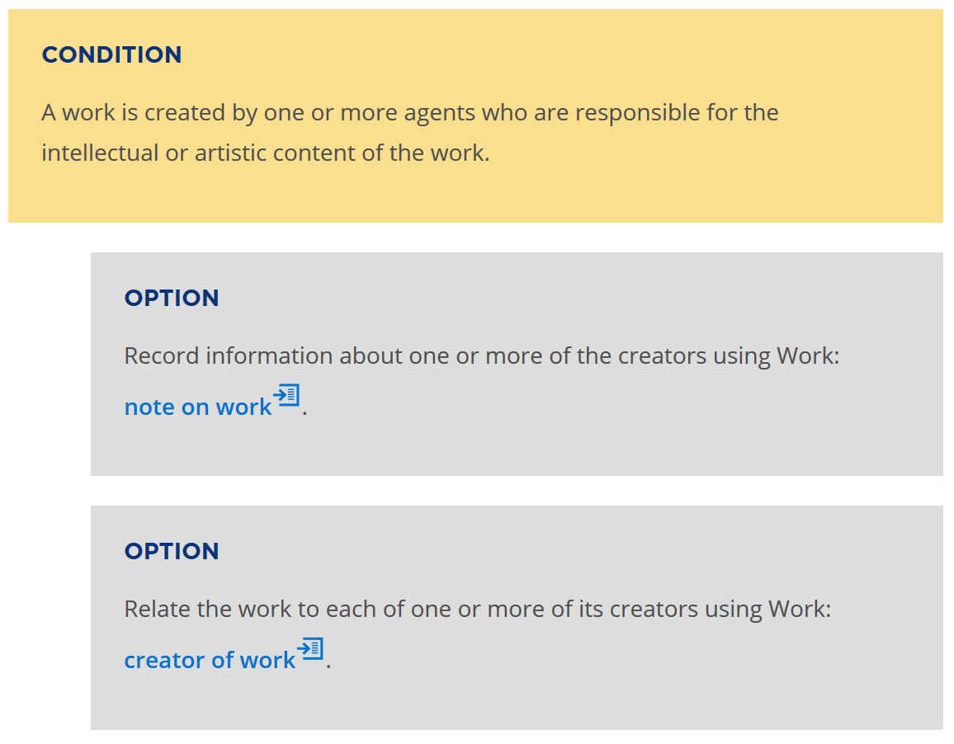
Notes:
Optional instructions are presented in a standard format and are linked to the conditions for which they can be applied.

Slide 14
Adding content
Move original and valid content to the new structure
Different level of granularity
Reword content to meet design goals
Internationalization
Create content for existing gaps as well as new entities and elements
Aggregates and serials
Appellation elements
Retain legacy “redundancy”
Notes:
The Toolkit uses boilerplate, or fixed, text as much as possible.
Standard paragraphs and other content syntax are used for guidance, instructions, and in-page navigation.
These paragraphs are re-used in multiple pages.
This allows the content to be updated once, and used many times.
A translator only needs to translate the re-usable content once.

Slide 15
Current RSC Activity
Kathy Glennan, Chair-Elect, RDA Steering Committee

Slide 16
Beta Toolkit Content:
Consultation
Appellation elements (96 elements)
  Being reviewed for consistency and clarity by
  Thomas Brenndorfer, NARDAC Representative to the RSC
  Includes:
    appellation of [entity]
    preferred name of [entity]
    access point for [entity]
    identifier for [entity]
  Will be reviewed by RSC in October

Slide 17
Beta Toolkit Content:
Consultation
Aggregates and serials
  Ongoing work by the RSC Aggregates Working Group, which incorporates
    Modeling of aggregates in IFLA-LRM
    Recommendations from the ad hoc Serials Task Force
  Will be reviewed by RSC in October

Slide 18
Beta Toolkit Content:
Consultation
Stabilizing the English text
  RSC members reviewing selected elements and making recommendations for clarity
    Need to complete so that work can start on policy statements and translations
Guidance chapters
  Development by RSC members
  Feedback from Toolkit users

Slide 19
Beta Toolkit Content:
Consultation
Navigating the LRM/RDA semantic structure
  Relationship Matrix
    A text-based browser for all entities and “relationship” elements in hierarchical order
  Graphic Browser
    A means to show context for an element page
    Replaces the expand/collapse browse of the table of contents in the original Toolkit
RSC members currently reviewing both of these; look to finalize styles before the end of the year

Slide 20
Beta Toolkit Content:
Development
Examples
  Ongoing work by the Examples Editor
    More examples coming in each Toolkit release
    Translations can use different examples

Slide 21
New Activities Arising from the 3R Project
Develop examples of application profiles
  Liaise with Policy Statement agencies
    Major work must wait until English text is stabilized
Directed development of specific topics, e.g.:
  Further refining use of Collective Agent
  Implementation of “extent” recommendations from ALA in 2013 (6JSC/ALA/Discussion 1)

Slide 22
RSC’s New Governance Model
New members and representation
  New regions with reps:
  Europe, North America, Oceania
  New regions with reps to come:
  Africa, Asia, Latin America and the Caribbean
Impact of internationalization
  Regional representatives bring different cataloging perspectives to the discussion
    Instructions must be flexible while also ensuring data compatibility across cataloging agencies

Slide 23
RSC’s New Governance Model
Develop consultation procedures and communication with RDA communities
  Reopen a proposal process
    But it will be different from the previous model
  Ensure outreach to wider communities and to special communities
    For the former, in part through the new position,
    Wider Community Engagement Officer
    For the latter, participation in RSC Working Groups

Slide 24
RSC Working Groups
Task and finish groups created around a particular need
  Membership must be from multiple regions
    Members often have subject or format expertise
  Terms of Reference reviewed and updated annually by the RSC
  Create reports and/or proposals for RSC consideration
  The RSC expects to form an Archives Working Group in 2019

Slide 25
Update on NARDAC:
The North American RDA Committee
Thomas Brenndorfer
NARDAC Representative to the RDA Steering Committee
1 of 2 Canadian Committee on Cataloguing (CCC) representatives to NARDAC
1 of 2 Canadian Federation of Library Associations representatives to the CCC
Librarian, Guelph Public Library, Ontario, Canada
Notes:
I have been asked to talk to you today about the activities and plans of NARDAC. I am pleased to report that NARDAC, which was planned for more than two years, is now officially up and running.

Slide 26
What is NARDAC?
North American RDA Committee
Formed in January 2018 to represent the North American region on the RDA Steering Committee (RSC)
Notes:
Some of you might ask: “But what is NARDAC?” NARDAC stands for
North American RDA Committee.
It is the entity that represents, since last January, the North American region on the RDA Steering Committee (RSC).

Slide 27
UN Geoscheme for North America
Bermuda
Canada
Greenland
Saint Pierre and Miquelon
United States of America
Notes:
As defined by the United Nations, North America includes Bermuda, Canada, Greenland, Saint Pierre and Miquelon, and the United States of America.

Slide 28
NARDAC Communities
United States
  American Library Association (ALA)
  Library of Congress (LC)
Canada
  Canadian Committee on Cataloguing (CCC)
[Bermuda, Greenland, Saint Pierre and Miquelon: If/when they implement RDA]
Notes:
Only communities that have implemented RDA can have representation on NARDAC.
For now, those communities are
the American Library Association (ALA) and the Library of Congress (LC) in the United States,
and the Canadian Committee on Cataloguing (CCC) in Canada.
Bermuda, Greenland, and Saint Pierre and Miquelon do not yet have representation on NARDAC. But if communities in these places do adopt RDA, they could potentially have representation on NARDAC.

Slide 29
NARDAC Members
ALA Representatives
Dominique Bourassa, Yale University (3-year term)
Kathy Glennan, University of Maryland (1-year term)
CCC Representatives
Thomas Brenndorfer, Guelph Public Library
Nathalie Mainville, Library and Archives Canada, Standards and Systems
LC Representatives
Damian Iseminger, Bibliographic Access Section, Music Division
Kate James, Policy & Standards Division
Nonvoting ex‐officio member
RDA Board representative for North America, Beacher Wiggins, Library of Congress
Notes:
The current membership of NARDAC includes
two representatives from the American Library Association: Kathy Glennan, from the University of Maryland, and Dominique Bourassa, from Yale University. Dominique will serve a three-year term; Kathy’s term will exceptionally end after only one year when she will become the RSC Chair.
NARDAC also includes two representatives from the Canadian Committee on Cataloguing: Thomas Brenndorfer, from Guelph Public Library, and Nathalie Mainville, from Library and Archives Canada; and two from the Library of Congress: Damian Iseminger and Kate James.
In addition, Beacher Wiggins, the RDA Board representative for North America, serves as NARDAC’s ex-officio member.

Slide 30
NARDAC ROLES
Chair
Dominique Bourassa, Yale University (3-year term)
Representative to the RSC
Thomas Brenndorfer, Guelph Public Library (minimum 2-year term)
Representative back-up
Kate James, LC Policy & Standards Division
Coordinator of Web content
Damian Iseminger, LC Bibliographic Access Section, Music Division
Notes:
We unanimously agreed on the following roles:
Dominique became the NARDAC chair for a three-year term. This seemed befitting because she is a former chair of the Committee on Cataloging: Description & Access.
Dominique was named NARDAC representative to the RSC for a minimum of two years. Since then, Thomas has been added to the RSC and the RSC plus listservs and has started his work as NARDAC representative contributing to the work of the RSC.
Kate, who had served as the back-up to the LC representative to the RSC, Dave Reser, was chosen as Thomas’s back-up;
and Damian was selected as the coordinator of Web content.

Slide 31
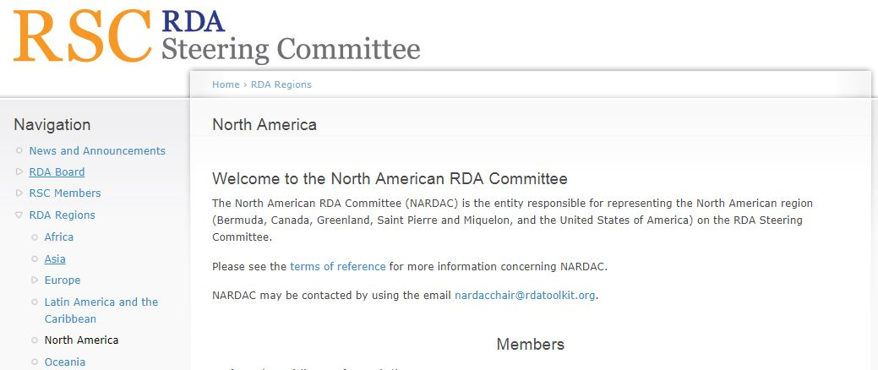
Source: http://www.rda-rsc.org/northamerica
Notes:
Damian has received a log in to the RSC website and a quick primer on how to make pages. He has started building the committee’s webpages on the RSC website (http://www.rda-rsc.org/northamerica).

Slide 32
NARDAC Charge
Formulate North American positions on RDA proposals, discussion papers, and drafts
Keep the North American communities informed of RDA developments and RSC decisions
Select a member of NARDAC to serve as the North American regional representative to the RSC
Respond to other RSC initiatives as they arise
Support the work of RSC by helping to identify possible members for the working groups
Source: NARDAC Terms of Reference
http://www.rda-rsc.org/sites/all/files/North%20American%20RDA%20Committee_TermsOfReference2017.pdf
Notes:
We know that our “charge is to:
Formulate North American positions on RDA proposals, discussion papers, and drafts (…)
[To] Keep the North American communities informed of RDA developments and RSC decisions (…)
[To] Select a member of NARDAC to serve as the North American regional representative to the RSC (…) [– as I mentioned, we already have done that by electing Thomas in this role]
[To] Respond to other RSC initiatives as they arise (…)
[And to ] Support the work of RSC by helping to identify possible members for the working groups (…).”
Despite this well-defined charge, it is still difficult for us to project exactly what we will be doing in the short term considering the status of the 3R Project. We realize that the extra layer created between the existing communities (CCC, CC:DA, and LC) will definitely be a challenge as we move forward. We are well aware that we will need to figure out how to work efficiently despite this constraint.

Slide 33
RDA Revision Proposals
Because NARDAC is an umbrella committee…
NARDAC does not replace the successful committees already in place
Proposals for additions and revisions to RDA should be submitted through regular channels
American proposals: CC:DA
LC proposals: LC
Canadian proposals: CCC
HIATUS ON REVISION PROPOSALS STILL IN EFFECT!
Notes:
NARDAC members have already received requests for additions to RDA. We anticipate receiving many more requests for additions and revisions to RDA now that the beta version of the new RDA Toolkit has been released. After discussion, we decided that, since NARDAC is an umbrella committee that should not replace the successful committees already in place, proposals for revision to RDA should continue to be submitted through the regular channels, that is:
American proposals should continue to be submitted to CC:DA; except for LC proposals which should continue to be submitted to LC ; Canadian proposals should continue to be submitted to CCC.
If you submit an RDA revision proposal to a NARDAC member, the committee will evaluate your proposal. If we believe your proposal cannot move forward, we will contact you and explain why. But if we think your proposal has potential to succeed, we will ask you to send it to the appropriate group (that is CCC, CC:DA, or LC). Consequently, it might be faster to submit your proposals directly to CCC, CC:DA, or LC.
However, no matter what you choose to do, please remember that the RSC has not lifted the hiatus on revision proposals. For this reason, NARDAC will not be able to present to the RSC proposals coming from CCC, CC:DA, and LC until the RSC informs us that it is ready to accept proposals. Also, keep in mind that new proposals will need to fit within the new RDA Toolkit.

Slide 34
RDA Regions
In Place:
Europe: European RDA Interest Group (EURIG)
Oceania: Oceania RDA Committee (ORDAC)
North America: North American RDA Committee (NARDAC)
Still to be formed:
Africa
Asia
Latin America and the Caribbean
Notes:
We NARDAC members are honored to join the European RDA Interest Group (EURIG) and the Oceania RDA Committee (ORDAC) in the process of realizing the new RDA governance structure. We are pleased to be collaborating with our North American constituencies and the RSC in the development of RDA.

Slide 35
Contact
nardacchair@rdatoolkit.org
Notes:
Please do not hesitate to contact the NARDAC chair or another NARDAC member If you have any questions, comments, suggestions. You can reach us at nardacchair@rdatoolkit.org.

