Slide 1
Functional interoperability and choice in RDA
Gordon Dunsire, RDA Technical Team Liaison Officer
Presented at AKM 23, Poreč, 2019

Slide 2
3R Project
RDA Toolkit Restructure and Redesign
Modern responsive design
Users of mobile devices
Users with sensory preferences
RDA content infrastructure
Convert to DITA standard
Increase re-use of RDA Reference data
IFLA Library Reference Model
RDA Board strategy
Notes:
The RDA Toolkit Restructure and Redesign (3R) Project has several high-level goals.

Slide 3
Wider community, wider choice
2011:
DNB joins RDA governance structure
International governance structure for RDA Board strategic markets:
International communities
Cultural heritage communities
Linked data communities
2019:
Most RDA tools are optional

Slide 4
Choice of agent entities
Agent
Person
Collective Agent
Corporate Body
Family

Slide 5
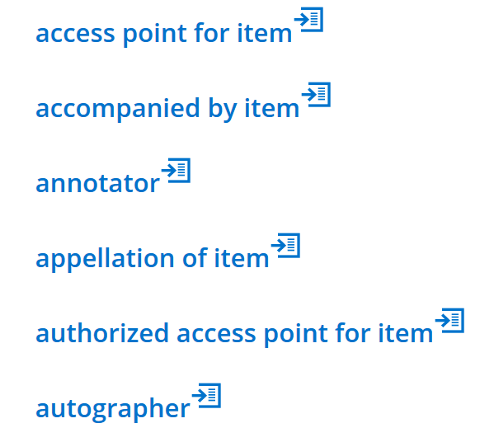
Choice of elements
Example: Item elements
…

Slide 6
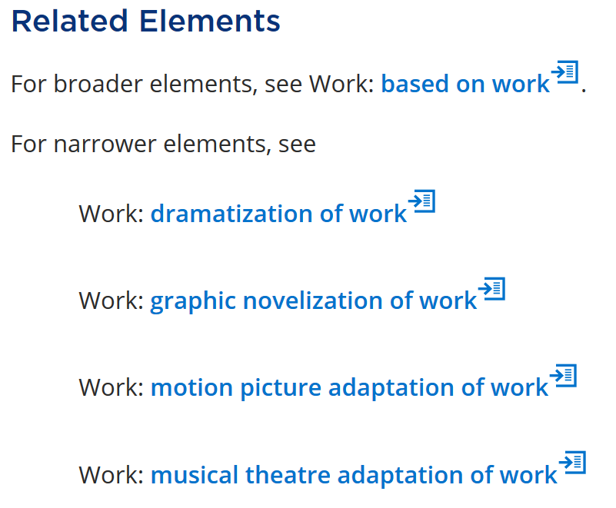
Element hierarchies
Example: adaptation of work
…

Slide 7
Choice of recording methods
Unstructured description
Transcriptions, notes, names, etc.
Structured description
Formatted statements, access points, etc.
Identifier
Local identifier codes, numbers, etc.
IRI (Internationalized Resource Identifier)
Global Semantic Web

Slide 8
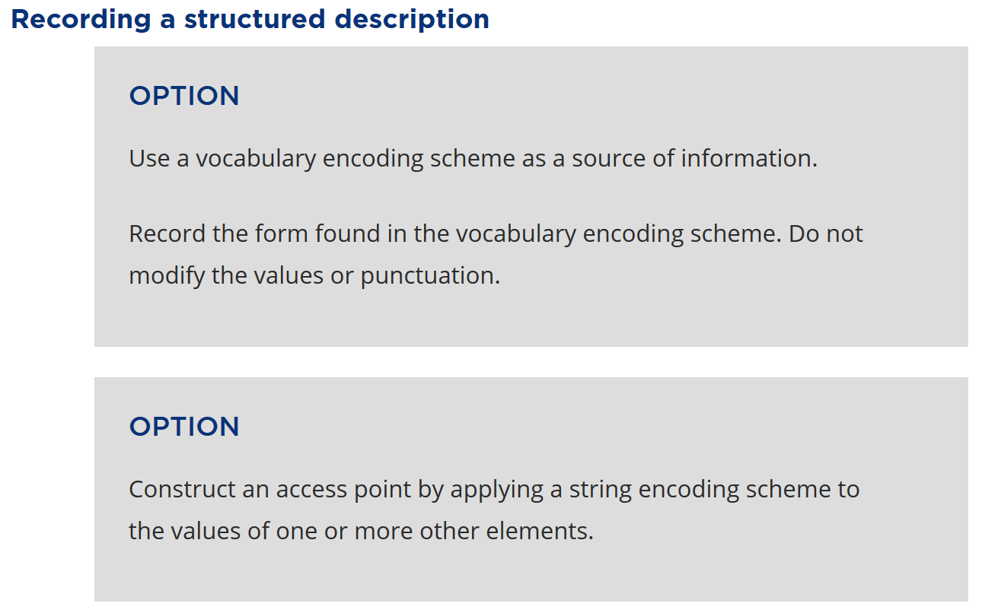
Optional instructions
Example: access point for …

Slide 9
Choice vs Consistency
Local values of an element vary naturally (e.g. source), culturally (e.g. language, naming conventions), by policy (e.g. audience), etc.
There is no one-size-fits-all
RDA entities and elements are consistent with the IFLA Library Reference Model, with coherent semantics
Assured levels of global interoperability of RDA metadata
Global things described with local strings

Slide 10
Application profiles
Originally developed by Dublin Core Metadata Initiative

Slide 11
Utility of profile
Front-end to RDA Toolkit
Which choices to take
Data input
Element + input field
Data validation
Metadata conformance, quality control, etc.
Data extraction
What to select from external metadata sources

Slide 12
Profile characteristics
An application profile typically specifies:
The elements to be recorded as a metadata description set for an entity
The mandatory and repeatability status of each element
The vocabulary encoding scheme to be used as a source of data for an element
The string encoding scheme to be used to assemble the data for an element

Slide 13
RDA application profile
Selects only RDA elements
Additional parameters that are unique to RDA:
Links to RDA instructions at multiple levels
The recording method to be used for an element, where a choice is available
The optional instruction to be applied to an element
The policy statement to be applied to an element

Slide 14
Profile documentation
Profile may be documented in various formats
From Narrative (unstructured):
“Record at least one content type taken from the RDA Content Type vocabulary.”
To Machine-readable: Several linked data vocabularies for profiles available or in development

Slide 15
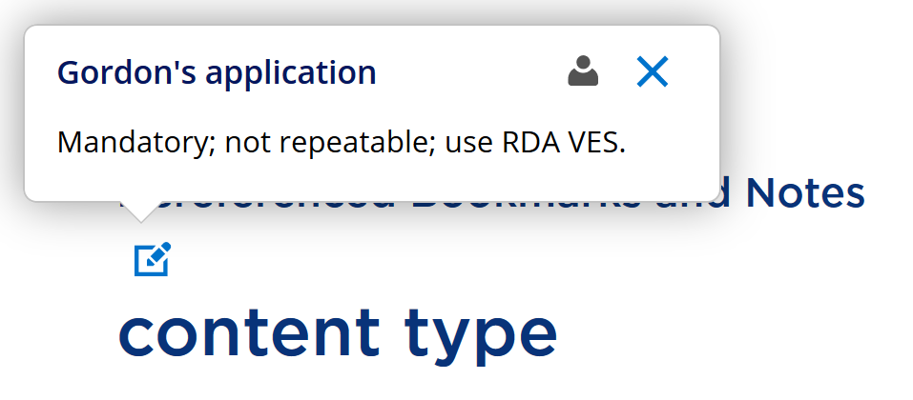
Toolkit notes
Simple, unstructured, personal application profile

Slide 16
Tabular/template layout
Each row specifies a separate element
Each column specifies a profile parameter for the element
Spreadsheet, word-processor, database
Element | pA | pB | pC | pD | pE | pF | pG | Application notes
Element 1
Element 2
Element 3
…

Slide 17
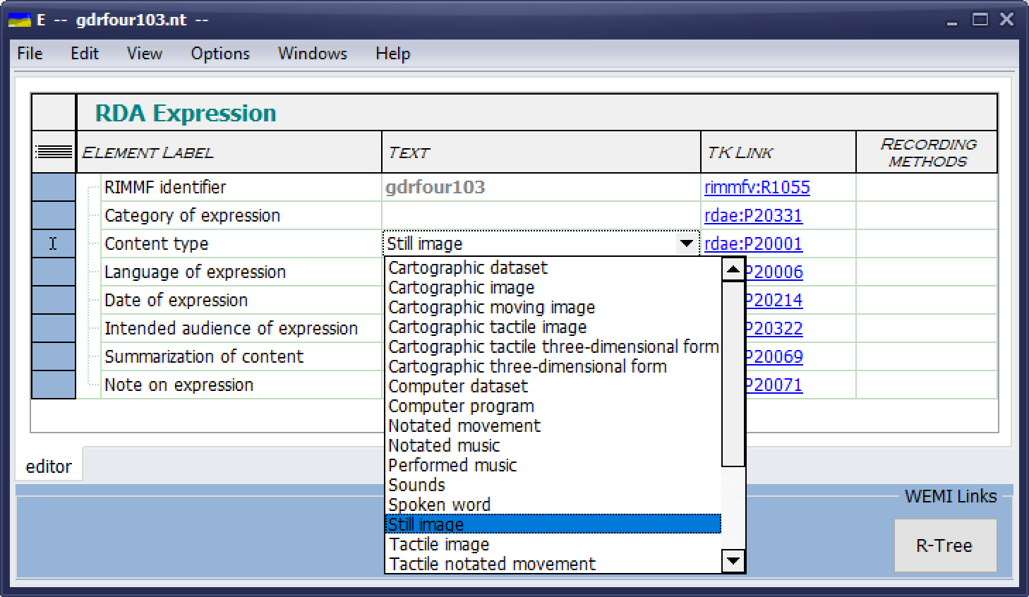
RIMMF4

Slide 18
Conclusion
Choice is essential for local applications
Global consistency = functional interoperability
Based on coherent semantic model(s)
Application profiles present a local view on a global landscape

Slide 19
Thank you!
Questions?

