Slide 1
RDA linked data stuff
Gordon Dunsire, RDA Technical Team Liaison Officer
Presented at RDA Linked Data Forum
June 24, 2019, Washington, D.C.

Slide 2
Overview
RDA Reference and GitHub releases
Short-cuts
Data inheritance
Implementation scenarios

Slide 3
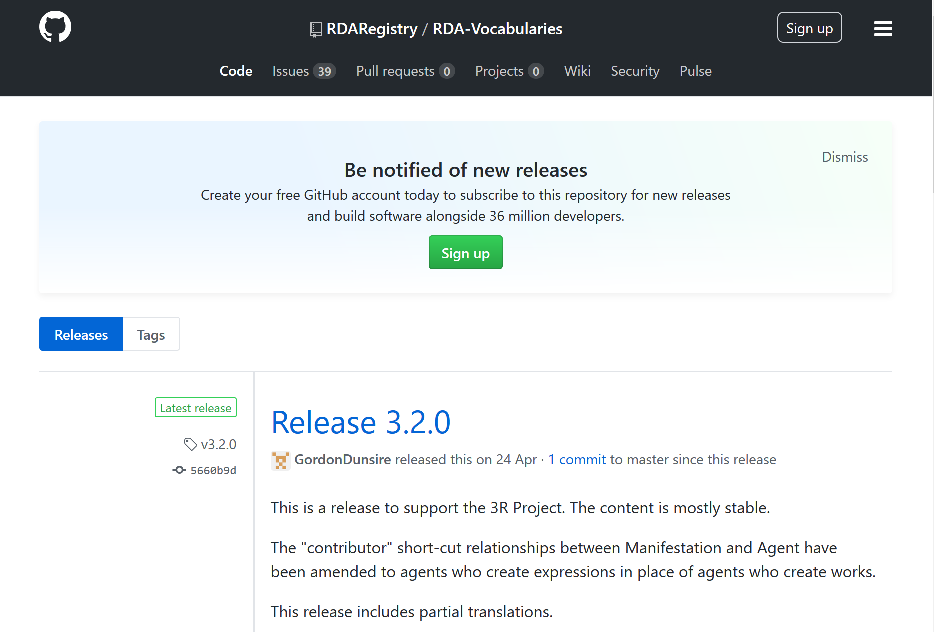
Notes:
The latest release of RDA Vocabularies on GitHub is v3.2.0
This is the third full release of the 3R Project.

Slide 4
Short-cuts
An element/property that represents a linked chain of two or more other elements
has work manifested
Manifestation
Work
Expression
has expression manifested
has work expressed
Expression not recorded
The only short-cut in the original Toolkit

Slide 5
New short-cuts
New Toolkit short-cuts simplify aggregates
has contributor agent to aggregate
Manifestation
Agent
Expression
has expression manifested
has creator agent of expression
Aggregated expression not recorded

Slide 6
Element hierarchies
All elements belong to a well-defined and well-formed semantic hierarchy
13 x 13 high-level relationship matrix
13 entities linked to 13 entities
Full matrix hierarchy under construction
Semantics support “smart” machine-processing of RDA data

Slide 7
Data inheritance
appellation of work | “This presentation”
related agent of work | Gordon Dunsire
> related person of work | Gordon Dunsire
>> creator person of work | Gordon Dunsire
>>> author person of work | Gordon Dunsire
>>>> screenwriter person
appellation of work | “This presentation”
related agent of work
> related person of work
>> creator person of work
>>> author person of work | Gordon Dunsire
>>>> screenwriter person
entailment
X
Data is automatically ‘inherited’ up a hierarchy through semantic inferencing

Slide 8
Appellation inheritance
Person
appellation of person | Gordon Dunsire
> name of person | Gordon Dunsire
>> preferred name of person | Gordon Dunsire
appellation of person | Dunsire, Gordon
> access point for person | Dunsire, Gordon
>> authorized access point for person | Dunsire, Gordon
appellation of person | nb2001072552
> identifier for person | nb2001072552

Slide 9
Database implementation scenarios
0: Linked data (RDF)
1: Relational
Review and re-cast in light of new RDA Toolkit
2: Bib/authority
3: Flat file

Slide 10
Scenario: Linked data
Discrete entities (and vocabularies) linked by IRI
nomen
agent
place
work
expression
timespan
manifestation
item

Slide 11
Scenario: Relational data
Discrete entities linked by (local) identifier
nomen
agent
place
work
expression
timespan
manifestation
item

Slide 12
Scenario: Bib/authority
Compound entities linked by authorized access point
agent
nomen
work
expression
manifestation
Item
nomen
place
nomen
timespan
nomen

Slide 13
Scenario: Flat file
Compound entities with no links
work
expression
manifestation
item
nomen
agent
place
timespan
agent
nomen

Slide 14
Thank you!
Questions? Discussion!

